Slide 1


Tic-tac-toe game
BY: Brandon Richards
https://github.com/ksu-is/Tic-Tac-Toe-Game-By-Brandon-Richards-/tree/main

Slide 2
Tag Line Introduction
This is a simple game of Tic-Tac-Toe it doesn’t play against the system instead it is meant to be played with someone beside you, so its a real-time two player game. As you will see on the next slide the board where the game will be played is created using a “drawBoard()” function and you mark your position on board using numbers 1-9.

Slide 3
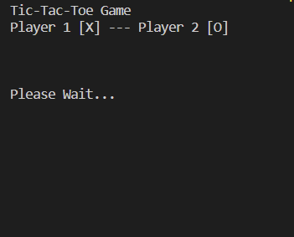
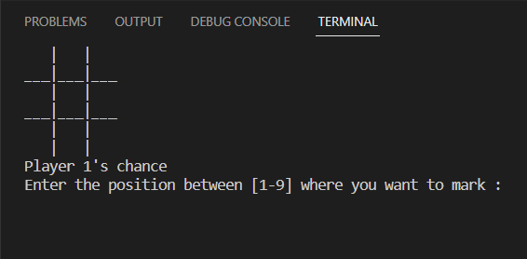
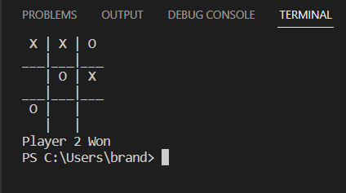
Photo Examples

