Slide 1
Predicting Vaccine Uptake
Insights and Recommendations

Slide 2
Overview
This analysis aims to understand and predict vaccination behavior for H1N1 and seasonal flu using data from the National 2009 H1N1 Flu Survey. Findings will help public health organizations design targeted campaigns to increase vaccination rates.

Slide 3
Business and Data Understanding
- Stakeholder: Public health organizations and policymakers
- Objective: Predict vaccine uptake based on demographic, social, and behavioral factors
- Dataset Overview:
- Targets: H1N1 vaccine uptake, seasonal flu vaccine uptake (binary: vaccinated or not)
- Predictors: Demographic (age, gender), social (education, marital status), behavioral (health conditions, vaccine awareness)

Slide 4
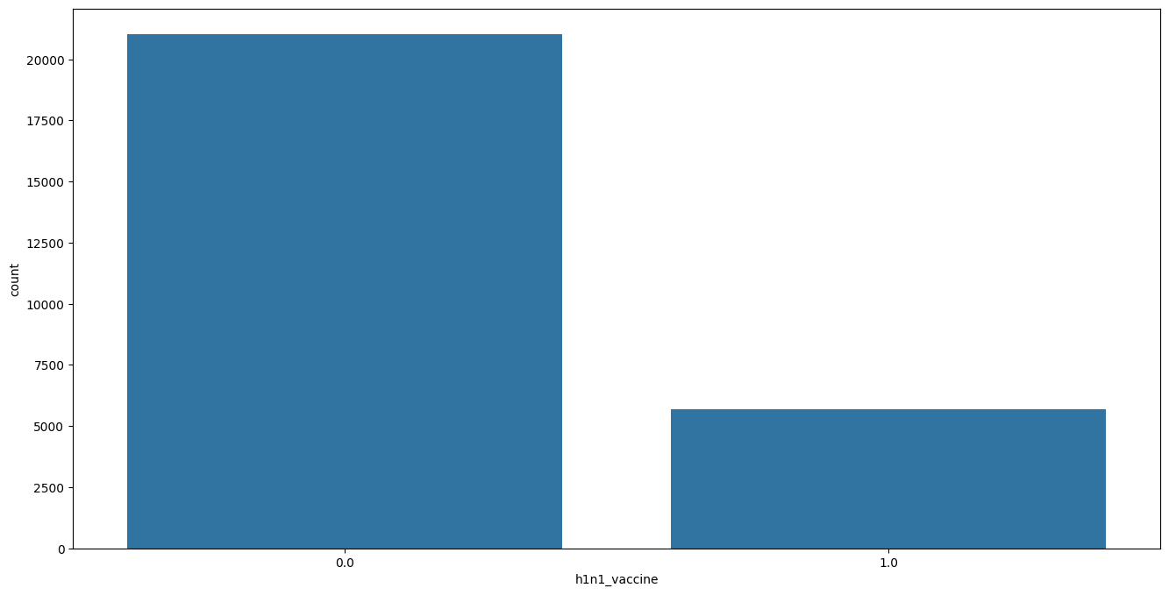
Exploratory Data Analysis
H1N1 Vaccine distribution
Distribution of people who took the h1n1_vaccine
Slightly more than 2000 didn’t take the vaccine and 5000 did.

Slide 5
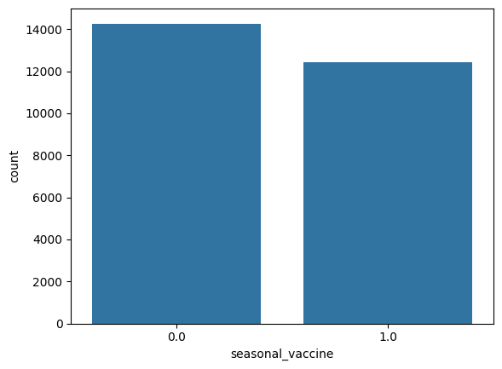
Seasonal Vaccine distribution
Slightly more than 14000 did not take the vaccine and slightly more than 12000 took it.

Slide 6


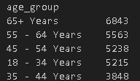
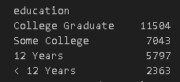
Audience distribution
The distribution of the audience that responded to the survey is as follows.

Slide 7
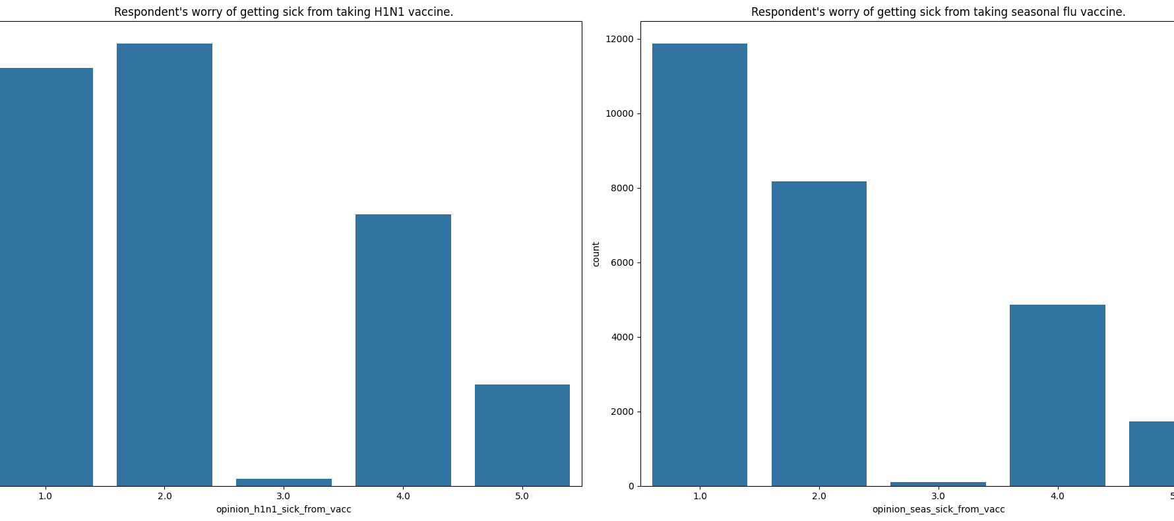
The above is the concern for taking the vacicne
- 1 Represents not all worried and 5 very worried.

Slide 8
Medical understanding from data
Conclusion:
Public Awareness and Trust: Seasonal flu vaccines are more familiar and accepted by the general public because they are offered regularly every year, whereas the H1N1 vaccine may be perceived as specific to a past pandemic.
Target Audience: Seasonal flu vaccines protect against multiple influenza strains predicted to circulate in a given year, making them broadly applicable, while the H1N1 vaccine targets a specific strain, leading to a more limited perceived need.
Epidemiology: The seasonal flu is a recurring issue, affecting millions annually, so its vaccine is prioritized for routine public health efforts. The H1N1 vaccine is targeted at a specific outbreak and has less uptake outside of outbreak periods.

Slide 9
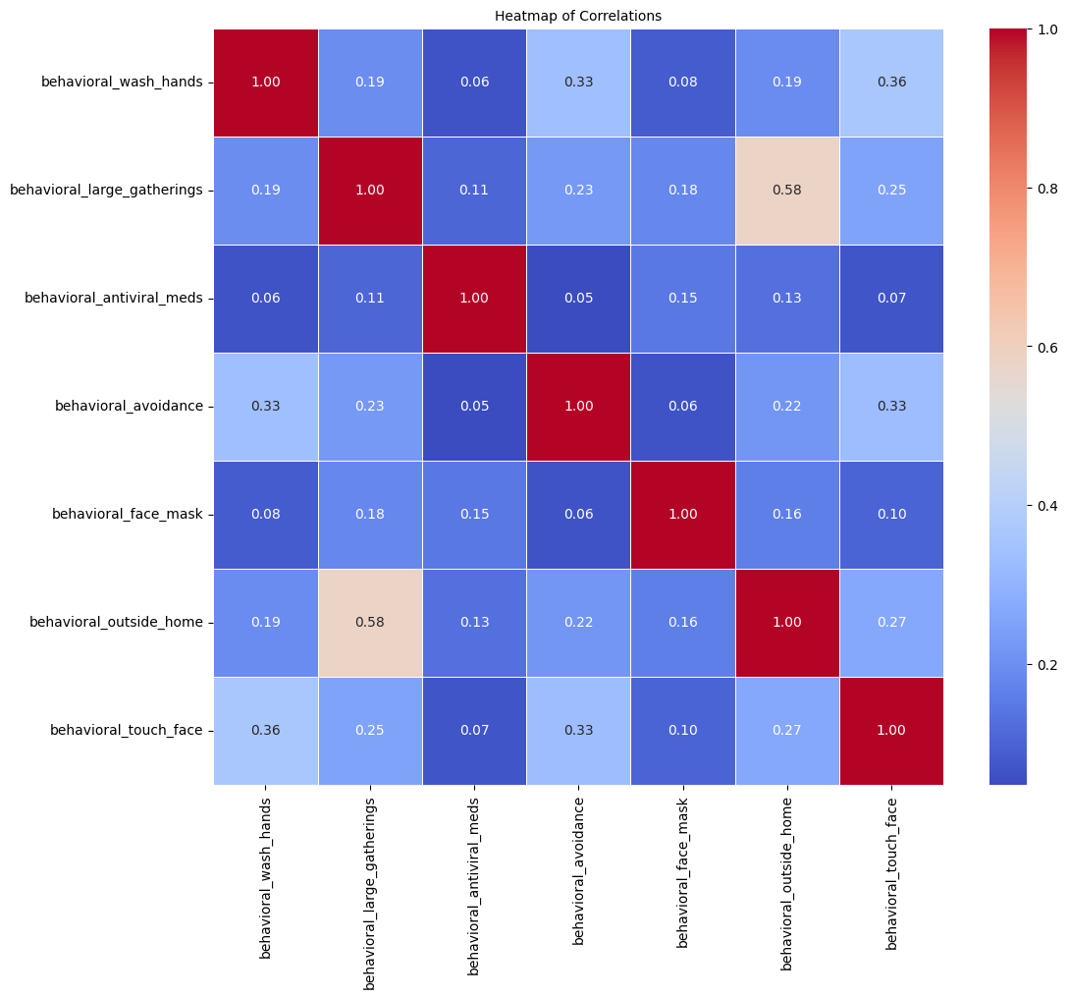
Relationship of different preventive methods

Slide 10
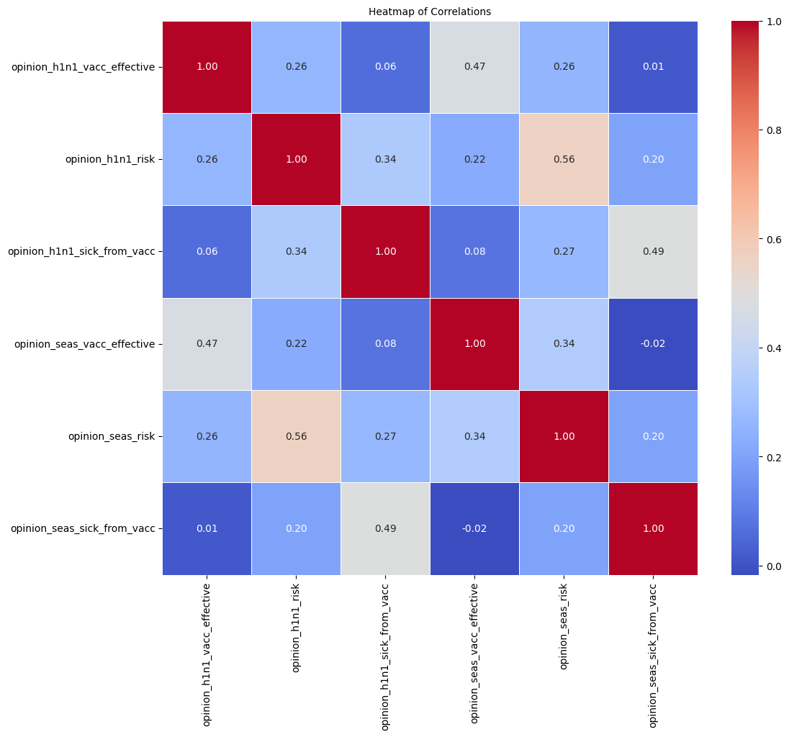
Relationship of opinion on vaccine safety

Slide 11
Modeling
- Approach: Classifier chain Logistic regression to predict vaccine uptake
- Why Classification: Identifies patterns in vaccination behavior for targeted interventions
- Model Inputs: Age, education level, marital status, health conditions, opinions, behaviour

Slide 12
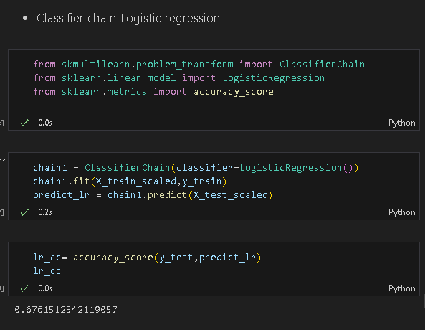
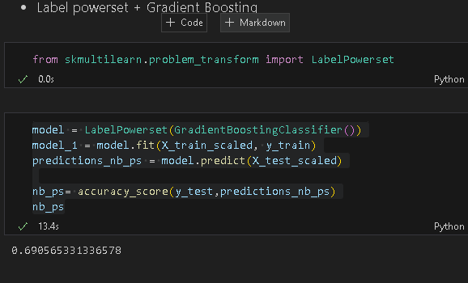
Baseline model vs Highest Performing model
baseline
Highest performing
The prediction is at 69%
The prediction is at 68%

Slide 13
Evaluation
- Key Metrics:
- Accuracy: Overall correct predictions
- Precision: Correctly predicted vaccinations
- Recall: Effectiveness in identifying vaccinated individuals
- Feature Importance:
- Demographic factors like age and gender are critical
- Behavioral aspects such as vaccine awareness influence decisions

Slide 14
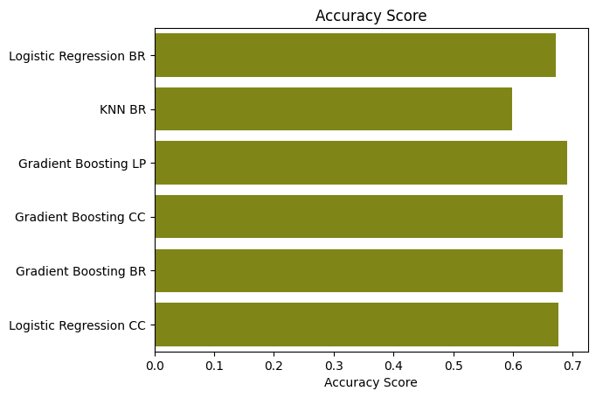

Evaluation
I compared the accuracy score with other models to see the best performing model which is the Gradient Boosting using Label PowerSet

Slide 15
Recommendations
1. Targeted Campaigns:
- Focus on demographic groups less likely to vaccinate
2. Education Programs:
- Increase awareness of vaccine benefits
3. Accessibility Initiatives:
- Address barriers like cost and access to vaccination centers

Slide 16
Next Steps
- Expand the dataset with recent vaccination campaigns
- Enhance the model with new predictors (e.g., social media influence)
- Pilot targeted campaigns and measure their effectiveness

Slide 17
Thank You
I look forward to discussing how these findings can improve public health outcomes.

