Slide 1


The Drivers of Box Office Success: Budget, Star Actors, Reviews and the Moderating Effect of Seasonality across Movie Genres
Angeliki Loulo
January 2025
First Supervisor: Dr. Evert de Haan Second Supervisor: Dr. A. Minnema
Notes:
Today I will be presenting my thesis focusing on 'Predicting Customer Redemption in Short-Term Loyalty Programs through RFM Analysis and Transfer Learning.
This study explores the integration of traditional marketing models with advanced machine learning techniques to improve the effectiveness of loyalty programs in the retail industry.

Slide 2
Overview
1
2
3
4
5
6
7
Introduction
7
10
21
23
37
47
55
60
Literature Review
Conceptual Model
Data Preparation & Description
Methodology
Results
Discussion
Conclusion
Notes:
This presentation will cover the various aspects of my study, including the research objectives, conceptual model, methodology, results, discussion, limitations, and conclusions.
So Let's get started.

Slide 3
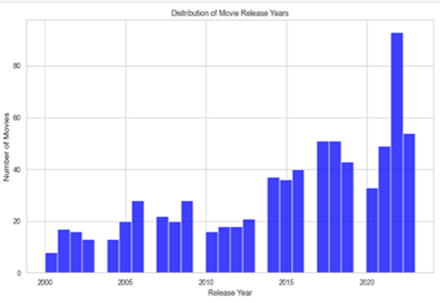
Introduction
Motivation – Why study this topic?
Mix of Art, Business, Strategy & Unpredictability of movie industry
Why some movies are hits and some flops?
A small percentage of movies 20%, generates 80% of revenue (Pareto Principle), (De Vany, 2004)
Challenges in Prediction → Key factors like budgets, star actors, reviews, time of release, are important but do not guarantee success
How these factors interact during holiday vs non holiday seasons?
This process helps in understanding: How turning Raw data → Useful insights
How different factors work together ?
Notes:
In today’s competitive retail market, loyalty programs have become crucial for driving customer engagement and retention.
However, the success and customer participation in these programs are not guaranteed.
Poor strategic planning, design, and inappropriate targeting can hinder the effectiveness of LPs despite the investments made in launching and maintaining them.
There are different kinds of LPs. The research focuses specifically on STLPs.
These programs typically last for 14 to 22 weeks; in this study, we focus on a 16-week duration.
The limited duration of STLPs presents unique challenges.
Limited data availability makes it difficult to understand and predict customer behavior within these short periods.
Despite the widespread use of loyalty programs, there is a notable gap in the literature.
Specifically, there is a lack of predictive models that forecast customer redemption behavior in STLPs.
Furthermore, while traditional RFM analysis is a common method for segmenting and understanding customer behavior, it has not been widely integrated with advanced machine learning techniques like transfer learning.
This integration could significantly enhance predictive accuracy, especially in data-limited contexts typical of STLPs.

Slide 4
Introduction
Relevance of the Topic & Research Objectives
Relevance of the Topic: Timing is critical for movie success. Holiday periods attract larger audiences & revenue (Pangarker et al., 2013).
Post-release factors, play a critical role in success, often overlooked in pre-release predictions (De Vany, 2004)
Post-release & pre-release dynamics combined with competition during holiday periods, makes studying seasonality even more important.
Globalization & Technological advancements reshaped box office performance ( making it more complex)
Research Gap: Papers like ( Pangarker et al.,2013, Mirrlees, T. et al., 2013) & (Scott, 2019) → do not explore how does seasonality ( holiday vs non-holiday) interact with reviews, budgets & star actors to influence revenue
They focus more on individual factors but not on these moderating effects of seasonality across those factors, genres and sequels
Research Objective: RQ: “How do key factors such as budget, star actors, consumer and professional reviews interact with seasonality ( holiday vs non – holiday periods) to influence box office performance across specific genres? “
This will help to optimized release strategies of movies and improve overall performance."
Notes:
In today’s competitive retail market, loyalty programs have become crucial for driving customer engagement and retention.
However, the success and customer participation in these programs are not guaranteed.
Poor strategic planning, design, and inappropriate targeting can hinder the effectiveness of LPs despite the investments made in launching and maintaining them.
There are different kinds of LPs. The research focuses specifically on STLPs.
These programs typically last for 14 to 22 weeks; in this study, we focus on a 16-week duration.
The limited duration of STLPs presents unique challenges.
Limited data availability makes it difficult to understand and predict customer behavior within these short periods.
Despite the widespread use of loyalty programs, there is a notable gap in the literature.
Specifically, there is a lack of predictive models that forecast customer redemption behavior in STLPs.
Furthermore, while traditional RFM analysis is a common method for segmenting and understanding customer behavior, it has not been widely integrated with advanced machine learning techniques like transfer learning.
This integration could significantly enhance predictive accuracy, especially in data-limited contexts typical of STLPs.

Slide 5
Literature Review
Key Findings from Literature & Hypothesis
Complexity of Movie Success
-"The movie industry is dynamic, influenced by both commercial (box office revenue) and critical (reviews and awards) factors, making predictions complex.“
-Balancing these factors reflects artistic and popular appeal (Gao et al., 2019).“, While some movies excel commercially, generating significant revenue, others achieve critical acclaim.
Hypothesis 1:"Consumer reviews positively impact box office performance, with stronger effects during holiday periods (Li et al., 2018, Pangarker et al., 2013).“
Hypothesis 2: “Professional reviews have a positive impact on box office performance, and this is stronger during the holiday season compared to non-holiday season. ((Basuroy et al., 2003, Reinstein et al., 2005)”
Hypothesis 3: “Budget has a significant positive impact on box office performance, with stronger effects during the holiday season compared to non-holiday season”. (Scott, 2019)
Hypothesis 4: “The presence of star actors positively impacts box office performance, with stronger effects during the holiday season compared to the non-holiday season.” (Gunter, 2018,Nelson et al., 2012)
Notes:
In today’s competitive retail market, loyalty programs have become crucial for driving customer engagement and retention.
However, the success and customer participation in these programs are not guaranteed.
Poor strategic planning, design, and inappropriate targeting can hinder the effectiveness of LPs despite the investments made in launching and maintaining them.
There are different kinds of LPs. The research focuses specifically on STLPs.
These programs typically last for 14 to 22 weeks; in this study, we focus on a 16-week duration.
The limited duration of STLPs presents unique challenges.
Limited data availability makes it difficult to understand and predict customer behavior within these short periods.
Despite the widespread use of loyalty programs, there is a notable gap in the literature.
Specifically, there is a lack of predictive models that forecast customer redemption behavior in STLPs.
Furthermore, while traditional RFM analysis is a common method for segmenting and understanding customer behavior, it has not been widely integrated with advanced machine learning techniques like transfer learning.
This integration could significantly enhance predictive accuracy, especially in data-limited contexts typical of STLPs.

Slide 6
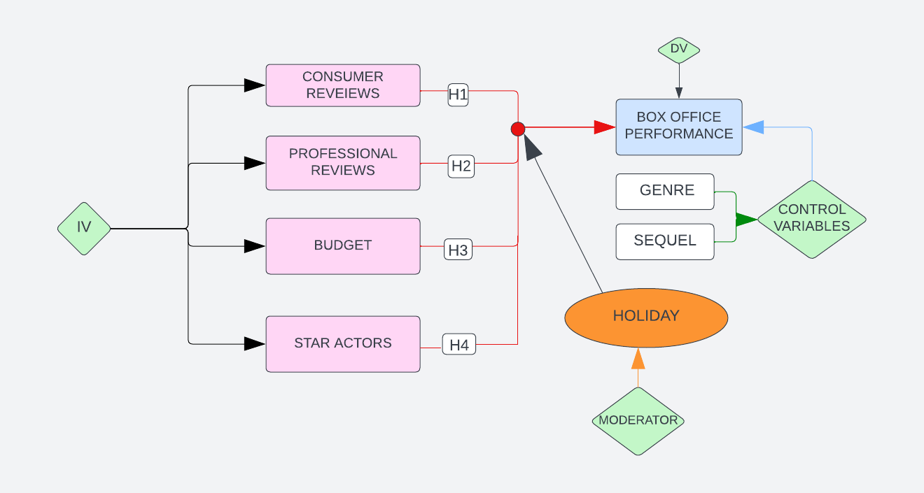
Conceptual Model
Genres & Sequels → control variables
Moderator → Holiday
Genres are control variables because some genres naturally do better than others, and sequels are included because they usually have a loyal audience."
These are included to isolate better and understand the specific impact of the main variables on a movie’s box office performance.
holiday periods bring larger audiences and increased competition→ explores how timing affects the relationship between key factors on box office performace
Notes:
In today’s competitive retail market, loyalty programs have become crucial for driving customer engagement and retention.
However, the success and customer participation in these programs are not guaranteed.
Poor strategic planning, design, and inappropriate targeting can hinder the effectiveness of LPs despite the investments made in launching and maintaining them.
There are different kinds of LPs. The research focuses specifically on STLPs.
These programs typically last for 14 to 22 weeks; in this study, we focus on a 16-week duration.
The limited duration of STLPs presents unique challenges.
Limited data availability makes it difficult to understand and predict customer behavior within these short periods.
Despite the widespread use of loyalty programs, there is a notable gap in the literature.
Specifically, there is a lack of predictive models that forecast customer redemption behavior in STLPs.
Furthermore, while traditional RFM analysis is a common method for segmenting and understanding customer behavior, it has not been widely integrated with advanced machine learning techniques like transfer learning.
This integration could significantly enhance predictive accuracy, especially in data-limited contexts typical of STLPs.

Slide 7
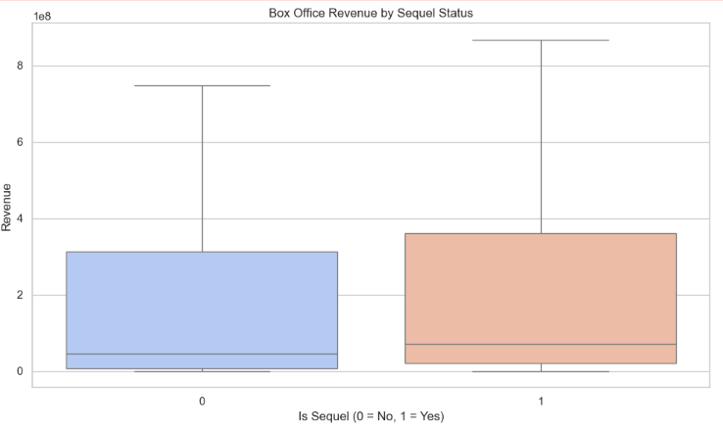
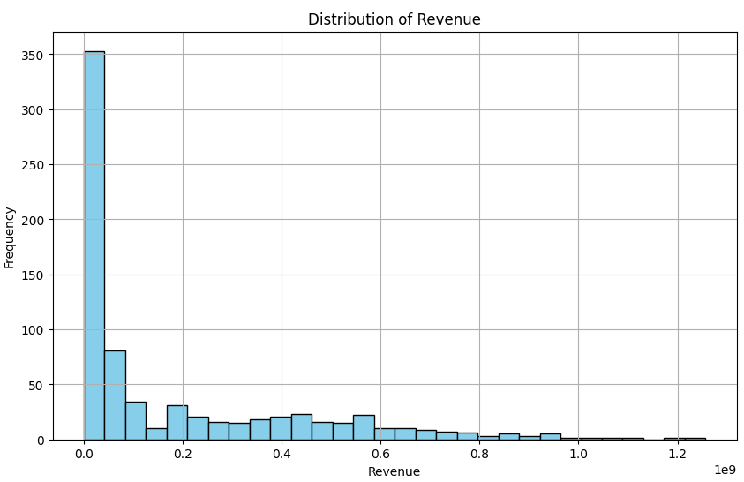
Data Preparation
Data sources : IMDB & Rotten Tomatoes ( sources via Kaggle) → verified for accuracy through web scraping
Data Integration:
Merged datasets using movie titles & release dates
Final dataset: 745 movies (2000-2023)
Excluded movies from Asia & genres: biography, western
Created dummy variables :( 7 Genres with most populars being thriller, drama, comedy),
Star Actors (150 top actors: 228 movies featured at least one star actor), Sequels ( 89 movies marked as sequels)
Missing values:
-Professional reviews: 61 missing values (8%), using MICE ( under assumption of MAR)
-Revenue: 5 missing values (0.67%), using Median Values <Mean ( to handle highly skewed data)
-Consumer Reviews: 1 missing value, replaced by the mean
Outliers: Detected using IQR & Z – score Methods:
-Revenue: 25 outliers retained for insights into blockbusters
-Budget: 10 outliers retained to assess high – budget impact
-Consumer Reviews: 7 outliers retained to capture variability

Slide 8
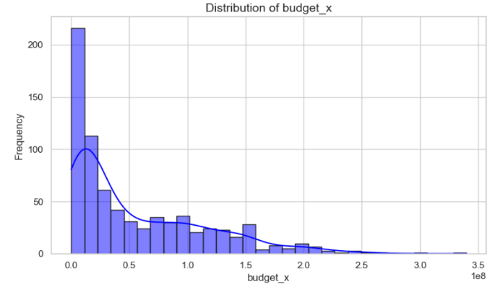
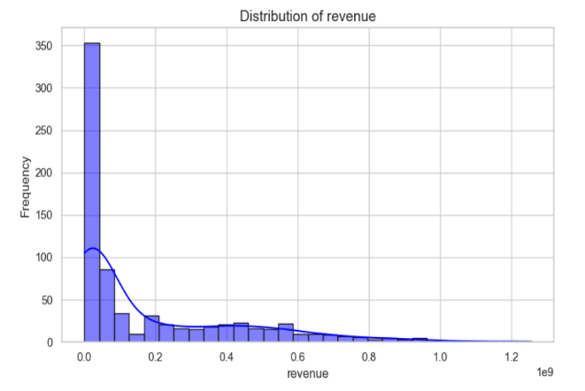
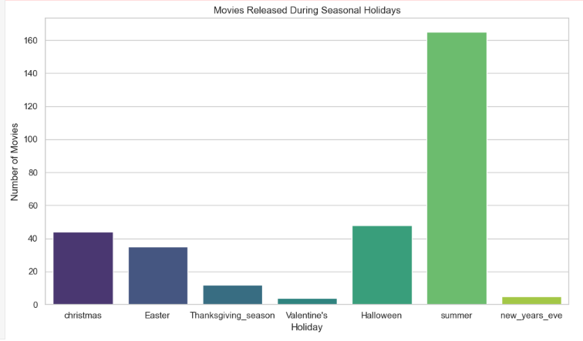
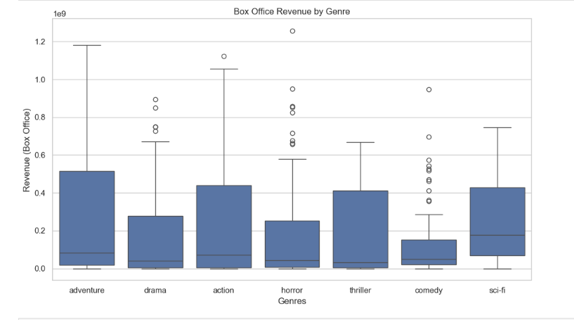
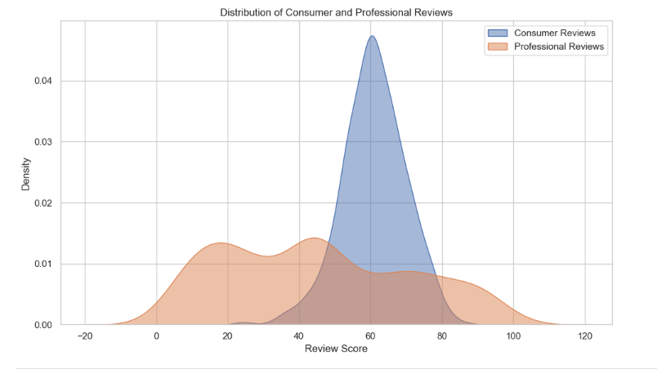
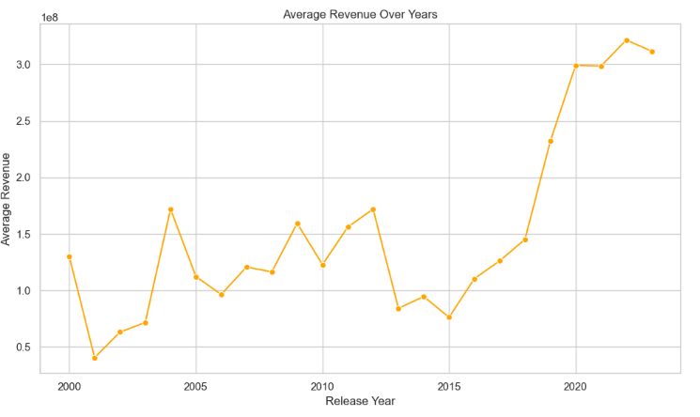
Data Description
Variables | Data Description | N | Mean | Standard Deviation | Minimum | Maximum
title | Title of movie i | 745
Dependent Variable
revenue | Global Box office revenue for movie I in USD$ | 745 | 182,042,633 | 247,492,045 | 43 | 1,256,887,580
Independent Variables
budget_x | Production budget of movie I (in USD) | 745 | 56,253,180 | 59,110,483 | 85,645 | 340,000,000
tomato | Average professional review score (1-100), Rotten Tomatoes | 745 | 44.9557047 | 25.9434232 | 1 | 100
score | Average consumer reveiws (1-100) IMDB | 745 | 60.88590604 | 8.976170815 | 23 | 87
star_actor | Indicator for whether the movie I features a star actor (1 = Yes, 0 = No) | 745 | 0.30738255 |  | 0 | 1
Moderator Variable
Holiday | Indicator for whether the movie I was released during a holiday season (1 = Yes, 0 = No) | 745 | 0.413422819 |  | 0 | 1
Control Variables
sequel | Indicator for whether the movie I is a sequel (1 = Yes, 0 = No) | 745 | 0.119463087 |  | 0 | 1
Genre | Indicator for where the movie I belongs to the genres : (drama, comedy, sci-fi, adventure, thriller, action, horror) | 745

Slide 9
Methodology
Model Specification:
Holiday Model: log_revenue_{i​}= β₀ + β₁​log_budget_{i​} + β₂​scores_{i​} + β_{3​}tomato_{i​} + β₄star_actor_{i} + β₅​(Holiday = 1)_{i​} + β₆​sequel_{i​} + β₇​action_{i} + β₈​comedy_{i} + β₉​ drama_{​i} +β₁₀horrori₊ β₁₁adventure_{i}+β₁₂thrilleri+ β ₁₃sci-fi_{i}+ϵ_{i​}
Non-Holiday Model: log_revenue_{i​}= β₀ + β₁​log_budget_{i​} + β₂​scores_{i​} + β_{3​}tomato_{i​} + β₄star_actor_{i} + β₅​(Holiday = 0)_{i​} + β₆​sequel_{i​} + β₇​action_{i} + β₈​comedy_{i} + β₉​ drama_{​i} +β₁₀horrori₊ β₁₁adventure_{i}+β₁₂thrilleri+ β ₁₃sci-fi_{i}+ϵ_{i​}
Baseline Model: log_revenue_{i​}= β₀ + β₁​log_budget_{i​} + β₂​scores_{i​} + β_{3​}tomato_{i​} + β₄star_actor_{i} + β₅sequel_{i​} + β₆action_{i} + β₇​comedy_{i} + β₈ drama_{​i} +β₉horrori₊ β₁₀adventure_{i}+β₁₁thrilleri+ β ₁₂sci-fi_{i}+ϵ_{i​,}
Combined Model: log_revenue_{i​}= β₀ + β₁​log_budget_{i​} + β₂​scores_{i​} + β_{3​}tomato_{i​} + β₄star_actor_{i} + β₅​((Holiday =1) * log_budget)_{i​} + β₆ ((Holiday=1) * scores)i + β₇ ((Holiday=1)) * tomato)i + β₈ ((Holiday=1) * star_actor)_{i​} + β₉ sequel_{i​} + β₁₀ action_{i} + β₁₁ comedy_{i} + β₁₂ drama_{​i} +β₁₃ horrori + β₁₄ adventure_{i} + β₁₅thrilleri+ β ₁₆sci-fi_{i} + β₁₇ Holidayi +ϵ_{i​}
Isolated Interaction Effects : Budget, Star Actors, Consumer & Professional Reviews → for Hypothesis Testing
Tested each isolated interaction term of key factors, moderated by seasonality

Slide 10
Methodology
Explanatory Model: 𝑌𝑖 = 𝛼 + 𝛽𝑥𝑋𝑖 + 𝛽𝑧𝑍𝑖 + 𝛽𝑥𝑧𝑋𝑖 𝑍𝑖 + 𝜀𝑖 → MMR analysis
OLS (Ordinary Least Squares):Used for parameter estimation, capturing direct and interaction effects → provides interpretable coefficients
DV: Box Office Performance revenue, as log-transformed to address skewness
IV: Budget (log-transformed), volume of Professional Reviews and Consumer reviews, Star Actors ( dummy variable), 1= presence, 0=absence)
Moderator Variable: Seasonality: Dummy variable for holiday periods= 1, non-holiday periods=0 → Seasonality
Control Variables: Genre: Dummy variable for 7 genres) & Sequel: Dummy variable (1=sequel, 0= no sequel)
Interaction Terms: IV * Seasonality → explore how seasonality moderates the relationship between predictors & revenue
Interaction Effects: Log Budget * Holiday = 1, Reviews * Holiday=1, Star Actors * Holiday = 1
Model Specification:
Baseline Model: Examines direct effects of predictors without interaction effects,
Holiday Model & Non- Holiday model: Separate Regressions to analyze predictor impacts in each season ( Holiday =1 , Non-Holiday = 0)
Full Model: includes all predictors, control variables and interaction terms
Isolated Interaction Effects: were tested individually to evaluate their significance and directly address specific hypothesis: (1-4) about the moderating role of seasonality

Slide 11
Methodology
Model Estimation & Assumptions:
Heteroscedasticity: Constant variance of residuals across predictors ( homoscedasticity)
Test: Breusch-Pagan Test ( detected heteroscedasticity) p < 0.05 for all the models
Corrected Using Robust Standard Errors
Multicollinearity: Test: Variance Inflation Factor (VIF), High VIF values > 10 → Holiday & Combined Model ( holiday_budget, holiday_score) ( centering interaction terms)
Non-Normality: Shapiro-Wilk test: p <0,05, W-statistic close to 1 → mild deviations from Normality of residuals ( Q-Q plots→ residuals deviated slightly from Normality)
OLS robust to non-normality
Linearity: Scatterplots & Rainbow test ( p > 0.05) accepting null hypothesis that they are linear relationships between predictors
Assessment of Influential Data Points: Test: Cook’s Distance (threshold = 1) & Leverage Plots → no data points exceeded the threshold, model is not influenced from outliers
Ridge regression penalizes large coefficients to reduce multicollinearity, particularly in interaction terms.

Slide 12
Results
Models | Significant Predictors | Non-Significant Predictors | R-squared | Adjusted R-squared | F-statistic | MSE (Ridge Regression)
Holiday Model | log_budget (+), holiday_star_actor (-), action (-, marginal), horror (+, marginal) | tomato (professional reviews), score (consumer reviews) | 0.334 | 0.306 | 12.30 (p < 0.001) | 4.84
Non-Holiday Model | log_budget (+), score (consumer reviews, +), tomato (professional reviews, -), thriller (+), sequel (+) | star_actor | 0.446 | 0.403 | 28.46 (p < 0.001) | 3.97
Baseline Model | log_budget (+), star_actor (-), tomato (professional reviews, -), score (consumer reviews, marginal +), sequel (+) | Genres (except action, marginal -) | 0.379 | 0.369 | 37.24 (p < 0.001), 19.86 (robust) | 4.48
Combined Model | log_budget (+), holiday (+), holiday_star_actor (-), tomato (-), sequel (+) | holiday_budget (-, not significant in 2,3), score (consumer reviews, limited significance) | 0.393 | 0.371 | 27.70 (1), 28.48 (2), 15.73 (3) (all p < 0.001) | 4.49

Slide 13
Results
Adjusted R- Squared: Highest in Combined Model → better explains variability in box office revenue with seasonality included
Key Predictors:
Budget: Consistently significant across all the models at non-holiday periods and stages
-Consumer Reviews: Stronger marginal effect during non-holiday periods, insignificant during holidays
-Professional Reviews: minor negative effect during non-holiday periods
-Star Actors: Negative significant effect during holiday periods, positively significant during non-holidays
MSE for Evaluation:
MSE→ penalized large errors, suitable for example for blockbuster outliers, other metrics like MAE less sensitive to outliers
Lower MSE in Ridge Regression→ robust predictions & accuracy
Robust standard Errors: Address heteroscedasticity, improve reliability of coefficients
F-statistic in the Baseline and Combined Model became smaller because the test is now more realistic and less inflated by error variability.
Notes:
The primary objective of this research is to understand the customer behavior in STLPs
by integrating the RFM model
with transfer learning techniques.
Specifically, we aim to predict customer redemption behavior using the RFM model and How purchase frequency, spending, and recency affect the likelihood of customers becoming redeemers, with redemption serving as a tangible indication of customer engagement.
Secondly, assess whether previous reward redemptions predict future engagement in subsequent programs.
Additionally, we explore the potential of transfer learning to improve model performance across different loyalty programs and retailers.

Slide 14
Discussion- Hypothesis Testing
H1 (Consumer Reviews): Not supported
-Non-significant during holiday periods, marginally significant during non-holiday periods
-Due to competition during holidays reduces their influence
H2(Professional Reviews): Not Supported
-Non-significant during holiday periods
-minimal negative impact during non-holiday periods
-do not align with audience tastes, and users rely more on online reviews
H3(Budget): Not Supported
-Negative, significant during holiday periods but positive & significant during non-holiday periods
-High competition among high-budget movies eliminates their effect and audiences’ attention
H4(Star Actors): Not Supported
-Negative, significant during holiday periods, Positive, significant during non-holiday periods
- Popular series with popular storylines overshadow movies with star actors during holiday periods (high competition)
Notes:
The primary objective of this research is to understand the customer behavior in STLPs
by integrating the RFM model
with transfer learning techniques.
Specifically, we aim to predict customer redemption behavior using the RFM model and How purchase frequency, spending, and recency affect the likelihood of customers becoming redeemers, with redemption serving as a tangible indication of customer engagement.
Secondly, assess whether previous reward redemptions predict future engagement in subsequent programs.
Additionally, we explore the potential of transfer learning to improve model performance across different loyalty programs and retailers.

Slide 15
Discussion- Managerial Implications
Tailored Marketing & Release strategies:
-Promoting Positive Consumer Reviews during non-holiday periods
-Encourage WOM through social media, ads (“MUST SEE”), engagement campaigns, trailers
-Use of Predictive Analytics Using Historical Data
-Focus less on Professional Reviews and more on audience ones
Using professional reviews for niche markets or middle budget films during non-holiday periods,
improving technical aspects
Optimized Budget Allocation:
High budget movies released during non-holiday periods,
Star Actor Strategy:
Promotion of movies with star actors during non-holiday periods avoiding the high competition
Promote them to sequel movies during holiday periods works better
Notes:
The primary objective of this research is to understand the customer behavior in STLPs
by integrating the RFM model
with transfer learning techniques.
Specifically, we aim to predict customer redemption behavior using the RFM model and How purchase frequency, spending, and recency affect the likelihood of customers becoming redeemers, with redemption serving as a tangible indication of customer engagement.
Secondly, assess whether previous reward redemptions predict future engagement in subsequent programs.
Additionally, we explore the potential of transfer learning to improve model performance across different loyalty programs and retailers.

Slide 16
Discussion- Limitations & Future Research
Dataset Scope:
-Focused on global box office revenue, markets like Asia are excluded
Limited Streaming Data:
Did not analyze the role of streaming platforms in box office performance.
Reviews:
-Relied on volume and not on sentiment analysis, focusing also to the review variance
Model Limitations:
Multicollinearity among predictors (e.g., budget, reviews, star actors) persisted despite mean-centering, robust standard errors, and Ridge Regression.
Impact: Obscured the true relationship between variables, reducing the reliability of coefficient estimates.
:Seasonality Analysis:
Simplified Approach: Holiday season treated as a single category due to time constraints. Instead of (e.g., Christmas, Thanksgiving).
Future Direction: Analyze individual holidays to better capture audience behaviors and seasonality effects.
While Ridge Regression addressed multicollinearity in this study, future research with larger datasets could explore alternative methods like Elastic Net or PCA to evaluate whether these approaches yield additional insights."
Notes:
The primary objective of this research is to understand the customer behavior in STLPs
by integrating the RFM model
with transfer learning techniques.
Specifically, we aim to predict customer redemption behavior using the RFM model and How purchase frequency, spending, and recency affect the likelihood of customers becoming redeemers, with redemption serving as a tangible indication of customer engagement.
Secondly, assess whether previous reward redemptions predict future engagement in subsequent programs.
Additionally, we explore the potential of transfer learning to improve model performance across different loyalty programs and retailers.

Slide 17
Conclusion
Main Findings:
Budget: Strongest predictor of box office success, especially during non-holiday periods when competition is lower.
-Ridge Combined Model: Best model, addressing multicollinearity and accurately capturing the interaction between predictors and seasonality.
-Strategic budget allocation and release timing are critical for maximizing box office revenue.
-Future Trends: Explore the impact of Social Media Buzz & Marketing campaigns on box office performance
-Hybrid Models: Analyze simultaneous streaming & theatrical releases influence audience behavior & revenue
Notes:
The primary objective of this research is to understand the customer behavior in STLPs
by integrating the RFM model
with transfer learning techniques.
Specifically, we aim to predict customer redemption behavior using the RFM model and How purchase frequency, spending, and recency affect the likelihood of customers becoming redeemers, with redemption serving as a tangible indication of customer engagement.
Secondly, assess whether previous reward redemptions predict future engagement in subsequent programs.
Additionally, we explore the potential of transfer learning to improve model performance across different loyalty programs and retailers.

Slide 18
Thank you!
Questions

