Slide 1
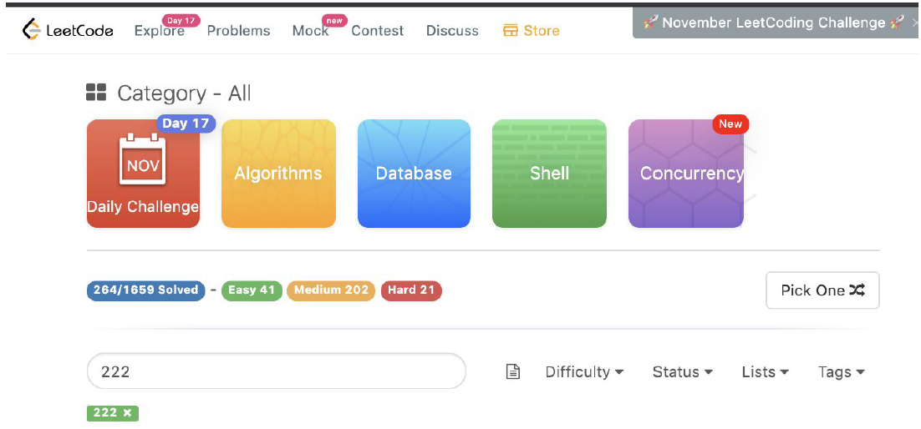
Brief Introduction of Leetcode search engine
What is Leetcode search engine for?
various coding questions + community for programmers
Why interests me?
helpful to my career life + user-friendly

Slide 2


Search types and ranking features
search types:
coding problems + user-posted interview questions + interview experience
+ compensation information + topics of career + general discussion + feedback
How does system rank results?
ranking features:
number of votes + the level of hotness
examples:

Slide 3
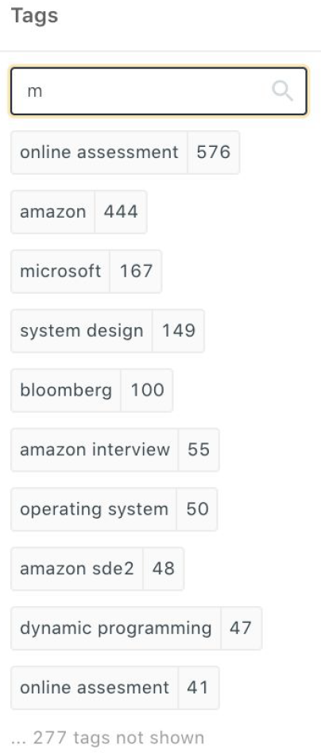
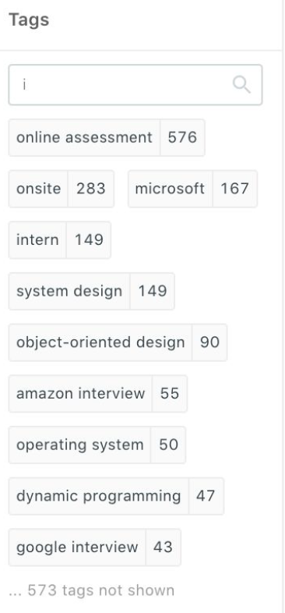
Technical problems
How to search out all interview questions accurately and order them by relevance according to the description words users type in ?
1. Search out all candidates with tags including the company’s name or having the company’s name in posts’ titles or full text contents.
2. Use tf-idf weighting to calculate ranking scores and sort them from highest to lowest.
3. Maybe the weight of tags is bigger than the occurrence of the company’s name in text, since tags of each result are manually added by online posters, so they are more accurate and important.
How to enable the function of updating the suggested results for searching tags ?
Every time I add a character, the search engine updates the results by listing out all tags containing the current query ordering by post amounts until finish typing.

Slide 4
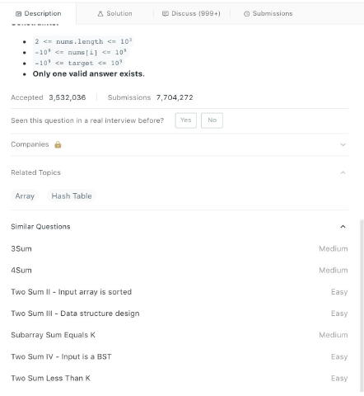
Strength and limitations of Leetcode search engine
Strength
Leetcode is best for clustering and topics/tags classification.
Each problem has similar questions given by Leetcode.
This feature is enabled by clustering’s document grouping.
Limitations
Have limitations on implementing query searching:
1. Users can’t query out certain contests with their id numbers in the section of “Contest”.
2. In the section of “interview questions” , although we can filter out questions with company names, further filtering by different positions is not allowed.

Slide 5
Suggestions for improving Leetcode search engine
Optimize the tagging strategies for users:
Leetcode can better the process of labeling by adding categories of labels so that other users can clearly search out posts meeting their requirements.
Leetcode can add more functions to merge social properties into its platform:
For example, add a social forum to enhance connections between users and their friends.
In this forum, users are able to display their progress of solving coding problems or communicating with their friends about interview experience together.

