Slide 1
Machion Learning 02 PreProcessing
姓名 王選仲
興創知能 AI工程師
2020.05.02
jeremy4555@yahoo.com.tw
https://www.linkedin.com/in/hsuanchungwang/

Slide 2
Target of PreProcessing
Convert data to be understood by the model
Help model Learn Efficiently

Slide 3
Table of Content
DataFrame Inspection
Missing Data
Outlier
Inconsistent Data e.g. Negative Age
Categorical Data e.g. Natural Language Data
Normalization
Feature Generation
Notes:
議題:
請問取log與normalize有什麼差別?

Slide 4
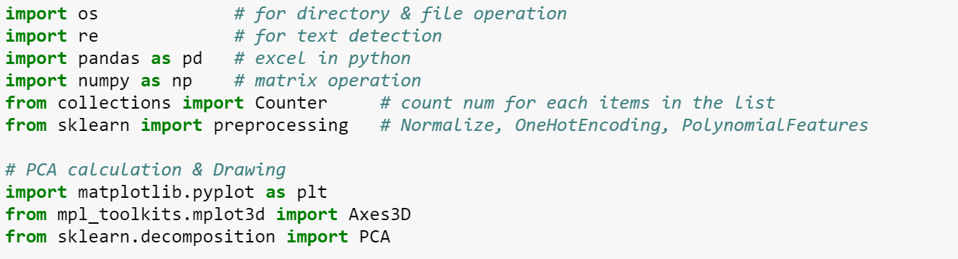
Package Used

Slide 5
Table of Content
DataFrame Inspection
Missing Data
Outlier
Inconsistent Data e.g. Negative Age
Categorical Data e.g. Natural Language Data
Normalization
Feature Generation
Notes:
議題:
請問取log與normalize有什麼差別?

Slide 6
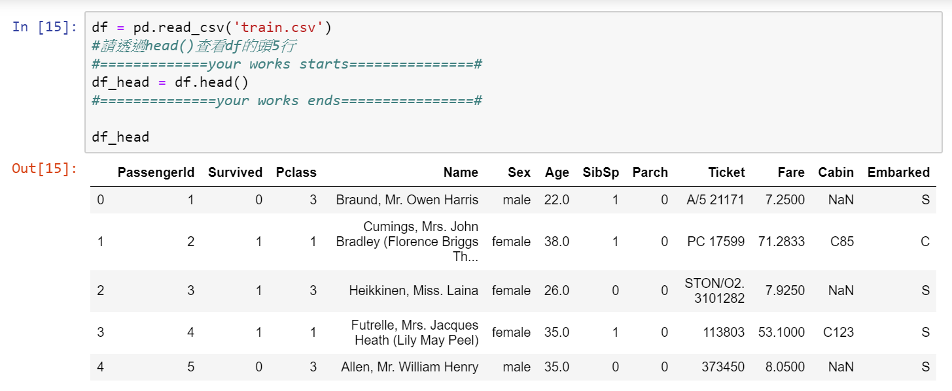
DataFrame Inspection
head

Slide 7
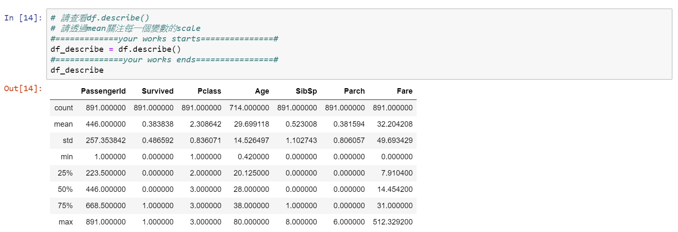
DataFrame Inspection
Statistics

Slide 8
Table of Content
DataFrame Inspection
Missing Data
Outlier
Inconsistent Data e.g. Negative Age
Categorical Data e.g. Natural Language Data
Normalization
Feature Generation
Notes:
議題:
請問取log與normalize有什麼差別?

Slide 9
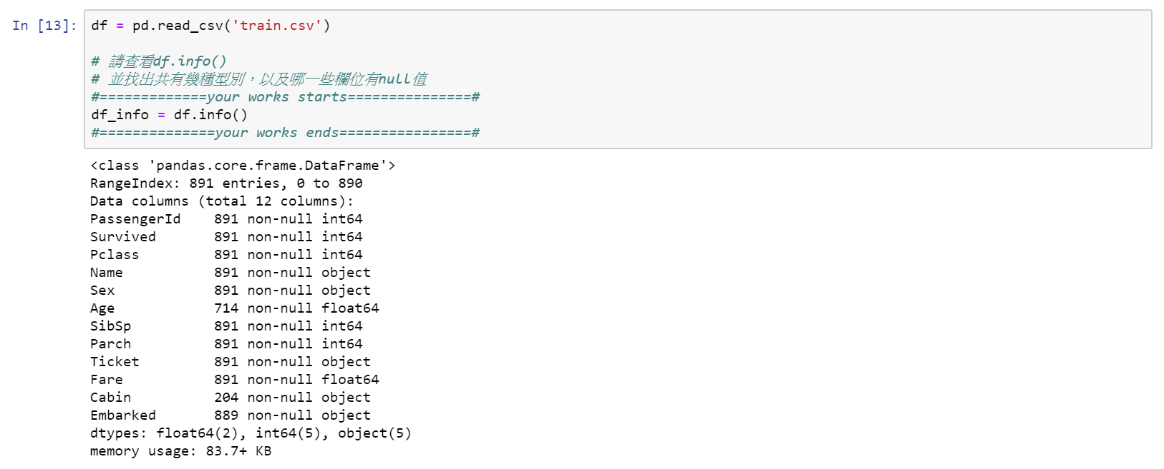
Missing Data
Detection

Slide 10
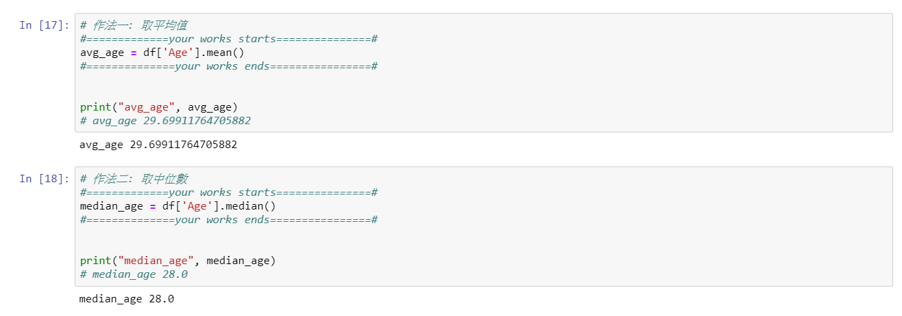
Missing Data
Filling
Mean
Median

Slide 11
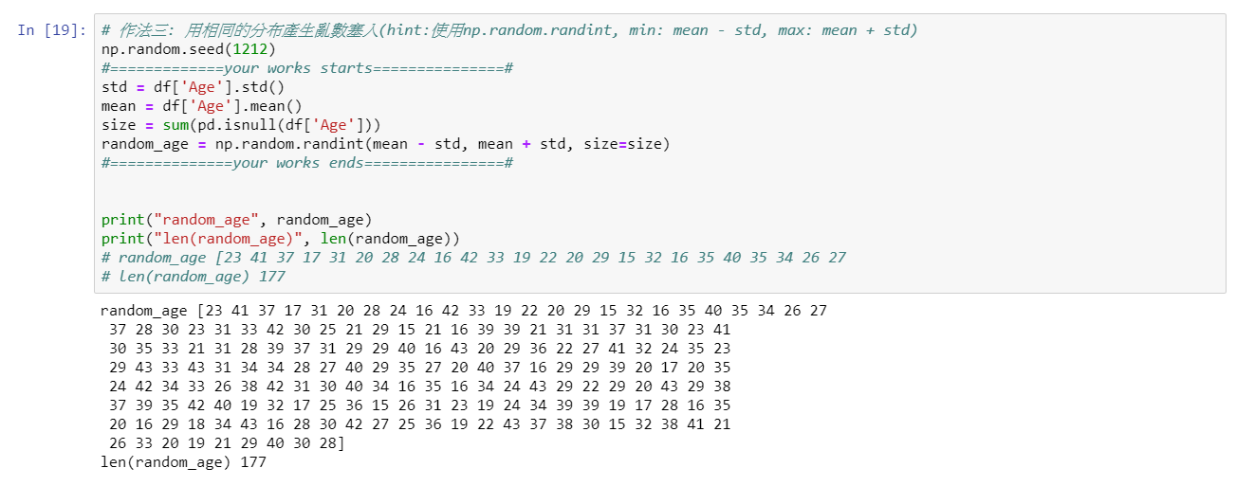
Missing Data
Filling
Random number between mean ± std

Slide 12
Table of Content
DataFrame Inspection
Missing Data
Outlier
Inconsistent Data e.g. Negative Age
Categorical Data e.g. Natural Language Data
Normalization
Feature Generation
Notes:
議題:
請問取log與normalize有什麼差別?

Slide 13
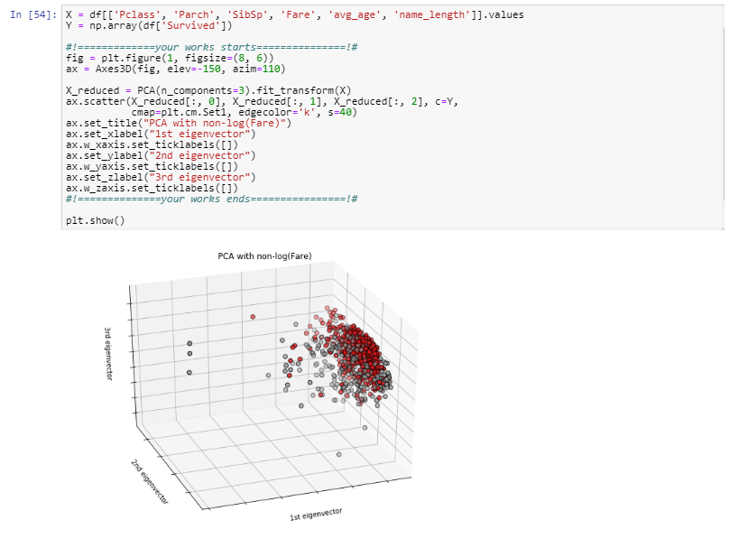
Outlier
Detection

Slide 14
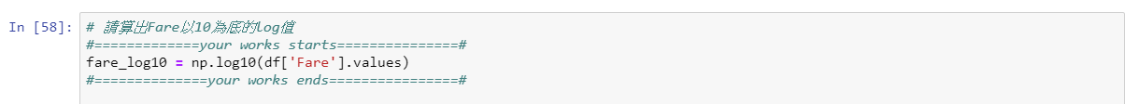
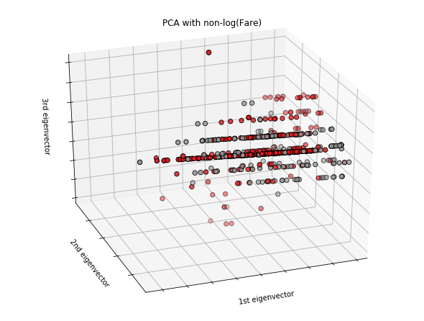
Outlier
Processing: log

Slide 15
Table of Content
DataFrame Inspection
Missing Data
Outlier
Inconsistent Data e.g. Negative Age
Categorical Data e.g. Natural Language Data
Normalization
Feature Generation
Notes:
議題:
請問取log與normalize有什麼差別?

Slide 16
Inconsistent Data
Detection: Domain Knowledge
Processing: Domain Knowledge

Slide 17
Table of Content
DataFrame Inspection
Missing Data
Outlier
Inconsistent Data e.g. Negative Age
Categorical Data e.g. Natural Language Data
Normalization
Feature Generation
Notes:
議題:
請問取log與normalize有什麼差別?

Slide 18
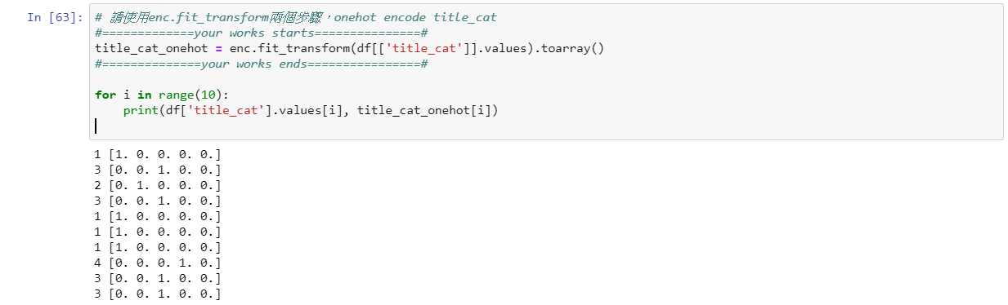
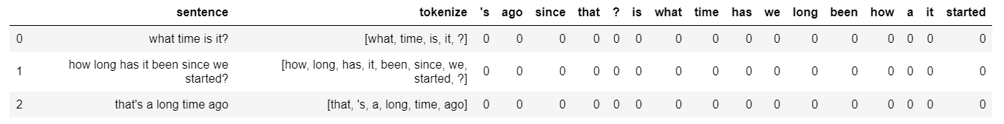
Categorical Data
OneHot Encoding
NLP Example

Slide 19
Table of Content
DataFrame Inspection
Missing Data
Outlier
Inconsistent Data e.g. Negative Age
Categorical Data e.g. Natural Language Data
Normalization
Feature Generation
Notes:
議題:
請問取log與normalize有什麼差別?

Slide 20
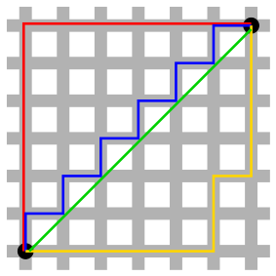
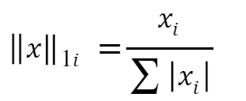
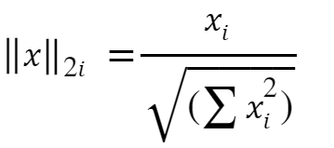
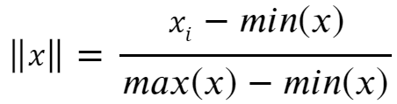
Normalization
L1 Norm
L2 Norm
Norm to 0 ~ 1

Slide 21
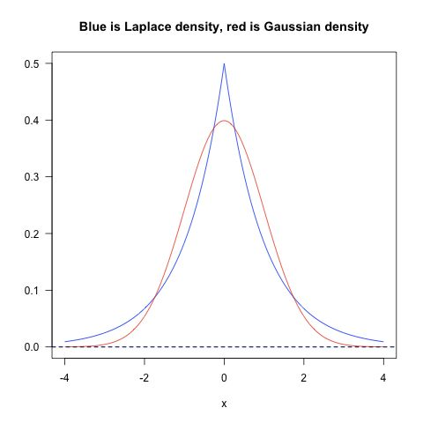
Normalization
How to Choose
L1是蓝色的线，L2是红色的线，很明显，L1的分布对极端值更能容忍。那么如果数据损失项使用L1 Norm，很明显，L1 Norm对outlier没有L2 Norm那么敏感；如果正则化损失项使用L1的话，那么使学习到的参数倾向于稀疏，使用L2 Norm则没有这种倾向。
实践中，根据Quaro的data scientist Xavier Amatriain 的经验，实际应用过程中，L1 nrom几乎没有比L2 norm表现好的时候，优先使用L2 norm是比较好的选择。

Slide 22
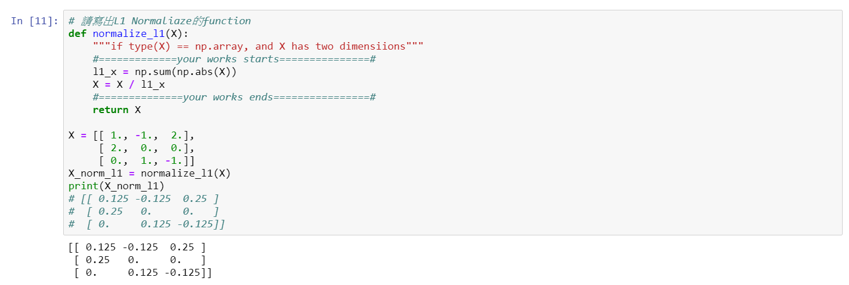
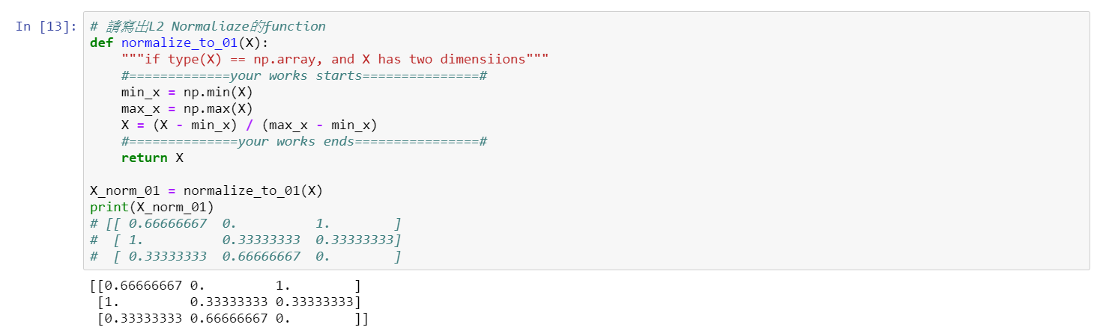
Normalization
Inplementation: L1

Slide 23
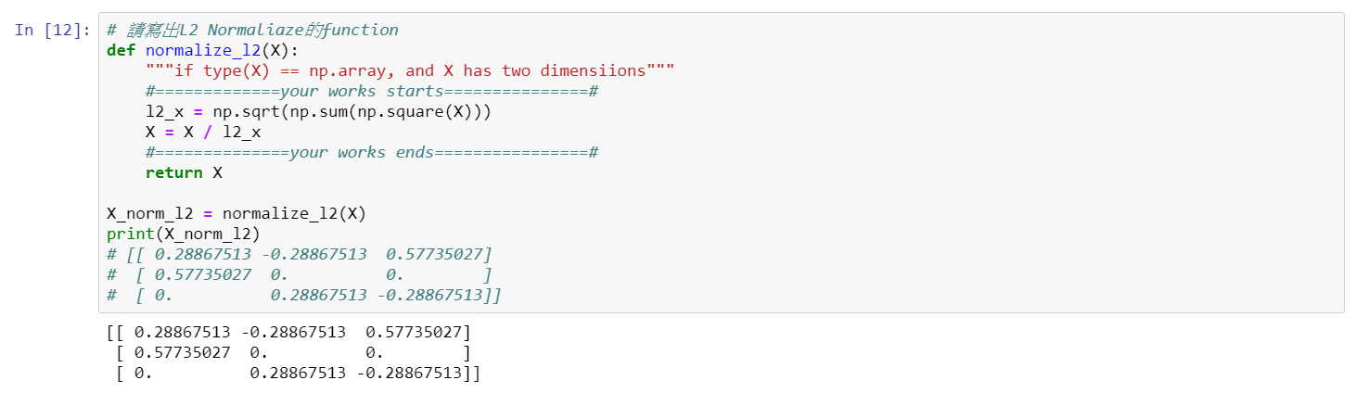
Normalization
Inplementation: L2

Slide 24
Normalization
Inplementation: Norm to 0~1

Slide 25
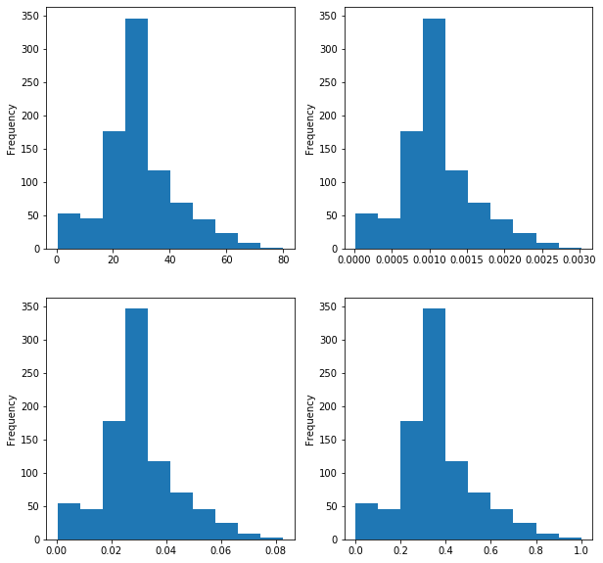
Normalization
Result

Slide 26
Table of Content
DataFrame Inspection
Missing Data
Outlier
Inconsistent Data e.g. Negative Age
Categorical Data e.g. Natural Language Data
Normalization
Feature Generation
Notes:
議題:
請問取log與normalize有什麼差別?

Slide 27
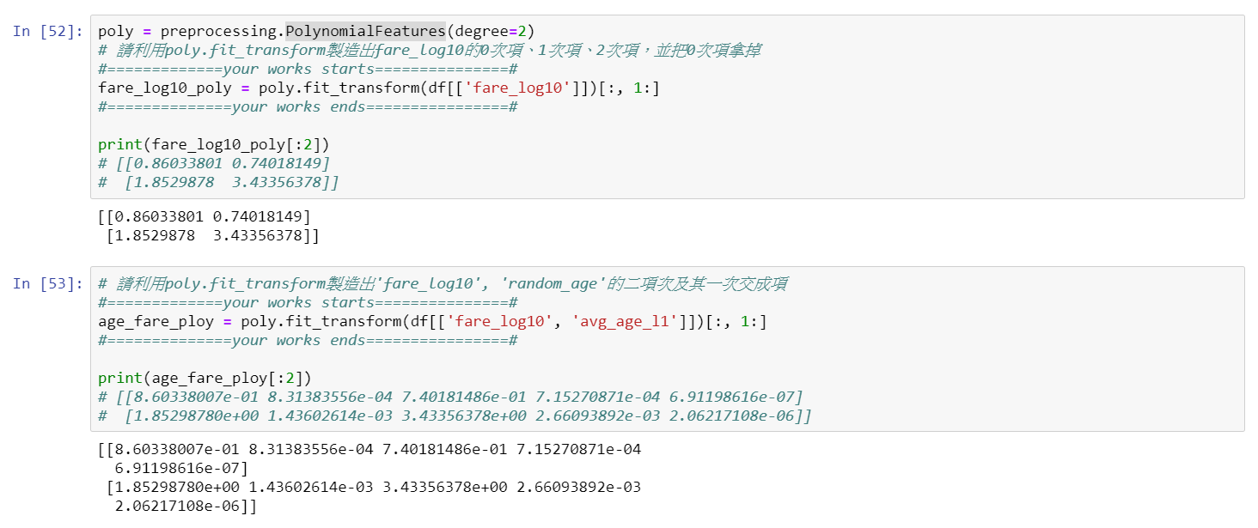
Feature Generation
PolynomialFeatures:
(𝑋1) => (1, 𝑋1, 𝑋1^2)
(𝑋1, 𝑋2) => (1, 𝑋1, 𝑋2, 𝑋1^2, 𝑋1 𝑋2, 𝑋2^2)

Slide 28
Thank you

