Slide 1
Machion Learning 02 PreProcessing
姓名 王選仲
興創知能 AI工程師
2020.05.02
jeremy4555@yahoo.com.tw
https://www.linkedin.com/in/hsuanchungwang/

Slide 2
Target of PreProcessing
Convert data to be understood by the model
Help model Learn Efficiently

Slide 3
Table of Content
DataFrame Inspection
Missing Data
Outlier
Inconsistent Data e.g. Negative Age
Categorical Data e.g. Natural Language Data
Normalization
Feature Generation
Notes:
議題:
請問取log與normalize有什麼差別?

Slide 4
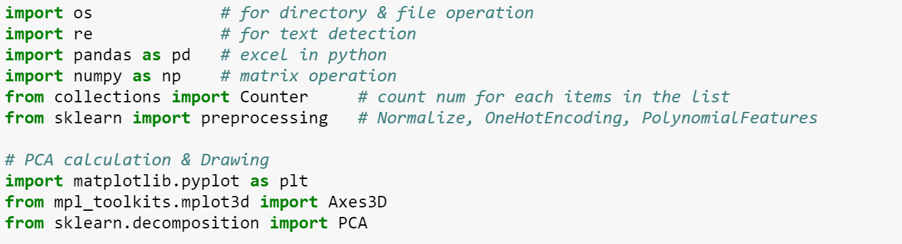
Package Used

Slide 5
Table of Content
DataFrame Inspection
Missing Data
Outlier
Inconsistent Data e.g. Negative Age
Categorical Data e.g. Natural Language Data
Normalization
Feature Generation
Notes:
議題:
請問取log與normalize有什麼差別?

Slide 6
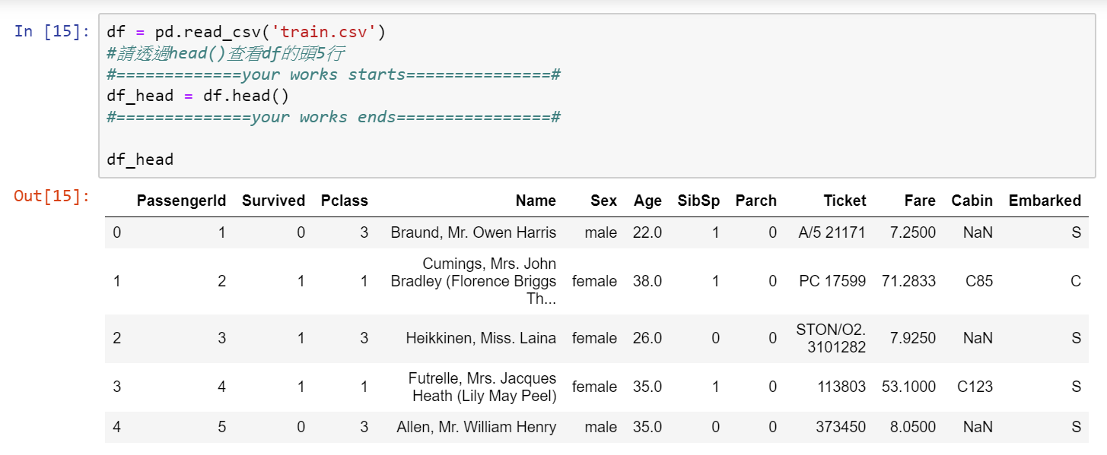
DataFrame Inspection
head

Slide 7
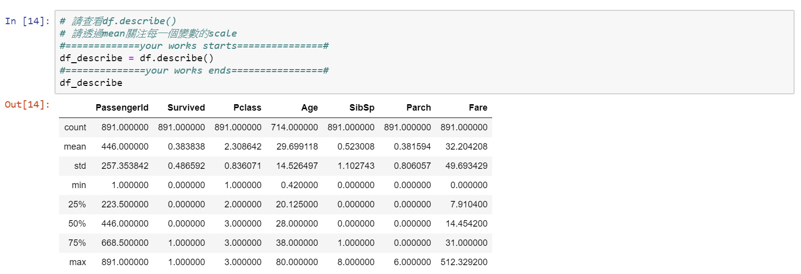
DataFrame Inspection
Statistics

Slide 8
Table of Content
DataFrame Inspection
Missing Data
Outlier
Inconsistent Data e.g. Negative Age
Categorical Data e.g. Natural Language Data
Normalization
Feature Generation
Notes:
議題:
請問取log與normalize有什麼差別?

Slide 9
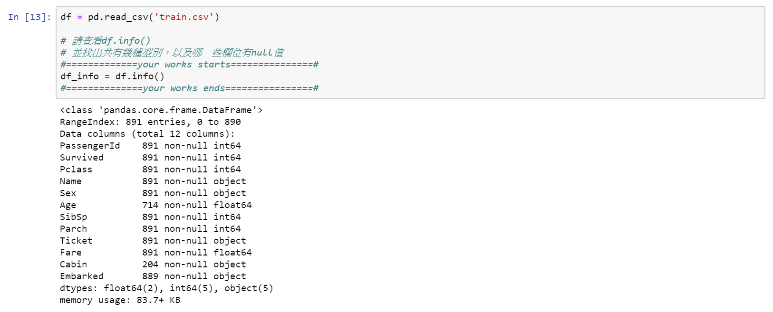
Missing Data
Detection

Slide 10
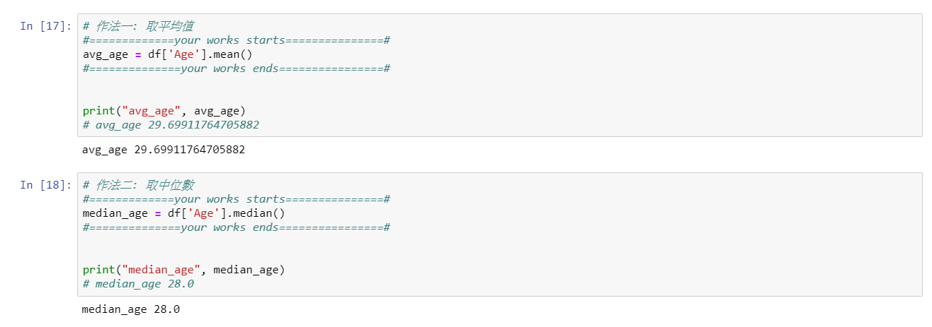
Missing Data
Filling
Mean
Median

Slide 11
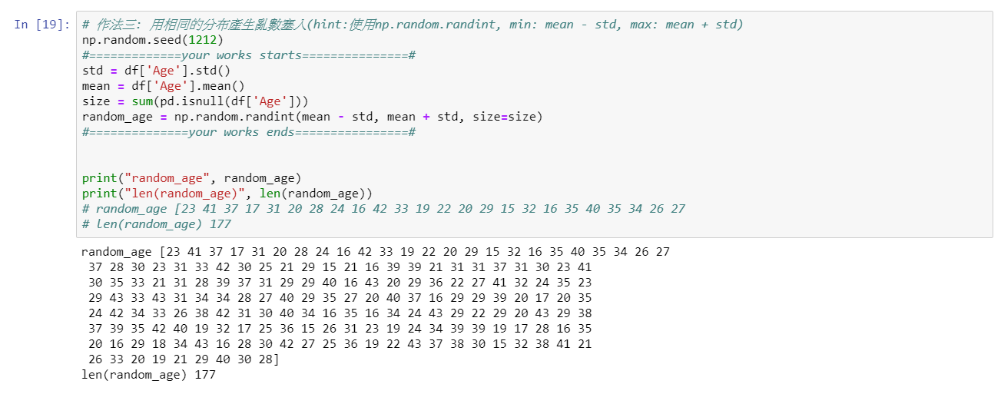
Missing Data
Filling
Random number between mean ± std

Slide 12
Table of Content
DataFrame Inspection
Missing Data
Outlier
Inconsistent Data e.g. Negative Age
Categorical Data e.g. Natural Language Data
Normalization
Feature Generation
Notes:
議題:
請問取log與normalize有什麼差別?

Slide 13
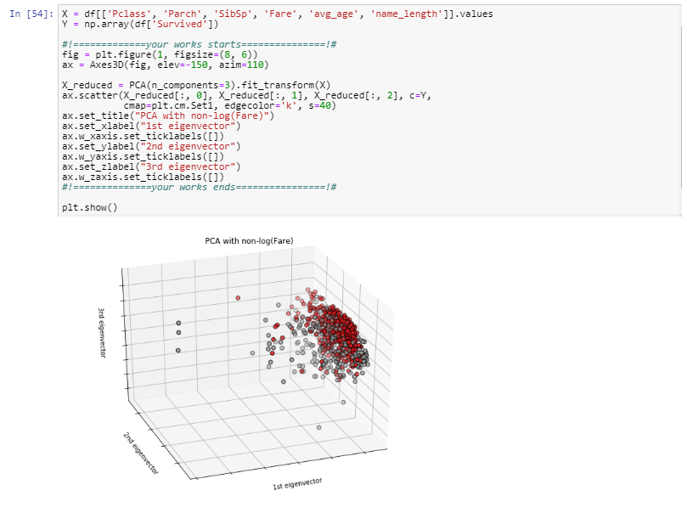
Outlier
Detection

Slide 14
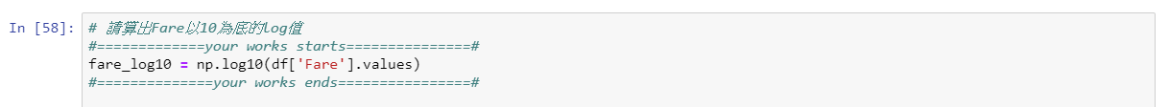
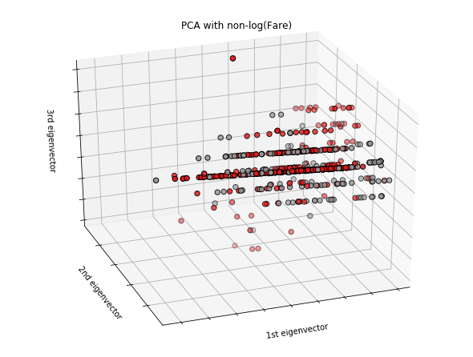
Outlier
Processing: log

Slide 15
Table of Content
DataFrame Inspection
Missing Data
Outlier
Inconsistent Data e.g. Negative Age
Categorical Data e.g. Natural Language Data
Normalization
Feature Generation
Notes:
議題:
請問取log與normalize有什麼差別?

Slide 16
Inconsistent Data
Detection: Domain Knowledge
Processing: Domain Knowledge

Slide 17
Table of Content
DataFrame Inspection
Missing Data
Outlier
Inconsistent Data e.g. Negative Age
Categorical Data e.g. Natural Language Data
Normalization
Feature Generation
Notes:
議題:
請問取log與normalize有什麼差別?

Slide 18
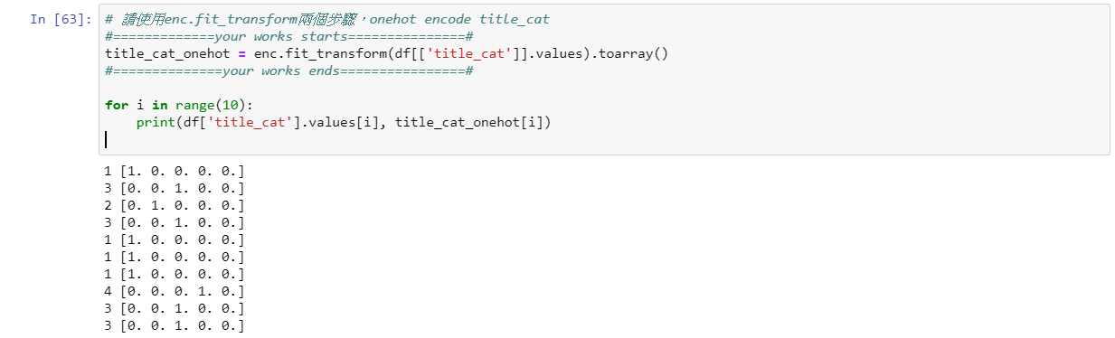
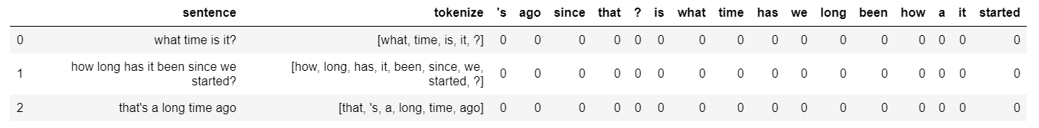
Categorical Data

Slide 19
Table of Content
DataFrame Inspection
Missing Data
Outlier
Inconsistent Data e.g. Negative Age
Categorical Data e.g. Natural Language Data
Normalization
Feature Generation
Notes:
議題:
請問取log與normalize有什麼差別?

Slide 20
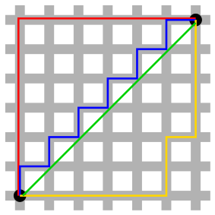
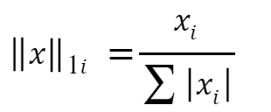
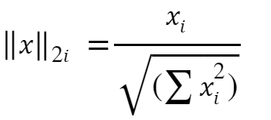
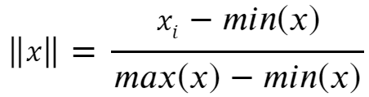
Normalization
L1 Norm
L2 Norm
Norm to 0 ~ 1

Slide 21
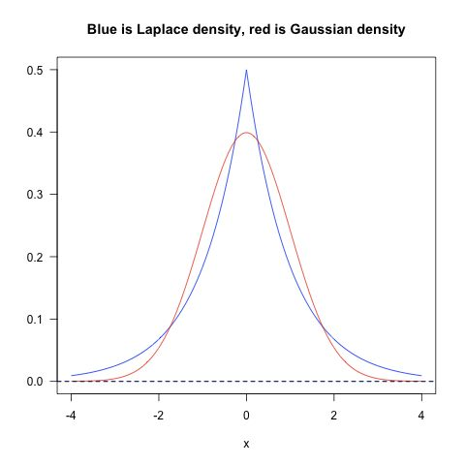
Normalization
How to Choose
L1是蓝色的线，L2是红色的线，很明显，L1的分布对极端值更能容忍。那么如果数据损失项使用L1 Norm，很明显，L1 Norm对outlier没有L2 Norm那么敏感；如果正则化损失项使用L1的话，那么使学习到的参数倾向于稀疏，使用L2 Norm则没有这种倾向。
实践中，根据Quaro的data scientist Xavier Amatriain 的经验，实际应用过程中，L1 nrom几乎没有比L2 norm表现好的时候，优先使用L2 norm是比较好的选择。

Slide 22
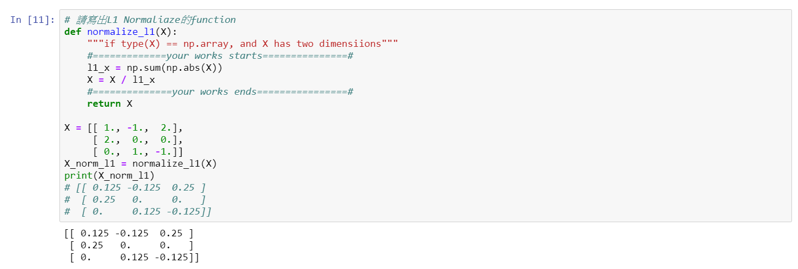
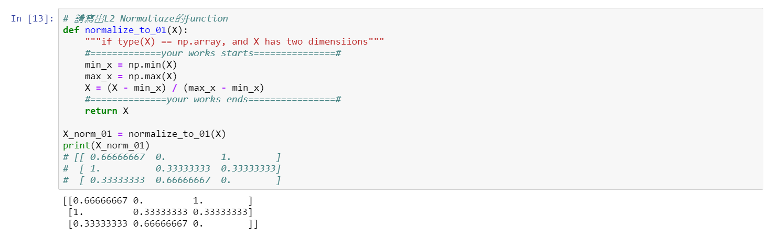
Normalization
Inplementation: L1

Slide 23
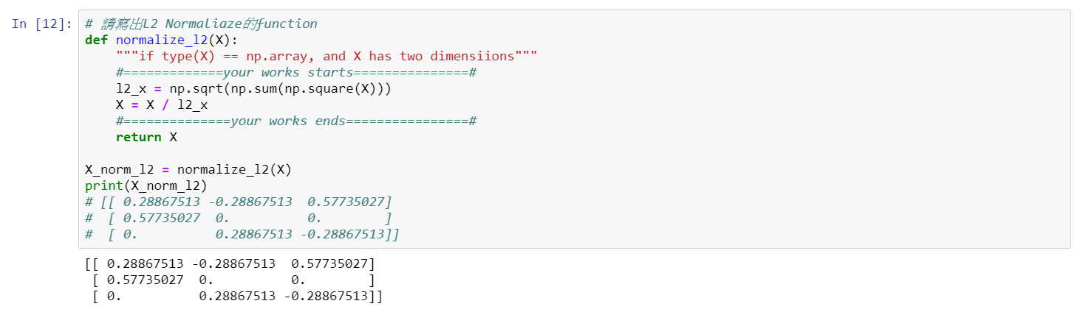
Normalization
Inplementation: L2

Slide 24
Normalization
Inplementation: Norm to 0~1

Slide 25
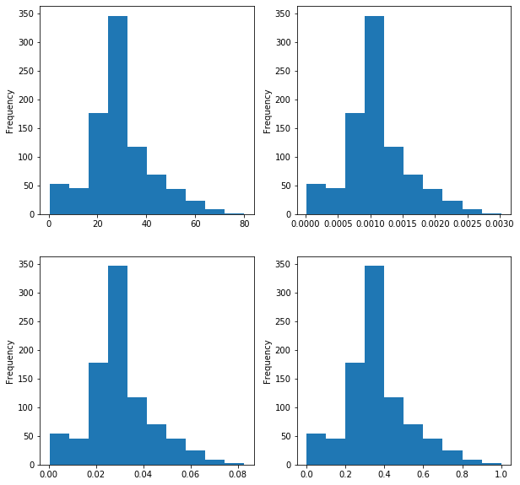
Normalization
Result

Slide 26
Table of Content
DataFrame Inspection
Missing Data
Outlier
Inconsistent Data e.g. Negative Age
Categorical Data e.g. Natural Language Data
Normalization
Feature Generation
Notes:
議題:
請問取log與normalize有什麼差別?

Slide 27
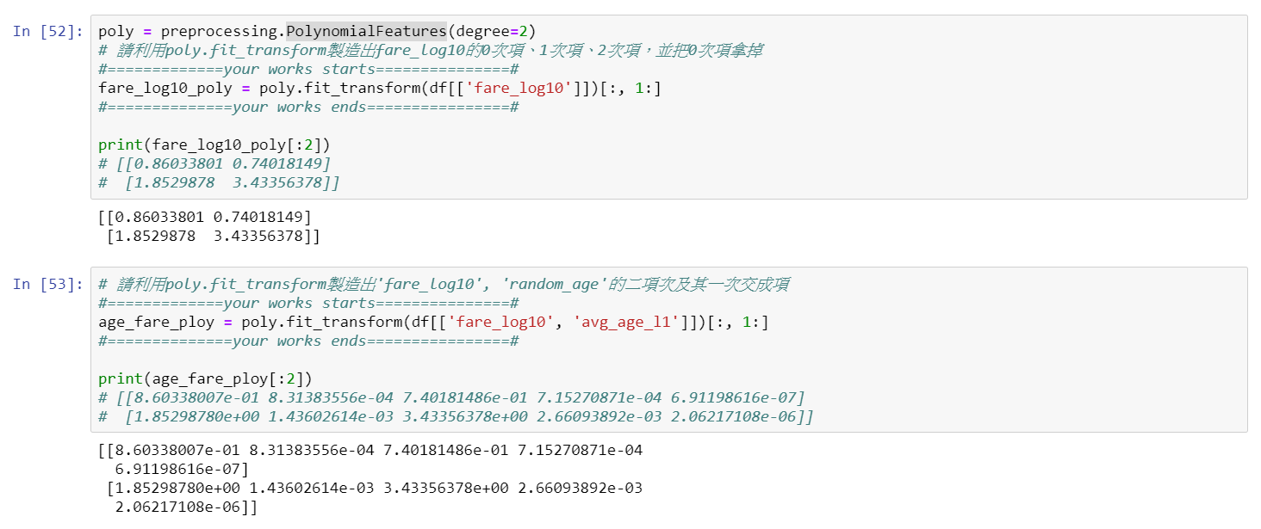
Feature Generation
PolynomialFeatures:
(𝑋1) => (1, 𝑋1, 𝑋1^2)
(𝑋1, 𝑋2) => (1, 𝑋1, 𝑋2, 𝑋1^2, 𝑋1 𝑋2, 𝑋2^2)

Slide 28
Thank you

