Slide 2
RNA-seq
Options & FAQs

Slide 3
Can we compare RNA-seq data from different labs?
Library fragmentation and size selection influences analyses
RNA-seq library enrichment influences analyses
Stranded and unstranded influences analyses

Slide 4
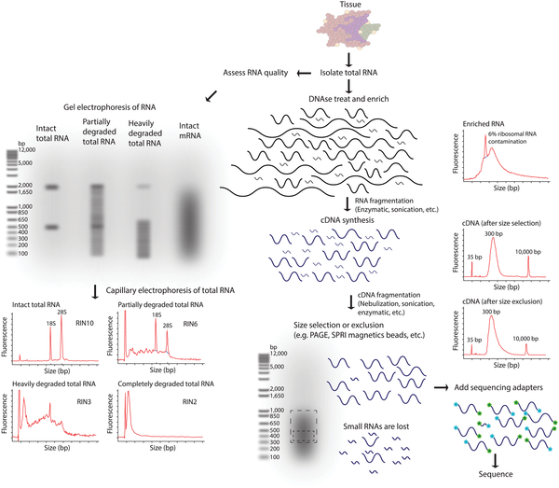

Library fragmentation and size selection influences analyses
Griffith M, Walker JR, Spies NC, Ainscough BJ, Griffith OL (2015) Informatics for RNA Sequencing: A Web Resource for Analysis on the Cloud. PLOS Computational Biology 11(8): e1004393. doi:10.1371/journal.pcbi.1004393
http://journals.plos.org/ploscompbiol/article?id=10.1371/journal.pcbi.1004393

Slide 5
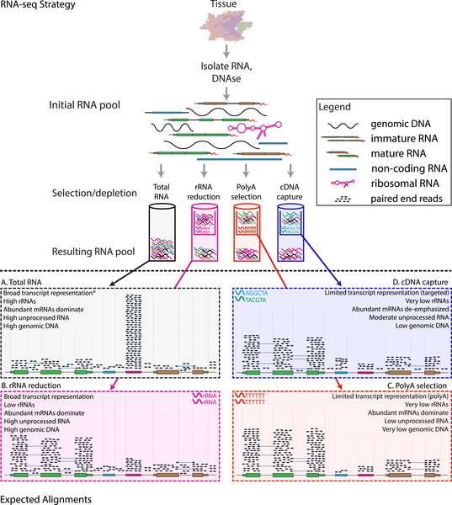
RNA-seq library enrichment influences analyses
Griffith M, Walker JR, Spies NC, Ainscough BJ, Griffith OL (2015) Informatics for RNA Sequencing: A Web Resource for Analysis on the Cloud. PLOS Computational Biology 11(8): e1004393. doi:10.1371/journal.pcbi.1004393
http://journals.plos.org/ploscompbiol/article?id=10.1371/journal.pcbi.1004393

Slide 6
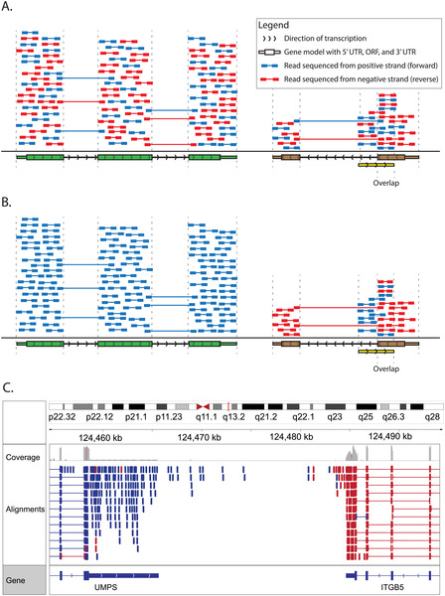
Stranded and unstranded influences analyses
Griffith M, Walker JR, Spies NC, Ainscough BJ, Griffith OL (2015) Informatics for RNA Sequencing: A Web Resource for Analysis on the Cloud. PLOS Computational Biology 11(8): e1004393. doi:10.1371/journal.pcbi.1004393
http://journals.plos.org/ploscompbiol/article?id=10.1371/journal.pcbi.1004393

Slide 7
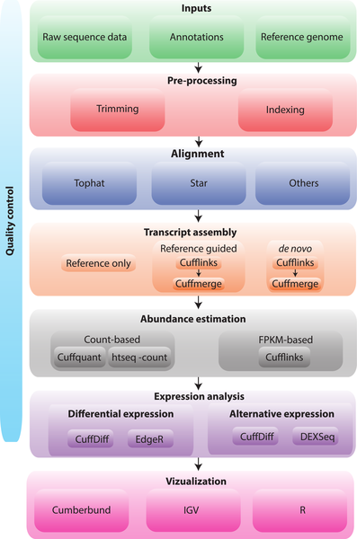
Analysis flow chart
Griffith M, Walker JR, Spies NC, Ainscough BJ, Griffith OL (2015) Informatics for RNA Sequencing: A Web Resource for Analysis on the Cloud. PLOS Computational Biology 11(8): e1004393. doi:10.1371/journal.pcbi.1004393
http://journals.plos.org/ploscompbiol/article?id=10.1371/journal.pcbi.1004393

Slide 8
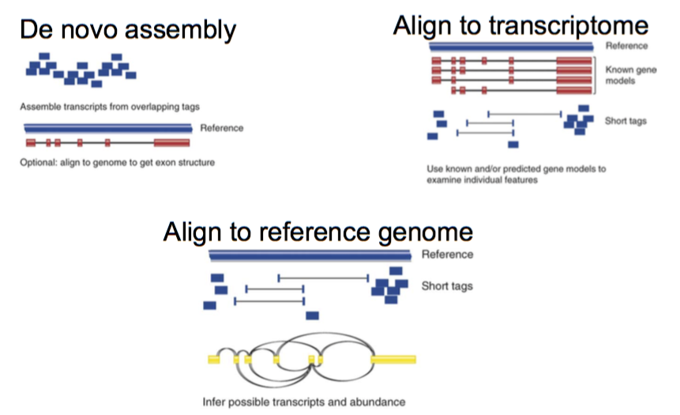
RNA-seq mapping strategies – which is best?
Cloonan, Grimmond, Nature Methods 2010

Slide 9
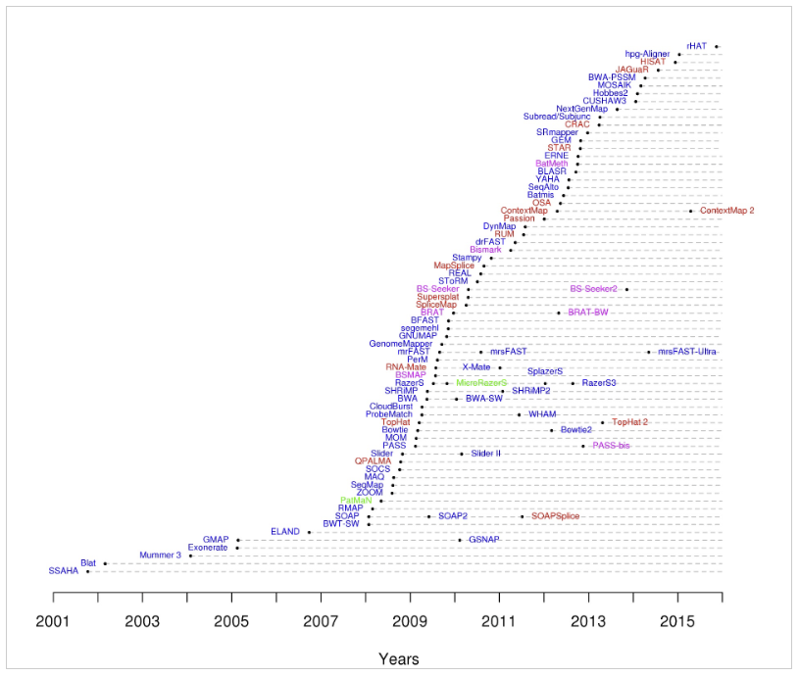
Which aligner should I use?
http://www.ebi.ac.uk/~nf/hts_mappers/

Slide 10
Precision and Recall
Maximal precision
(no false positive)
Maximal recall
(no false positive)
Type I and Type II errors
Recall of 80% means?
80% of all dogs are identified as dogs by our prediction
Precision of 80% means?
80% of the animals we predict as dogs are indeed dogs

Slide 11
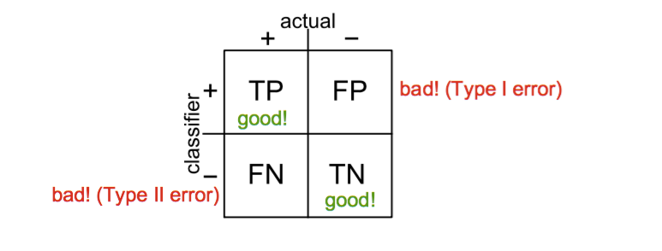

Slide 12
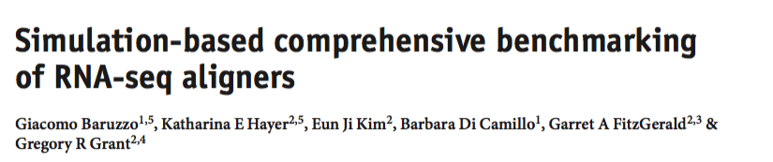
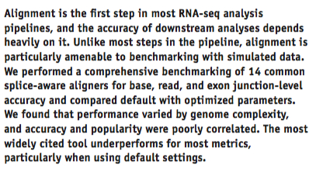

Slide 13
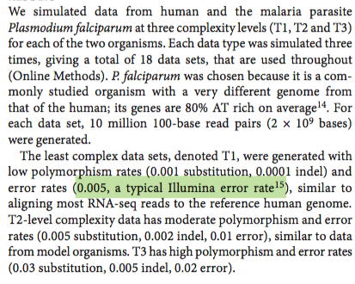
Can handle spliced reads
Paired end reads
Strand-specific
Run efficiently
CLC
ContextMap
CRAC
GSNAP
HISAT
HISAT2
Mapsplice2
Novoalign
Olego
RUM
SOAPsplice
STAR
Subread
Tophat

Slide 14
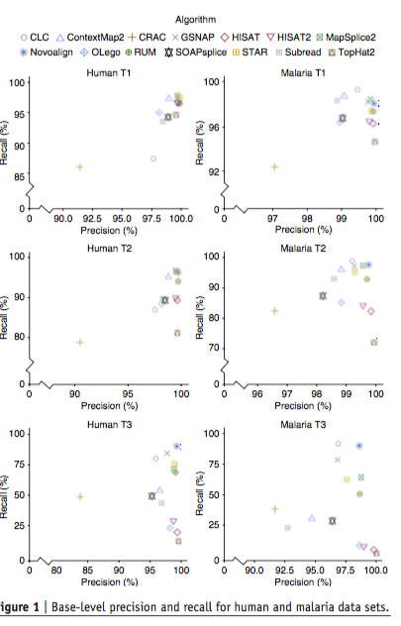
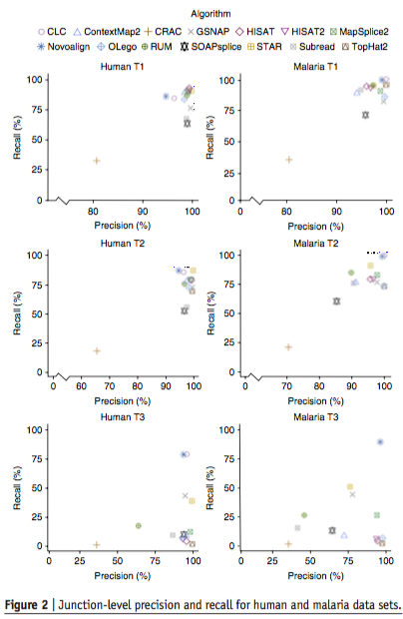
Notes:
CLC STAR NOVOALIGN

Slide 15
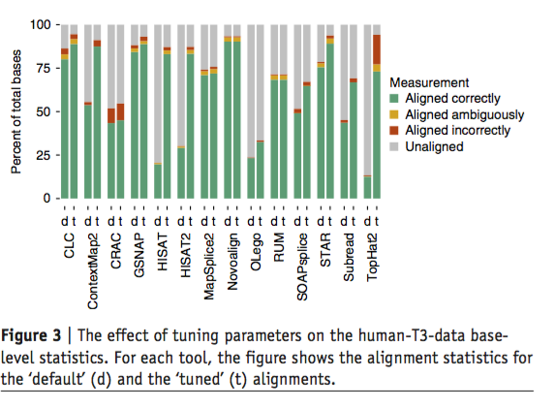
CLC
Novoalign
STAR
GSNAP

Slide 16
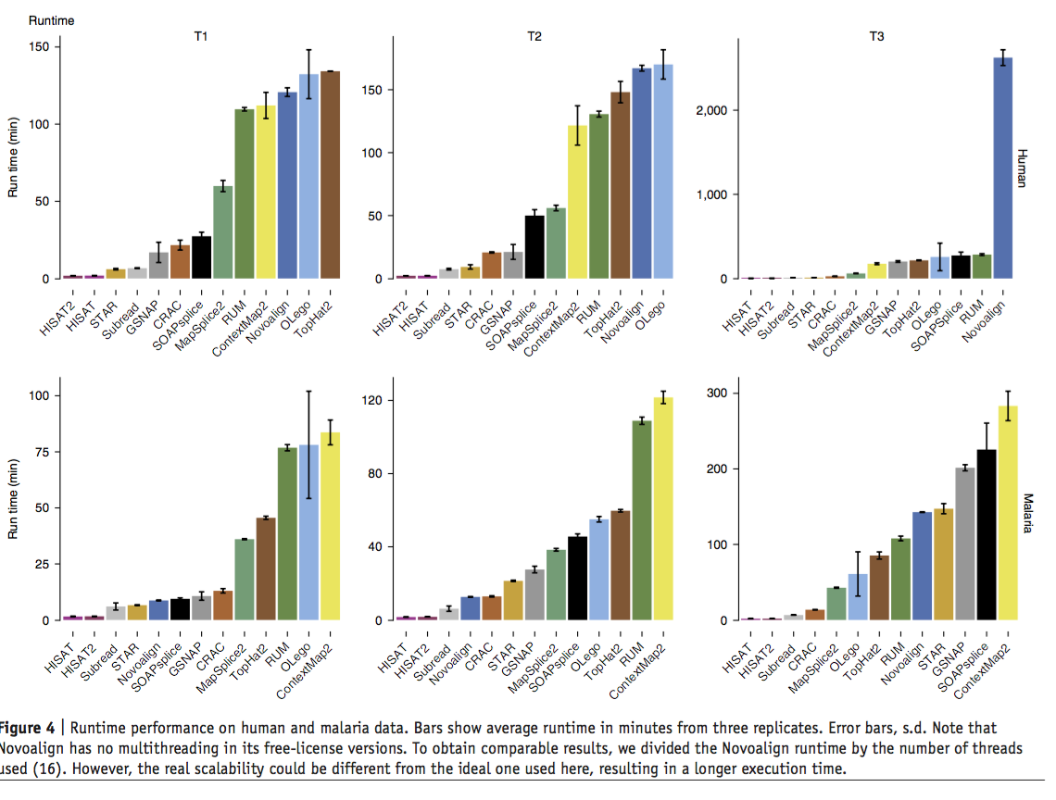

Slide 17
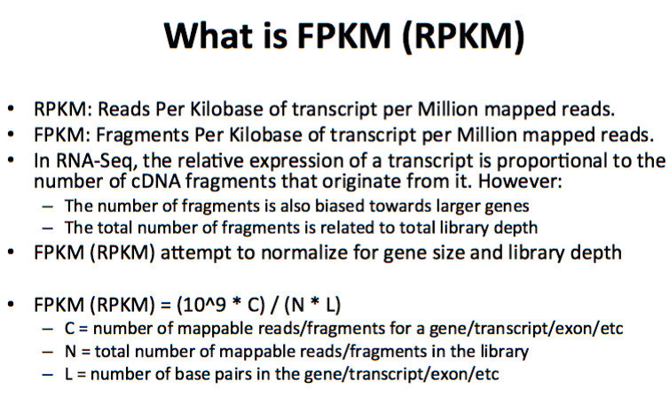
What is FPKM?

Slide 18
What’s the difference between RPKM/FPKM and TPM?
What do we normalize for ?
RPKM:
Get total read counts
Normalize by depth and scale
Normalize for gene lengths
TPM:
Normalize for gene length (to get RPK)
Get total RPK and scale (RPK)
Normalize by depth
http://www.rna-seqblog.com/rpkm-fpkm-and-tpm-clearly-explained/

Slide 19
Gene name | Rep 1 read counts | Rep 2 | Rep 3
A (2kb) | 10 | 12 | 30
B (4kb) | 20 | 25 | 60
C (1kb) | 5 | 8 | 15
D (10kb) | 0 | 0 | 1
RPKM:
Sum total # reads
Scale total by 10^6
Divide by total scaled # reads in library
Divide by length of the gene (kb)
TPM:
Divide by length of the gene (kb)
Sum RPK values
Scale total by 10^6
Divide RPK by total

