Slide 1
Intro to RNA-Seq
Week 1 Day 2 BIOM262
Emily Wheeler

Slide 2
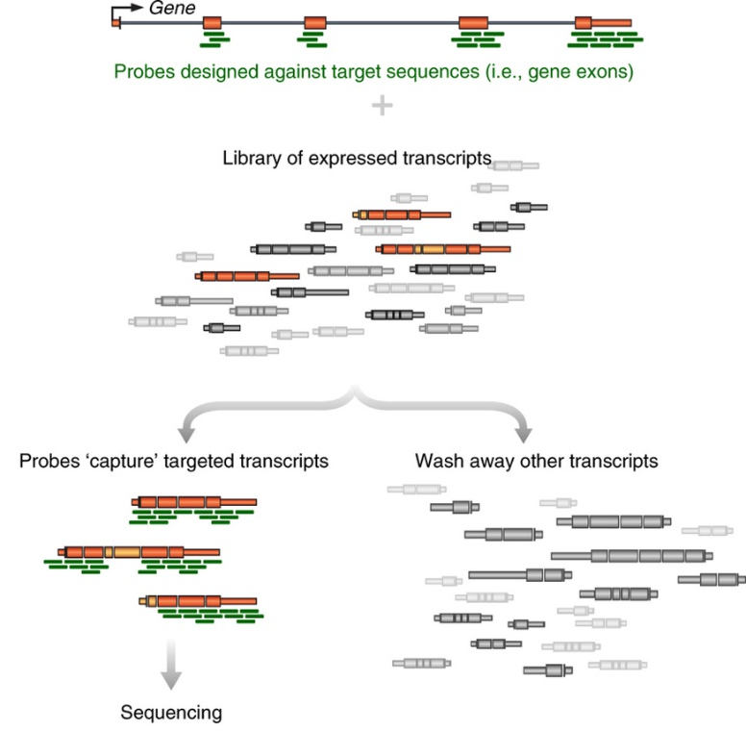
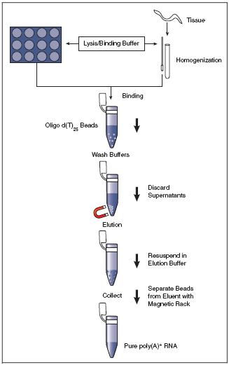
Generating RNA-seq libraries
Step 1: What RNA do you want to profile?
mRNA only -> PolyA selection
Specific RNAs -> targeted enrichment
(All mRNAs are polyadenylated at the 3’ end – can use d(T)₂₅ beads to select)

Slide 3
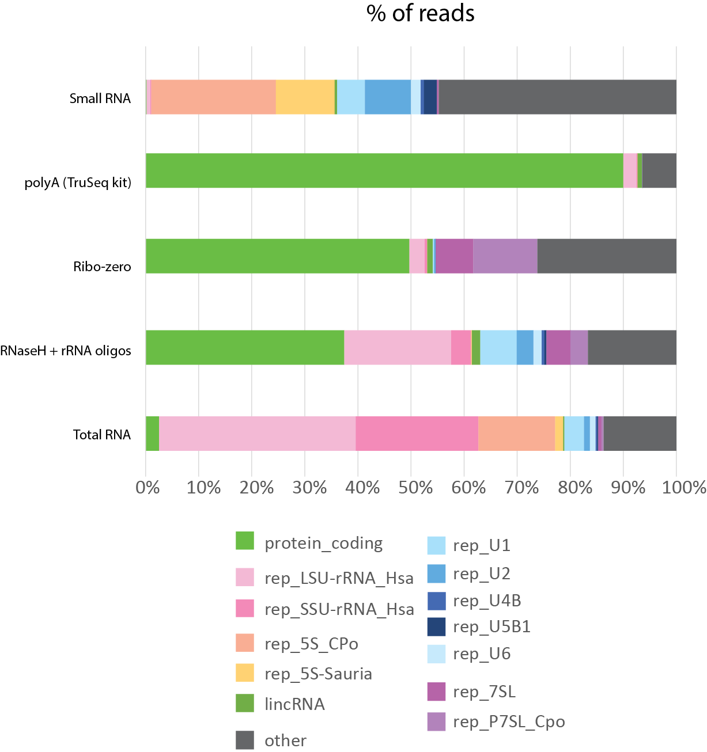
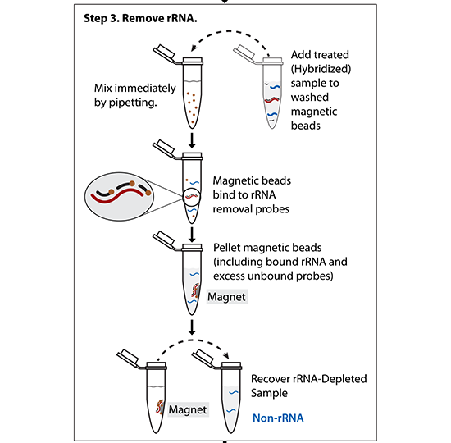
Step 1: What RNA do you want to profile?
Total RNA -> ribosomal RNA depletion
(Ribo-zero)
(Other methods – hybridize targeted DNA oligos + RNAseH treat)

Slide 4
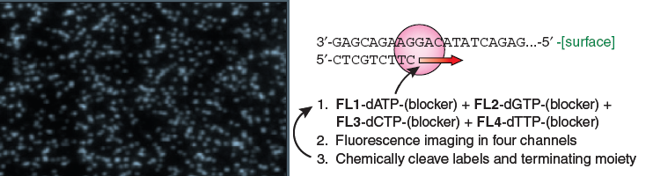
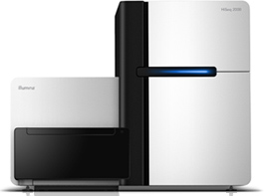
Sequencing by synthesis: HiSeq 2500 (Illumina)
Shendure & Lee, Nat. Biotech. 2008
Can do 50bp to 250bp single-end or paired-end reads
~300 million reads per lane x (2 or 8) lanes
4-8 days run time
200 billion bp output each run
Notes:
4

Slide 5
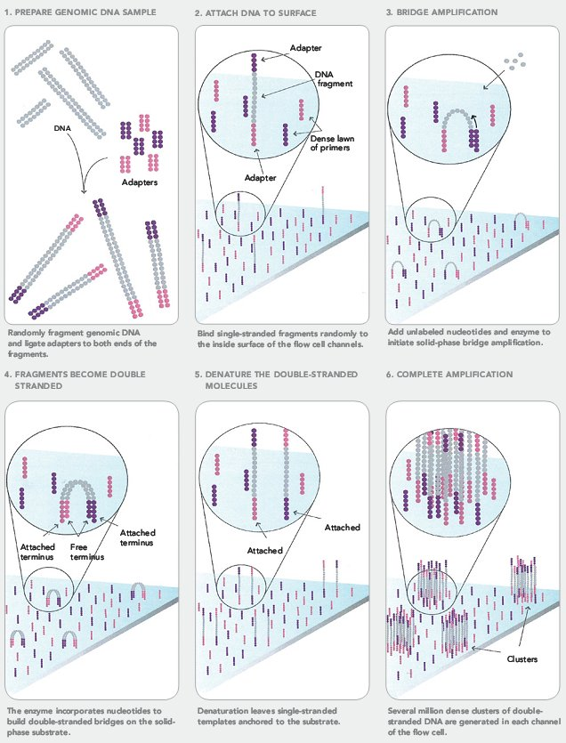
Cluster Formation on Illumina Flowcell

Slide 6
Reversible Terminator Chemistry
O
O
X
5’
HN
cleavage
site
HN
fluor
DNA
O
N
O
N
PPP
O
O
O
Incorporation
Detection
Deblock; fluor removal
3’
3’
block
OH
free 3’ end
Next cycle

Slide 7
Sequencing by Synthesis
3’-
…-5’
5’-
G
T
A
T
T
T
T
C
G
G
C
A
C
A
G
A
G
A
C
T
T
C
T
G
Cycle 1: Add sequencing reagents
First base incorporated
Remove unincorporated bases
Detect signal
Cycle 2-n: Add sequencing reagents and repeat

Slide 8









Sequential Base Calling
T G C T A C G A T …
1
2
3
4
5
6
7
8
9
T T T T T T T G T …

Slide 9
Illumina sequencing – fragment strategy
I5 adapter
Read1 primer
DNA insert (your library)
Read2* primer
I7 adapter
Flow Cell Surface
I5 index*
I7 index*
* optional
Reaction #
Flow Cell Surface
1
Read1 primer
Read1 sequence
Flow Cell Surface
2*
Index1 primer
Index1 sequence

Slide 10
Illumina sequencing – Paired End & Dual Indexing
Reaction #
Flow Cell Surface
1
Read1 primer
Read1 sequence
Flow Cell Surface
2*
Index1 primer
Index1
(I7) sequence
Flow Cell Surface
3*
Index2 primer
Index2
(I5) sequence
Flow Cell Surface
4*
Read2 primer
Read2
sequence
* optional

Slide 11
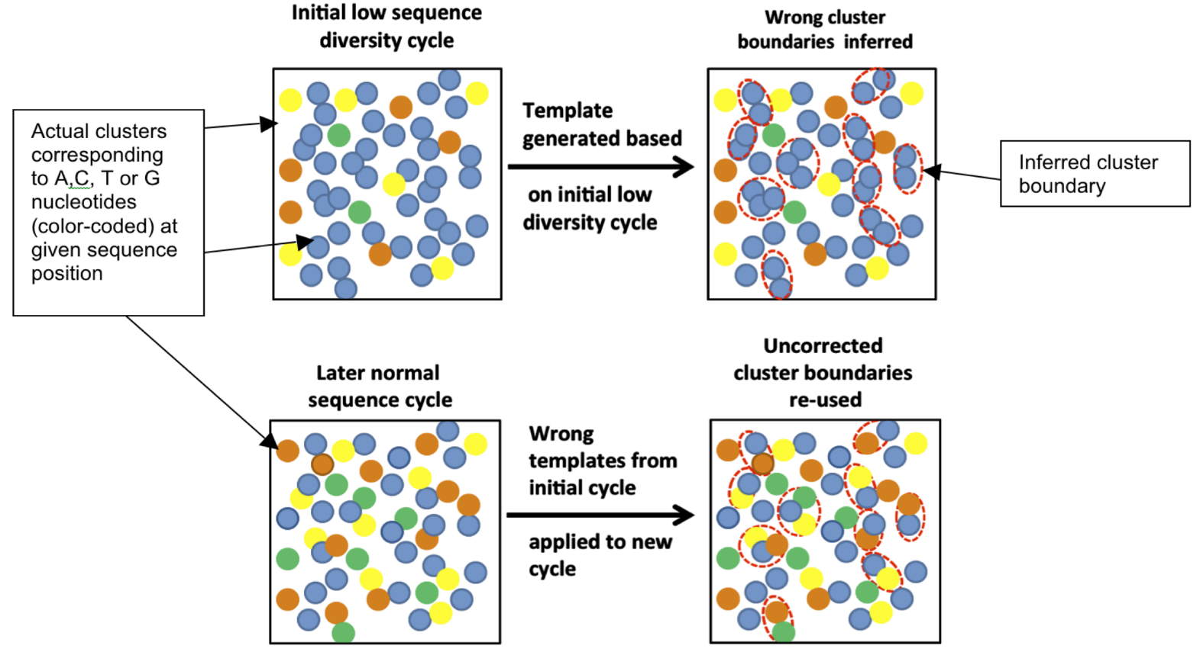
Key considerations
“Cluster Density” = how many clusters are there per mm²
If too high, hard to properly draw cluster boundaries
“Library Complexity” = how diverse are the sequences?
Illumina identifies clusters in the first 5 cycles – if those 5 cycles are identical for nearby clusters, the software doesn’t know to split them into two
Mitra, A. et al. Plos ONE (2015)

Slide 12
Key considerations
How can you solve a problem like this?
Decrease cluster density – works, but lose sequencing power
Artificially add complexity
Spike in other libraries
Add random-mers
Instead of this:
Read1 primer
Read1 sequence
NNN
Add diversity to adapters:
NN
N
Key to sequencing – how to hack the standard fragment strategy to get the desired results

Slide 13
HiSeq 4000
Patterned flow cell with nanowells
Only 1 cluster per nanowell
Explicitly defines cluster density
Increased throughput:
400 million reads per lane x 8 lanes

Slide 14
Illumina sequencing – great for read #, not great for read length
Quality score
0
100
200
300
400
Cycle #

Slide 15
Fastq File
First line is the information about the location of the read and specific sequencing machine used:
Second line is the nucleotide sequence called
Third line is “+” and can optionally be followed by a repeat of the filename in line 1
Fourth line contains the quality score as determined by the sequencer
@NS500672:54:HL775BGXX:1:11101:22716:1042 1:N:0:CCCCGG
CCGCCNATGCCCATGCCACAGTTGTTGAGCTTGAGTTCCTGCAGGGTGAAGCAGGCTGAGCTCTTGAGCAGGGCCTCGAA
+
AAAAA#EEEEEEEEEEEEEEEEEEEEEEEEEEEEEEEEEEEEEEEEEEEEEEEEEAEEEEEEEEEEEEEEEEEEEEEEEE
Notes:
Four lines represent 1 read off the machine

Slide 16
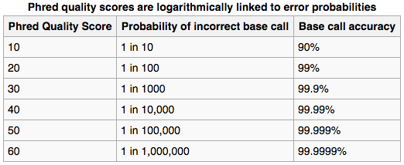
Fastq File – Phred Quality Score
Quality scores report the probability that the base call is incorrect
Field standard is to accept bases with quality >20
Notes:
Four lines represent 1 read off the machine
Quality scores have been converted into the ascii code for reporting… not important here

Slide 17
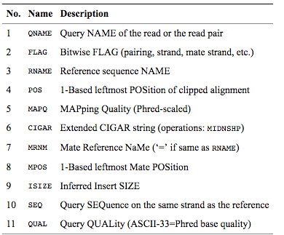
BAM File
BAM files are binary, you must use samtools to view them
Bioinformatics. 2009 Aug 15;25(16):2078-9. Epub 2009 Jun 8. The Sequence Alignment/Map format and SAMtools.
Notes:
Four lines represent 1 read off the machine

Slide 18
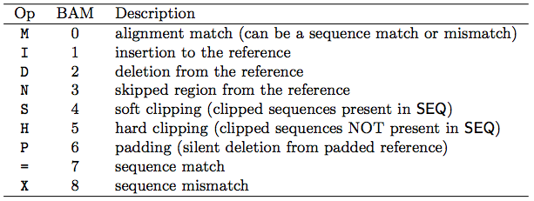
CIGAR String
Contains specific information about the mapping information at specific positions across the read
Bioinformatics. 2009 Aug 15;25(16):2078-9. Epub 2009 Jun 8. The Sequence Alignment/Map format and SAMtools.

Slide 19
RNA-Seq Analysis Overview:
Download Data
(fastq)
Check Quality (fastqc)
Align to Genome (STAR)
Sort and Index BAM (samtools)
Count Reads Mapped to Genes (featureCounts)
Differential Expression (DESeq2)
Interesting Biology!

