Slide 1

Project 3: Cleaning data-Salaries
Angela SALGADO

Slide 2

Dataset Description

Slide 3




topic: salaries in technology companies.
number of rows: 62642
number of columns: 29
Variable themes:
Position
Salary
Salary bonus
Years of experience
Years in the company
Gender
Education
Race
Encoding about education and race
Information entry date

Slide 4
Challenges
Missing data:
Critical: education, race, gender, "other details”
In some other variables less than 15% data was missing, and I thought it was possible to complete it…
maybe not…

Slide 5
Outliers
Years of experience over 50 years .. (one was=160)
Years in the company over 50 years
people who were in the company before it was founded
Base salary =0

Slide 6
Duplicated data
the "timestamp" column had to be the one with the unique values ,however, there were repeated rows.
There were rows without any information.

Slide 7
Inconsisted data
Company names and title names had misspellings.
the encoding of the education and race variables was incomplete: some rows had no race at all or had multiples values.
Years at the company > years of experience

Slide 8

Methodological inconsistency
To obtain data about “race”, the following categories were used:
”Race_Black”, “Race_Asian”, “Race_Hispanic”, “Race_White”, “Two_Race_or_More”
From a sociological perspective “Hispanic” IS NOT A RACE
Hispanic=
“The term Hispanic refers to people, cultures, or countries related to Spain, the Spanish language, or Hispanidad.”

Slide 9
Process

Slide 10
Learnings
You need to explore the data in depth.
In the cleaning process, you have to save the changes progressively.
There are some inconsistencies that are not obvious from the very beginning and that appear throughout the cleaning process.

Slide 11
Improvements
Organization: At some point I had a very long file with a lot of codes, which I couldn’t no longer understand.
Save in variables, the changes made, to be able to track them

Slide 12
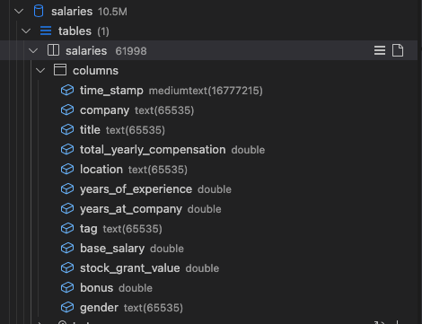
Datasets comparison
Initial number of rows: 62642
Final number of rows: 62561
Initial number of columns: 29
Final number of columns: 12

Slide 13
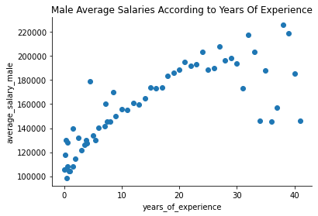
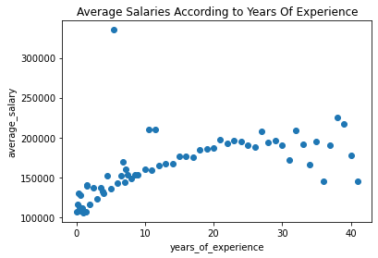
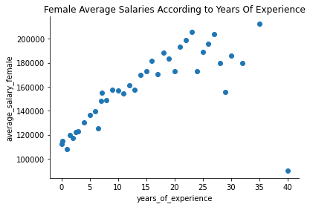

Slide 14
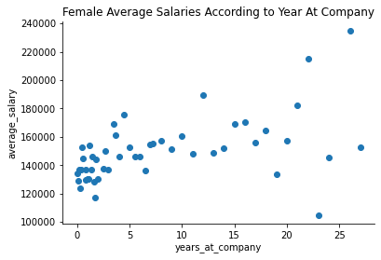
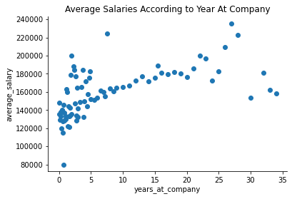
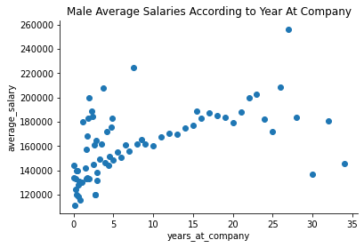

Slide 15
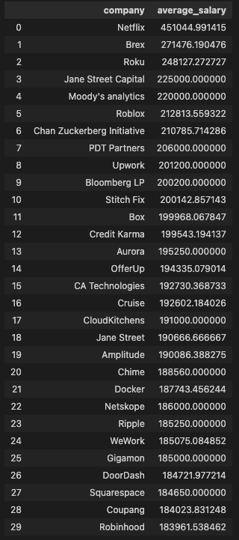
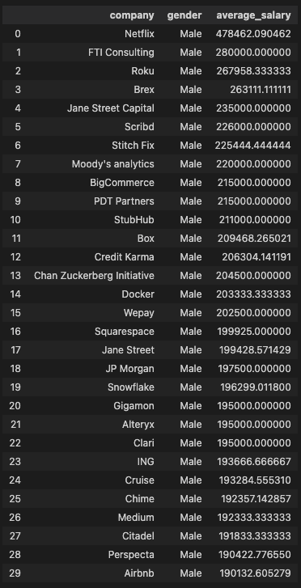
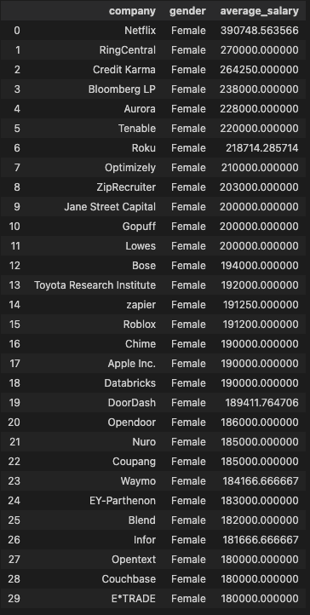

Slide 16
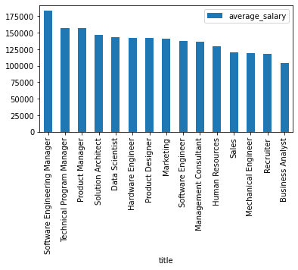

Slide 17

Q & A

