Slide 1
SIP10 – FINAL PROJECT
Independent Artist Comeback Campaign Engine
A simple governed agentic AI system: Plan > Orchestrate > Execute > Check > Human Approval > Output
Team: [add names here] | Agentic AI + AI Governance + AI Orchestration
Notes:
Intro (1 min). Introduce the team and the project name. Say: our system helps indie artists plan a comeback campaign without a big label.

Slide 2
The problem: comebacks are hard to run alone
Too much noise
No label team
Generic AI hurts
Thousands of tracks are released every day.
Just uploading a song is not enough.
Artists need a multi-week plan.
Solo artists have no manager, planner, or marketing team.
They do it all alone and on a small budget.
Normal AI output sounds robotic or too corporate.
It can add wrong dates, fake claims, or leaks.
Niche fans notice, and leave.
Our answer: a governed team of 3 AI agents with a human in control.
Notes:
(1.5 min) Thousands of tracks drop every day. Indie artists have no team. Normal AI tools make generic, robotic captions that push niche fans away, and can also make mistakes or leak things.

Slide 3
Our system: 3 agents + an Orchestrator
1. Planner Agent
2. Execution Agent
3. Review & Compliance
Builds the 4-week release calendar and the phases: announce, teaser, pre-save, countdown, drop day.
Skill: planner-skill
Writes hooks, captions, hashtags, visual prompts, and press snippets in the artist's vibe.
Skill: execution-skill
The strict brand auditor. Checks facts, tone, privacy, and platform rules. Sends notes back.
Skill: review-compliance-skill
Orchestrator (controller): decides which agent or skill works next, counts rewrite rounds, calls the human gate, and keeps the activity log.
Notes:
(2 min) Explain each agent in one sentence. The Orchestrator is the controller, not a 4th agent. It decides who works next.

Slide 4
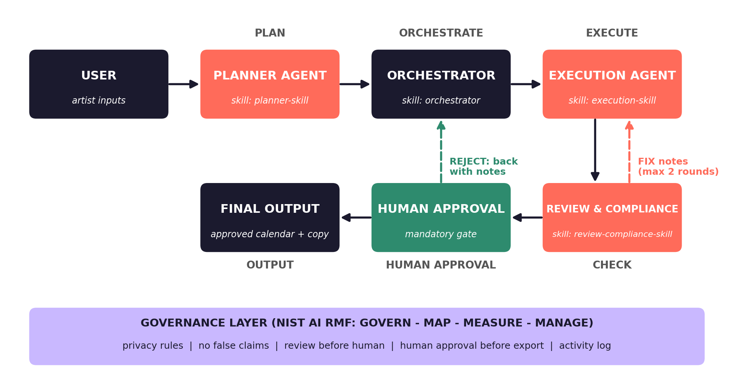
System diagram and workflow
Notes:
(2 min) Walk left to right: User, Planner, Orchestrator, Execution. Then down to Review. FIX loop goes back to Execution, max 2 rounds. Then Human Approval, then Final Output. The purple bar is the governance layer.

Slide 5
3 SKILL.md files
planner-skill
execution-skill
review-compliance-skill
Counts back from the release date.
Week -4 to Week +1, with exact dates.
Never changes the release date.
Unknown items: [TO BE CONFIRMED].
One post per milestone and platform.
Hook + caption + 3 to 5 hashtags.
Only facts the artist gave.
No copied lyrics. No unreleased titles.
Checks facts, tone, privacy, platform rules.
PASS or FIX for each check.
If unsure: FIX.
Max 2 rewrite rounds, then human decides.
Every skill file uses the same structure: Purpose · When to Use · When NOT to Use · Inputs · Workflow · Tools · Rules · Output · Error Handling
Notes:
(1.5 min) Each skill file has the same parts: purpose, when to use, when NOT to use, inputs, workflow, tools, rules, output, error handling. Show one quickly if time allows.

Slide 6
Demo: a sample comeback run
1
Inputs
2
Plan
3
Execute
Artist, title, date, vibe, platforms
6-milestone timeline, drop day = Nov 27
Draft posts for each milestone
4
Check
5
Fix
6
Approve
NEEDS FIX: fake "award-winning", 10 spammy hashtags
Execution rewrites. Review says PASS
Human approves. Calendar + copy exported
Sample names and details are made up for the demo.
Notes:
(2.5 min) LIVE DEMO or screenshots. Inputs: sample artist Mira Sol, single Late Bloom, release Fri Nov 27 2026. Show the timeline, then the first draft with problems, the NEEDS FIX review, the fixed draft, PASS, then approval.

Slide 7
NIST AI RMF: Govern, Map, Measure, Manage
GOVERN
Rules + who is responsible
MAP
Context + what can go wrong
MEASURE
How we know it works
MANAGE
What we do about it
6 governance rules
Artist / team lead approves
Orchestrator logs every step
Team owns skills and rules
Users: indie artists
Affected: artist and fans
Limits: no auto-posting
7 risks identified
Date accuracy: 100%
Privacy leaks: 0
False claims: 0
Rewrites: 2 or fewer
Tone rating: 4 of 5+
Feedback loop (max 2)
Stop if input missing
Remove and log leaks
Human can reject
Update skills after each run
Notes:
(2 min) One sentence for each column. GOVERN = rules and who is responsible. MAP = what can go wrong. MEASURE = numbers we check. MANAGE = what we do about it.

Slide 8
Top risks and governance rules
RISKS (7 identified)
GOVERNANCE RULES (6)
Generic, robotic tone
Unreleased tracks or private data leak
Wrong dates
Invented awards or numbers
Spammy hashtags
Copied lyrics
Human approves without reading
G1 Protect private information
G2 No false information
G3 Check AI content before a human sees it
G4 Human approval before export
G5 Keep a record of AI activity
G6 No copied work. Keep the indie voice
Notes:
(2 min) Pick the main risks. Say each rule has a place where it is enforced. Full tables are in the report (5+ risks and 5+ rules required; we have 7 risks and 6 rules).

Slide 9
Testing and human approval
7 test cases
Human approval gate
T1 Normal request: 4-week plan, dates correct
T2 Date in the past: system stops and asks
T3 Under 4 weeks: shorter plan, clear note
T4 Unreleased title in draft: review marks FIX
T5 Spammy post: review marks FIX
T6 Fake claim: review marks FIX
T7 Export without approval: blocked
Where: after CHECK, before OUTPUT.
Why: the posts speak for the artist in public. Mistakes are hard to undo after posting.
The human sees the timeline, final posts, review result, and open problems.
Choices: APPROVE · REJECT with notes · EDIT.
Also asks the human when: 2 rewrites fail, or an input is missing.
Notes:
(1.5 min) Mention a few test cases and what they prove. Then explain the human gate: the AI never approves for the human, and nothing exports without APPROVE.

Slide 10
Summary
3 agents + an Orchestrator that controls the flow
3 SKILL.md files with the same clear structure
A feedback loop: check, fix, check again (max 2)
NIST AI RMF applied: Govern, Map, Measure, Manage
A mandatory human approval gate before anything is exported
Result: a professional comeback campaign that still sounds like the artist
Thank you! Questions?
Notes:
(1 min) Summary and thank you. Invite questions.

