Slide 1
Podcasts
Angela Zhai 15 December, 2018

Slide 2


Slide 3
Exploratory Data Analysis

Slide 4
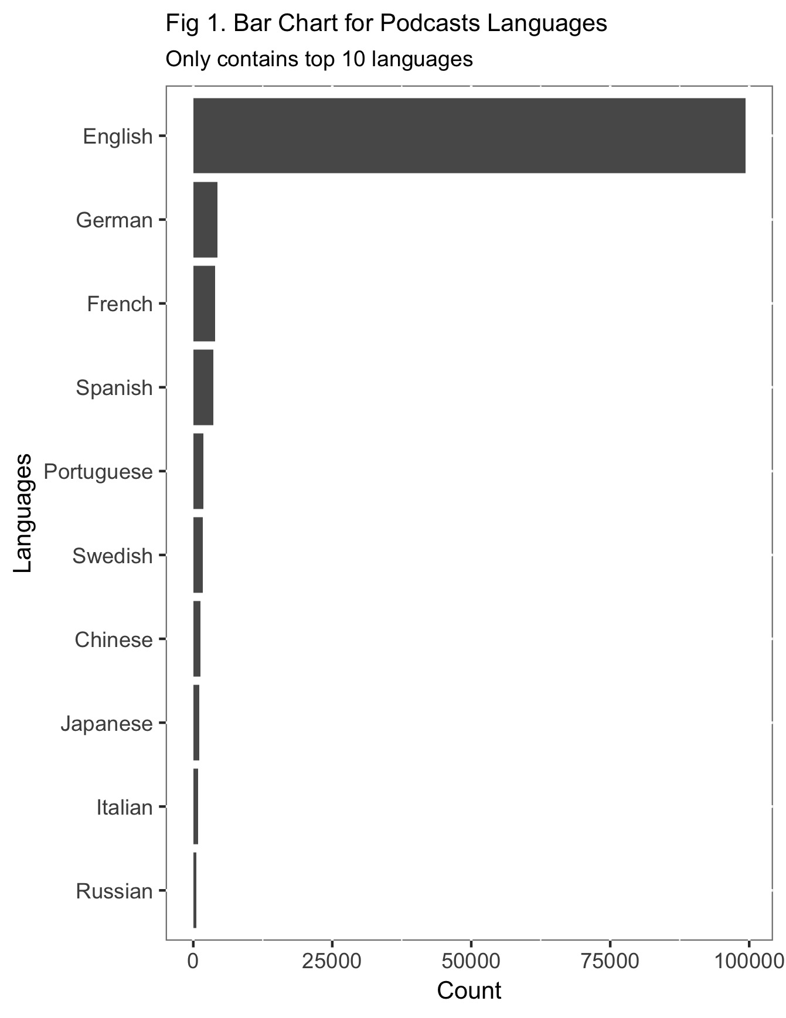
Most of the podcasts are by English. Only a few used other languages.

Slide 5
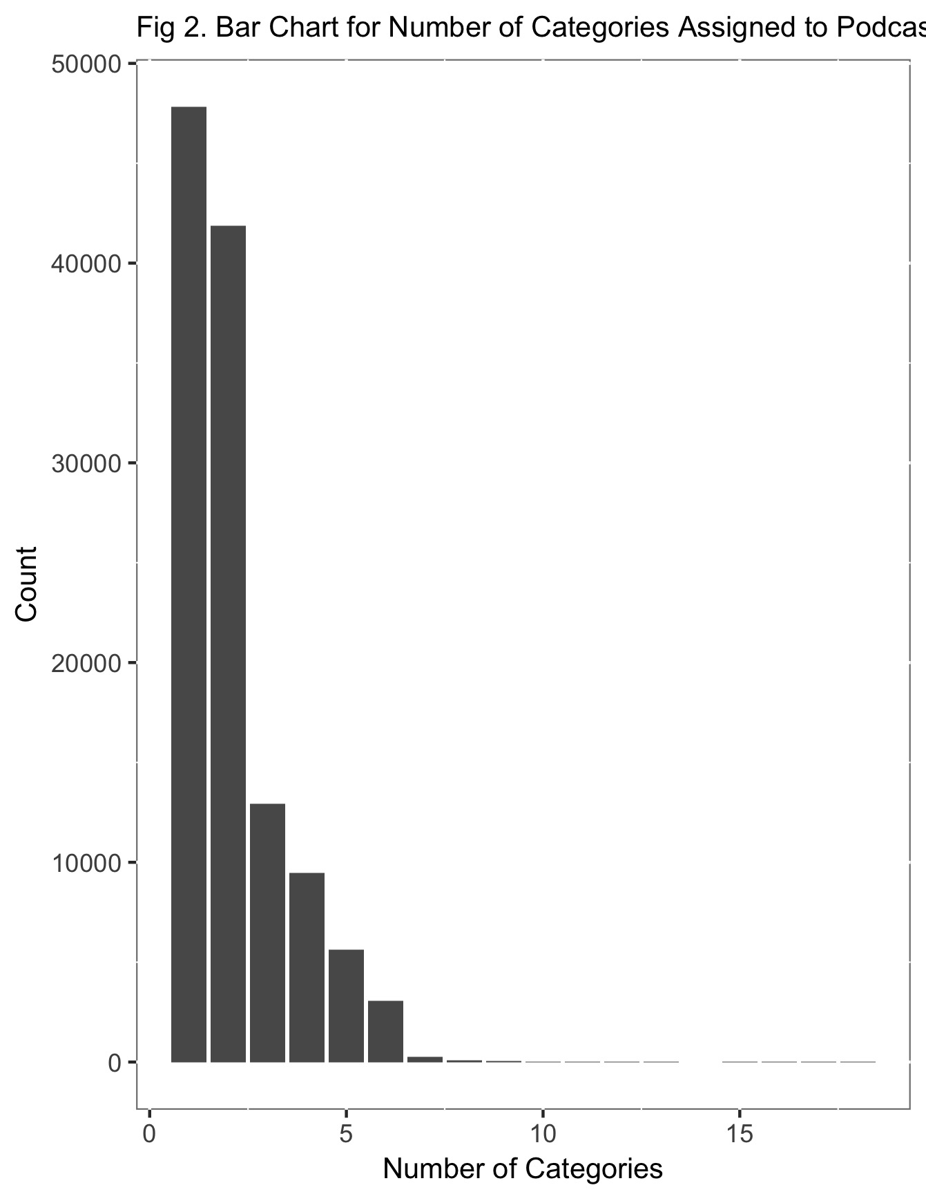
Each podcasts are collected under different categories, and some providers will assign a bunch of categories to their podcasts.

Slide 6
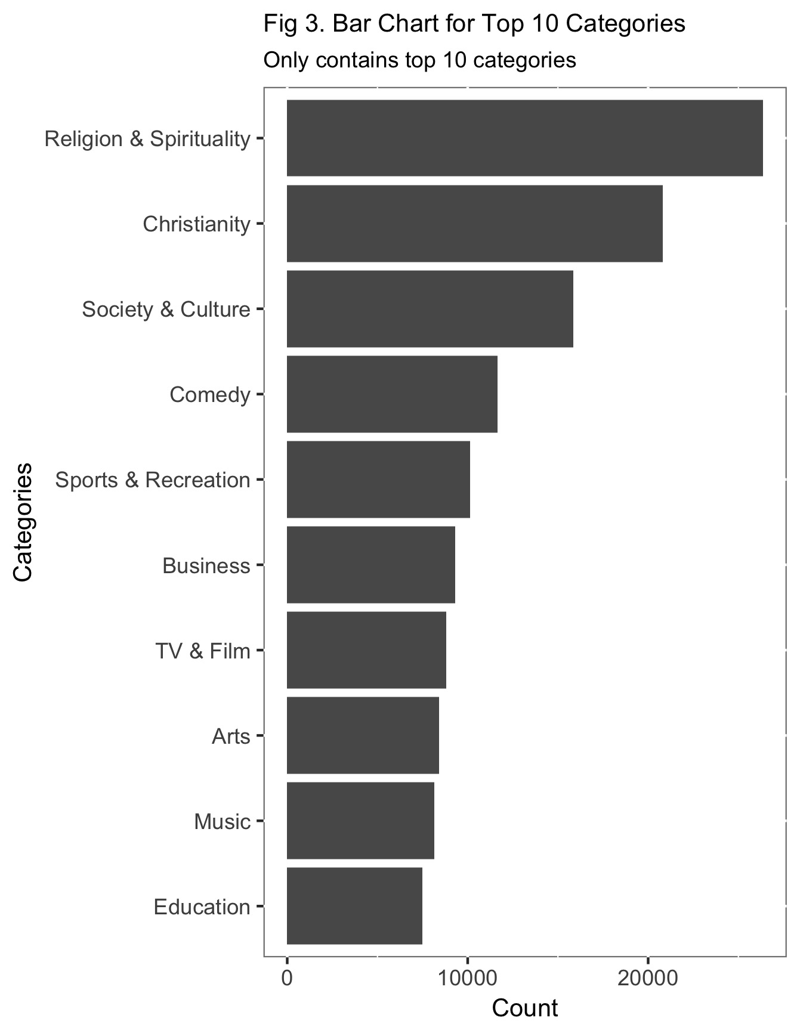
Religion and Christianity are on the top. Society & Culture is a broad concept for category.

Slide 7
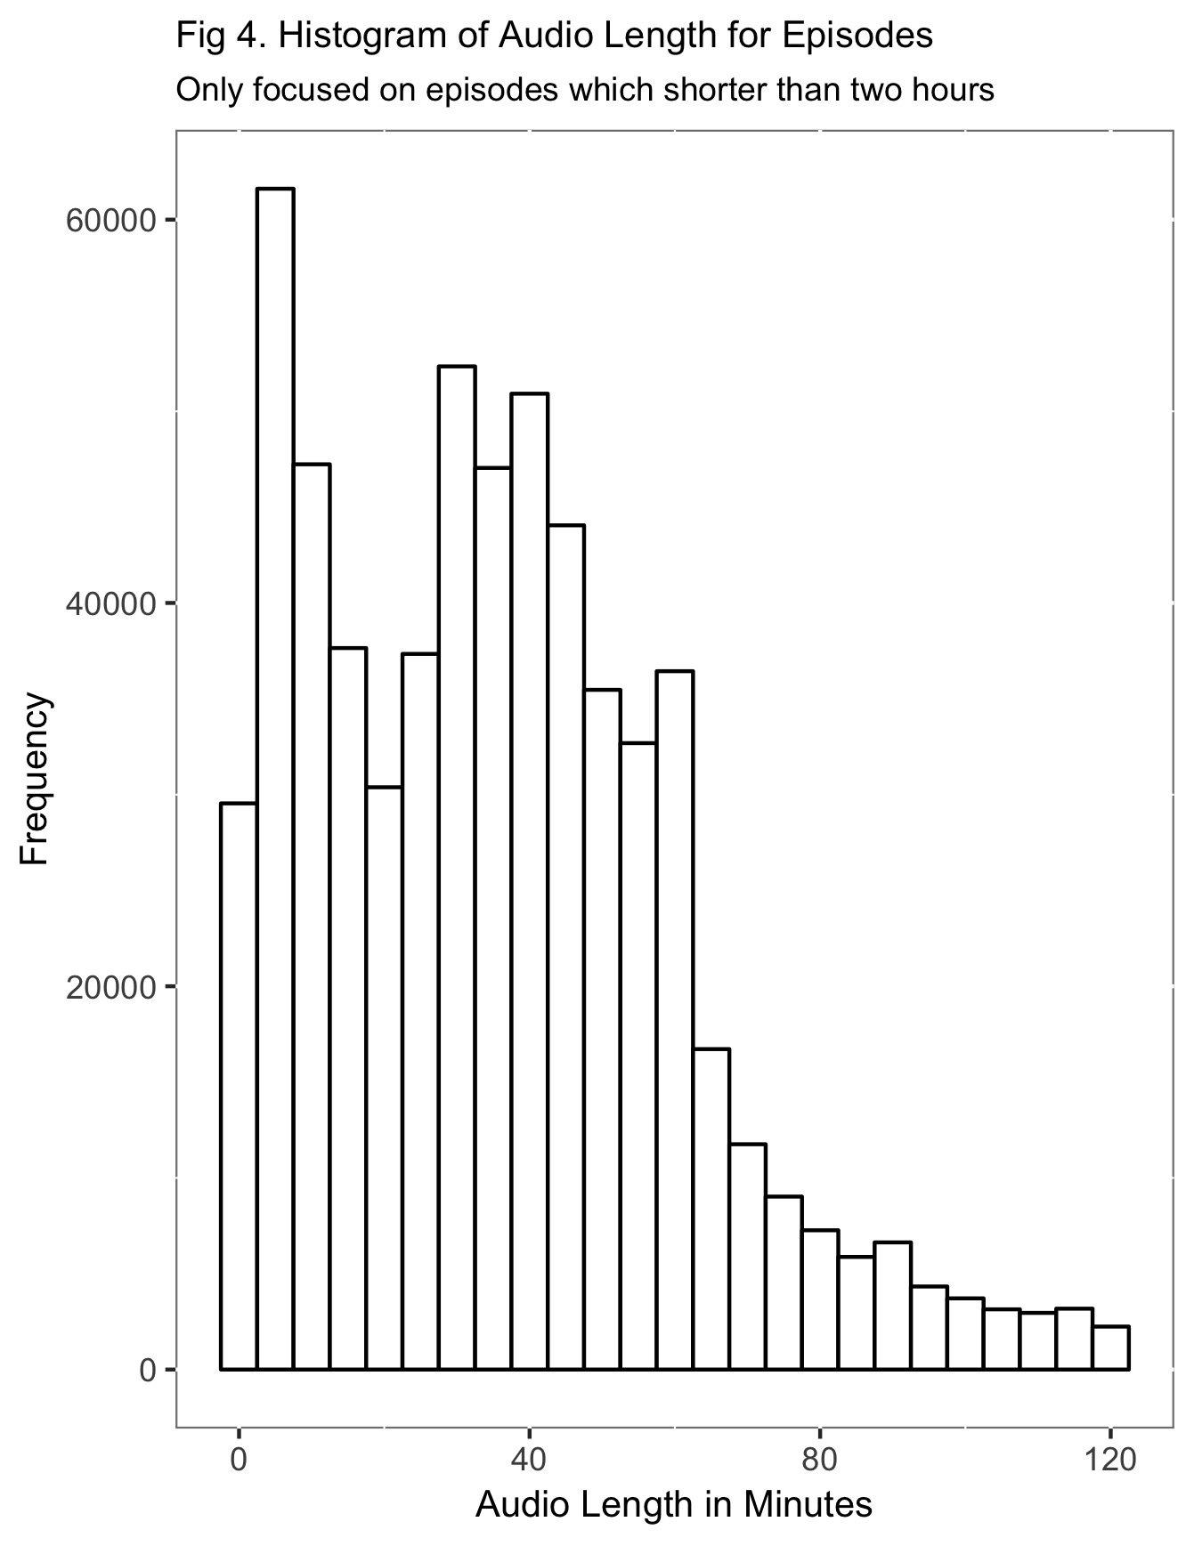
Most episodes are shorter than an hour.

Slide 8
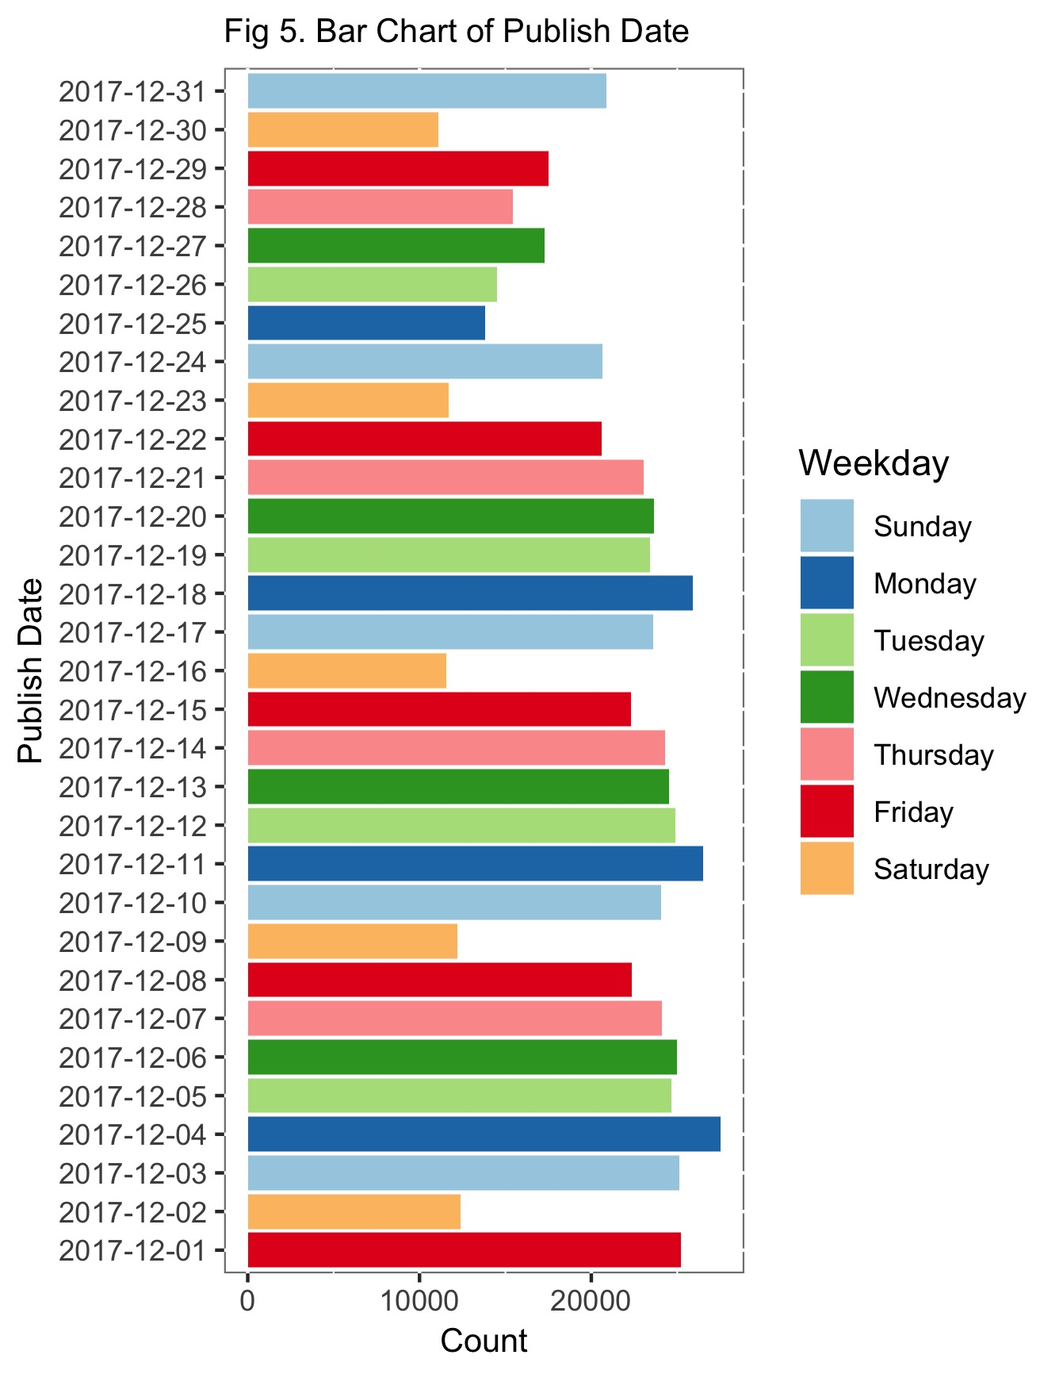
Only a few episodes published on Saturday, and a lot episodes published on Monday. However, holiday is another factor which will influence whether the providers willing to publish their episodes.

Slide 9
Text Mining

Slide 10
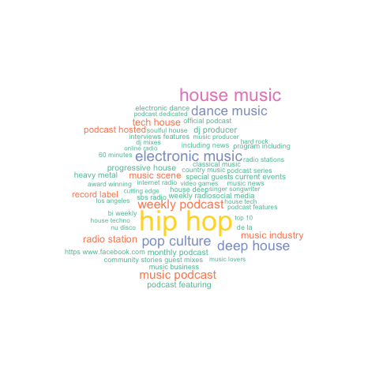
Wordcloud for music category podcasts description

Slide 11
THANK YOU

