Slide 1
Water Body Segmentation
Binary Semantic Segmentation of Sentinel-2 Satellite Imagery | U-Net + ResNet34
Candidate
Backbone
Repository
Angel Gupta
U-Net + ResNet34
Angelgupta13/water-segmentation

Slide 2
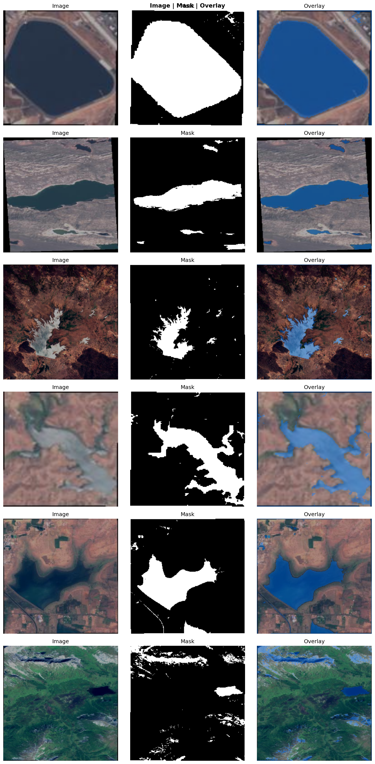
2. Problem Statement & Dataset
Slide 02
Extracting dynamic water boundaries from Sentinel-2 earth observations is essential for automated flood risk mapping, reservoir monitoring, and climate metrics.
Key challenges:
Class imbalance: 7.6% water vs 92.4% non-water pixels
JPEG artifacts: 96% of masks have compression noise (values 1-199)
RGB-only input -- no NIR band to distinguish water from shadow
Data split: 70% train (1,989), 15% val (426), 15% test (426) from 2,841 images
Data Split: 70% Train (1,989) | 15% Val (426) | 15% Test (426)

Slide 3
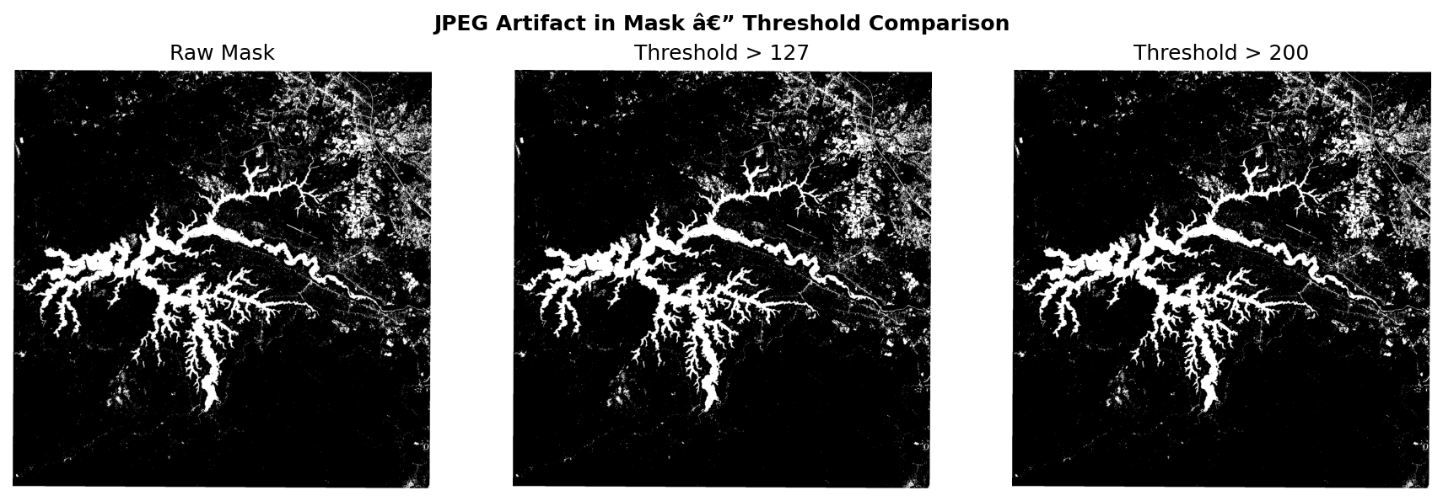
3. Preprocessing & Artifact Scrubbing
Slide 03
Original mask files are riddled with compression artifacts (values 1-199). Standard thresholding limits detail, requiring an optimized configuration:
Resize: 256x256 (bilinear for images, nearest-neighbor for masks)
Threshold: Masks thresholded at >200 to remove JPEG noise
Augmentation: Horizontal/vertical flips (50%), 90-degree rotations, color jitter (30%)
Normalization: ImageNet mean (0.485, 0.456, 0.406) and std (0.229, 0.224, 0.225)
ImageNet Normalization: mean=[0.485, 0.456, 0.406], std=[0.229, 0.224, 0.225]

Slide 4
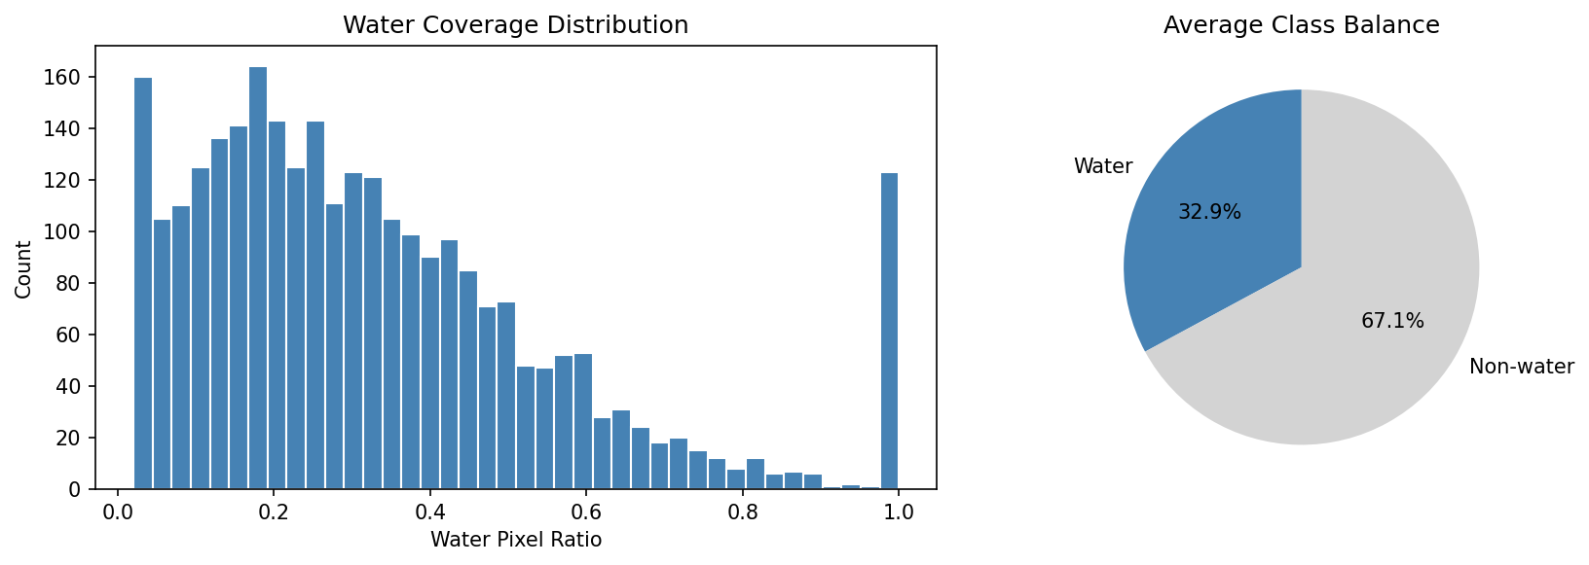
4. Exploratory Data Analysis
Slide 04
A complete histogram scan over the water-to-land ratio demonstrates extreme pixel imbalance across scenes:
Water Pixel Ratio: Heavily left-skewed, majority of scenes consist mainly of land background features.
Class Imbalance: Water pixels = 7.6% of total dataset, non-water = 92.4%
Imbalance Handling: Hybrid loss (BCE + Dice) used rather than standard cross-entropy to protect spatial boundaries.
Spatial diversity: Images cover coastlines, rivers, lakes, reservoirs across multiple geographic regions.
Water pixels: ~7.6% of total | BCE + Dice hybrid loss handles imbalance without focal loss

Slide 5
5. Model Architecture
Slide 05
Encoder: ImageNet-pretrained ResNet34 (21M parameters) ensures fast, stable convergence.
Decoder: Symmetric up-sampling with spatial skip connections from encoder stages.
Loss: 0.5 x BCE + 0.5 x Dice Loss to combat the 7.6% class imbalance.
Optimizer: AdamW (lr=1e-4, weight_decay=1e-4) + CosineAnnealingLR scheduler.
Early stopping: Patience=10 epochs on val IOU (stopped at epoch 34).
Hyperparameter Configuration
Learning Rate
1e-4
Batch Size
8
Optimizer
AdamW
Scheduler
CosineAnnealingLR
Patience
10 epochs
Stopped At
Epoch 34
Weighted BCE handles local spatial gradients; Dice directly addresses global Jaccard metric boundaries

Slide 6
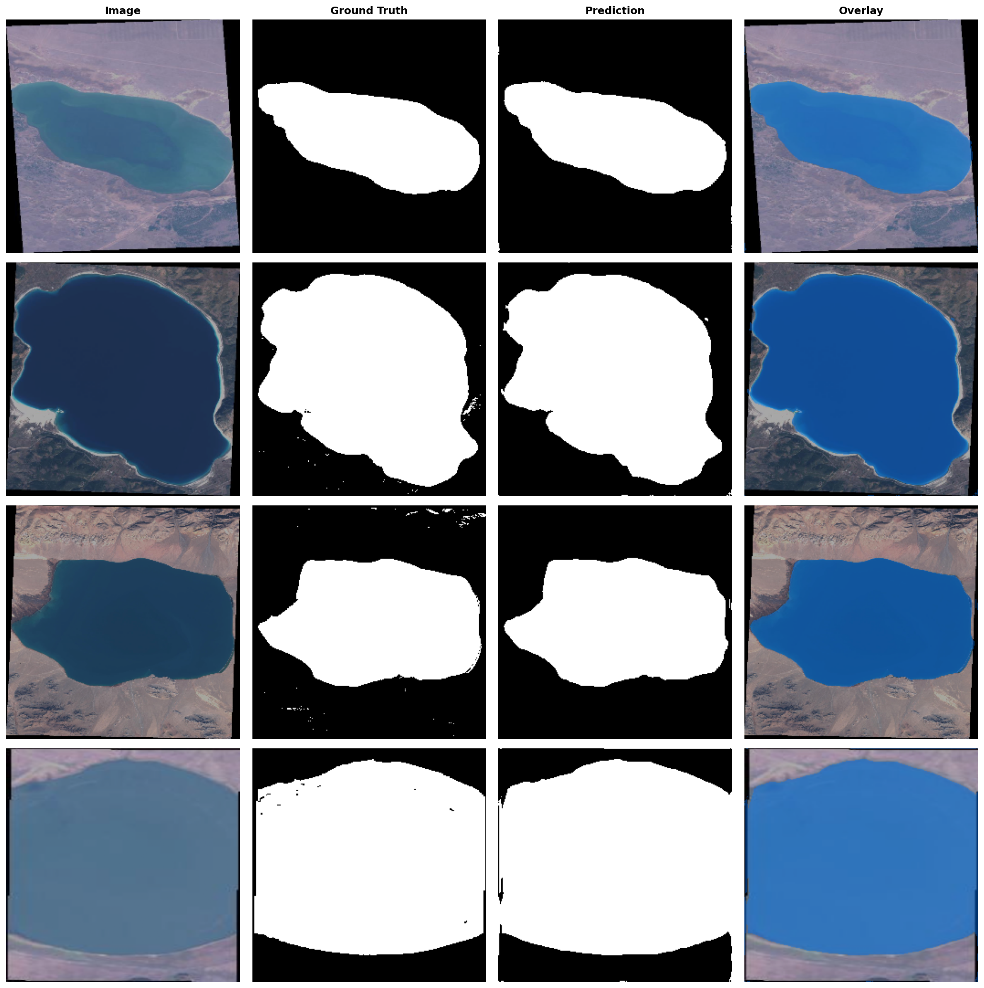
6. Hyperparameter Tuning & Results
Slide 06
Run | LR | Batch | IOU | Accuracy
lr1e-4_bs8 | 1e-4 | 8 | 0.8018 | 92.65%
lr5e-5_bs8 | 5e-5 | 8 | 0.7928 | 92.31%
lr1e-4_bs16 | 1e-4 | 16 | 0.7542 | 90.86%
Final Model (Test Set)
IOU | Accuracy | Precision | Recall
0.8249 | 93.80% | 91.90% | 88.70%
Precision > Recall (91.90% vs 88.70%): under-segments slightly -- safer bias for flood mapping (fewer false alarms)

Slide 7
7. Optimized Inference Service
Slide 07
ONNX Runtime delivers ~2.2x CPU speedup through operator fusion (conv+bn+relu -> single kernel).
Sliding-window tiling: 256x256 tiles, 32px overlap (~72 tiles/image).
Without tiling, a 2009x2007 image would require 46 GB GPU memory.
Test-Time Augmentation: horizontal flip averaging (+0.5-1% IOU).
Auto-fallback: ONNX -> PyTorch -> MLflow registry.
Latency per 256x256 Tile
PyTorch (CPU) (~120 ms, 1.0x)
1.0x
ONNX Runtime (CPU) (~55 ms, 2.2x)
2.2x
ONNX Runtime (GPU) (~15 ms, 8.0x)
8.0x
Fallback chain: ONNX -> PyTorch -> MLflow Registry Weight Pull

Slide 8
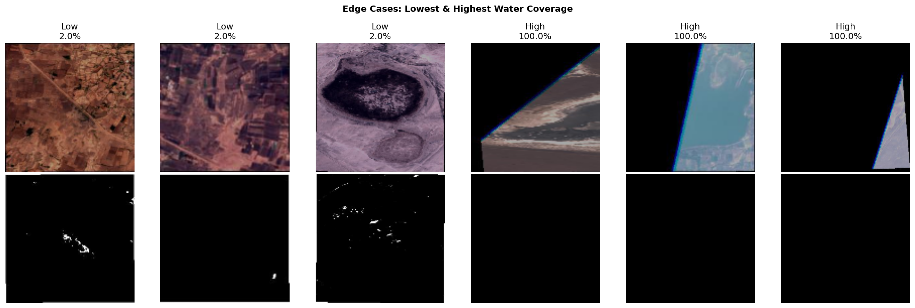
8. Failure Modes & Model Transparency
Slide 08
Failure Mode | Impact | Root Cause
Narrow waterways | Streams <4px wide missed | 256x256 resize destroys thin features
Shadow / dark terrain | Shadows classified as water | RGB-only; NIR band disambiguates
JPEG boundary noise | Ragged mask edges (+/-1px) | Compression artifacts in source masks
Operational Boundaries
Production-ready for: lakes, large rivers, wide reservoirs
Not suitable for: narrow canals, small ponds (<500 m2), shadow-prone terrain
Biggest bottleneck: RGB-only input -- adding NIR band gives +5-10% IOU

Slide 9
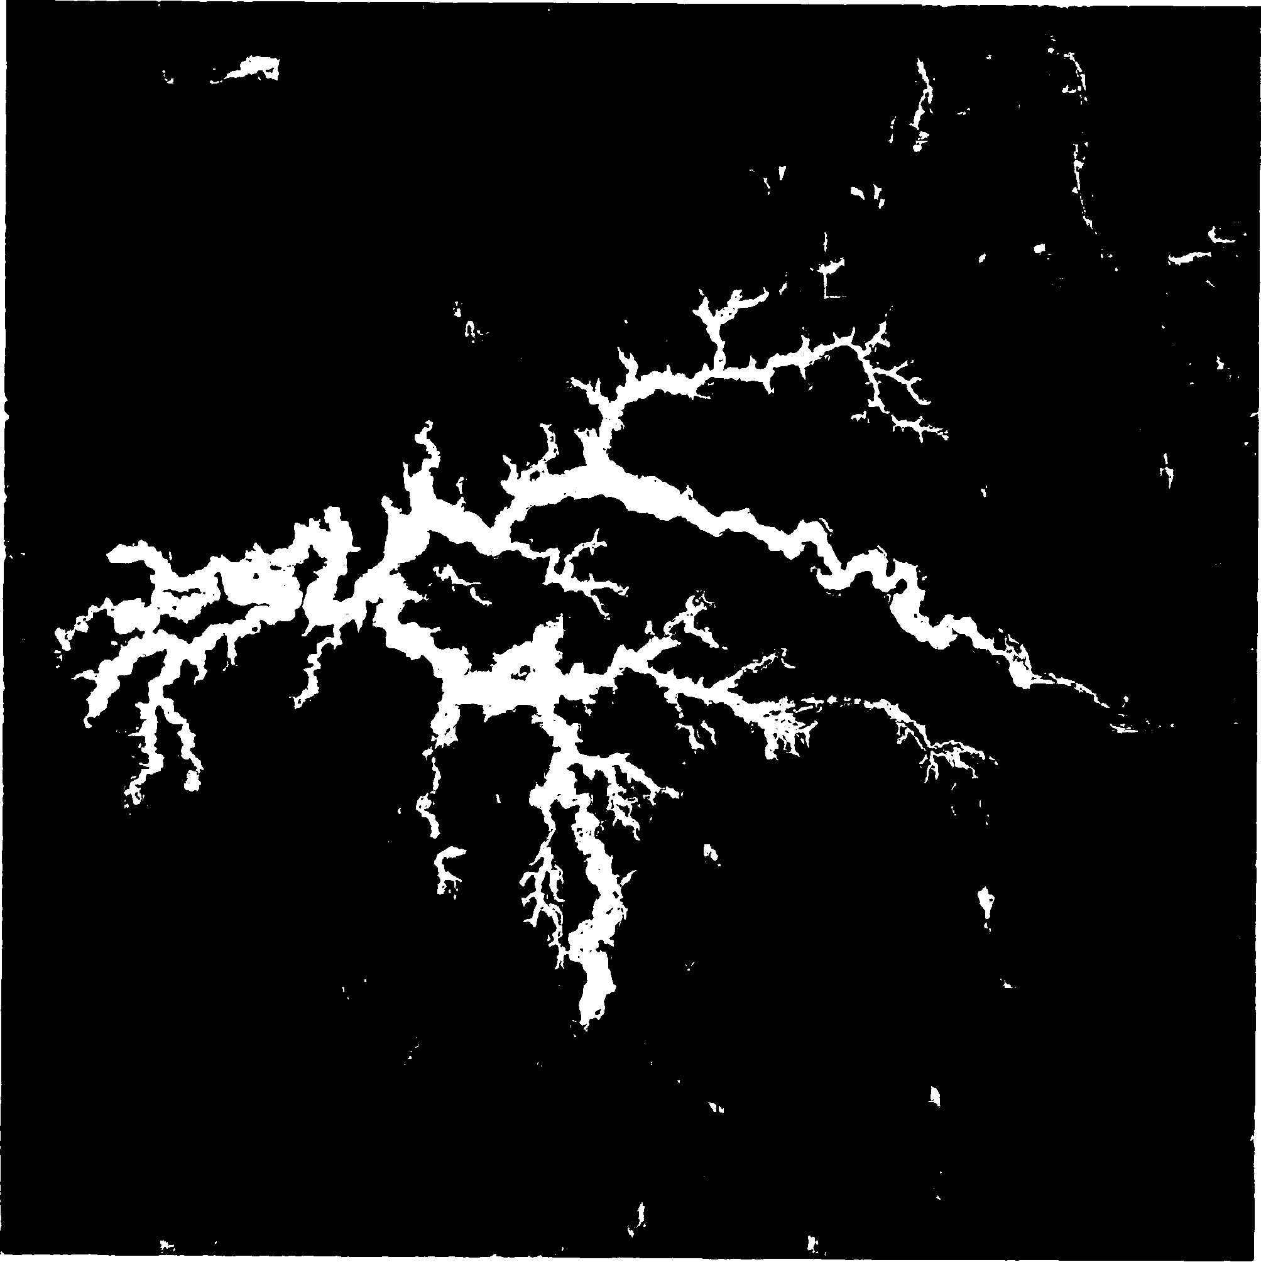
9. MLOps Deployment Pipeline
Slide 09
COMMIT
LINT
TEST
BUILD
PUSH
GitHub Actions on push to master: flake8 lint -> 15 pytest -> Docker build -> Docker Hub push.
Dockerfile: python:3.11-slim, ONNX model baked in, HEALTHCHECK every 10s.
MLflow: per-epoch metrics, model registry (water-segmentation-unet v1, serialization_format=pt2).
Security: 60 req/min rate limiter, 100 MB upload cap, path traversal protection.
Image: angelgupta/water-segmentation:latest on Docker Hub.

Slide 10
10. Recommendations & Strategic Roadmap
Slide 10
HIGH IMPACT (+5-10% IOU)
MEDIUM IMPACT (+1-3% IOU)
LOW IMPACT (+0.5-1% IOU)
Add NIR band input (Band 8) for NDWI
Train on full-resolution random crops
EfficientNet-B4 encoder swap
Optuna Bayesian search (30+ trials)
Ensemble (3-5 seeds)
CRF post-processing
Current model (IOU 0.82) is production-ready for coarse water mapping. Adding NIR band closes the gap to high-precision applications.
7 prioritized recommendations with expected impact and effort in REPORT.md Section 10

