Slide 1
MINI PROJECT PRESENTATION
Quiz Game with
High Score
A Python-based multiple-choice quiz that checks answers, calculates scores, and tracks the player’s high score.
MANGASANG, ANGELICA B.
PHINMA – University of Iloilo

Slide 2
Description
What the program does
10
Questions
Quiz Game with High Score is a terminal-based Python program that presents multiple-choice questions about basic computer and Python concepts. The player enters a name, answers each question using A, B, C, or D, and immediately receives feedback. After all questions are answered, the program calculates the total score and percentage, displays performance feedback, and keeps the highest score achieved during the session.
A–D
Answer Input
%
Score Result
★
High Score
Key idea: simple Python fundamentals organized into clear functions.

Slide 3
Objectives
What the project aims to achieve
GENERAL OBJECTIVE
To develop a Quiz Game with High Score using Python.
01
Present multiple-choice questions and accept valid A, B, C, or D answers.
02
Check each response and give immediate correct or incorrect feedback.
03
Calculate the player’s score and percentage after the quiz.
04
Track the highest score and allow the player to replay the quiz.

Slide 4
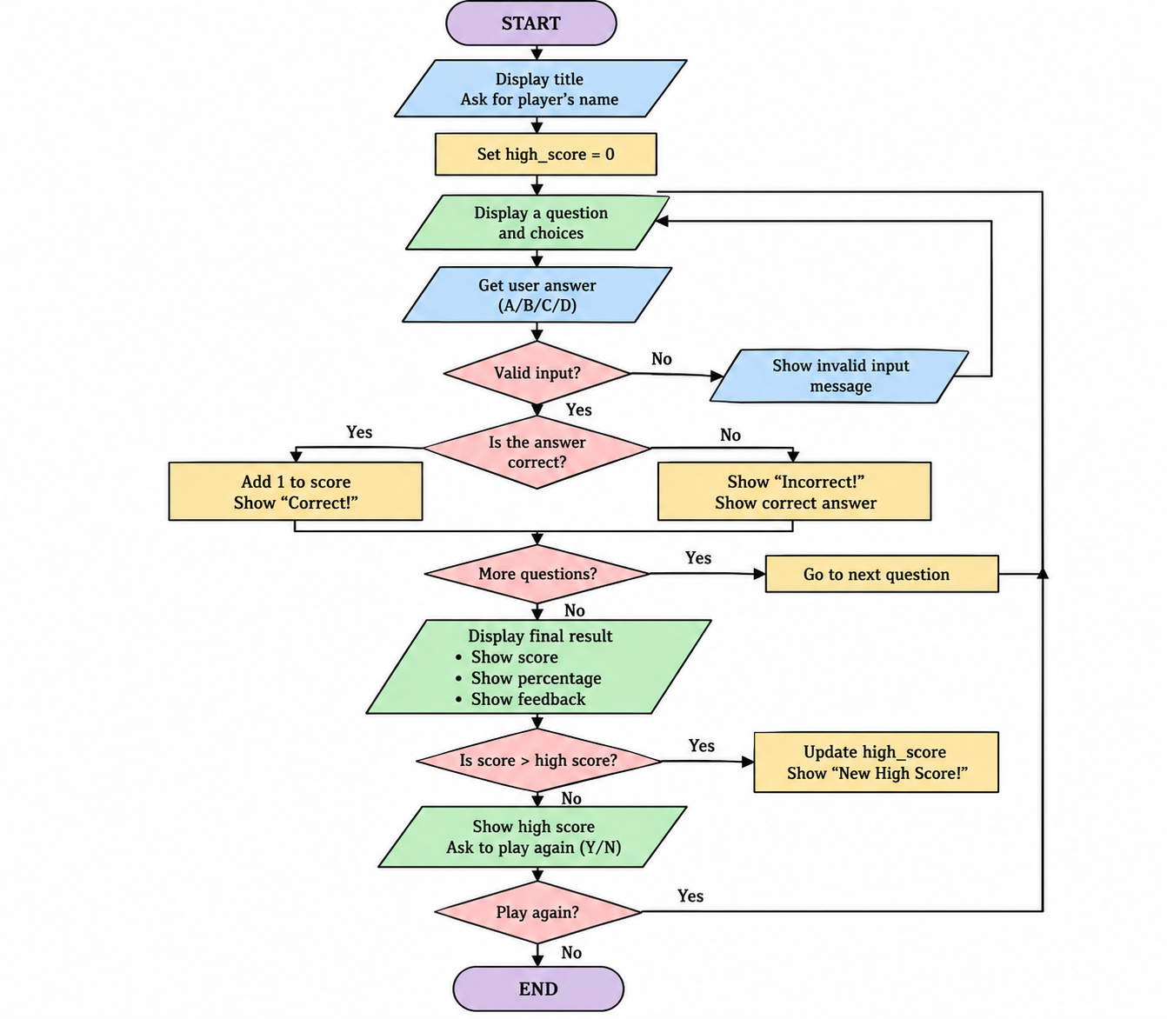
Flowchart
Program flow from start to finish

