Slide 1


Dimension reduction
Thomas Corpetti
Copernicus master, 2025-2026

Slide 2
Curse of dimensionality
Real-world datasets are often
  Unstructured and high-dimensional (images, audio, time series, etc.)
  Challenging to visualize and subject to the curse of dimensionality

Slide 3
Curse of dimensionality
Real-world datasets are often
  Unstructured and high-dimensional (images, audio, time series, etc.)
  Challenging to visualize and subject to the curse of dimensionality
Problem with high dimensions
1D
1

Slide 4
Curse of dimensionality
Real-world datasets are often
  Unstructured and high-dimensional (images, audio, time series, etc.)
  Challenging to visualize and subject to the curse of dimensionality
Problem with high dimensions
d
d
1D
1

Slide 5
Curse of dimensionality
Real-world datasets are often
  Unstructured and high-dimensional (images, audio, time series, etc.)
  Challenging to visualize and subject to the curse of dimensionality
Problem with high dimensions
d
d
1D
1
Probability to be in the grey area :

Slide 6
Curse of dimensionality
Real-world datasets are often
  Unstructured and high-dimensional (images, audio, time series, etc.)
  Challenging to visualize and subject to the curse of dimensionality
Problem with high dimensions
d
d
1D
1
Probability to be in the grey area :

Slide 7
Curse of dimensionality
Real-world datasets are often
  Unstructured and high-dimensional (images, audio, time series, etc.)
  Challenging to visualize and subject to the curse of dimensionality
Problem with high dimensions
d
d
1D
2D
1
Probability to be in the grey area :

Slide 8
Curse of dimensionality
Real-world datasets are often
  Unstructured and high-dimensional (images, audio, time series, etc.)
  Challenging to visualize and subject to the curse of dimensionality
Problem with high dimensions
d
d
1D
2D
1
Probability to be in the grey area :
Probability to be in the grey area :

Slide 9
Curse of dimensionality
Real-world datasets are often
  Unstructured and high-dimensional (images, audio, time series, etc.)
  Challenging to visualize and subject to the curse of dimensionality
Problem with high dimensions
d
d
1D
2D
1
Probability to be in the grey area :
Probability to be in the grey area :

Slide 10
Curse of dimensionality
Real-world datasets are often
  Unstructured and high-dimensional (images, audio, time series, etc.)
  Challenging to visualize and subject to the curse of dimensionality
Problem with high dimensions
d
d
1D
2D
3D
1
Probability to be in the grey area :
Probability to be in the grey area :

Slide 11
Curse of dimensionality
Real-world datasets are often
  Unstructured and high-dimensional (images, audio, time series, etc.)
  Challenging to visualize and subject to the curse of dimensionality
Problem with high dimensions
d
d
1D
2D
3D
1
Probability to be in the grey area :
Probability to be in the grey area :
Probability to be in the grey area :

Slide 12
Curse of dimensionality
Real-world datasets are often
  Unstructured and high-dimensional (images, audio, time series, etc.)
  Challenging to visualize and subject to the curse of dimensionality
Problem with high dimensions
d
d
1D
2D
3D
1
Probability to be in the grey area :
Probability to be in the grey area :
Probability to be in the grey area :

Slide 13
Curse of dimensionality
Real-world datasets are often
  Unstructured and high-dimensional (images, audio, time series, etc.)
  Challenging to visualize and subject to the curse of dimensionality
Problem with high dimensions
N D

Slide 14
Curse of dimensionality
Let’s have a look

Slide 15
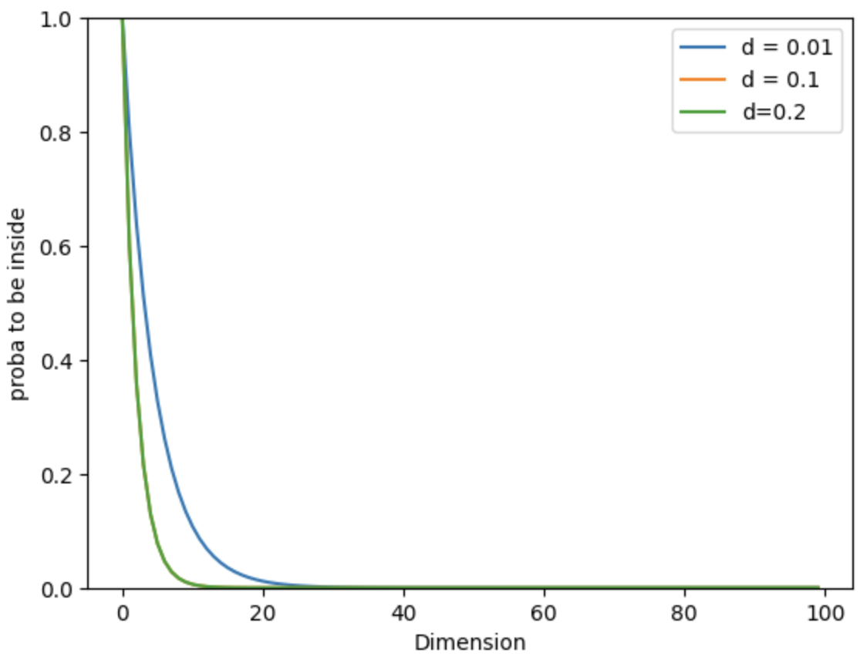
Curse of dimensionality
Let’s have a look
After ~25 dimensions, all probabilities fall to 0

Slide 16
Curse of dimensionality
Let’s have a look
After ~25 dimensions, all probabilities fall to 0
Eucledian distance is not adapted to high dimensions

Slide 17
Curse of dimensionality
Let’s have a look
After ~25 dimensions, all probabilities fall to 0
Eucledian distance is not adapted to high dimensions
Need to have alternative tools than the euclidian space
for data visualization

Slide 18
Reuction of dimension
PCA, LLE, tSNE, UMAP

