Slide 1
🚗
MyTrip
Route
Budget Road Trip Planner
Cost
CS 4398 – Software Engineering Project
Texas State University · Summer 2026
Budget
Mustafa Al Azzawi · Angelica Alvarado · William Parker
MyTrip · CS 4398 · Texas State University · Summer 2026
01

Slide 2
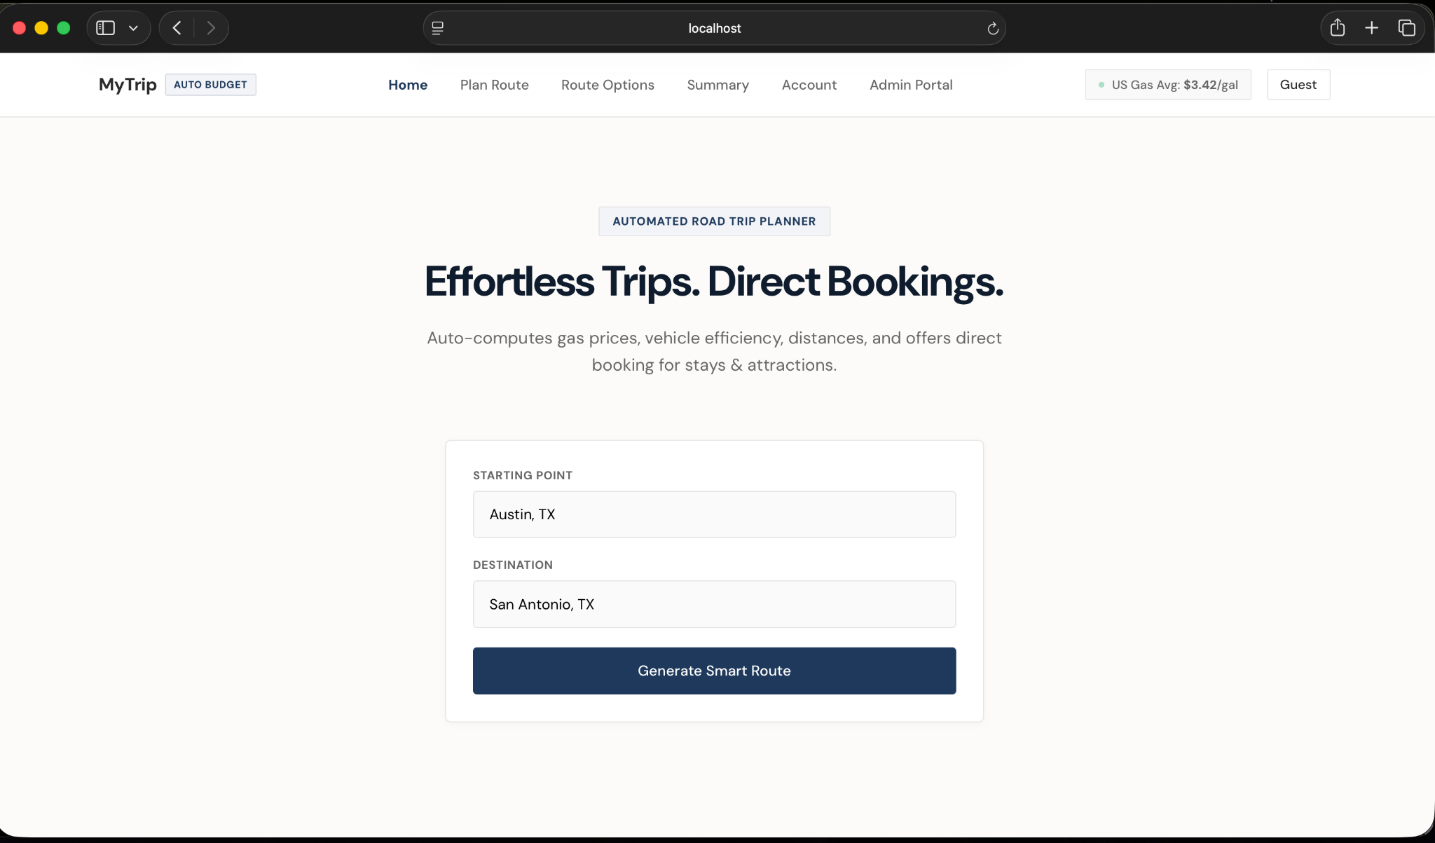
🧭
Project overview
One simple workflow for planning a road trip
1
Plan a route
2
Estimate costs
3
Compare budget
Traveler enters starting point, optional waypoint, and destination.
MyTrip calculates fuel cost, total estimated cost, and drive time.
The summary shows if the trip is within the traveler’s target budget.
Home page starts the planning flow with a clean route search.
• Web-based prototype
• Easy to use for travelers
• Designed for CS 4398 final project
MyTrip · CS 4398 · Texas State University · Summer 2026
02

Slide 3
🎯
Project purpose
The goal is to reduce scattered trip planning
Before MyTrip
With MyTrip
• Maps on one website
• Hotels on another website
• Gas prices somewhere else
• Budget math done manually
• Route display
• Cost estimation
• Budget comparison
• Saved trip plans
Main idea: help travelers understand the route and cost before committing to a trip.
MyTrip · CS 4398 · Texas State University · Summer 2026
03

Slide 4
✅
Main features
Implemented features kept simple for the prototype
🗺️
Route display
📍
Waypoint
⛽
Fuel cost
Google Maps shows the trip route.
Optional stop between start and destination.
Mileage, MPG, and gas price estimate fuel cost.
💵
Budget
💾
Saved trips
👤
Account filter
Total cost is compared to the target budget.
Trips can be saved, reopened, edited, updated, and deleted.
Saved trips are filtered by traveler email.
MyTrip · CS 4398 · Texas State University · Summer 2026
04

Slide 5
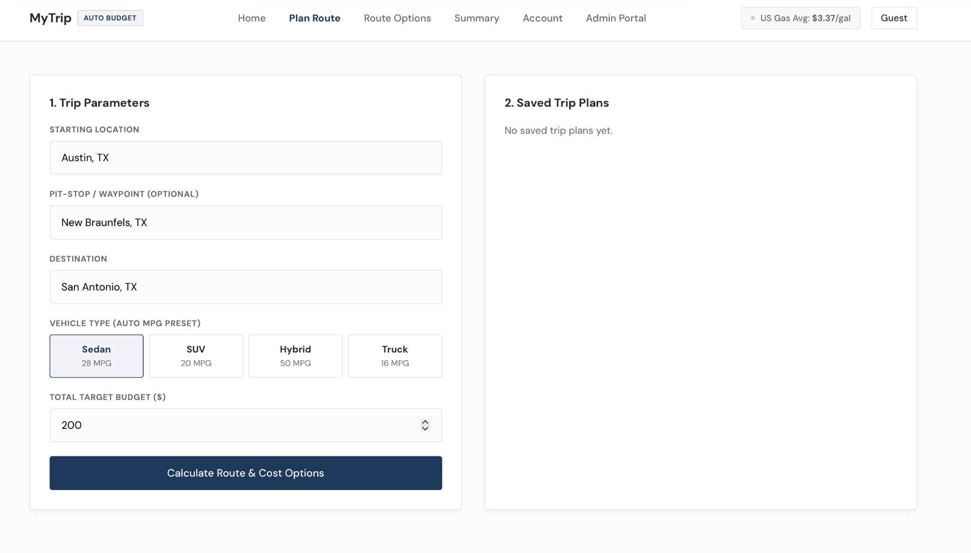
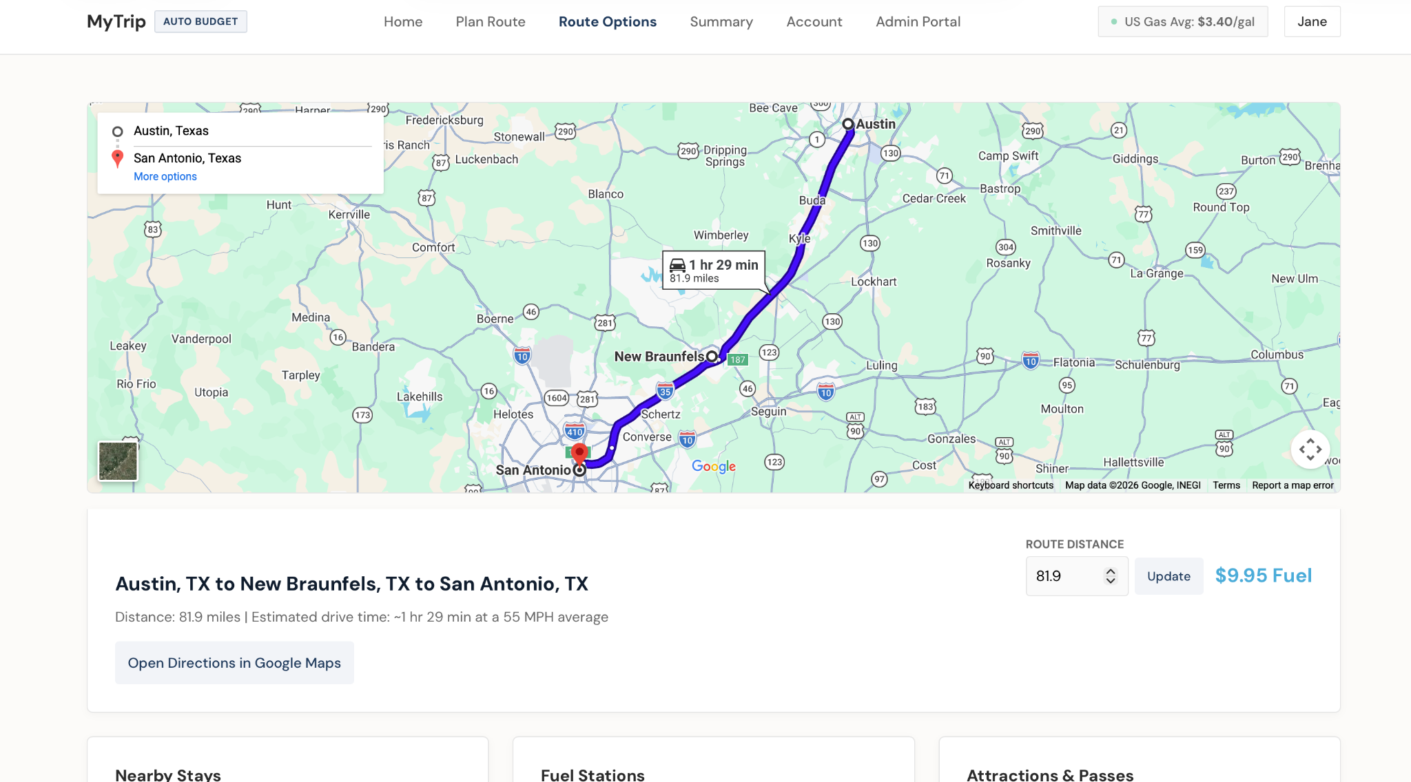
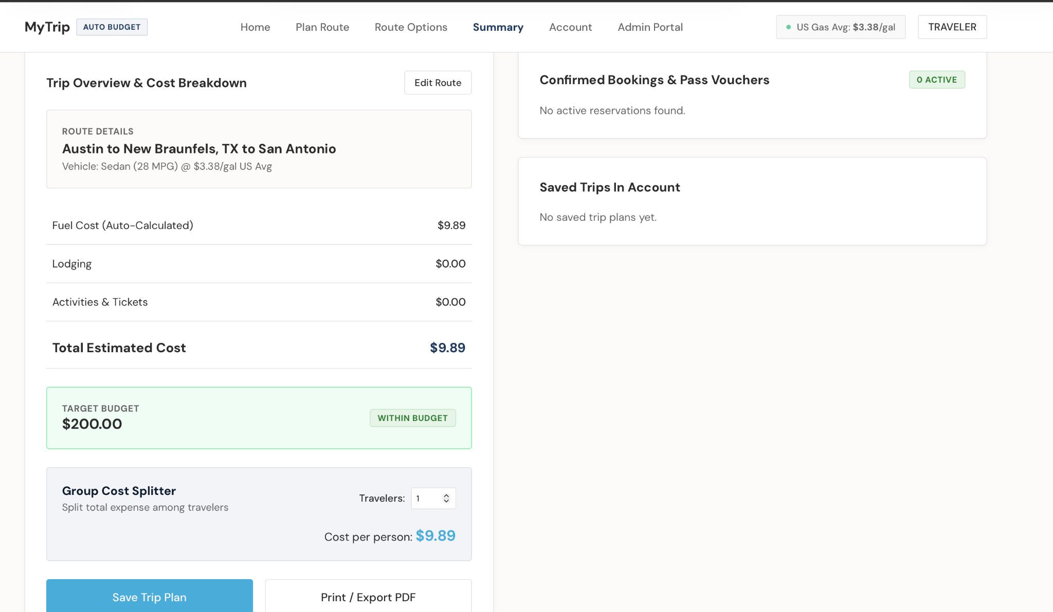
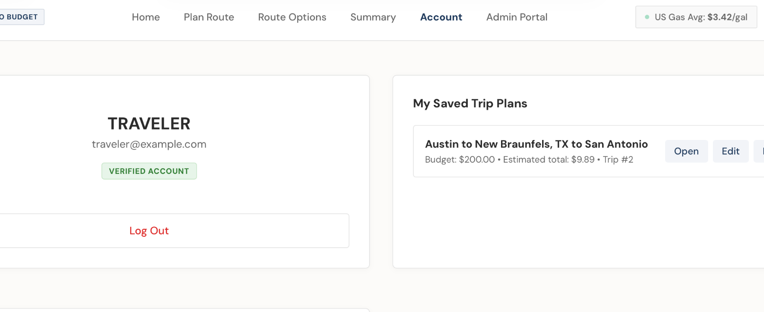
🖥️
Website walkthrough
The interface moves through clear pages
1 · Plan Route
2 · Route Options
3 · Summary
4 · Account
MyTrip · CS 4398 · Texas State University · Summer 2026
05

Slide 6
🏗️
System structure
Layered design used by the application
MyTrip · CS 4398 · Texas State University · Summer 2026
06

Slide 7
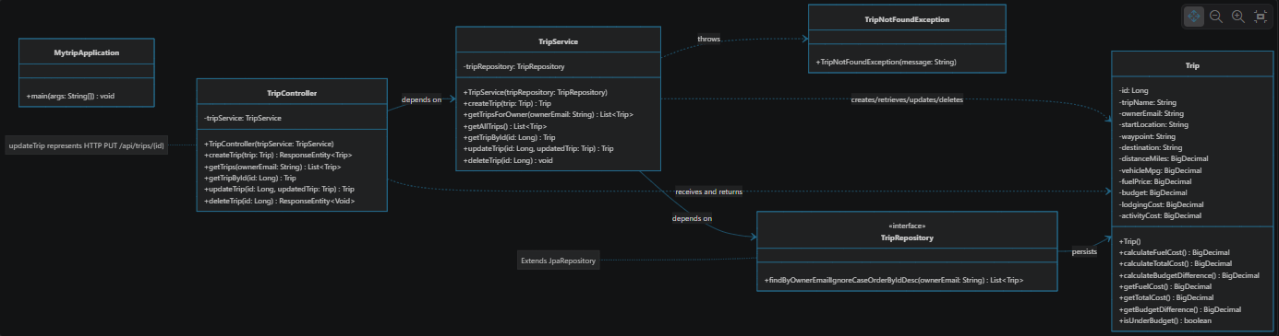
🧩
UML class diagram
Main classes and relationships
MyTrip · CS 4398 · Texas State University · Summer 2026
07

Slide 8
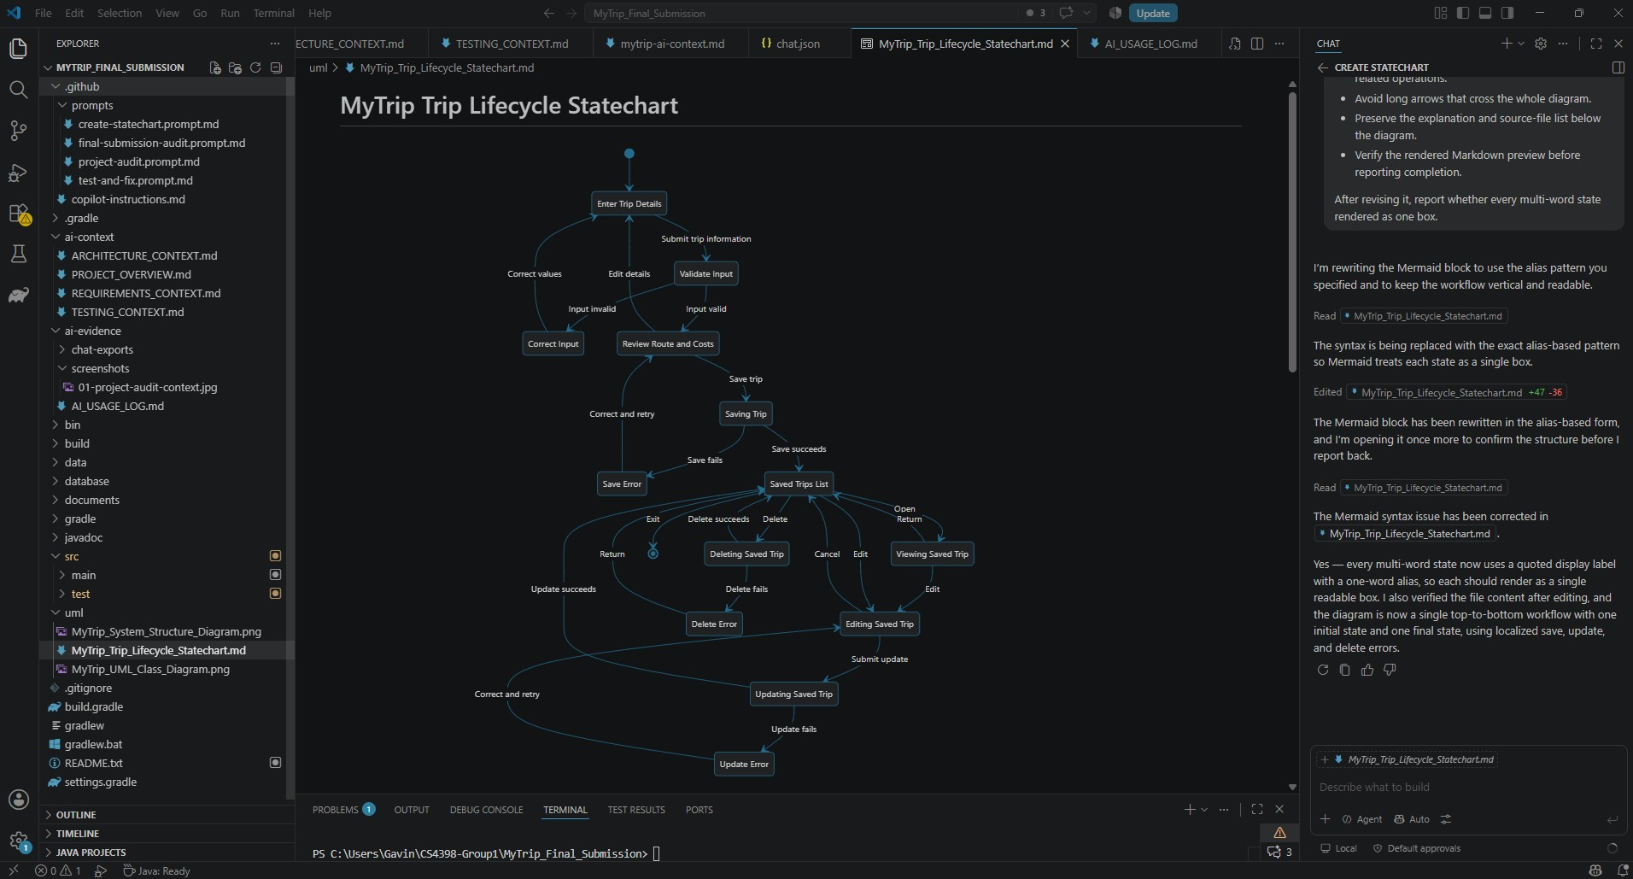
🧩
Lifecycle Statechart
Main classes and relationships
MyTrip · CS 4398 · Texas State University · Summer 2026
07

Slide 9
🧮
Algorithms
Simple calculations create the trip estimate
Fuel Cost
(Route Distance / Vehicle MPG) × Fuel Price Per Gallon
Tested example
• 81.9 miles
• 28 MPG vehicle preset
• $3.38 per gallon
• ≈ $9.89 fuel cost
• Drive time ≈ 1 hr 29 min at 55 MPH
Total Estimated Cost
Fuel Cost + Lodging Cost + Activity Cost
Budget Difference
Budget − Total Estimated Cost
MyTrip · CS 4398 · Texas State University · Summer 2026
08

Slide 10
🧪
Acceptance testing
The main traveler workflow was tested
Manual Acceptance Testing
Automated Acceptance Testing
10
29
TESTS EXECUTED
TESTS EXECUTED
10
29
PASSED
PASSED
0
0
FAILED
FAILURES
0
• Login and account access
• Create, calculate, save, reopen, and delete a trip
• Invalid mileage and invalid budget validation
• Logged-out save restriction
• Email-based trip filtering
ERRORS
0
SKIPPED
MyTrip · CS 4398 · Texas State University · Summer 2026
09

Slide 11
⚠️
Known limitations
These are acceptable for the academic prototype
• Route mileage is entered manually
• Drive time uses an average-speed estimate
• Hotel, attraction, and gas-station data is simulated
• Reservations and payments are simulated
• Login and email filtering are demonstration-level, not secure authorization
• The H2 database is local to each computer
MyTrip · CS 4398 · Texas State University · Summer 2026
10

Slide 12
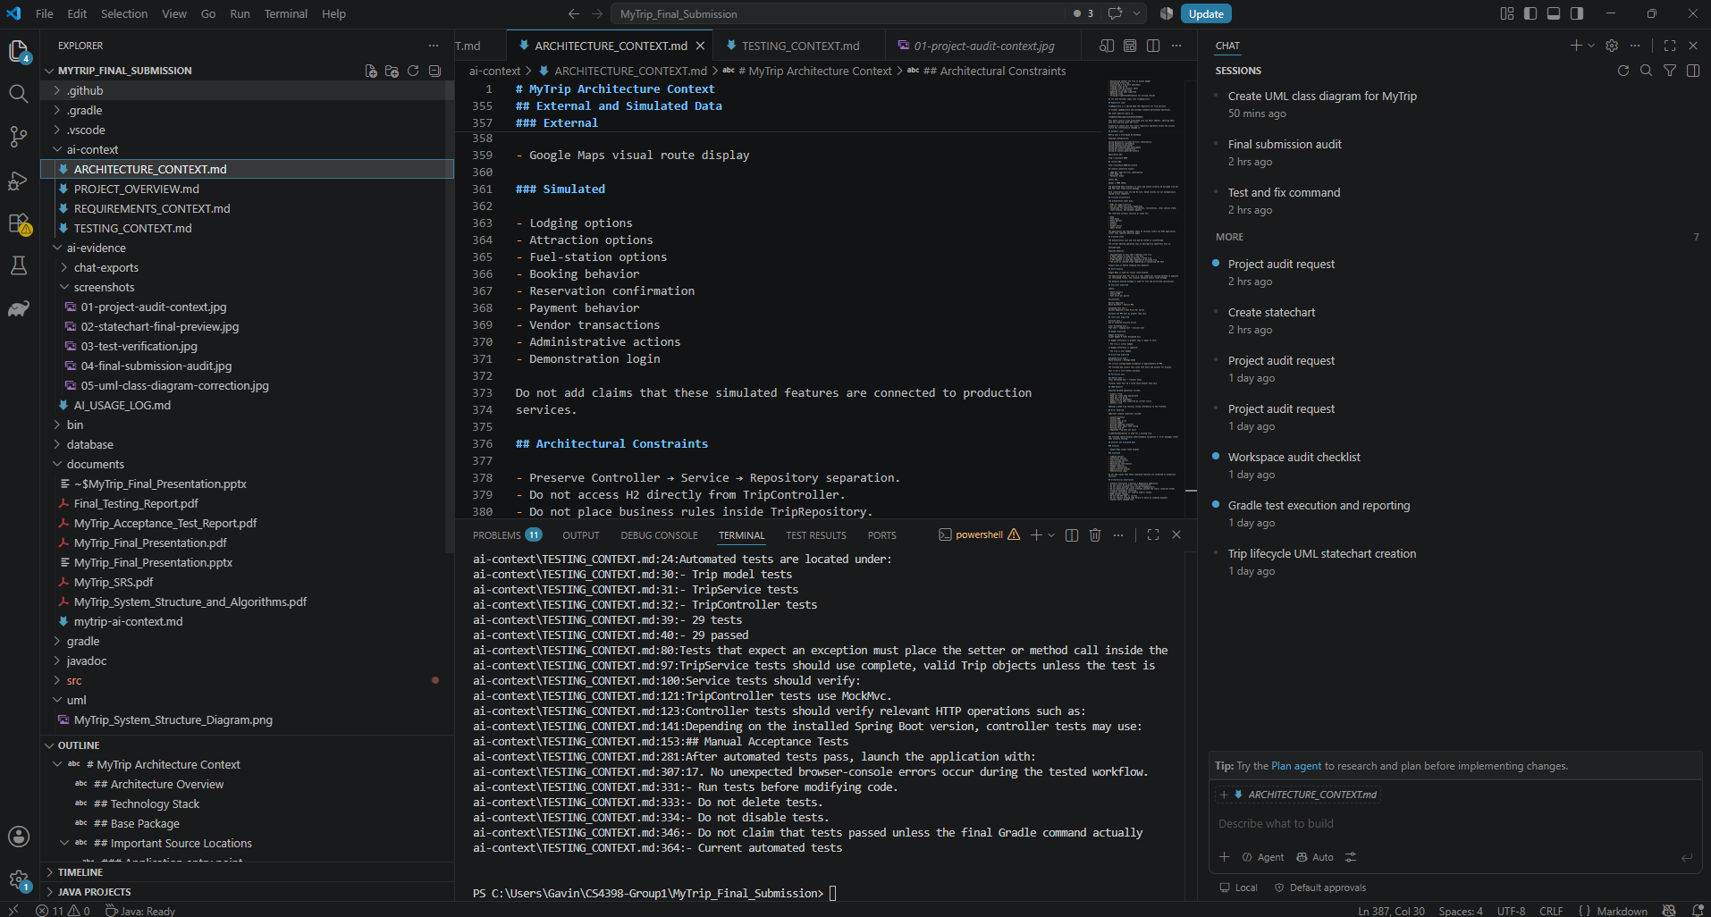
IDE-Integrated AI Workflow
GitHub Copilot Agent was used directly inside Visual Studio Code during the
final development and verification phase.
• Repository instructions: .github/copilot-instructions.md
• Four reusable prompts: .github/prompts/
• Four project context files: ai-context/
• Corrected zero-distance and zero-budget validation
• Added regression tests for verified defects
• Corrected Spring parameter binding through the Java -parameters option
• Generated the Trip lifecycle statechart
• Generated the corrected as-built UML class diagram
• Verified 29 automated tests with 0 failures
• Exported IDE chats and screenshots are preserved in ai-evidence/

Slide 13
❓
Questions?
Thank you
MyTrip – Budget Road Trip Planner
Mustafa Al Azzawi · Angelica Alvarado · William Parker
Plan clearly. Estimate early. Travel within budget.
MyTrip · CS 4398 · Texas State University · Summer 2026
12

