Slide 1
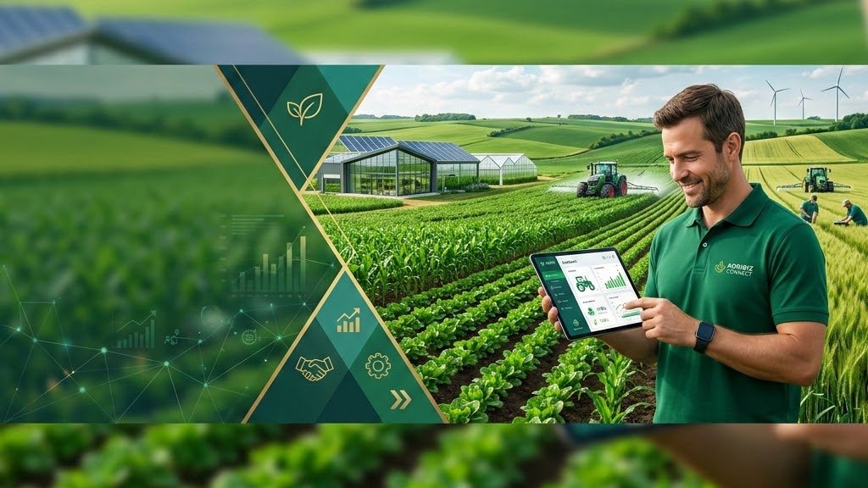



Every industry has its operating system.
WORK
LIFE
SALES
COMMERCE
Microsoft
Apple
Salesforce
Shopify
Agriculture still doesn't have one.
GAia will become it.

Slide 2








The $13 Trillion Disconnection
THE CURRENT STATUS QUO
$13 Trillion
Global Agriculture Industry
Yet millions of farmers make critical daily operational and financial decisions using fragmented, analog, and disconnected consumer tools.

Slide 3

We Compete For Attention, Not ERP Software
We are not competing with traditional Farm Management Software.
DAILY SCREEN TIME COMPETITION
We compete for the farmer's daily digital attention.
Facebook
TikTok
Traditional AgTech builds heavy desktop software used once a month for compliance. GAia is built for daily mobile engagement—capturing the primary screen time of the agricultural world.
YouTube
GAia

Slide 4

The Monopoly Stack
Attention
Trust
Transactions
FinServices
Proprietary Data
Autonomous AI
Monopoly OS
"Whoever owns the farmer's daily attention... owns agriculture."

Slide 5
Solving AgTech's Fundamental Flaw
Company | Focus Area | Relationship Ownership
John Deere | Machinery & Hardware | Equipment level only
Climate Corp / Bayer | Field & Agronomy Data | Field level only
Agri Marketplace | Commercial E-Commerce | Transactional level only
GAia | The Farmer (Every Single Day) | Complete Relationship Ownership

Slide 6
CORE PRODUCT STRATEGY
Our product is not software.
Our product is HABIT.
We don't sell features. We engineer human behavior—creating an indispensable daily ritual around agricultural decisions.

Slide 7






Designing Human Behavior Around the Clock
The Result
Daily Loop
365-Day Cycle
Unrivaled DAU/MAU retention matching world-class platforms like Duolingo & Strava.
Weather, morning briefings, localized market prices, AI alerts, community discussions.
Winter education, spring planting execution, summer harvest, autumn analysis.

Slide 8




The Daily Active User (DAU) Loop
Morning Briefing
Weather & Soil
Field Tasks
GAia AI Advisory
Marketplace
Community
Evening Report

Slide 9

The Yearly Loop: Never-Ending Lifecycle
WINTER
SPRING
SUMMER
AUTUMN
Planning & Education
Buying & Sowing
Protecting & Harvest
Analysis & Next Cycle
Agronomic learning, seed procurement, machinery budgeting.
Fertilizer purchases, sowing execution, real-time AI weather guidance.
Crop protection, grain sales, yield optimization diagnostics.
Financial reporting, soil testing, repeat order planning.

Slide 10
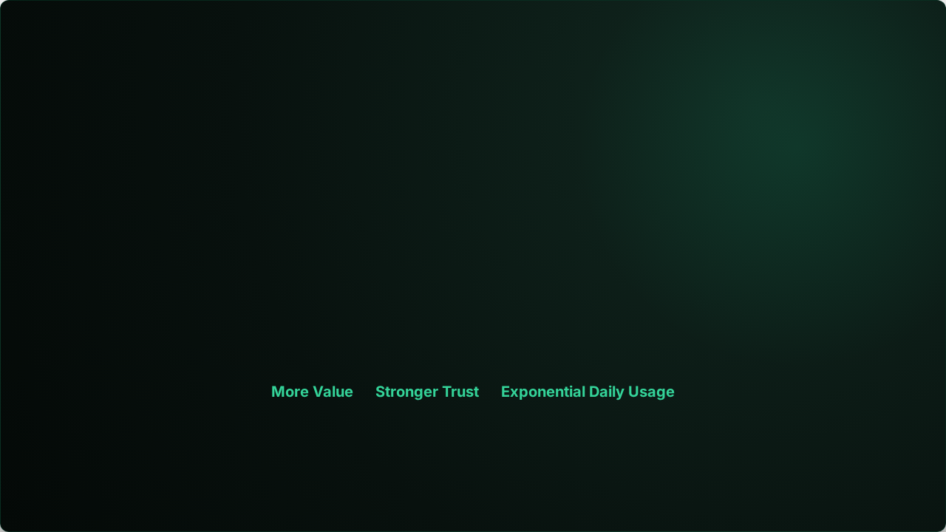






The Core GAia Flywheel
1. High Daily Usage
2. Hyper-Local Data
3. Superior AI Intelligence
Farmers check GAia multiple times daily for operational utility.
Every interaction enriches our agronomic data network.
Predictive AI delivers higher yield and massive cost savings.

Slide 11
The Marketplace Engine
Attention Capture
Farmer actively engaged on GAia daily
Contextual AI Recommendations
Optimal input recommendations delivered in-app
Seamless Transactions & BNPL
Fertilizer, seed & crop protection purchase with trade credit
High Margin Monetization
Marketplace take-rate, financial services, vendor ad monetization

Slide 12
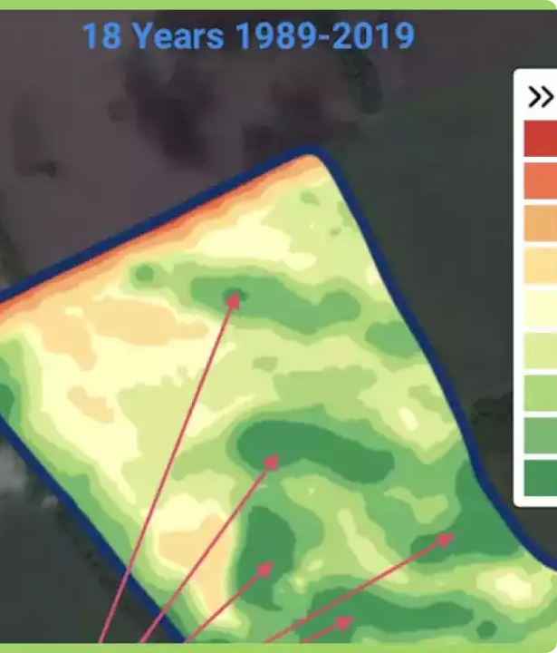
An Unfair Data Moat
5 Years of Proprietary Agronomic Datasets
GAia collects granular real-time field insights: precise fertilizer application efficiency, micro-soil chemistry, and crop performance across varying weather conditions.
This dataset cannot be acquired, scraped, or duplicated by traditional tech giants or big agriculture corporations.

Slide 13

Unfair Advantage & Traction
300,000
12B PLN
Existing Active Farmers
Fertilizer GMV Handled
This is not an unproven startup idea. This is massive established distribution and trust ready to scale globally.

Slide 14


The Inflection Point
GAia TODAY
GOOGLE
AMAZON
FACEBOOK
The OS Scale Moment
Before Search Ads
Before 3P Marketplace
Before Mobile News Feed
We stand precisely at the inflection point where utility transitions into exponential categorical monopoly.

Slide 15

We are not building software.
We are building the digital infrastructure of European agriculture.
Connecting every field, farmer, transaction, and financial product under one unified operating system.

Slide 16

The Single Metric That Matters
NORTH STAR METRIC
DAU / MAU
Daily Engagement Velocity
GMV follows
•
Revenue follows
•
Monopoly follows

Slide 17

The company that owns the farmer's attention will own the next generation of agriculture.
We intend to build that company.
GAia Platform • 1 Billion Investment Opportunity

Slide 18

Image Sources
https://geopard.tech/wp-content/uploads/2021/11/AnyConv.com__Multi-Layer-Analytics-1.webp
Source: geopard.tech

