Slide 1
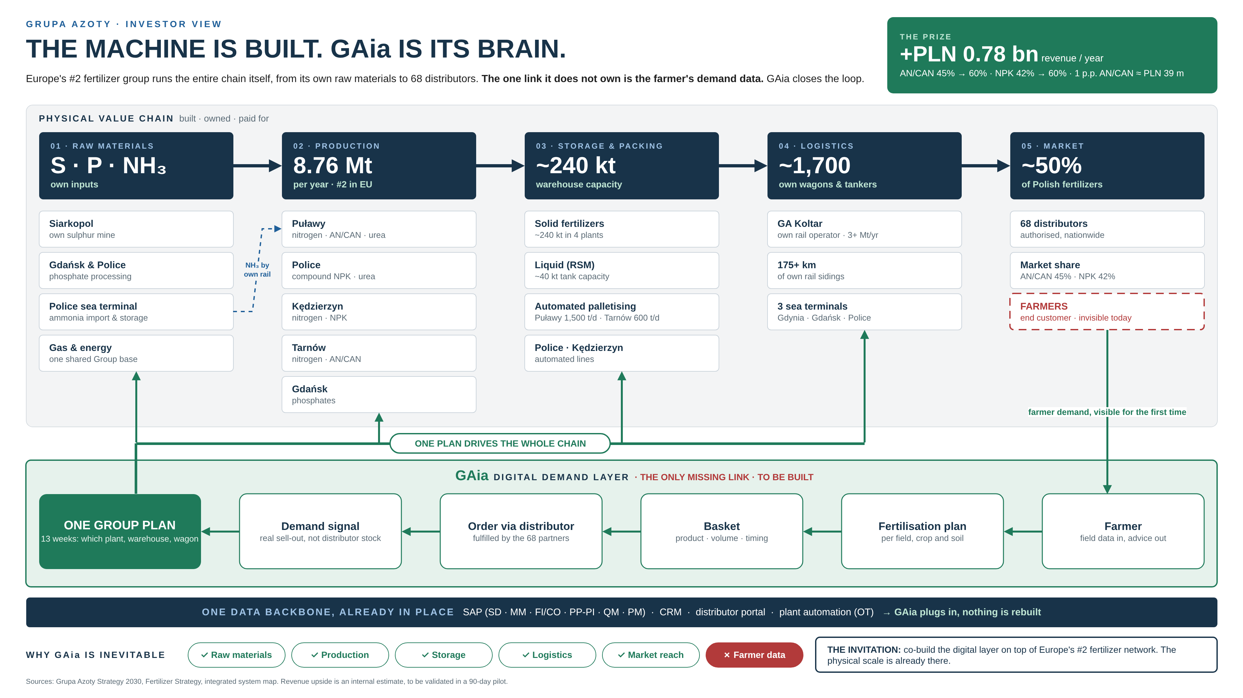
Notes:
One minute. Grupa Azoty is not a start-up looking for assets. It is the number two fertilizer producer in the European Union and holds about half of the Polish market.
Look at the chain from left to right: our own raw materials, 8.76 million tonnes of capacity per year, around 240 thousand tonnes of storage, our own railway with about 1,700 wagons and tankers, three sea terminals and 68 distributors covering the country.
Everything is built and paid for. One link is missing: we see what distributors order, not what the farmer needs. GAia closes that gap: the farmer gets a fertilisation plan, it becomes a basket and an order at the distributor, and that data goes straight back into one production plan for the whole Group.
The prize: from 45 to 60 percent in nitrates and from 42 to 60 percent in NPK, around 0.78 billion zloty of additional revenue per year. One percentage point of AN/CAN alone is about 39 million zloty. GAia is not an experiment, it is the necessary last step, and we invite you to build it with us.
Sources: Grupa Azoty Strategy 2030, Fertilizer Strategy, integrated system map. Revenue figures are internal estimates to be confirmed in the pilot.

