Slide 1

Displaying Image Information
John Muschelli
Johns Hopkins Bloomberg School of Public Health
January 26, 2015

Slide 2

Reading In Data
The readNIfTI command (oro.nifti package) can read in NIfTI file (compressed or not) into a nifti object. We will read in the NIfTI (T1-weighted) image from the previous session:
library(oro.nifti)
print({nii = readNIfTI(fname = "Output_3D_File")})
NIfTI-1 format
Type
Data Type
Bits per Pixel Slice Code Intent Code Qform Code Sform Code Dimension
: nifti
: 4 (INT16)
: 16
: 0 (Unknown)
: 0 (None)
: 2 (Aligned_Anat)
: 2 (Aligned_Anat)
: 512 x 512 x 22
Pixel Dimension : 0.47 x 0.47 x 5
Voxel Units Time Units
: mm
: sec

Slide 3
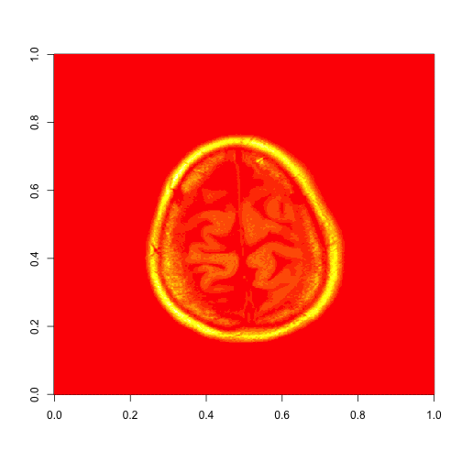
Visualizing a Slice
The nifti object is a 3D array (see ?array) with header information. We can use the image function (graphics package) to visualize a slice (slice 20 in the z-direction/axial):
image(nii[,,20])

Slide 4
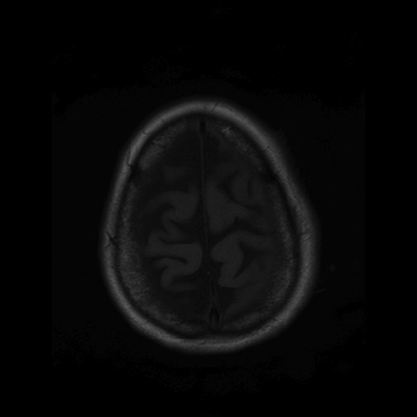
Visualizing a Slice
graphics::image uses heat.colors(12) for coloring, which is not useful for this task. We can either set the colors manually, or use the oro.nifti::image function. The function is still image, but we don’t pass in a slice, but the nifti object and specify the slice z=20:
image(nii, z = 20, plot.type='single')

Slide 5
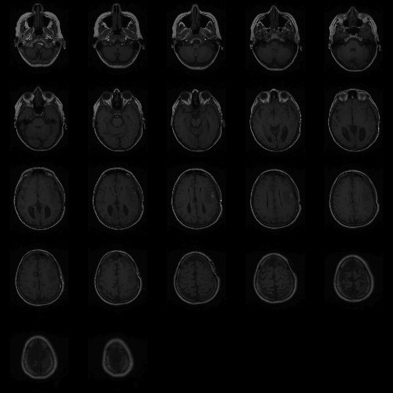
Visualizing a Slice
If plot.type is not 'single', image.nifti defaults to plotting ALL slices with data, even if z is specified (also called a “lightbox”):
image(nii, z = 20)

Slide 6
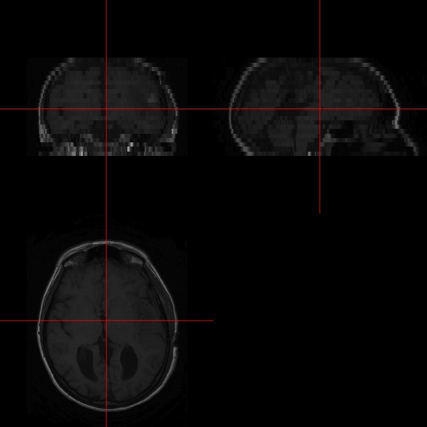
Visualizing all 3 planes
To show all 3 planes (axial, sagittal, and coronal) of an image, we can use the orthographic function:
orthographic(nii)

Slide 7
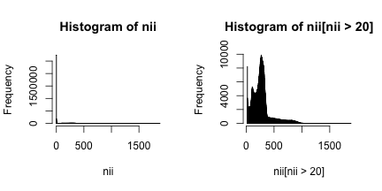
Histograms
What about the data? We can do normal operations, such as histograms of the image intensities and intensities over 20:
par(mfrow=c(1,2));
hist(nii, breaks = 2000); hist(nii[nii > 20], breaks = 200

Slide 8
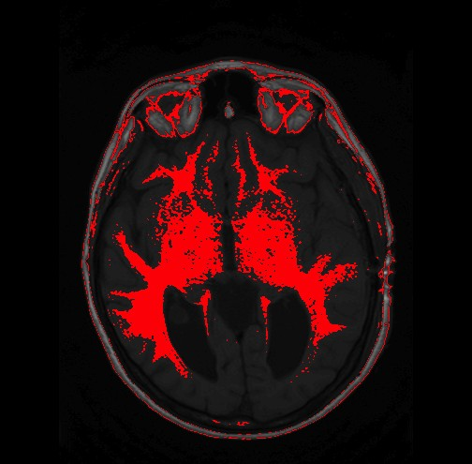
Image Overlays
We can do overlays as well, where we have one image and color it by a second. For example, we plot slice 10 and highlight values between 300 and 400 (next slide we discuss the code):
library(fslr) # need niftiarr
mask = fslr::niftiarr(nii, nii > 300 & nii < 400) mask[mask == 0] = NA
overlay(nii, mask, col.y= c("red"), plot.type="single", z = 10)

Slide 9
Image Overlays: Explained
We load the fslr package, which has helper functions for nifti objects. The nii > 300 & nii < 400 operation returns an array, not nifti object. The niftiarr command takes in a nifti object and array and returns a nifti object with the array in the data slot. We then set any 0 in mask to NA so the overlay (oro.nifti package) will not mask out data.
library(fslr) # need niftiarr
mask = fslr::niftiarr(nii, nii > 300 & nii < 400) mask[mask == 0] = NA
overlay(nii, mask, col.y= c("red"), plot.type="single", z = 10)

Slide 10
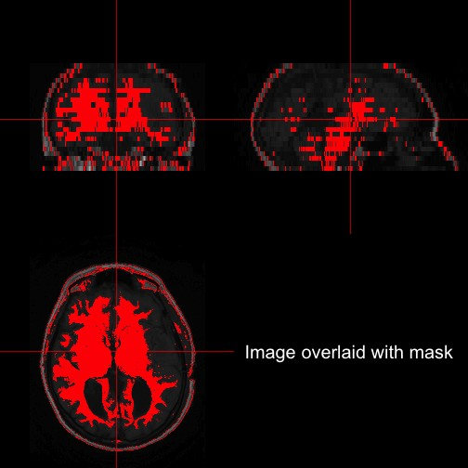
Image Overlays: 3 Planes
We can perform the same operation of overlaying, but in all 3 planes:
orthographic(nii, mask, col.y= c("red"),
text ="Image overlaid with mask")

Slide 11






Functions discussed here
readNIfTI: read in data graphics::image: display matrix data oro.nifti::image: display nifti data
oro.nifti::orthographic: display 3-planes of an image
oro.nifti::overlay: display overlay of 2 images (NA are not plotting in y image)
fslr::niftiarr(x,y: Copy nifti header from object x and put in new array y into data part

