Slide 1
Speed up your AI development with LangChain.js
Generative AI with JavaScript
Notes:
In this session, we’ll see how you can speed up your AI development using the LangChain.js framework.

Slide 2
Developing AI applications
Notes:
The Generative AI field is evolving very fast, and there’s still so much to explore!
When things move fast like this, you need to be able to experiment and iterate quickly. First to validate your ideas with a prototype, then to scale up to production if it works.

Slide 3
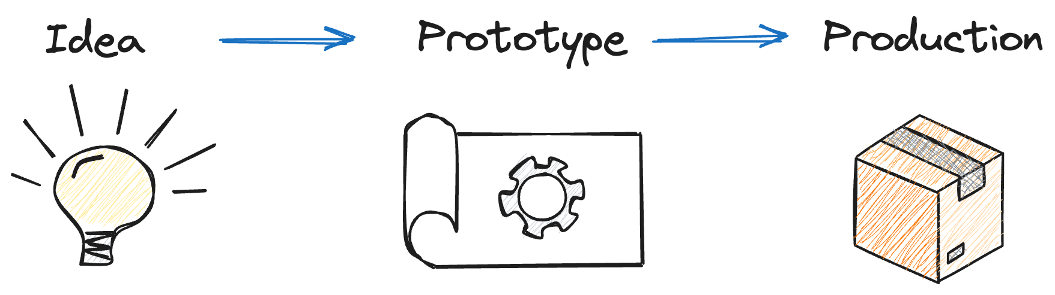
The process of developing AI applications
Developing AI applications
Notes:
The Generative AI field is evolving very fast, and there’s still so much to explore!
When things move fast like this, you need to be able to experiment and iterate quickly. First to validate your ideas with a prototype, then to scale up to production if it works.

Slide 4
LangChain.js
Open-source JavaScript library for working with LLMs
Provides high-level abstractions
models, vector databases, agents…
Bridge between local and cloud-based components
Allows complex compositions of models and data
https://js.langchain.com
Notes:
Let me introduce you to LangChain.js, a JavaScript library for working with large language models (LLMs).
If the name sounds familiar, it's because it's the sister project of LangChain, which is made for Python, and it’s one of the popular open-source project in the AI community.
It's a great tool for experimenting and building generative AI apps very quickly.

Slide 5
What’s LangChain.js?
LangChain.js
Open-source JavaScript library for working with LLMs
Provides high-level abstractions
models, vector databases, agents…
Bridge between local and cloud-based components
Allows complex compositions of models and data
Notes:
LangChain.js is an open-source JavaScript library for working with LLMs
It provides high-level abstraction for all the components you might need when creating your AI application,
And thanks to a compatibility layer it makes it easy to swap components like models or vector database, allowing to quickly switch from local to cloud resources.
It gives you tools to create complex workflows that use your own data, like RAG applications

Slide 6
Core concepts
Notes:
Let’s take a look at some of the core concepts of the framework.

Slide 7
Prompt templates
Inject user input, parameters and context into prompts
main.js
const promptTemplate = ChatPromptTemplate.fromMessages([
["system", "You are a helpful assistant"],
["user", "Tell me a joke about {topic}"],
]);
await promptTemplate.invoke({ topic: "cats" });
Notes:
LangChain includes helpers to create prompt templates.
It allows to inject user input and parameters or augment the context of your prompts dynamically.
In this simple example, we have chat prompt template to generate jokes on a specific topic.
When invoking the template, we can set which topic we want and the placeholder in the prompt will be updated.
This is especially useful when you’re building complex workflows where the prompts is augmented in different steps.

Slide 8
Runnable and chains
Compose processing sequences
main.js
type Joke = { joke: string };
const model = new ChatOpenAI({ model: "gpt-4o-mini" });
const prompt = ChatPromptTemplate.fromTemplate(
"Tell a joke about {topic}. Answer with valid JSON, containing one field: 'joke’”);
const parser = new JsonOutputParser<Joke>();
const chain = prompt
.pipe(model)
.pipe(parser);
await chain.invoke({ topic: "bears" });
Notes:
Now speaking of workflows, Langchain was built to compose complex AI workflows made from multiple processing sequences.
Here we’re using a prompt template with a few components, let’s detail how it works.
First we define a type for the output object that we want.
We initialize a chat model, here using OpenAI’s “gpt-4o-mini”
Next we define our prompt template, where we also ask the output format we want.
Then we create a parser, to transform JSON into an object confirming to the “Joke” type we defined.
And we define our workflow, called a chain. We take our template, pipe it to the chat model to generate the response and pipe the response to the output parser.
Finally, we invoke our chain with our parameter, and will get our object as a result.

Slide 9
Components overview
Component | Usage
Chat models | AI chat completions
Embedding models | Transform text into vectors
Document loaders | Load text from various document formats
Document transformers | Process documents (chunking, tagging…)
Vector stores | Store documents and perform vector search
Store | Store chat history
Retrievers | Get documents
Tools | Functions that can be called by agents
Notes:
Langchain provides many components that you can use to build your AI applications, we’ve already seen a few.
We have chat models, that provides a compatibility layer allowing you to switch between AI models from different providers easily. It makes it very easy to compare different models’ results, or to switch from local to cloud models.
And it’s the same for embeddings, when you need to transform text into vectors.
There are all sorts of document helpers, to load data from various sources and formats, like Office documents, YouTube videos, web pages, GitHub repos and more.
You also have everything you need to process the text from these documents, like splitting it in smaller pieces or autmatically tagging the content to add metadata.
Then we have the stores and retrievers: vectors stores allow you to store documents and perform vector search, while the regular store is used as memory to save your chat sessions. Retrievers can be used to load documents from various sources, including a vector store, to implement the RAG pattern.
Finally we have tools, which are functions that can be called by agents to perform various tasks, like generating an image, executing code, querying an API and more.

Slide 10
Ask YouTube API
Demo
Notes:
Let’s see a practical example of how you can use LangChain.js to quickly create an application prototype that works locally first, and then deploy it to Azure.

Slide 11
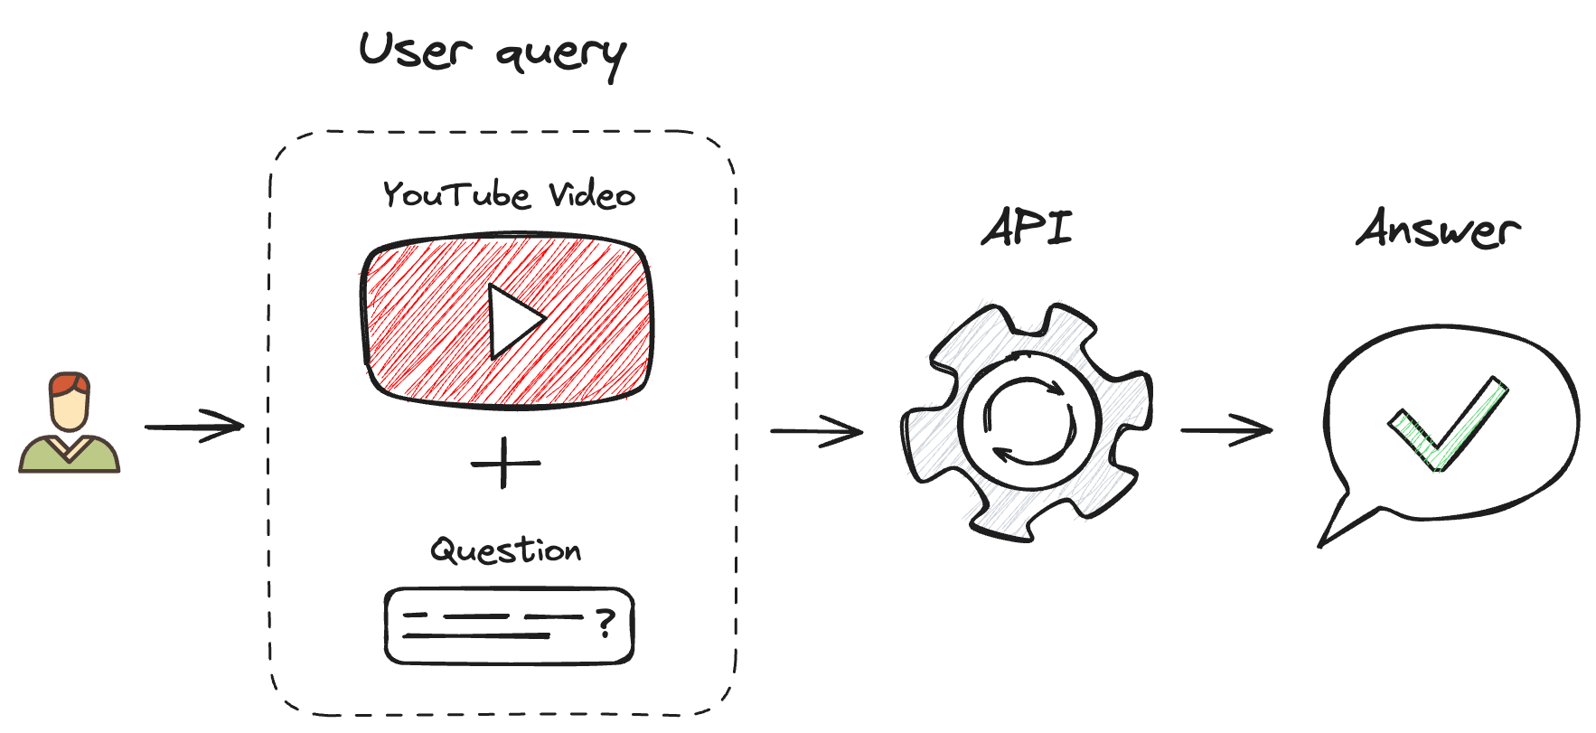
Ask YouTube API workflow
Ask YouTube API
Notes:
For this demo I wanted to build an API where I can send a link to a YouTube video and ask a question, so I can get an answer without having to watch the video.
Let’s see how we implemented that with LangChain.js.
DEMO: open this repo’s code: https://github.com/Azure-Samples/langchainjs-quickstart-demo
open local.js, and explain the code step by step
Run the demo using play button
Update the prototype to use Azure:
Replace model/db imports
Use the imp snippet
Replace the model init section
Use Copilot or newai snippet for the AI Search part
Explain that the models are defined in .env file (show the file)
Replace the embeddings part
Use the sea snippet to first need to check if documents are already indexed
Add snippet (or use Copilot) to complete the embedding part
npm start to run the demo again
We did not have to change any of the workflow logic, as you’ve seen the migration is quite straightforward. Now I can take this code and wrap it in a serverless function to deploy it to Azure.
If you want to take a closer look at this demo, you’ll find the link to the github repo in the video description.
Next session: we’ll detail how you can install and use local AI models on your machine using Ollama, like I just did in the demo.

Slide 12
Resources
LangChain.js docs
Ask YouTube API demo
AI chat with RAG workshop
js.langchain.com
aka.ms/ai/js/ask-yt
aka.ms/ws/openai-rag-qdrant

Slide 13
Microsoft Logo

