Slide 1
What you need to know about LLMs
Generative AI with JavaScript
Notes:
In this session, we’ll review the essential things you need to know when you’re working with LLMs.

Slide 2
LLM
Notes:
First, what’s an LLM?

Slide 3
Large Language Model
Notes:
LLM stands for Large Language Model:
Deep neural network trained on huge amount of data, that’s able to perform various tasks using natural language.
Its main capability is to recognize and generate text

Slide 4
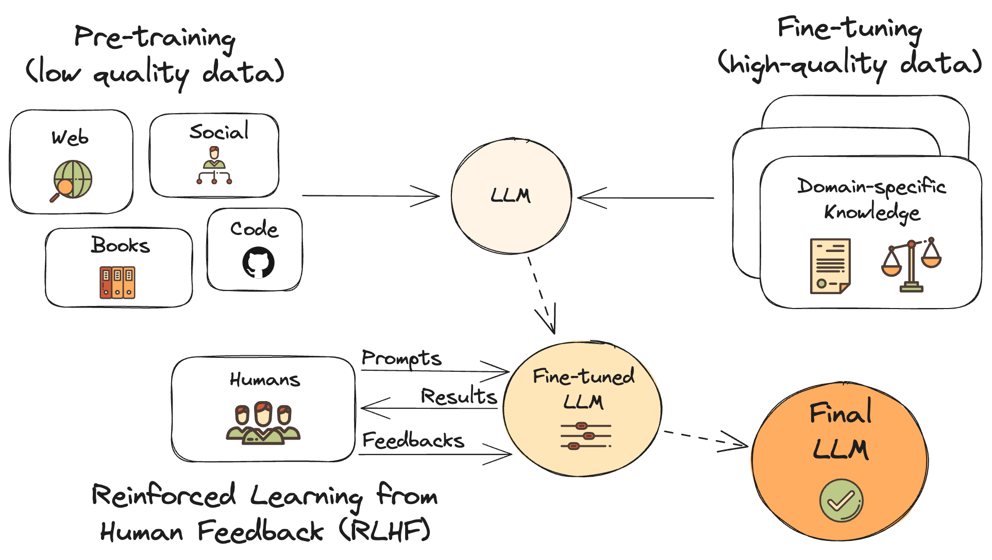
Training
Notes:
How to you create an LLM?
First you take as many data as you can from various sources, and feed it to the model: very expensive $$$ (= fundamental models)
Next, you can fine-tune the model using specialized domain-specific data, and give it more weight: cheap $ (= specialized models)
To improve the quality of the results, you reinforce the training by having humans ask questions and evaluate the results: long and complicated

Slide 5
Model types
Text completion
Instruction-following (a.k.a. chat models)
These models specialize in text completion tasks such as question answering, machine translation and summarization.
<|im_start|>system
You are a professional translator<|im_end|>
<|im_start|>user
How do I translate "hello" in French?<|im_end|>
<|im_start|>assistant
Bonjour<|im_end|>
Notes:
From a practical standpoint, there are two model types.
LLMs do no think: they just complete text
DEMO 1: In empty js file 1. // print hello to the console
2. // prints hello to a DOM element with the id of 'root’
Chat models are tuned to follow instructions.
DEMO 2: in Copilot Chat
create function that prints hello to a DOM element with the id of 'root’
Chat models integrates special tokens to mark specific parts of the prompt. But what’s a token?

Slide 6
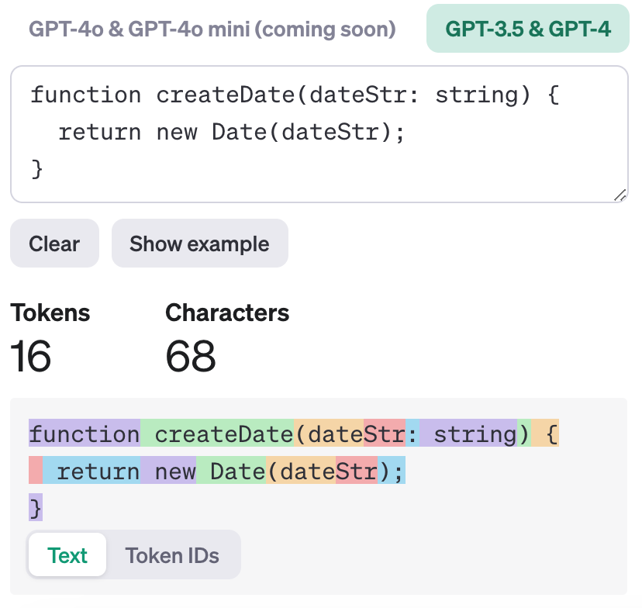
Tokens (1/2)
Tokens
LLM don’t work with words, but with tokens.
Notes:
LLMs don’t work directly using the text you provide, instead they use tokens.
This means that before being able to understand your request, there’s a processing step that transform the input text into tokens, called tokenization.
Here you can see how a piece a code in split into multiple tokens.
Ok, so the text is split in small pieces, but why?
1 token = roughly 4 characters in average
https://platform.openai.com/tokenizer

Slide 7
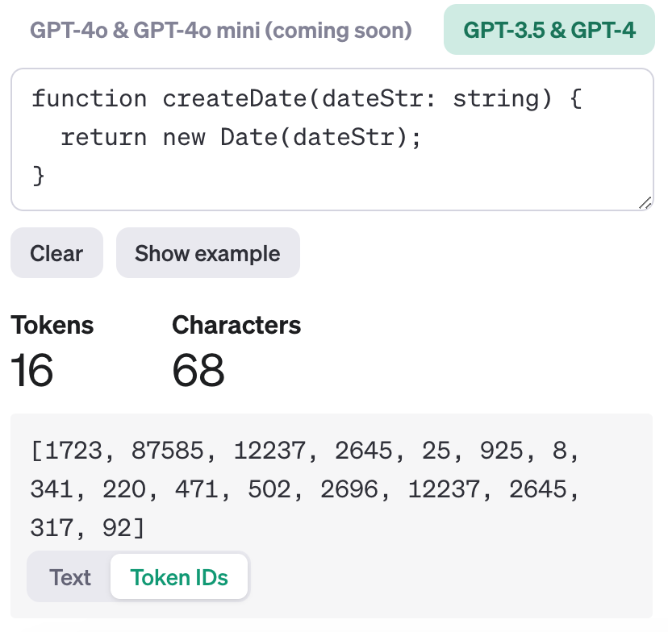
Tokens (2/2)
Tokens
LLM don’t work with words, but with tokens.
Notes:
Tokens are in fact just number, and that’s great because AI models can only work with numbers.

Slide 8
Tokens: text vs numbers
Notes:
For example, the word “function” correspond to this number here. In the end, every AI models is trained on specific vocabulary of tokens, that they use to understand the input text but also to generate the output.

Slide 9
Limits
Context window
4K tokens for common models
128K+ tokens for newer models
= How much text you can use as input
Notes:
Now let’s talk about the limits.
LLMs currently only have a limited amount of tokens that you can use to define the context of your prompts.
This is basically how much text you can use as input.
AI commonly use 2 to 4K tokens, which fits about 3K words or 6 pages of a document.
Newer models can use more than 100K tokens, which can fit entire books!
But the less context you use, the more attention you get which means more accuracy
(context training: O(n^2) complexity)

Slide 10
Mind the bias
Notes:
Another limit to keep in mind: while these AI models are powerful to achieve many tasks, just like humans, they have biases: it’s statistical bias, to be precise. Because the models have been trained on content created by humans, it can sometimes exhibit the same biases as found in the training content. That’s why you should not rely on LLMs for any critical judgment or decision, without taking some mitigation measures.

Slide 11
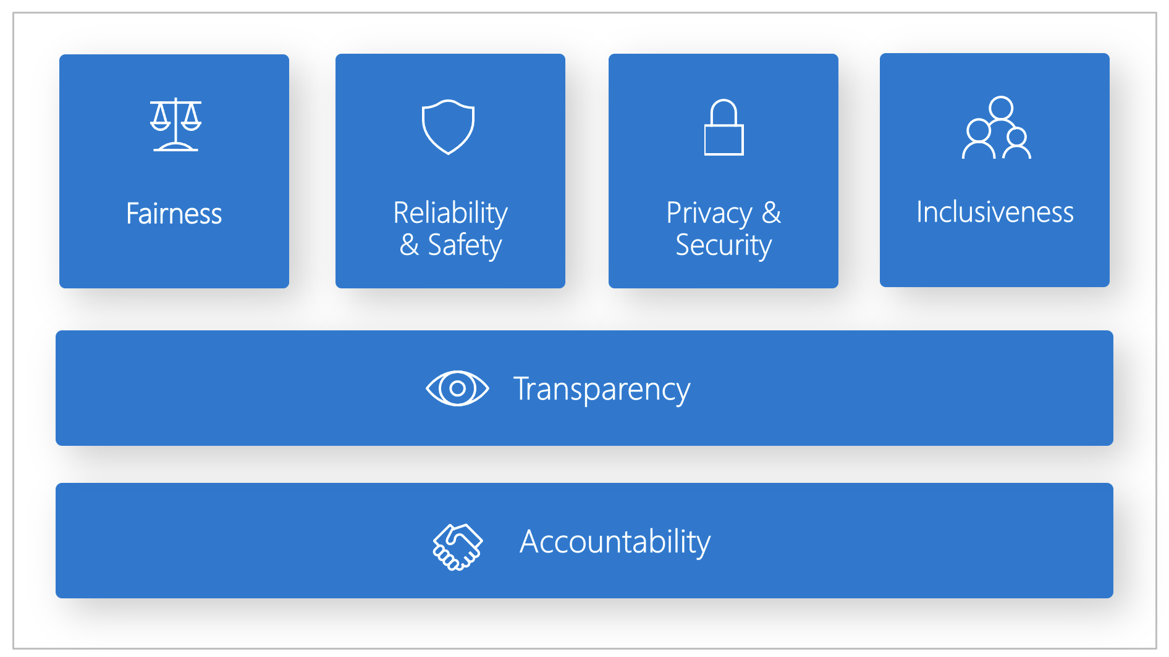
Responsible AI
Learn more at aka.ms/RAI
Notes:
It’s also why at Microsoft we’ve been deeply committed to Responsible AI:
A framework for building AI systems according to six principles: fairness, reliability and safety, privacy and security, inclusiveness, transparency, and accountability.
For Microsoft, these principles are the cornerstone of a responsible and trustworthy approach to AI, especially as intelligent technology becomes more present in products and services that people use every day.
And this is not only for us, it’s something you also have to keep in mind when using AI models to build your own applications.
Next session: essential prompt engineering techniques, that will help you get the best out of AI models.

Slide 12
Resources
Intro to LLMs training
Responsible AI training
Azure OpenAI quickstart
aka.ms/genai/llms
aka.ms/genai/rai
aka.ms/ai/js/azure-quickstart

Slide 13
Microsoft Logo

