Slide 1
Building Generative AI Apps with Azure Cosmos DB
Generative AI with JavaScript
Notes:
In this session, we're going to be talking about building generative AI applications with Azure Cosmos DB in JavaScript. Let's get into it.

Slide 2
Agenda
Vector Indexing in Azure
Azure Cosmos DB for AI apps
GenAI use cases
Demo
Notes:
We'll start by talking about vector indexing options in Azure, then dive into Azure Cosmos DB for AI apps. We'll look at some generative AI use cases with Cosmos DB, followed by a JavaScript demo.

Slide 3




Choosing Vector Indexes in Azure
Vector Indexes in Azure databases is preferred when:
Azure AI Search is preferred when:
You have structured or semi-structured operational data (e.g. chat history, customer profiles, etc) in the database
Simplified architecture for single source of truth that combines vector similarity search inline with database queries. No need to synchronize separated database and vector index.
The workload benefits from mission-critical OLTP database characteristics (e.g. stronger guarantees for availability, performance, and data durability)
You need to index structured/unstructured data (e.g. images, docx, PDFs) from variety of internal and external data sources
Your application requires state-of-the-art search technology for higher search quality (e.g. hybrid full-text/vector search, fuzzy, autocomplete, semantic re-ranking, multi-language, metafiltering)
The workload requires multi-modal search and/or multi-modal embeddings to perform OCR, image analysis, translation, etc.
You're building a Bing-like search experience in a custom application
NoSQL / semi-structured data
PostgreSQL familiarity
Relational data
Cassandra familiarity Data is already in Apache Cassandra
Azure AI Search
Azure Cosmos DB
Azure Database for PostgreSQL (flex)
Apache Cassandra Managed Instance
Notes:
You have many options for choosing vector indexes or a vector search solution in Azure today. You can use any of the Azure database offerings. These are preferable when you have semi-structured or operational data or if you want a single source of truth for your data, performing vector search and retrieval augmented generation for your AI applications using one database.
We also have Azure AI Search, a very powerful service that can be used for vector search, full-text search, or hybrid search. It offers advanced capabilities for better relevancy in the search process and can index files, documents, or data items from multiple sources, such as Cosmos DB, web storage, or Postgres. Azure AI Search can serve as a single indexer over all your data, allowing flexibility across multiple sources.
So, if you want a single source of truth, you can use the database. If you need multiple sources, Azure AI Search is a great choice. These are powerful options for every scenario your application might encounter.

Slide 4
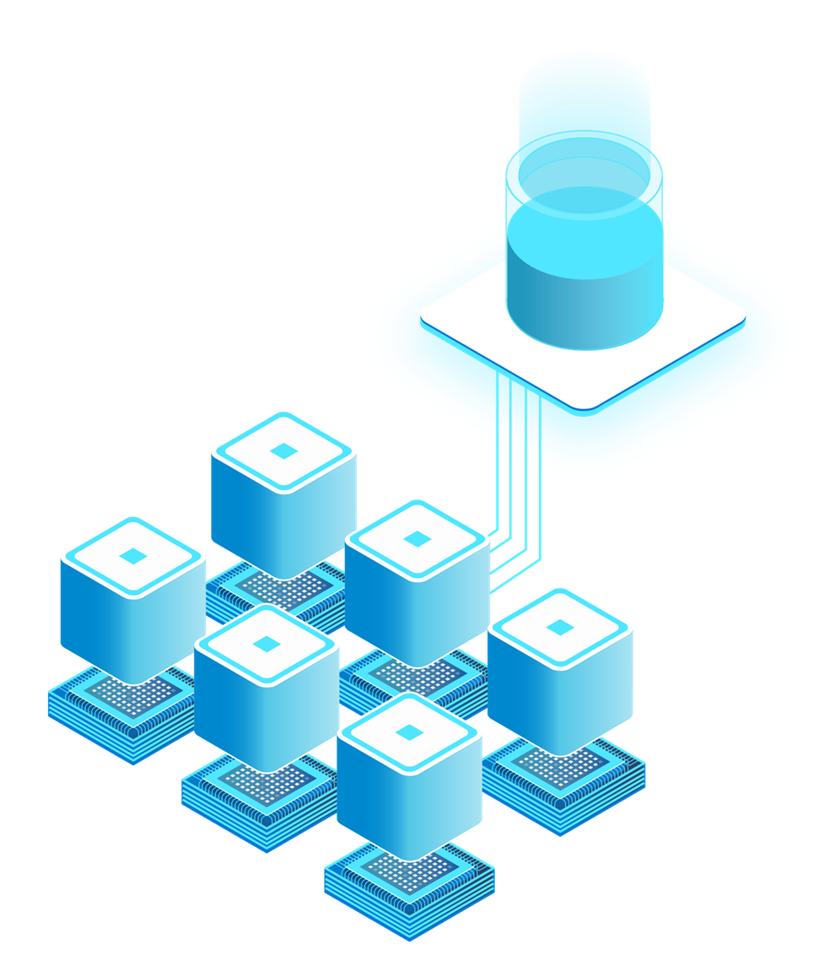

Azure Cosmos DB is a set of highly-scalable & AI-ready databases
Azure Cosmos DB NoSQL
Serverless or Provisioned Throughput
High elasticity with instant autoscale
Low latency, real-time data transactions
Mission critical reliability (99.999%)
Built-in vector index and search with DiskANN
Azure Cosmos DB
for MongoDB
Mongo DB compatible
Provision dedicated compute + storage
Store data + vectors together, keep consistent
Built-in vector index and search (ft. IVF & HNSW)
Notes:
Now, let’s talk a bit about Azure Cosmos DB. We offer two flavors: Cosmos DB for NoSQL, which is our core offering, and Cosmos DB for MongoDB. Both have vector search capabilities and are great for AI applications. Today, we’ll focus on Cosmos DB for NoSQL, which offers multiple options, including serverless and provisioned throughput with auto-scale. You pay for the compute you use, and when demand increases, Cosmos DB automatically scales out and back in as needed.
Cosmos DB for NoSQL also provides low-latency data transactions, often enabling reads and writes in under 10 milliseconds. It offers mission-critical reliability and vector search with a new indexing type called DiskANN, which provides cost-efficient and high-performance vector search at any scale. There are many different scenarios where customers are already building AI applications using Cosmos DB for NoSQL.

Slide 5





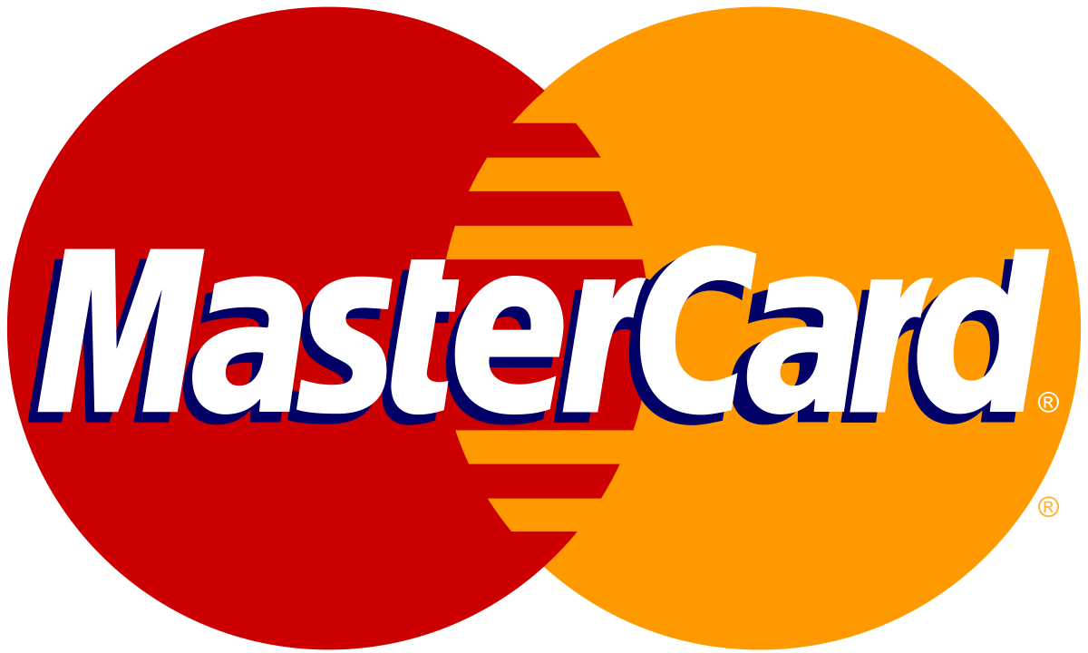
AI scenarios with Azure Cosmos DB for NoSQL
Chat history
Retrieval Augmented Generation (RAG)
Multi-tenant
AI apps
Real-time Recommendations
Real-time
Anomaly Detection
Multi-Agent AI
Notes:
Some common use cases include maintaining chat history for large language models or chatbot applications. This is useful for auditing or providing context in future conversations. Another key use case is retrieval-augmented generation, where the right data is brought in at the right time to personalize your large language model for specific scenarios using vector search. Other examples include multi-tenant apps, real-time recommendations, anomaly detection, and multi-agent AI systems.
Many companies are already using Azure Cosmos DB for NoSQL to build incredible AI applications. For example, OpenAI, TomTom, KPMG, ASOS, and MasterCard, among others.

Slide 6

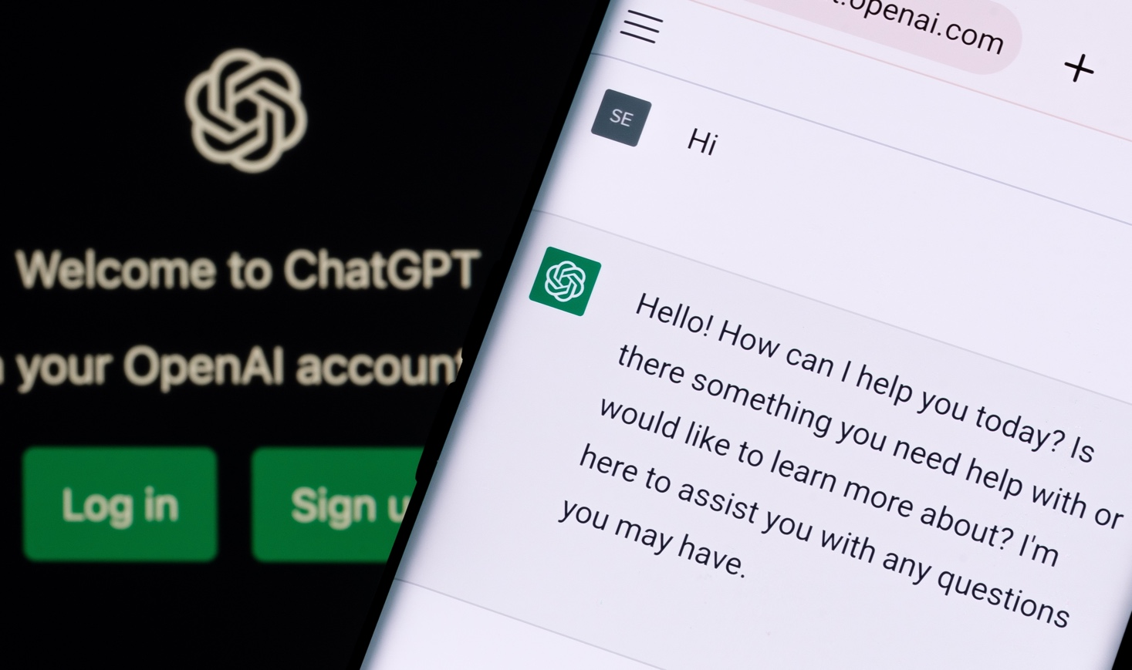

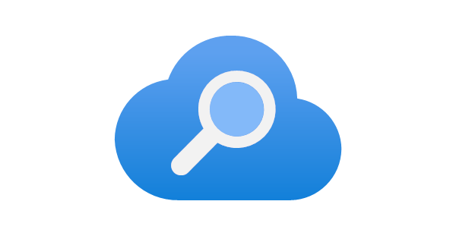
ChatGPT scales with Azure Cosmos DB
OpenAI
Challenge
Meet incredible demand from traffic spikes, without having to worry about database operations
Outcomes
Rapidly and seamlessly scaled as service grew, with zero downtime
Able to iterate fast on data shapes thanks to schemaless flexibility
Maintained high performance and availability
Key Azure products used
Open AI stores ChatGPT conversations and all other user interactions in Azure Cosmos DB, 40+ workloads
Azure Cosmos DB
Azure Kubernetes Service
Azure AI Search
Notes:
Let’s zoom in on the OpenAI scenario. ChatGPT scales very well with Azure Cosmos DB. All of the chat history for ChatGPT is stored in Cosmos DB to maintain session consistency between conversations. OpenAI chose Cosmos DB for its low latency, high availability, and scalable architecture, seamlessly meeting the demands of ChatGPT.

Slide 7
GenAI use cases with Azure Cosmos DB
What
Why
When
a
Drastically reduces latency
Saves on Token consumption
Reduces costs and latency for LLM
Semantic Caching
Slow moving / static content
FAQs, Policies…
Conversational context
UX improvements
LLM optimizations
Auditing
Chat History
A MUST for Chat sessions
Improving cost & performance
Retrieval Augmented Generation (RAG)
Personalize LLM on your data
Cheaper than fine tuning
Faster iteration on new data
Any workload for GenAI apps
Vector + Operational Database
No ETL
Consistent data
Reduce complexity & costs
Data & vectors together
Cosmos DB scale & performance
Notes:
We touched on high-level use cases earlier, but let’s look at some specific examples. One is using Cosmos DB as a vector and operational database in one, meaning you don’t need to store your data in a separate vector database. You can store vectors and data together in Cosmos DB for NoSQL, reducing the complexity and cost of your AI architecture.
Retrieval-augmented generation is another example, where you can bring your own data into a large language model and personalize it for your scenario. Chat history is also valuable for auditing and improving AI models.
Another exciting use case is semantic caching, which plays off retrieval generation and chat history. You can vectorize logged user questions and responses, so if the same or a similar question comes up later, you can use a cached response instead of making a costly API call to a large language model.

Slide 8
Vector Search in Azure Cosmos DB for NoSQL
Store data + vectors together
Reduced Complexity & Cost
Transactional Data & Vectors
Optimized for App Developers
Vector Search
+ Query Filters
Combine with equality, range & spatial filters
Optimize query focus
Flexible
Indexing
Flat, quantized flat, and DiskANN indexing available
Azure Cosmos DB for NoSQL Capabilities
Serverless or provisioned throughput
Built-in multitenancy
Instant & dynamic autoscale
<10ms point-reads
Globally-replicated
Industry-leading 99.999% SLA
Notes:
Now, let’s talk more about vector search in Cosmos DB. With Cosmos DB, you can store both your data and vectors in one place, simplifying your application architecture and reducing costs. You can also apply query filters supported by Cosmos DB’s NoSQL language, such as equality or range filters.
Cosmos DB offers multiple indexing types, from flat or brute-force search to compressed or quantized flat search, and even DiskANN, a new algorithm we're excited to offer. This algorithm was developed by Microsoft Research and is being used in a Microsoft product for the first time, providing very efficient vector search at scale.

Slide 9

Multi-modal database with built-in DiskANN*
Scalable and cost effective, ideal for multi-tenant apps
Vector compression
Storage and graph construction
Algorithms
Large Vectors
{ D1, D2, D3, D4, D5, …, D99, D100 }
RAM
Compressed vectors
Quantization
SSD
Compressed Vectors
{ D1, D2 .., D10 }
Full vectors + graph
Unlimited scale
Low latency
Robust to data changes
Serverless
^{*In preview, GA November ‘24}
Notes:
The way DiskANN works is that vectors are compressed and stored in an in-memory index, while full-fidelity vectors and the graph data structure are stored on high-speed SSDs. This hybrid approach allows for fast, cost-effective vector search, using both RAM and SSDs.

Slide 10
RAG with Azure Cosmos DB & LangChain.js
Demo – aka.ms/ai/js/chat
Notes:
Now let’s have a look at a practical example of using Azure Cosmos DB for RAG using LangChain.js. You may already have seen this support chat application that we built in a previous videos. Here we’re asking support questions, and all the answers comes from PDF data that was ingested and vectorized in Cosmos DB. Let’s take a quick look at how we implemented this. - Open documents-post
Here we have the function that ingest the PDF documents. Let’s skip to the most interesting part. So first we extract the text from the PDF using this component from LangChain.js.
Next, we split the text into smaller chunks, to improve the accuracy and allow multiple chunks to fit into the LLM context.
Then, we need to transform this text into vector, and store them into the database. To do so, first we initialize the embedding model using Azure OpenAI, then we only need a single line here to convert all the chunks into vectors, and store them into Cosmos DB.
That’s because we built an integration for Cosmos DB right into LangChain.js, to make it easier to use it.
Now, to use these documents to perform the RAG process, we go to the implementation of our chat API
First, we initialize everything we need: the embeddings and chat models, then our Cosmos DB vector store integration. We still need to pass the embeddings model here, to be able to convert a question into a vector, so we can perform the vector search.
Next, to use Cosmos DB as our retriever component, we make this call here to say that we want to retrieve the top 3 documents when performing a vector search.
And finally, we invoke the retrieve with the question to do the search, and it will take care of vectorizing the question, doing the search and returning the matching text that we can inject into our context.
Of course you can go further and fully customize the process, like choosing which algorithm you want to use. But if you’re ok with the defaults, it’s as simple as that to use it in your RAG applications.
Next video: We’ll see all the other Azure services and tools that you use for your AI applications.

Slide 11
Azure AI Advantage free offer
Up to $6,000 Azure Cosmos DB free for 90 days¹
Eligibility: customers using Azure AI Services or GitHub Copilot
Why Azure Cosmos DB for Era of AI
AI ready
Guaranteed performance and scale
Flexibility and efficiency
Mission critical
Learn more: Aka.ms/AzureAIAdvantageBlog
*Terms & conditions: Offer available to all Azure customers who are using or will use Azure AI Services (including Azure OpenAI Service), Azure Machine Learning, Azure AI Search) and/or GitHub Copilot. Offer provides 40,000 RU/s for free for a 90 day period. Offer only available where Azure Cosmos DB available. Customers must create a new Azure Cosmos DB account and register via Microsoft Form at https://aka.ms/AzureAIAdvantageSignupForm. Time period: the last day for customers to opt-in for the offer via the signup form is June 30, 2024.
Notes:
Before we wrap up, we’re excited to announce the continuation of the Azure AI Advantage free offer. If you're using Azure AI services or GitHub Copilot, you may be eligible for up to $6,000 of free Azure Cosmos DB credits for 90 days. Check out the link for more details.
Cosmos DB is already very cost-effective, but this offer makes it even easier to bring your AI applications to production.

Slide 12
Resources
Vector search with Cosmos DB
Docs, demos, videos and more
Serverless AI chat demo
aka.ms/CosmosVectorSearch aka.ms/CosmosAISamples
aka.ms/ai/js/chat
Notes:
Next session: We’ll see all the other Azure services and tools that you use for your AI applications.

Slide 13
Microsoft Logo

