Slide 1
Streaming generative AI output with the AI Chat Protocol
Generative AI with JavaScript
Notes:
In this session, we'll cover Streaming Generative AI Output with the AI Chat Protocol.

Slide 2
Agenda
Streaming GenAI output
Introducing the AI Chat Protocol
Usage Sample
Notes:
In terms of what we'll cover, first, we'll discuss Streaming Gen AI Output as a whole. Then we'll introduce the AI Chat Protocol, and lastly, we'll dive into a usage sample.

Slide 3
Streaming GenAI output
Notes:
First, let's cover Streaming Generative AI Output in your application.

Slide 4
Why use streaming?
Streaming is the expectation for GenAI apps
Reduced latency
Enhanced user experience
2 options for implementing
Use a GenAI Inference SDK directly in the browser
Use an AI inference server to stream to your client
Notes:
You might be wondering, why use streaming to begin with? Simply put, it's the expectation for Gen AI apps these days. It results in reduced latency from seeing the output from the model and also an enhanced user experience.
When it comes to streaming, there are two options for implementing it. First, you can use a Gen AI inference SDK directly in the browser. Alternatively, you could use an AI inference server to stream to your client. We'll cover both of them.

Slide 5


Streaming - Inference in Browser
The simplest approach to streaming is by using the SDK in the edge device
For example, using Azure OpenAI SDK for JS in your frontend browser code
Easy streaming to UI
Client (Edge) Device running inference SDK
AI Model Service
Notes:
The first option for streaming is inference in the browser, and this is the simplest one. It's done by using the inference SDK in the Edge device. For example, you could use the Azure OpenAI SDK for JavaScript in the front-end. The front-end would run the inference SDK and directly call the AI model service. This results in easy streaming to the UI, but unfortunately, it ends there.

Slide 6
Browser-side inference is unsafe and not best practice
Security risks
Application limitations
API key exposure
No data sanitization of input
No integration with data compliance
No rate limit/quota handling
No caching for performance
No integration with business logic
No handling of excess data to AI Model service ($$)
Notes:
Browser-side inference is unsafe and not the best practice. From a security standpoint, there's API key exposure in the browser and no sanitization of the input, meaning that users can potentially send malicious content to your model. Additionally, if you have data compliance requirements, there's no integration with that. From an application standpoint, there's also no rate limiting or quota handling, and no caching, which means performance and costs can go up. There's no integration with business logic since you're directly calling the AI model, and as such, no handling of excess data, which can result in more costs.

Slide 7

Streaming – AI Inference Service
A server sits in between the user’s device and the AI Model Service
Clean separation of concerns with AI inference and backend logic
Added challenge: streaming to the client/UI is now tricky
POST /api/chat
Inferencing SDK handles stream to server
Client Browser
AI Inference Service
“Middle Tier” server
AI Model Service
Notes:
The best alternative to running inference in the browser is to have an AI inference service in the middle. This means the server would sit between the user's device and the AI model service. This gives a clean separation of concerns between AI inference and back-end logic. The added challenge here is that streaming to the client and UI becomes tricky.

Slide 8
Streaming is hard!
Select a network protocol for streaming (HTTP, WebSockets, SSE…)
Define an exchange format
Parse the output (hundreds of lines of browser-side JS to write)
How do we stream from server to UI?
Client Browser
Endpoint “Middle Tier”
Notes:
For example, the client's browser could send a POST request giving the chat. The inference service would then handle the call to the AI model service using something like an inference SDK. While getting this stream is easy, we now face the issue of sending something back to the user, which turns out to be very tricky.
First, you need to select a network protocol for streaming, such as HTTP, WebSockets, or Server-Sent Events. From here, you need to define the exchange format of what things will look like when you're sending things back and forth. Lastly, you need to parse the output, which could involve writing hundreds of lines of browser-side JavaScript specifically for your application.

Slide 9
Introducing the AI Chat Protocol
Notes:
Fortunately, we have the AI Chat Protocol, which is designed to solve this problem.

Slide 10
Streaming to UI with AI Chat Protocol
The AI Chat Protocol (JS) is designed to make streaming easy
2 Requirements:
Server uses API Specification
Frontend uses lightweight parsing SDK
One client - AIChatProtocolClient
Two methods: getCompletion + getStreamedCompletion
Now you have easy streaming along with TypeScript models!
Also includes a flexible ‘context’ options bag for any other data needed
Notes:
The AI Chat Protocol is designed to make streaming easy. There are only two requirements. First, your server needs to use the API specification defined by the AI Chat Protocol. From there, the front-end would use a lightweight parsing SDK that we've created.
There's one client, the AI Chat Protocol client, and two methods you can use: the `getCompletion` method and the `getStreamedCompletion` method. The `getCompletion` method is synchronous, while the `getStreamedCompletion` method gives an asynchronous stream that you can iterate through. This provides easy streaming along with TypeScript models. Additionally, if you have any application context you'd like to pass back and forth, we have an options bag for any other data you might need.

Slide 11

For our sample, I would roughly estimate it to remove something between 200-400 lines of code, maybe a bit more because of the parser”
Yohan Lasorsa, Cloud Advocate, Microsoft
Notes:
Here at Microsoft, we create a lot of AI samples, and using the AI Chat Protocol has helped us build things even faster. Yohan Lasorsa, one of our Cloud Advocates, estimates that the AI Chat Protocol removed something like 200-400 lines of code in one of our samples.

Slide 12

Building with the AI Chat Protocol
Server-to-client only design pattern, not server-to-AI model
AI backend choices are flexible
Any orchestration, RAG option, programming language, and language model
AI Chat Protocol
ANY SDK / orchestration / retrieval you want!
SDK
API Spec
Client Browser
Endpoint “Middle Tier”
AI Model of choice
Notes:
When building with the AI Chat Protocol, it's important to note that it's a server-to-client-only design pattern, not server-to-AI model. This means that all of your AI back-end choices are flexible. You can use any orchestration service such as LangChain or Semantic Kernel. You can use any RAG option, such as Azure AI Search or something like pg-vector. You can use any programming language and any language model you'd like.
The way it works is simple. Your client browser would use the lightweight SDK we've discussed. It would send a request to the server that you run, which adheres to the API spec we've defined. Your AI service would then handle any orchestration or RAG or anything else you'd want, receive that output, and send it back according to the AI Chat Protocol. Your front-end browser would then have an easy way to iterate through all of the messages coming through.

Slide 13
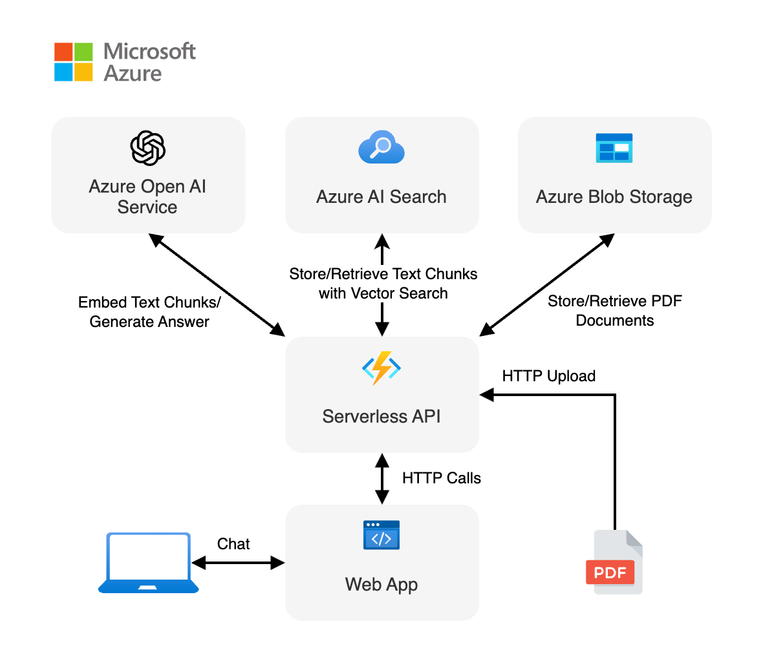
Adding the AI Chat Protocol
Ensure service API conforms to Chat Protocol
Incorporate SDK into frontend code
Enjoy streamed output to the client 🙂
1.
2.
Notes:
Adding the AI Chat Protocol to your application is actually very simple. On the right, we see a diagram with a serverless API that calls Azure OpenAI Service, Azure AI Search, and Azure Blob Storage. The serverless API performs retrieval augmented generation (RAG). We also have a web app that calls this serverless API and handles the content being sent back and forth via a chat interface.
To add the AI Chat Protocol to this example, first, ensure that the service API conforms to the chat protocol spec. Second, incorporate the SDK into your front-end code to easily parse the output. That's it. You can now enjoy streamed output to the client.

Slide 14
Example integration
Sample Code
Notes:
Let's dive into a sample. If you'd like to see the sample, it'll be linked at the end of this presentation.

Slide 15
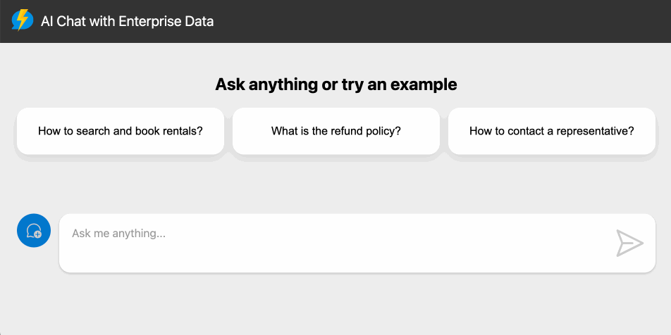
Serverless RAG with Langchain.js Sample
Sample uses the AI Chat Protocol for streaming to UI
2 core pieces:
RAG Service API – Conforms to AI Chat Protocol API Spec
Web App – Uses AI Chat Protocol library
Notes:
The sample we'll be using is a serverless RAG with LangChain.js sample, following the same architecture pattern we saw in the previous slides. The sample uses the AI Chat Protocol for streaming to the UI.
There are two core pieces of the sample. First, there's the RAG Service API, which conforms to the AI Chat Protocol API spec. The web app is the second component, which uses the AI Chat Protocol library. Below, we can see what the UI would look like for a user using this application.

Slide 16
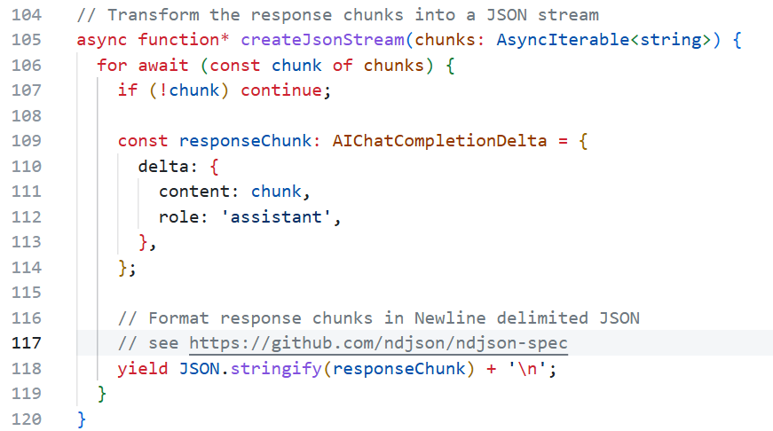
RAG Service API – ndjson Stream
Notes:
First, let's look at the RAG Service API. This function creates a new line-delimited JSON stream, which is what the AI Chat Protocol uses for streaming. It takes response chunks from either a RAG call or an AI model call and transforms them into the stream we'd like. On line 109, we create an AI Chat Completion Delta for each of the response chunks we receive. On line 118, we turn those into JSON strings and send them back one at a time in a generator pattern.

Slide 17
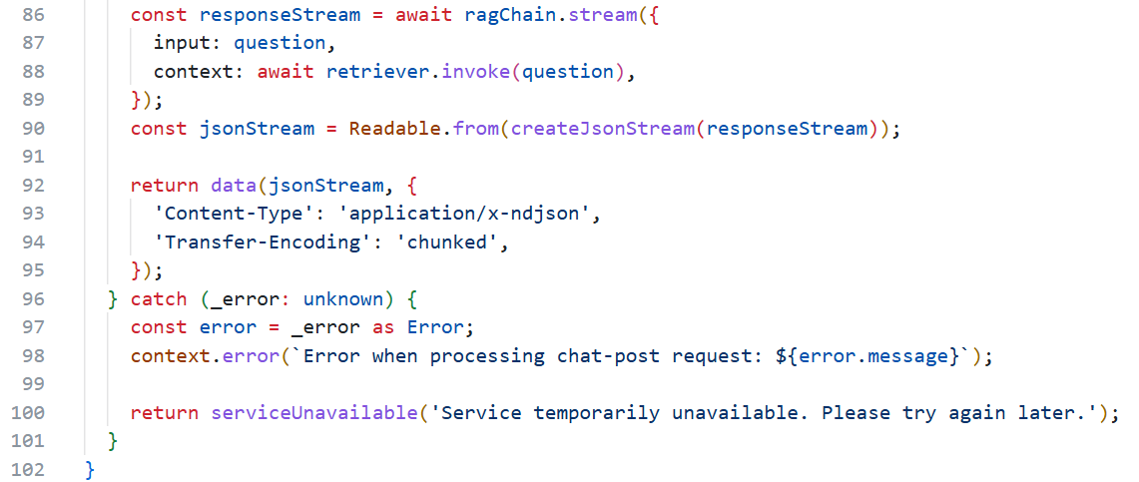
RAG Service API – AI Chat Protocol Spec
Notes:
Next, let's look at the POST endpoint of our API. On line 86, we create a response stream from our RAG chain, which uses LangChain.js underneath. This response stream is formatted into the JSON stream that the AI Chat Protocol API spec uses. On line 92, we return that with the content type application/x-newline-delimited-json, and we set the transfer encoding to chunked. This API now conforms to the AI Chat Protocol.

Slide 18
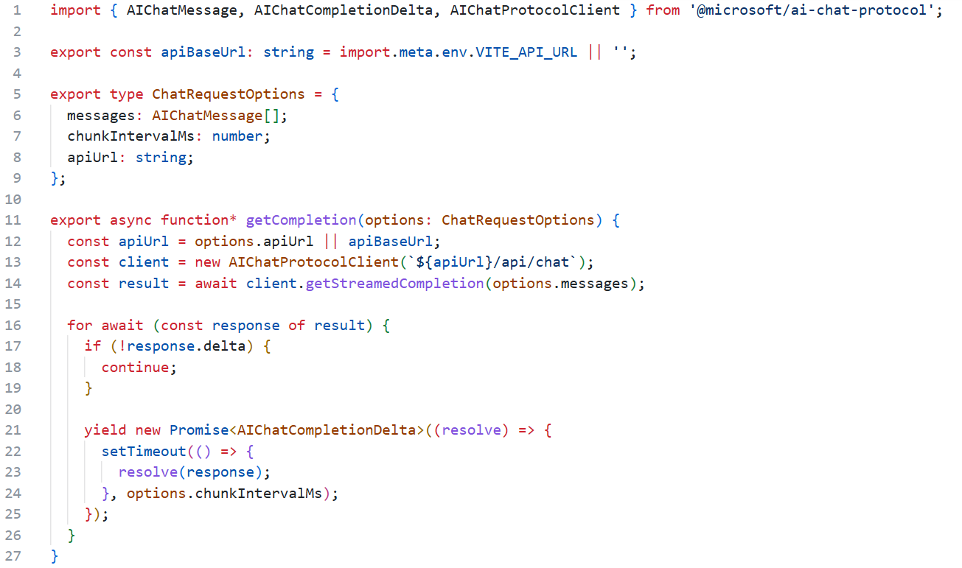
Web App – AI Chat Protocol Library
Notes:
Now, let's jump into the web app. On line 1, we import AI Chat Message, Chat Completion Delta, and AI Chat Protocol Client from the AI Chat Protocol library. On line 5, we set our chat request options. First, we set our messages, which are of the AI Chat Message type. We then set a chunk interval and the API URL for the endpoint that we want to target.

Slide 19
Web App – AI Chat Protocol Library
Notes:
Next, the web app has a function for getting completions, which uses the AI Chat Protocol underneath. On line 13, we take the API URL from our chat request options and set our endpoint URL. On line 14, we use the getStreamCompletion method and iterate over the result on line 16. We ignore everything that's not a delta, and on line 21, we yield a promise. Now, whenever we send a message to the AI endpoint, we get a streamed response in real time. Additionally, it can pass anything we want, such as application logic or context.

Slide 20
Easy streaming with context!
Notes:
That's all it takes to stream generative AI output to your application!

Slide 21
Resources
AI Chat Protocol GitHub
AI Chat Protocol API Spec
Serverless AI Chat sample
aka.ms/aichat
aka.ms/chatprotocol
aka.ms/ai/js/chat

Slide 22
Microsoft Logo

