Slide 1
Improve AI accuracy and reliability with RAG
Generative AI with JavaScript
Notes:
In this session, we’ll discuss how your can improve the accuracy and reliability of your AI outputs using RAG, an advanced prompt engineering technique.

Slide 2
Known AI challenges
Wrong or inaccurate information
Out of date data
Non-authoritative sources
Notes:
When working with AI models, there are some challenges that we’re facing:
LLMs sometimes make mistakes when generating information
The data that has been used to train the models may be out-of-date, or may come from shady or untrustworthy sources
This makes it difficult to tell if a generated information is correct.

Slide 3
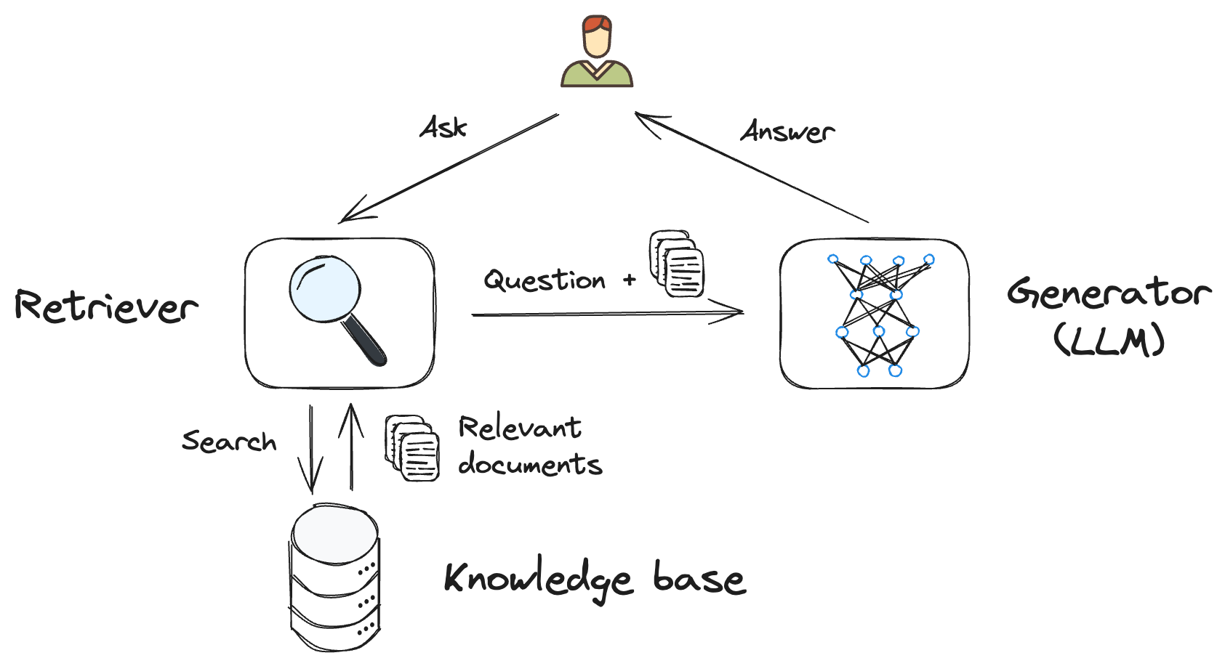
Retrieval-Augmented Generation (RAG)
Combination of a retriever and a generator
Allows for more precise and relevant answers
Notes:
To solve these issues, we can use a technique called Retrieval Augmented Generation, or RAG for short.
RAG is a combination of two components:
A retriever, that will fetch relevant information from a knowledgebase that you control
And a generator, that will create the answer.
This combination allows for more precise and relevant answers, by using data that you provide instead of relying on the model’s training data.

Slide 4
Why RAG?
No training needed
Up-to-date data
Groundedness
User trust
Notes:
Now, why is RAG useful?
It’s cheap because you don’t have to spend money to train expensive models, you can use the existing ones.
You maintain the knowledgebase separately from the AI model, and you can even use multiple data sources. That means that the data that will be used is always up to date.
It generates factual responses using a specific context made of information that you provide, instead of relying on the AI training. Answers are grounded into your context, not the model’s knowledge.
Because you’re able to show what documents were used to generate the response, users can check it by themselves if needed and see that they can have trust in the answers.

Slide 5
RAG workflow
Retrieval-Augmented Generation (RAG)
Notes:
How does RAG works?
The user asks a question
The retriever will search for information in the knowledgebase, and return documents that are relevant to answer the question
Then you send both the question and the documents to the generator, that will create the response based on the information provided
Now, how to implement that?

Slide 6
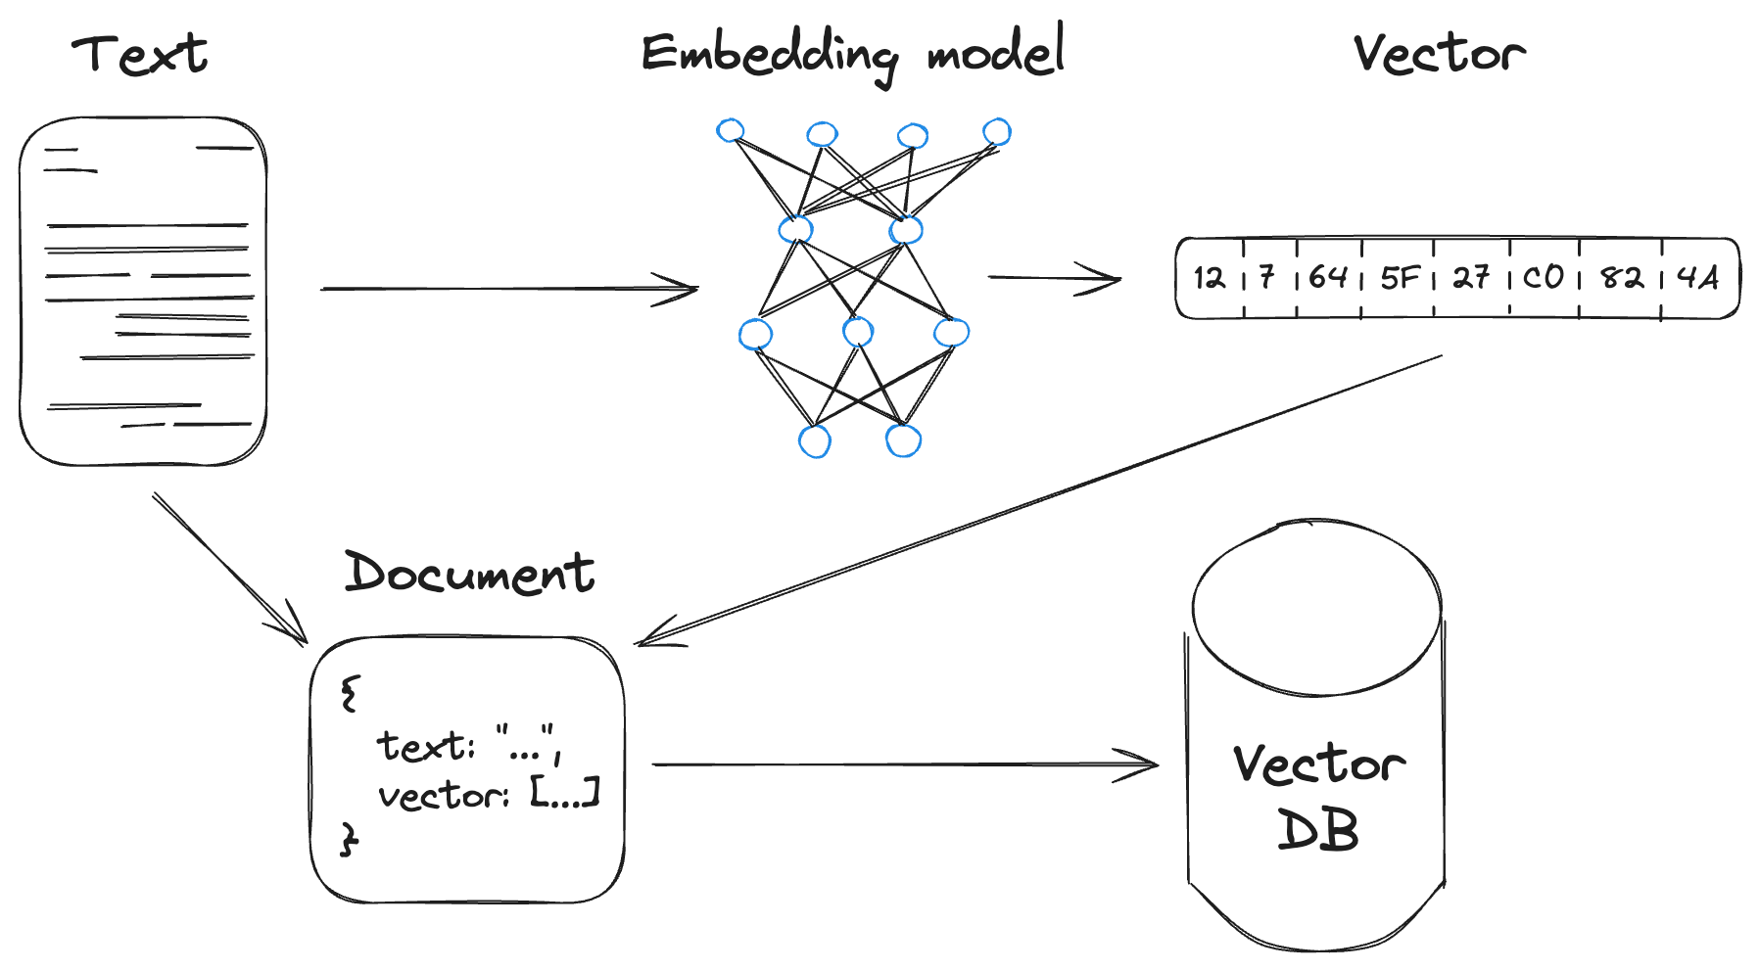
Building the knowledgebase (1/2)
Building the knowledgebase
Create document embeddings from text data to use in the retriever
Notes:
First you have to create the knowledgebase.
You extract text from documents, then send it to a special AI model called an embedding model, that will convert your text into a vector.
Vectors allows to capture the semantic information of the text, as opposed to just capturing the lexical information using the words. Said differently, the meaning of the text is retained, regardless of the language used.

Slide 7
Building the knowledgebase (2/2)
Building the knowledgebase
Notes:
Next, you put together the vector along with the original text to create a document and store it inside a vector database.
You repeat this process for every document that you want to include into your knowledgebase.

Slide 8
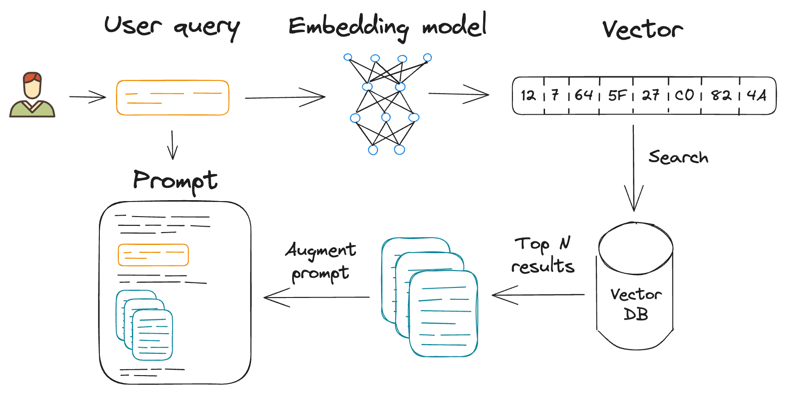
Retrieval and context augmentation (1/4)
Retrieval and context augmentation
Transform the user query into a vector
Search in vector DB for relevant documents
Add found documents to the context
Notes:
Once you have built your knowledgebase, you can perform the retrieval and context augmentation process. This process is done 3 steps.

Slide 9
Retrieval and context augmentation (2/4)
Retrieval and context augmentation
Transform the user query into a vector
Notes:
First, we transform the user query into a vector by sending it to the same embedding model that we used while creating the knowledgebase.

Slide 10
Retrieval and context augmentation
Search in vector DB for relevant documents
Retrieval and context augmentation (3/4)
Notes:
After that, we use the vector to search in our vector database for relevant documents, and we pick the N best results.

Slide 11


Retrieval and context augmentation (4/4)
Retrieval and context augmentation
Add found documents to the context
Notes:
Finally, we take the text from the most relevant documents, as well as the initial user question, and use it to craft the prompt.
It should be something along these lines: “answer the user’s question using the provided documents”
You then send the prompt to the LLM to get your answer.

Slide 12
Company support chat with RAG
Demo – aka.ms/ai/js/chat
Notes:
Let’s have a look at a practical example of using RAG for a support chat application.
DEMO: run the sample aka.ms/ai/js/chat
For the Contoso Real Estate company, we’ve built this experience that allows customers to ask support questions about the usage of its products. Here you’re looking at the final deployed version on Azure, that use a set of company documents in PDF format to answer the questions.
For example, if I ask a question about how the refund policy, we’ll get an answer citing the source documents used to generate this answer.
I can open the document to check it by myself if I want.
Let’s search for “refund”, and here we can the information used to generate the answer.
Now if we try to ask something that’s not in the provided documents, let’s see what happens. “How to deploy this app on Azure?”
It simply says “I don’t know”, because that’s what we told the model to say when it can’t answer a question using the documents we provide.
If you’re interested in this sample, have a look at the links in the video description and be sure to take a look at the other videos in the series to learn how we made it.
Next video: We’ll see how you can speed up your AI developments using the LangChain.js framework.

Slide 13
Resources
Serverless AI chat demo
Implement RAG training
AI chat with RAG workshop
aka.ms/ai/js/chat
aka.ms/genai/rag
aka.ms/ws/openai-rag-qdrant

Slide 14
Microsoft Logo
Notes:
Next video: Improve AI accuracy and reliability with RAG

