Slide 1
Azure tools & services for hosting and storing AI apps
Generative AI with JavaScript
Notes:
In this session, we'll cover generative AI with JavaScript. We'll walk through the Azure tools you'll likely need, along with the various Azure services that make sense to use together with your AI, so you can host and store your AI apps.

Slide 2
Agenda
AI Apps
Tooling, Azure Developer CLI, azd
Architecture, container-based, serverless
Manage APIs in production, Azure API Management
Notes:
Let's look at the agenda for this video and presentation. First off, we'll look into AI apps—what they are and the different types of AI apps you can build, because there is more than one. Then we'll talk about tooling, specifically the Azure Developer CLI (AZD), which is our recommended CLI tool. We'll also discuss architecture, as there are a few different choices. We'll go through container-based and serverless options, without taking a strong stance either way, but explaining where one of them may or may not fit your needs.
Then, we'll talk about managing APIs in production. Getting them into production is great, but you need to track them for cost, fair usage, scaling, security, and a lot of other factors, which we’ll explain in this video.

Slide 3



AI Apps
Chat apps
RAG Apps
Assistant/agent apps
Create chat apps, integrate Azure Open AI
Azure AI Search
Azure Cosmos DB
Azure Open AI
Azure Blob Storage
RAG App + Goal oriented
Azure AI Search, Azure Cosmos DB, Azure Blob Storage
Azure Functions
Notes:
Let's dive into AI apps. There are three major types of apps you could be building as an application developer. First, you might be building a chat app, where you integrate OpenAI—or in this case, Azure OpenAI—with your app. You send a prompt, and you get a response. This works for a lot of use cases.
Often though, you'll want to explore RAG (retrieval augmented generation) apps. This is where you want the ability to interact with your own data and make it searchable. First, you need to identify which part of your data should be searchable, then convert it into vectorized form for search. To handle this, we recommend using Azure AI Search for indexing, Azure Cosmos DB for storing vectorized content, and Azure Blob Storage for your static content like PDFs, Word files, and CSVs. Of course, Azure OpenAI plays a key role in this as well.
Thirdly, you might be building a more advanced AI app—an assistant or agent. Agents can range from simple to complex, goal-oriented, and autonomous. They combine different AI apps' skills, can run functions on your behalf, and do retrieval-augmented generation (RAG). To implement this, you'll be using services like Azure AI Search, Azure Cosmos DB, Azure Blob Storage, Azure Functions, and perhaps an agent-based framework.

Slide 4



Taking your AI to production
Deploy whole solutions to the cloud
Select architecture for your app
Monitor, scale and protect your APIs
A tool like Azure Developer CLI helps you deploy a whole solution
2 commonly used architectures: serverless or container based
Azure Functions
Azure Static Apps
Azure Container Apps
Secure, managed identity
Scale, load balancing
Error management, short circuit patterns and more
Monitor, logs, token usage and more
Notes:
Now, taking your AI to production is an interesting conversation. First, you want to deploy your solution to the cloud. Moving from local environment to cloud is a win. We think the Azure Developer CLI (AZD) makes this process nearly frictionless by deploying an entire solution. But architecture is a key consideration because the architecture you select dictates which services you can use. Most services can be combined, but the main choices are serverless or container-based platforms.
For those unfamiliar with serverless, think of it as event-driven architecture—code runs in response to something happening. Containers, on the other hand, are lightweight, programmatic environments that ensure a consistent experience across development and production. Containers can reduce the risk of bad surprises in production.
Next, let's discuss monitoring, scaling, and protecting your APIs. You're doing this as a business, so security matters. We recommend managed identity over API keys, which lack fine-grained control and flexibility. Managed identity allows Azure to manage identity and access for you.
Scaling is also important, particularly load balancing to ensure the load is distributed evenly. Additionally, you need to plan for resilience. For example, using a circuit breaker pattern can prevent calls to a failing resource for a short period, allowing it to recover.
Lastly, let's talk about monitoring. Deploying to production is great, but you need to stay on top of things. Monitoring logs, tracking token usage, and ensuring you don't overspend are crucial.

Slide 5
Tooling
Notes:
Let’s revisit tooling.

Slide 6

Azure Developer CLI (azd)
Accelerate process: from local env to Azure
Provides
Workflow
Open source CLI tool
Helps you deploy a whole solution
Developer friendly commands
Support in terminal, editor IDE and CI/CD
Select Azure Developer CLI Template
azd init : init project
azd up: package, provision and deploy app
azd deploy: update code or infra, deploy changes
Notes:
The Azure Developer CLI (AZD) accelerates your move from local to Azure. It’s an open-source CLI tool that helps you deploy an entire solution—front-end, back-end, storage, and more. It offers developer-friendly commands and support across terminal, editor, and CICD environments.
Here’s a basic workflow. First, open your terminal and run `azd init` to scaffold your project. You’ll answer some questions about the project, and infrastructure files will be created for you. Then, run `azd up` to package, provision, and deploy your app. Lastly, use `azd deploy` to update code and infrastructure, and deploy those changes live to production.

Slide 7
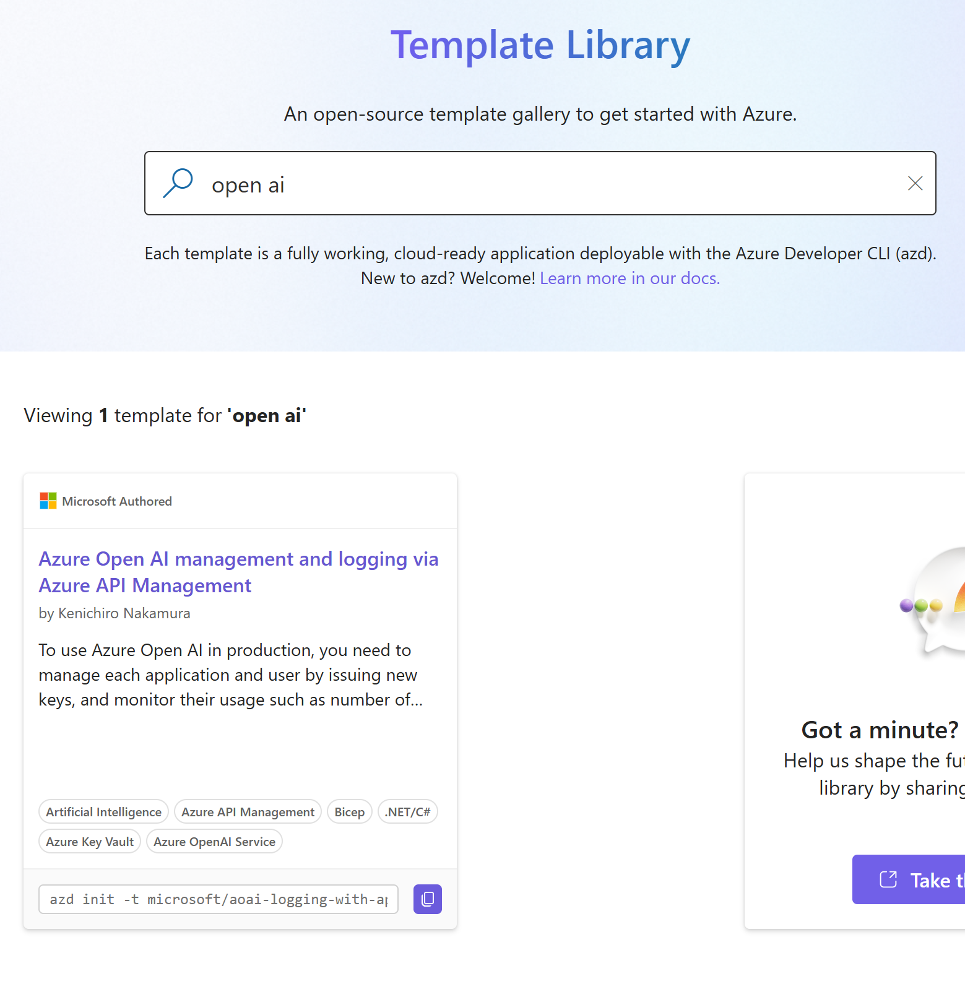
Get started with azd
Find a template:
aka.ms/azd/ai-templates
> azd init -t microsoft/aoai-logging-with-apim
Notes:
AZD makes it easier to get started by using a template library, so leverage that before doing everything from scratch.

Slide 8
Architecture
Notes:
Let’s dive into architecture.

Slide 9


Architecture choices
Architecture
Serverless
Container-based
Event-driven: code that runs when something important happens
Azure Functions
Host Static Apps with serverless backend
Scale from a few to millions of users in the cloud
Containers runs the same in your local environment as in production
Notes:
You have two main options: serverless and container-based. Serverless, like Azure Functions, is event-driven. For example, when you get a new customer, that event might trigger database updates, email notifications, and more. Containers, on the other hand, are programmatic environments that are consistent between development and production. They scale easily, and tools like Azure Kubernetes Service or Azure Container Apps can support millions of users.

Slide 10
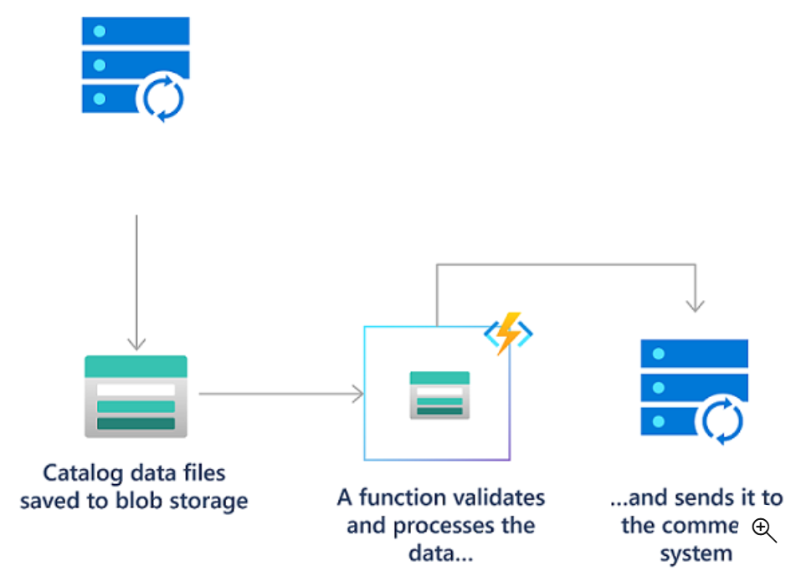
Serverless with Azure Functions
Definition
Run event-triggered code without having to explicitly provision or manage infrastructure
Integrate
Triggers and bindings allows easy integration with other services, e.g HTTP triggers, timer triggers, and many more
Combine Azure products e.g Azure Functions with Azure Container Apps to deploy modern apps and microservices using serverless containers
Notes:
Now that we’ve covered serverless, let’s touch on some key concepts with Azure Functions. A trigger defines when an event happens (like uploading a file to blob storage). Bindings simplify how your function communicates with other Azure services, like inserting data into a database. You can combine Azure Functions with other services, like Azure Container Apps.
For example, a user uploads a file to blob storage. This triggers an Azure Function, which processes the file, then adds data to a queue or sends an email. The point is: an important event occurs, and the function responds.

Slide 11


Azure Static Apps
How it works
Features
Automatically deploys full-stack web apps to Azure from a code repository
Tailored to a developer's daily workflow
Apps are built and deployed based on code changes
Serverless backend with Azure Functions
Global hosting
API Functions
Streamlined build and deployment
Seamless staging environments, dev experience and CI/CD
Notes:
Azure Static Apps is another great option, especially if you start with something simple, like an `index.html` file. As your app grows, Static Apps can support more complex features, including back-end integration with Azure Functions. A great feature of Static Apps is the built-in CICD pipeline with GitHub Actions. Once set up, you can deploy changes through Git and GitHub without needing to interact with Azure again.

Slide 12
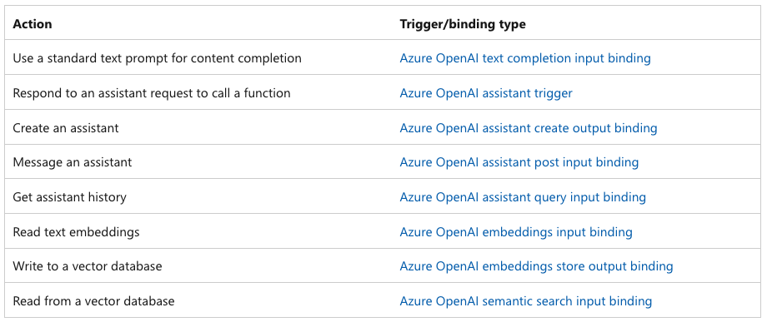
Azure Functions and AI Azure Open AI extension for Azure Functions
https://learn.microsoft.com/azure/azure-functions/functions-bindings-openai
Notes:
Speaking of combinations, you can combine Azure Functions with Azure OpenAI. Triggers and bindings simplify this process, making it easier to build robust AI-driven solutions.

Slide 13

Azure Container Apps (1/2)
Azure Container Apps
Serverless platform
Use for
Platform
Maintain less infrastructure
Save costs, while running container-based apps
API endpoints
Background processing jobs
Event-driven processing
Microservices
Automatic scaling based on
HTTP traffic,
Event-driven processing
CPU or memory load
Supports continuous deployment, code push, app deploy, image build & push, and revisions (immutable snapshot of container app)
Notes:
Next, let’s talk about Azure Container Apps. This serverless platform allows you to run container-based apps while reducing infrastructure management and saving costs. It’s great for API endpoints, background processing, event-driven processing, and microservices. Container Apps scale automatically based on traffic, CPU, or memory load.

Slide 14

Azure Container Apps (2/2)
Azure Container Apps
Integrates with Dapr
Choose your runtime
Rich microservices programming model e.g Observability, pub/sub, service-to-service invocation with mutual TLS, retries and more
Use any runtime, programming language, or development stack of your choice with Azure Container Apps.
Currently, only Linux-based container images can be used
Notes:
It also supports Dapr for microservice communication and provides observability, PubSub, and retries. Choose your runtime and language, and Azure Container Apps will handle the rest.

Slide 15
Scale, monitor and protect app
Notes:
Let’s wrap up with scaling, monitoring, and protecting your apps.

Slide 16


Azure API Management
What
API Gateway
E2E Management
Turn-key solution for publishing APIs to external and internal customers
Allows you to quickly create consistent and modern API gateways for existing back-end services hosted anywhere and
Analyse and optimise your APIs
Secure, scalable, and reliable way of publishing, consuming, and managing the execution of APIs over the Azure platform
Provides all the important tools essential for the end-to-end management of those APIs
Notes:
Azure API Management is a great solution for managing multiple APIs, providing a gateway between user requests and your API. It allows you to set policies for access control, rate limiting, and scaling.

Slide 17
Azure API Management and AI
Companion service
Policies
Azure API Management can be a great companion service
Managing generative APIs means paying attention to cost, fairness of used resources, security, and more.
Token limit policy, manage the token usage across multiple applications. Ensures that a single application does not consume the entire token quota
Emit Token Metric Policy, track token usage across different applications. Helps in calculating cross-charges for multiple applications or teams using Azure OpenAI Service models
Load balancer and Circuit Breaker, distribute the load across multiple Azure OpenAI endpoints. Ensures that the committed capacity in Provisioned Throughput Units (PTUs) is exhausted before falling back to pay-as-you-go instances
Semantic Caching Policy, caches responses from Generative AI models. Improves the performance of your applications by reducing the number of calls to the backend services
Notes:
When working with Azure OpenAI, we recommend putting API Management in front of it. This helps enforce token limits, ensures fair resource distribution, and provides metrics for monitoring usage.

Slide 18
Summary
Azure Developer Tools
azd for deploying whole solution
Select your architecture
Serverless: Azure Static Web Apps, Azure Functions
Container-based: Azure Containers Apps
API Management
Azure API Management (APIM)
Use APIM policies to secure, scale and keep track of cost and usage in production
Notes:
To sum up, Azure Developer CLI (AZD) is our top recommendation for deploying entire solutions. Whether you choose serverless (Azure Static Web Apps or Azure Functions) or container-based architecture (Azure Container Apps), you now have a mental model of both options. And once your app is in production, we recommend putting API Management in front of Azure OpenAI to secure it, manage costs, and track usage effectively.

Slide 19
Resources
APIM with OpenAI sample
GenAI gateway with APIM
Azure for JS developers
aka.ms/genai-apim
aka.ms/genai/apim-ai-gateway
aka.ms/js/azure

Slide 20
Microsoft Logo

