Slide 1
留下来的理由
A REASON TO STAY · National Day Special SG61
Under One Roof 《同一个屋檐下》
Storyboard & Shooting Deck
Target release: Aug 8 evening / Aug 9 · 12 scenes · 19–22 min · Dialogue: Chinese + Singlish

Slide 2
The Topic
A livelihood-level topic (not a petty issue)
Almost every working Singaporean has secretly done the emigration math: same work, elsewhere — more money, bigger home, less pressure. Staying is not a default; it is a choice remade every day.
What the viewer privately feels (source of the hook)
“I complain about this place daily, I have calculated leaving, and I am still here — why?” Complaining is our love language. National Day week is when this question hums loudest and gets said least.
Emotional arc: Problem → Hope
The spreadsheet says leave → the unquantifiable column says stay. No propaganda, no cynicism.
Story engine
Angeline receives a real KL offer: 40% more profit, half the rent. She gives the household two weeks: “Name one reason to stay — and don't say food.” Deadline: Aug 9, after the fireworks.
Spice (seasoning, never the main course)
Joseph loses a client to a cheaper vendor (outsourcing) · third revision free of charge (price squeeze) · rent-discount negotiation (landlord gag)
Deadpan iron rules
Nobody cries on camera — the audience does. Only two camera moves in the whole episode (S5 push-in, S10 pan).

Slide 3
Background & Art Direction
Overall mood
HDB-heartland National Day week: flags along the corridor, rehearsal on TV, red-and-white outfits. Patriotism is never spoken — it hides in the props.
The whiteboard
The through-prop. S1 sets up the two-column comparison (Singapore vs KL); it is never erased; S12 closes on the added line 「屋檐 x 1 (会升值)」. Continuity is critical.
The flag
Good condition, correct display (front facing out, never touching the floor). Display during the National Day period is standard practice; for any shoot outside the period, check current guidelines first.
TV / NDP footage
Copyright-conservative: TV screen soft-focus or audio only. Never re-film broadcast footage directly.
Red & white wardrobe
From S10: Joseph in full supporter kit (clapper, cheek sticker) · James in a red polo (he claims coincidence) · Angeline in white (restraint).
Props list
Flip chart + stand · printed spreadsheet with handwritten rows · “TOP SECRET” agenda sheet · a table of home-cooked local dishes · kaya toast breakfast · 2 fake WhatsApp screenshots · small handheld flags
Standing rule unchanged: NO bedroom scenes. Every location = living room · dining · open kitchen · entry/corridor · window.

Slide 4
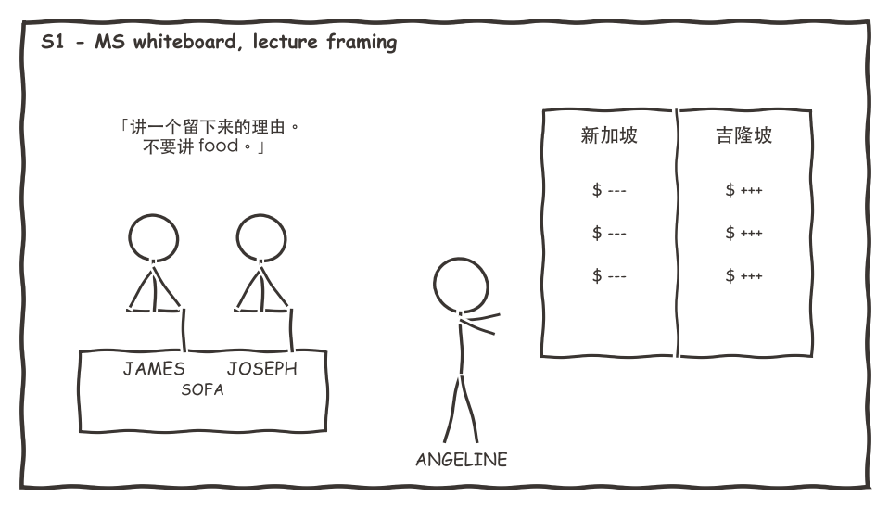
SCENE 1 · The Ultimatum
Living room · Night · ~1:45
The beat
Angeline lays out two columns on the whiteboard: KL wins on every number. She gives the household two weeks to name one reason to stay — food and safety don't count.
Background / set
Living room, everyday state. Whiteboard with the two-column numbers (fictional offer — never quote real market data).
Key lines (Chinese — as spoken)
「讲一个留下来的理由。不要讲 food。」
「这个不是 negotiate。是 ultimatum。」
Shots
① MS whiteboard + Angeline, lecture framing — her home turf ② two-shot sofa reactions ③ CU the two columns → title card
Props: Whiteboard + marker · two bowls of supper

Slide 5
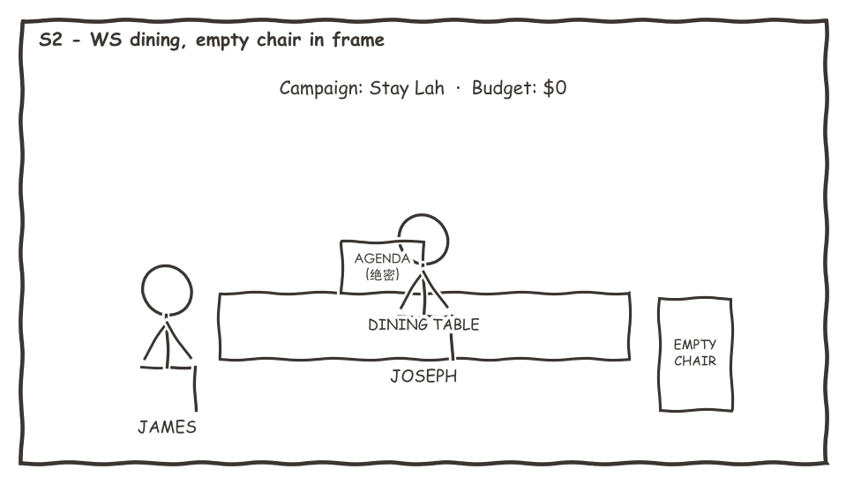
SCENE 2 · The Committee
Dining · Day · ~2:00
The beat
The two men convene “Campaign Stay Lah” — budget zero, motives entirely selfish (rent income, cheaper shared utilities). They resolve to find nobler reasons than their own.
Background / set
Dining table + printed agenda comically stamped TOP SECRET. Angeline's empty chair stays in frame — the empty seat is part of the joke.
Key lines (Chinese — as spoken)
「Zero budget 的 campaign 叫做祝你好运。」
「我们需要比我们自己高尚的理由。」
Shots
① WS dining table, empty chair in frame ② CU the minutes: “Campaign Stay Lah” ③ singles as each confesses his real motive
Props: Agenda sheet · notebook · pen

Slide 6
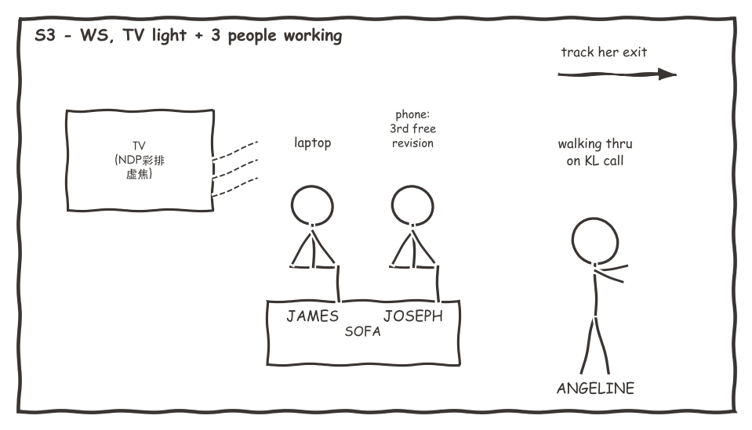
SCENE 3 · Rehearsal On TV
Living room · Day · ~1:45
The beat
NDP rehearsal songs play while all three work overtime: James drafts a listing, Joseph does a third free revision, Angeline walks through on a KL call. The song's ideals vs the reality in their hands.
Background / set
TV soft-focus or audio-only (copyright). Each character has an “overtime prop”.
Key lines (Chinese — as spoken)
「这首歌的时候，我还相信我会有 landed。」
「现在我帮别人卖 landed。」
Shots
① WS three people, three tasks, TV glow ② CU phone: “free of charge” ③ follow-focus on Angeline walking out
Props: Laptop · phone · earpiece

Slide 7
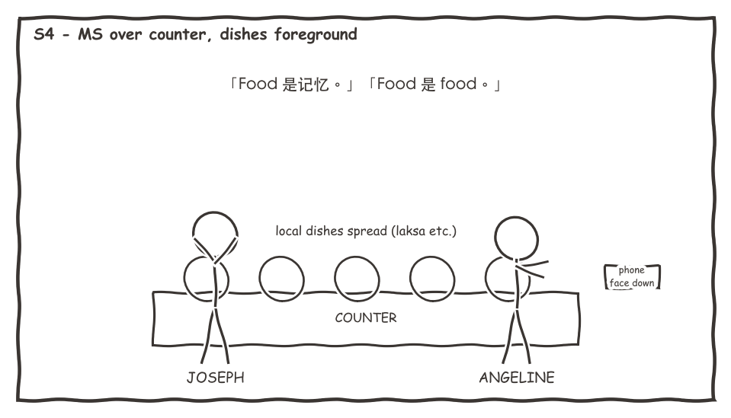
SCENE 4 · Food Is Not Food
Open kitchen · Night · ~2:00
The beat
Joseph cooks a full local spread and argues food is memory; Angeline counters with blind-test data. Mid-scene his phone buzzes: a client is switching to a cheaper vendor — outsourcing just reached him.
Background / set
Counter covered in home-cooked local dishes — generous but homely, not restaurant plating. Prepared fake message screenshot.
Key lines (Chinese — as spoken)
「Food 是记忆。」——「Food 是 food。」
「KL 的 laksa 便宜三成。」
Shots
① MS over counter, dishes foreground ② shot/reverse-shot argument ③ CU message (one readable flash) → phone face-down
Props: 5–6 local dishes · phone (fake screenshot)

Slide 8
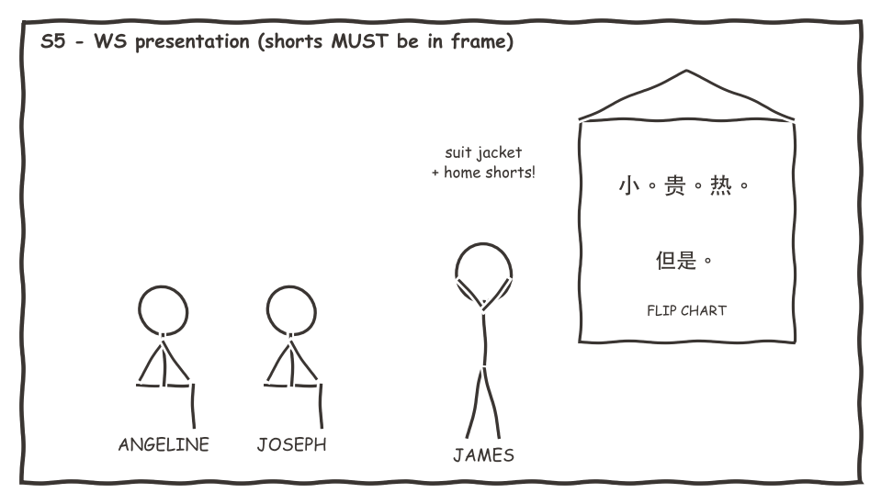
SCENE 5 · Pitching The Country
Dining · Night · ~2:30
The beat
James presents “Singapore” as a property on a flip chart — flaws first (small, expensive, hot), because an agent who leads with flaws can be trusted. He closes with the one selling point not on the chart.
Background / set
Dining area dressed as a presentation venue: flip chart, oversized handwriting, property-launch styling. James wears suit jacket + home shorts.
Key lines (Chinese — as spoken)
「先讲缺点的 agent，你才能信。」
「这个，是我唯一真的住过的。」
「但是光不能付 KL 的两倍薪水。」——「对。」
Shots
① WS full presentation (shorts MUST be in frame — the episode's biggest visual gag) ② CU each flip-chart page ③ slow push-in on the final line — first camera move
Props: Flip chart + stand · suit jacket + shorts · marker

Slide 9
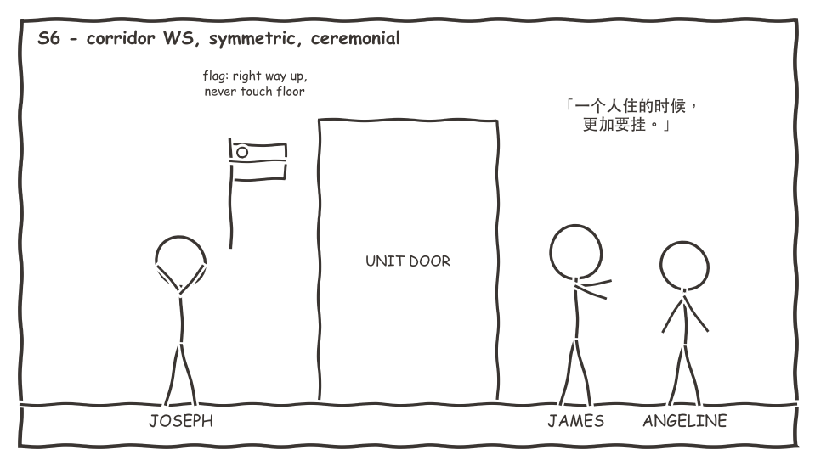
SCENE 6 · Hanging The Flag
Corridor/entry · Day · ~1:45
The beat
James directs the flag-hanging like a ceremony and lets slip he hangs it even when living alone. Joseph recalls a client office gone to KL — then realises whose argument that helps.
Background / set
Unit entrance + corridor. Flag in good condition, displayed correctly on camera (front out, never touching the floor).
Key lines (Chinese — as spoken)
「一个人住的时候，更加要挂。」
「……但是他们 CEO 很后悔！听讲的。」——「听讲的。」
Shots
① corridor WS, symmetric, ceremonial ② CU flag positioning ③ Joseph's story: single MS, flag soft-focus behind
Props: One national flag (good condition) · fixtures

Slide 10
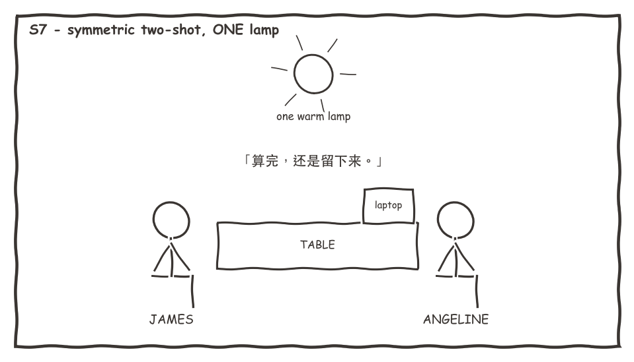
SCENE 7 · James's Math
Dining · Late night · ~2:15
The beat
No agenda this time. James admits that in his worst year, 2019, he ran the Perth numbers — and the numbers won. The episode's core line lives here.
Background / set
One warm lamp only. Lighting contrast: laptop's cold light on her face vs warm lamp on his.
Key lines (Chinese — as spoken)
「每一个留下来的人，都不是没有算过。」
「是算完，还是留下来。那个差别，就是理由。」
Shots
① symmetric two-shot across the table — the core conversation ② CU James on the key line ③ end on her not looking at the laptop
Props: Laptop · water glass

Slide 11
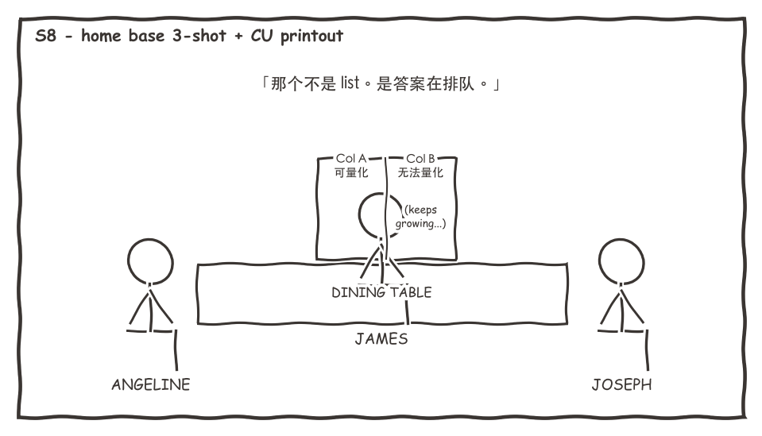
SCENE 8 · The List That Grows
Dining · Day · ~2:00
The beat
Angeline processes feelings the only way she knows: a printed spreadsheet. Column A (quantifiable): KL wins. Column B (unquantifiable) keeps growing on its own — which offends her as an analyst.
Background / set
Printed spreadsheet must survive a close-up: Column B full of handwritten rows (mum's Sunday dinner, the O Level students, the mama shop uncle).
Key lines (Chinese — as spoken)
「我删掉一行，它自己长两行。」
「那个不是 list。那个是答案在排队。」
Shots
① home-base three-shot ② CU handwritten Column B rows ③ Joseph's line: single MS
Props: Printed spreadsheet (handwritten rows) · pen

Slide 12
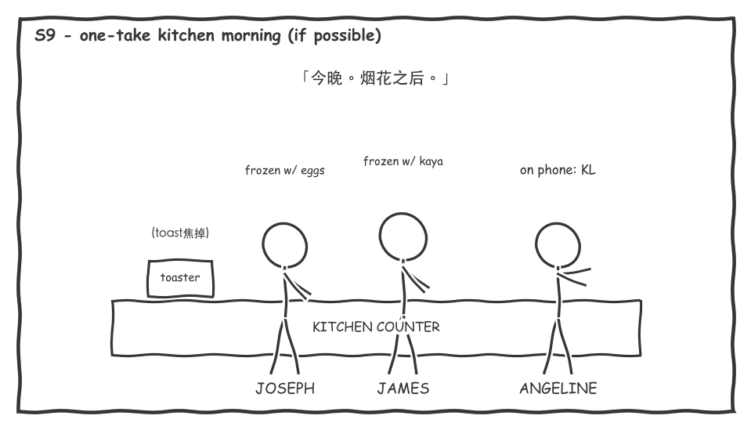
SCENE 9 · The Morning Of Aug 9
Open kitchen · Day · ~1:30
The beat
National Day morning, kaya toast breakfast. KL calls for the answer; she says tonight — after the fireworks. The men freeze mid-task; the toast burns.
Background / set
Breakfast reality: toaster, kaya, soft-boiled eggs, kopi. National Day radio programming as off-screen audio.
Key lines (Chinese — as spoken)
「今晚给你 final answer。烟花之后。」
「要看它会不会骗到我。」
Shots
① kitchen blocking in one continuous take if possible ② CU answering the phone ③ CU burnt toast (the laugh)
Props: Toaster · kaya · eggs · kopi cups · phone

Slide 13
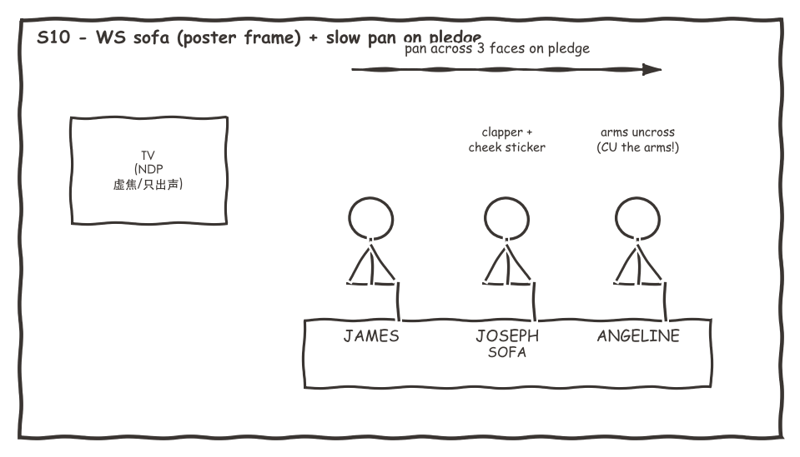
SCENE 10 · Watching The Parade
Living room · Evening · ~2:30
The beat
Red and white on the sofa; deadpan commentary (jets = flying revenue) — until the anthem and pledge, when muscle memory betrays all three: they straighten up and recite without deciding to.
Background / set
TV soft-focus/audio-only (as S3). Joseph in full supporter kit; James in red polo (“coincidence”); Angeline in white.
Key lines (Chinese — as spoken)
「六架。一秒钟飞掉我 centre 十年的 revenue。」
「……我还记得。」
「问题是念的时候，心里有没有东西动一下。」
Shots
① WS sofa three-shot (trailer frame) ② pledge segment: slow pan across three faces — second camera move ③ CU her arms uncrossing (shoot the arms, not the face)
Props: Red/white outfits · small flags · clapper · cheek sticker

Slide 14
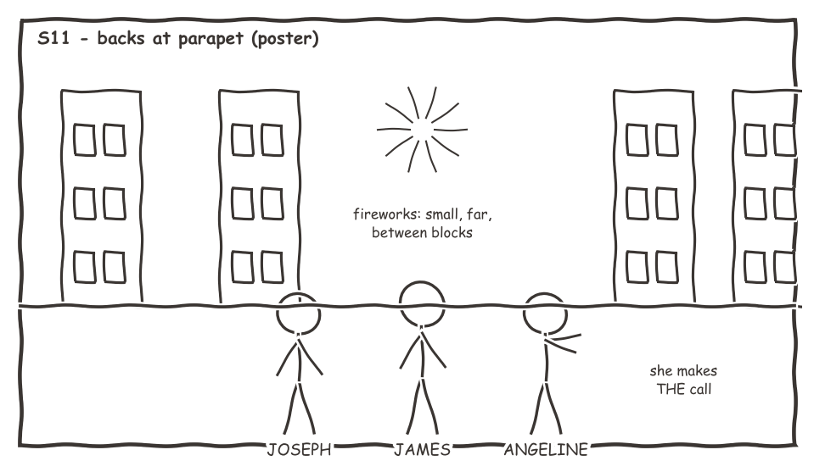
SCENE 11 · After The Fireworks
Corridor · Night · ~2:30
The beat
How most of the country actually sees the fireworks: small, far, between blocks. Facing them, Angeline calls KL and declines — with a businesswoman's reason, not a sentimental one. Then one more reason, off the record.
Background / set
Parapet + fireworks in the block gap. If not shootable live: clean plates for compositing, or “heard but not seen” (arguably truer). Wardrobe: half-changed back into home clothes — keep this detail.
Key lines (Chinese — as spoken)
「我卖的东西，我自己都不信——这种生意做不久的。」
「我的房东会哭。」——「我不会。」(he cries)
Shots
① three backs at the parapet WS — the poster frame ② her call: side MS, men pretending to watch ③ final faces in fireworks light, hold until the sound ends
Props: Phone · clapper (rehearse the one involuntary clap)

Slide 15
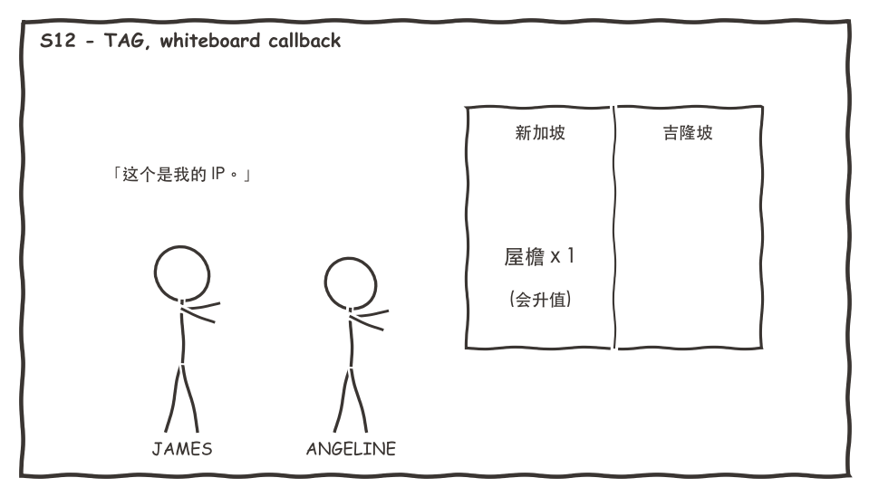
SCENE 12 · Tag · The Whiteboard
Living room · Night · ~1:00
The beat
The two columns from S1 are still up. Under 「新加坡」 she writes 「屋檐 x 1 (会升值)」 — borrowing James's EP1 joke — then immediately negotiates a loyalty discount on her rent renewal.
Background / set
Late night, one lamp. The whiteboard is the star and must still carry Scene 1's writing (continuity!).
Key lines (Chinese — as spoken)
「这个是我的 IP。」——「你要收 royalty？」
「留住一个旧的，比找一个新的便宜。你自己教我的。」
Shots
① MS whiteboard + her writing ② two-shot exchange ③ CU whiteboard, cut to black → end card
Props: Whiteboard (S1 writing preserved) · marker

Slide 16
Shorts Plan (6 vertical clips)
Release rhythm follows the holiday: hook clip before the episode, emotional clips on the day. Long-form builds loyal viewers; shorts get us discovered.
S1 · “Don't say food”
45s · release Aug 6–7 (hook, pre-episode)
S5 · Pitching the whole country
60–90s · strongest share clip, post-episode
S7 · “Everyone has done the math”
60s · emotional resonance clip
S8 · “Answers queueing up”
45s · quotable clip
S10 · Three reciting the pledge
60s · release ON National Day
S11 · “My landlord will cry”
45s · laugh-then-cry share clip

Slide 17
Countdown (release Aug 8–9)
Jul 27–29: James's read-through + line adjustments → locked script. One full table read (anyone who breaks laughing: retake)
Jul 30–31: art dept ready: whiteboard columns, flip chart, printed spreadsheet (handwritten rows), fake screenshots, flag condition checked, red/white wardrobe
Aug 1–2 (weekend): 2-day shoot — Day: S2/S3/S6/S8/S9 · Night: S1/S4/S5/S7/S10/S11/S12. If fireworks unshootable, capture clean plates for compositing
Aug 3–6: edit + Chinese subtitles (mandatory for overseas Chinese-language platforms). TV footage handled soft-focus/audio-only
Aug 7: James reviews the cut (gate: nothing releases before his OK). Aug 6–7: S1 hook short goes out first
Aug 8 evening or Aug 9: full episode release. Aug 9: S10 pledge short on the day. Per house rules: no public post without James's explicit OK
Fact discipline: all numbers fictional ✅ · flag display guidelines confirmed before shoot ⚠ · NDP footage copyright handled conservatively ⚠

