Slide 1
Exploring the Relationship Between Weather Conditions and COVID-19 Rates
Angel Martinez | Jordan Tasho | Matthew Saephan

Slide 2
Discovery
Notes:
We want to find a re

Slide 3
Our Plan
Goal
Find a relationship between Covid & Weather Conditions
Success
Find significant evidence that
<weather variables> increase/decreases covid rates
Failure
Can't find significant evidence of a relationship
Important Features
covid cases & deaths
weather
temp
percip
humidity
dew
etc

Slide 4
Data Prep

Slide 5
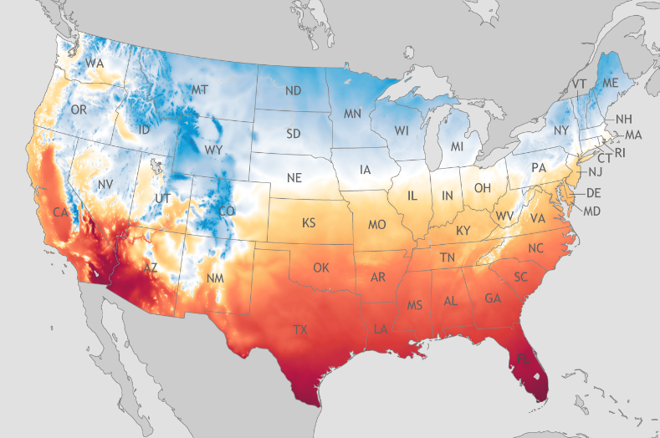
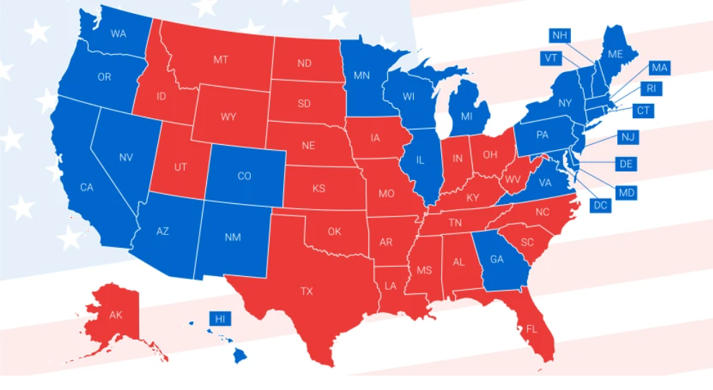
Data Collection
Cities
Jacksonville, Florida
Los Angeles, California
Detroit, Michigan
New York, New York
Houston, Texas
Red & Blue States
Located at different regions of US
Generally considered Hot or Cold

Slide 6
Joining Data & More Variables
Datasets
Covid data (for each city)
Weather data (for each city)
More Variables
Seasons
Political Color
US location
General temp
Weather it rained or not
New_cases
today cases - yesterday
Cases_growth
new_cases / yesterday cases
Incubation
Got the average incubation period across different variants of covid (5 days)
Shifted covid dates back 5 days
Then Joined covid data set with weather according to date

Slide 7
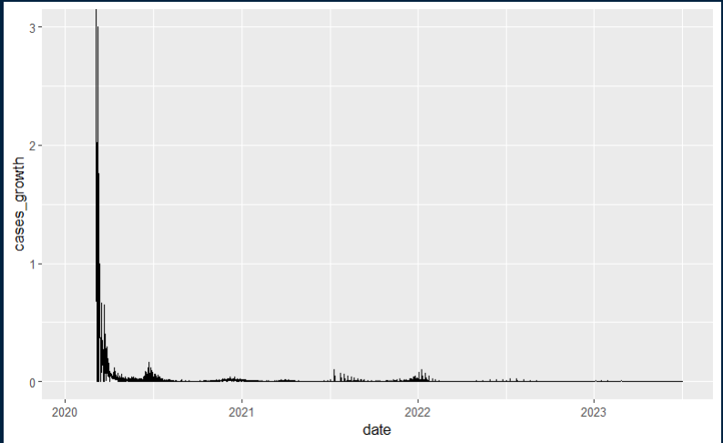
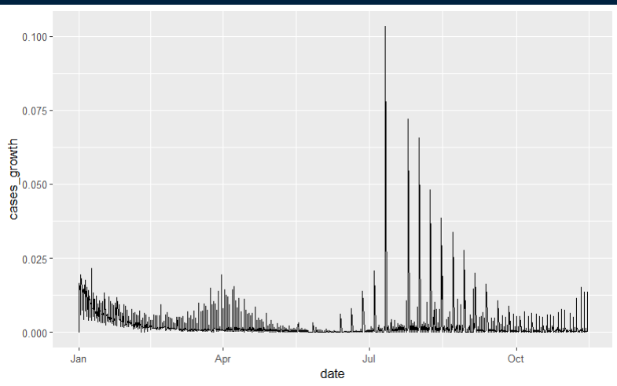
Filtering Data (cases_growth)
Notes:
So

Slide 8
Splitting Data
Focusing on 2021
60% → Training
for EDA and fitting parameters of a model
20% → Validation
for comparing models and tuning model parameters
20% → Testing
only use a single time to test the final model

Slide 9
Florida
(Florida Climate Center & Kaggle)

Slide 10
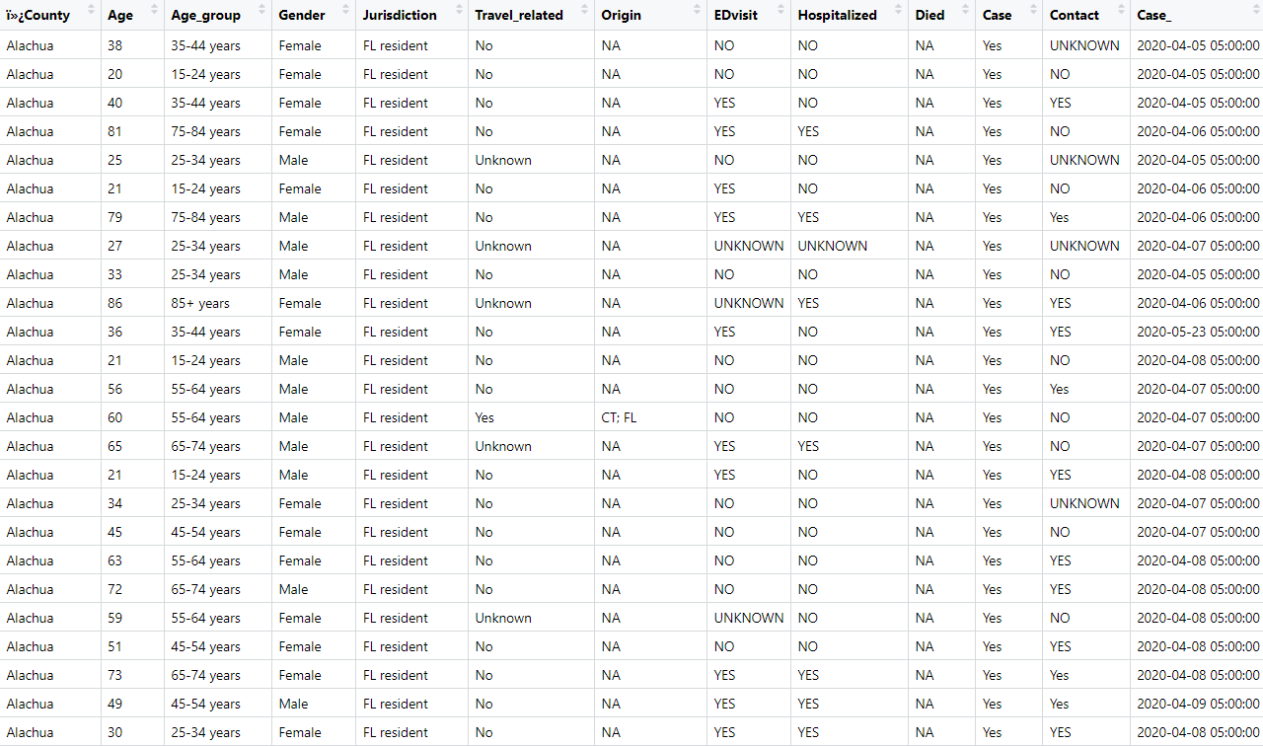

Slide 11
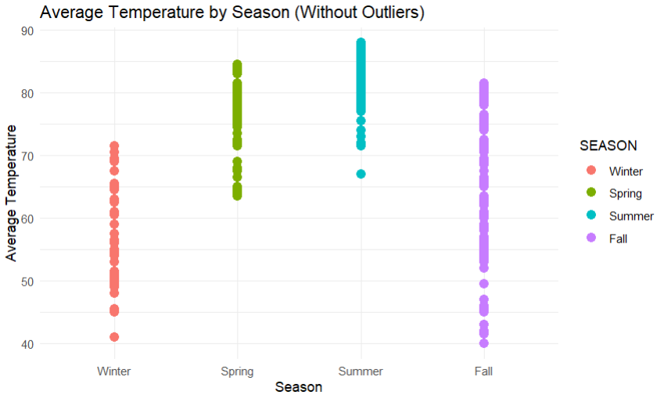

Slide 12
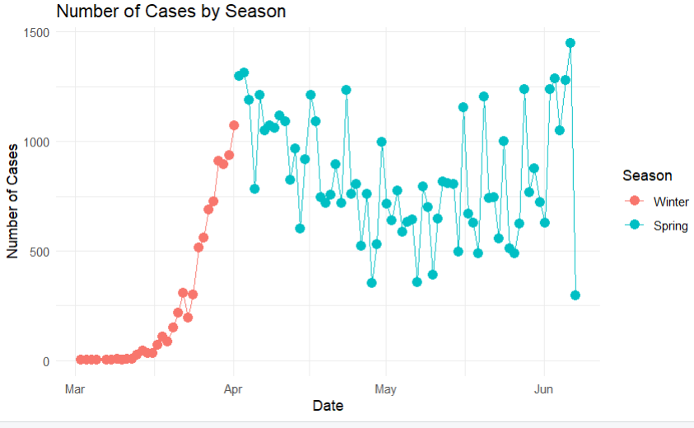

Slide 13
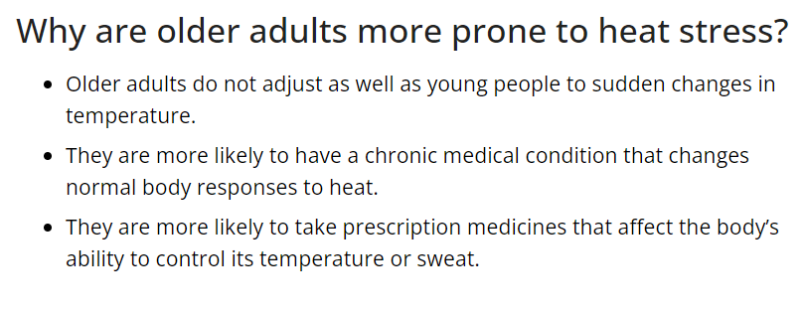
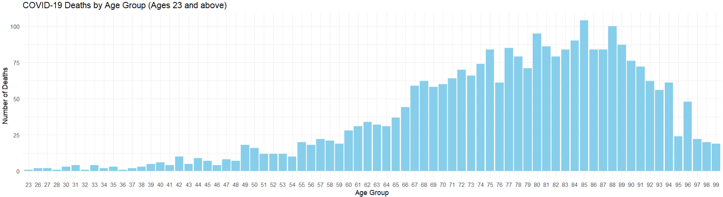
“ACE inhibitors, such as amlodipine and benazepril, are often used to treat heart disease. Beta-blockers, such as propranolol and metoprolol, reduce the blood flow to your skin. This restriction decreases your body's ability to cool itself.”
Catholic Health
(non-profit healthcare)

Slide 14
Models

Slide 15
ANOVA & TukeyHSD

Slide 16
Explanation
ANOVA (analysis of variance)
Estimates how a quantitative dependent variable changes according to the levels of one or more categorical independent variables
TukeyHSD (honest significant difference)
Used when we reject the null hypothesis of ANOVA analysis
Finds which categorical variable are different by comparing the means of each possible pair of groups
3 Conditions for
ANOVA
The observations are independent within and across groups.
The data within each group are nearly normal.
The variability across the groups is equal.

Slide 17
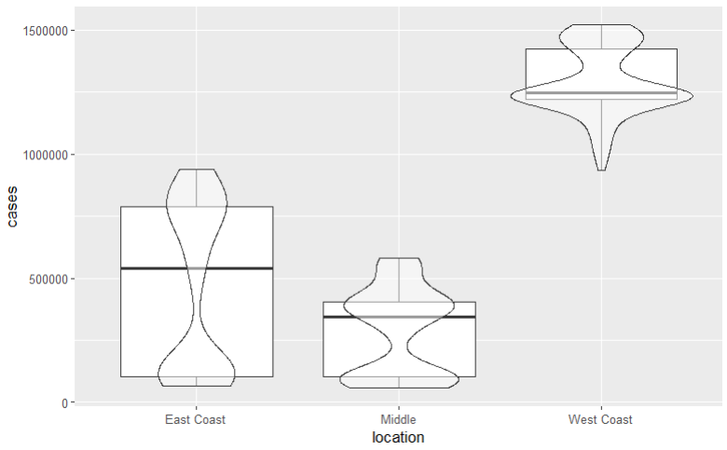
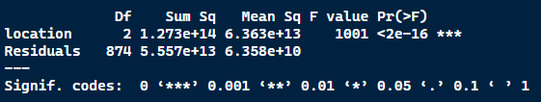
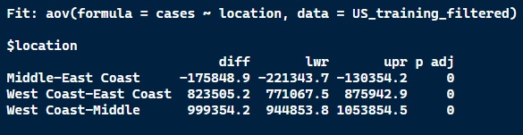
Covid Cases on US location

Slide 18
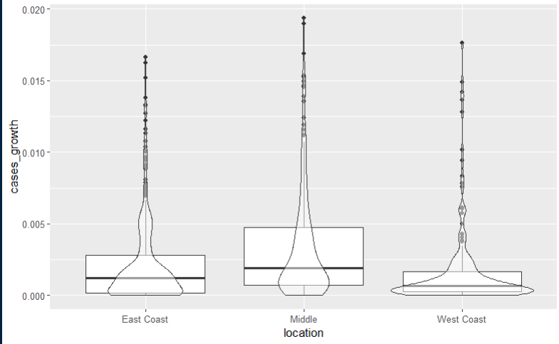
Cases Growth Rate on US location
Variance is not equal
Doesn't mean that there is no difference but instead this model can’t be used given the requirements

Slide 19
Logistic Regression

Slide 20
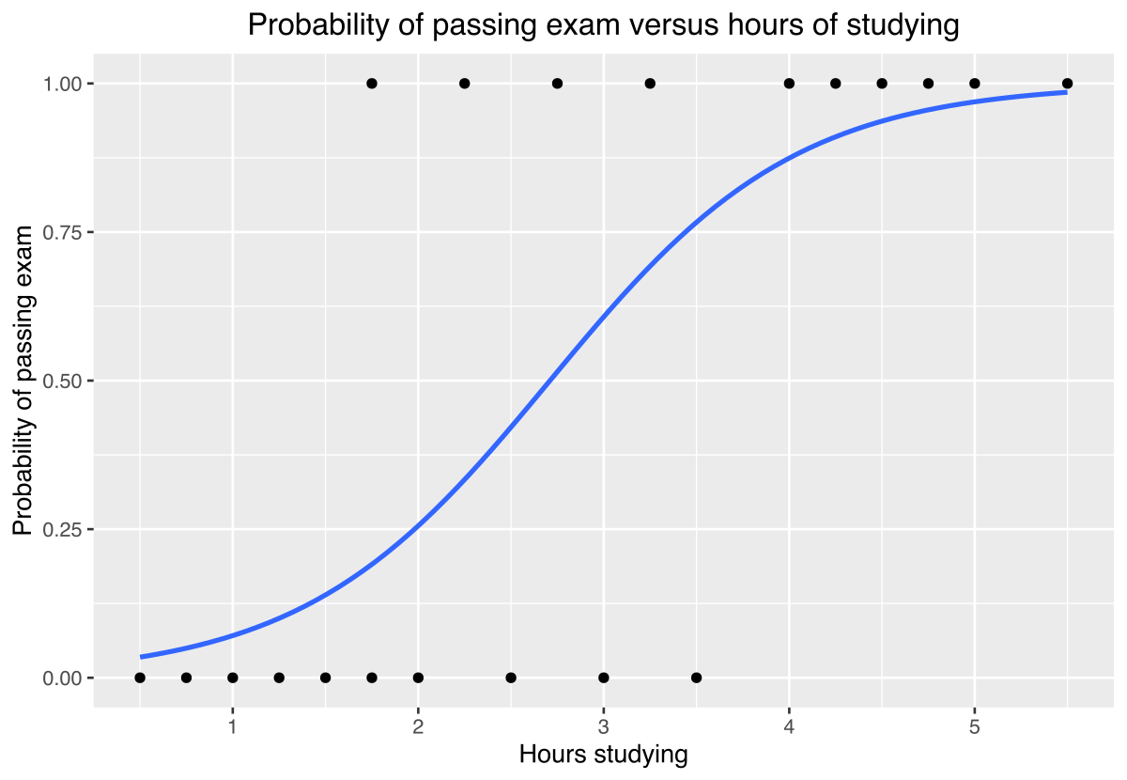
Explanation
Example
What is it ?
A regression model for response variables in a binary format (1 or 0)
How do we use ?
isBlue_state (1 = Blue, 0 = Red)
isHot_state (1 = Hot, 0 = Cold)
isRain (1 = it Rained, 0 = it didn’t)

Slide 21
If (inverse cubic & p-value < 0.05)
Claim
There is significant evidence rain has more covid growth rates than no rain
Get Difference
Given confidence intervals, we can be 95% confident that odds ratio for "isRain" is between <x> and <y>
Make Predictions
Compute the odds of a cases growth rate of 2% occurs if it rained

Slide 22
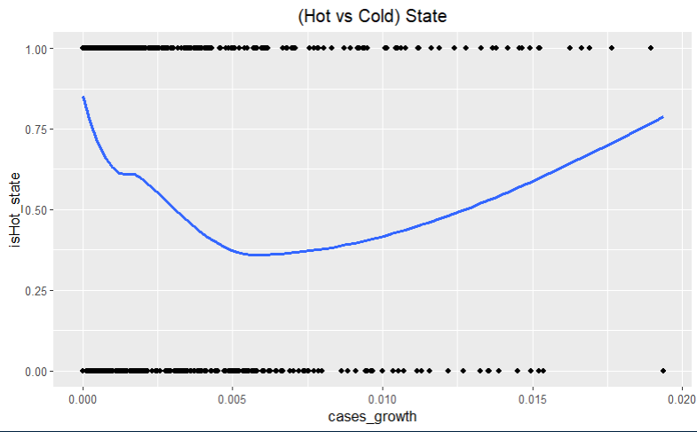
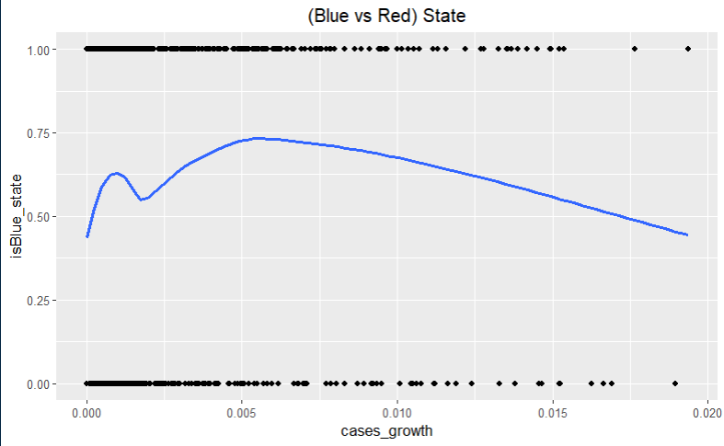
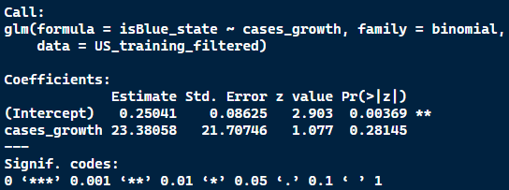
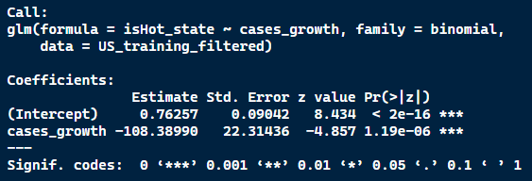
Results

Slide 23
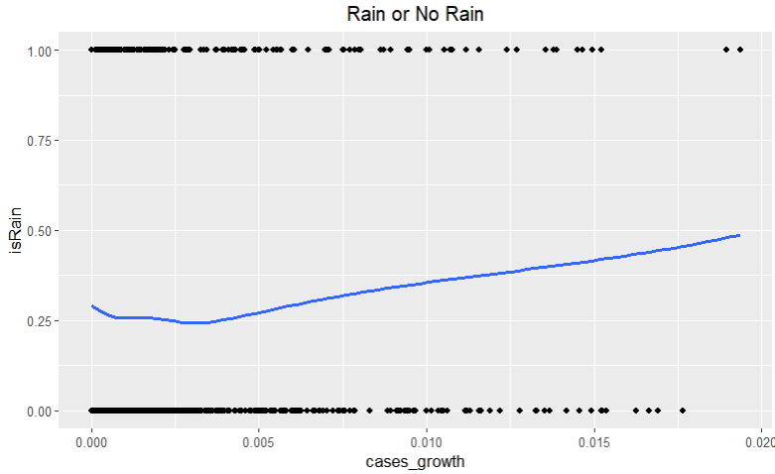
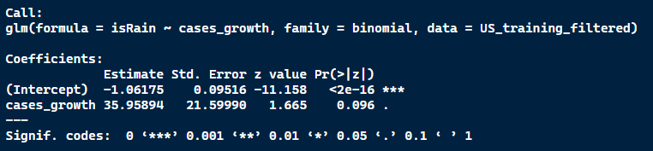
Results

Slide 24
Linear Regression

Slide 25
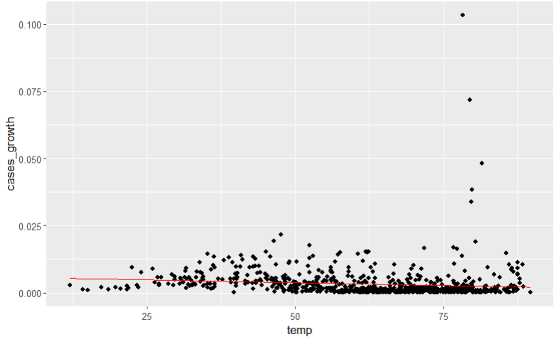
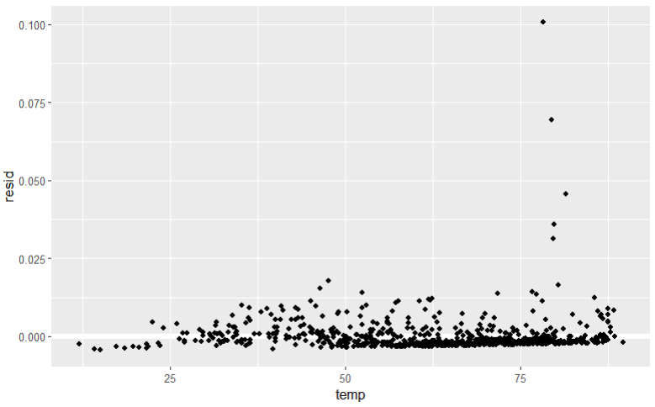
Not Linear

Slide 26
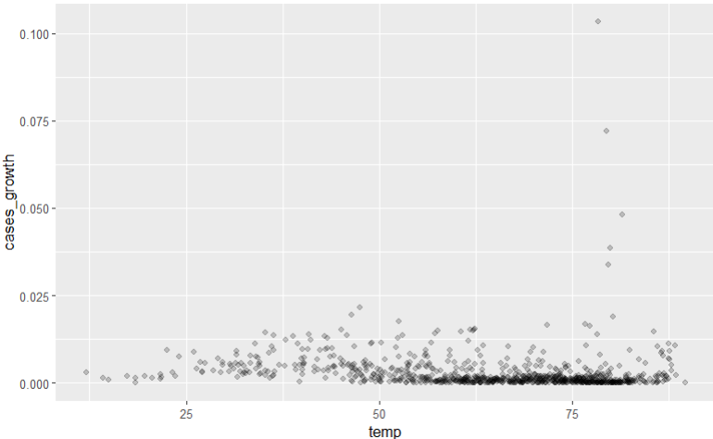
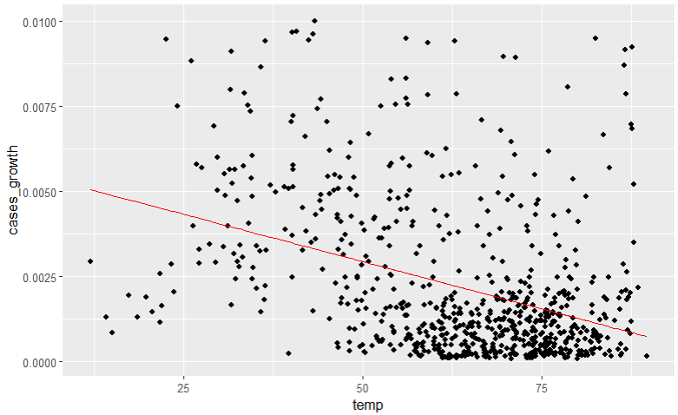
Investigation

Slide 27
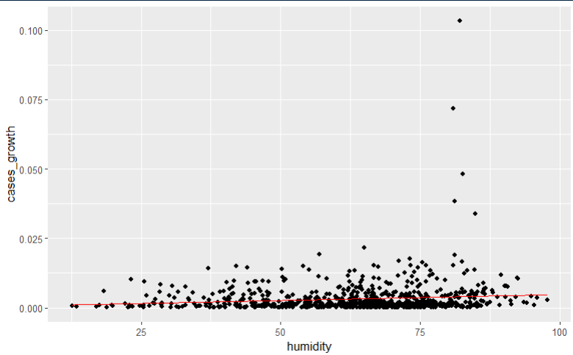
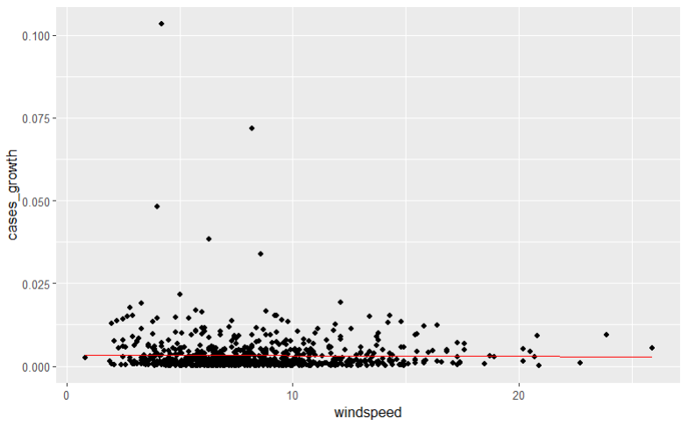
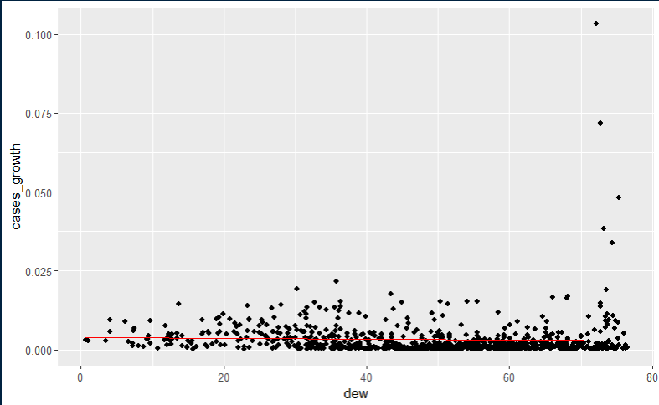
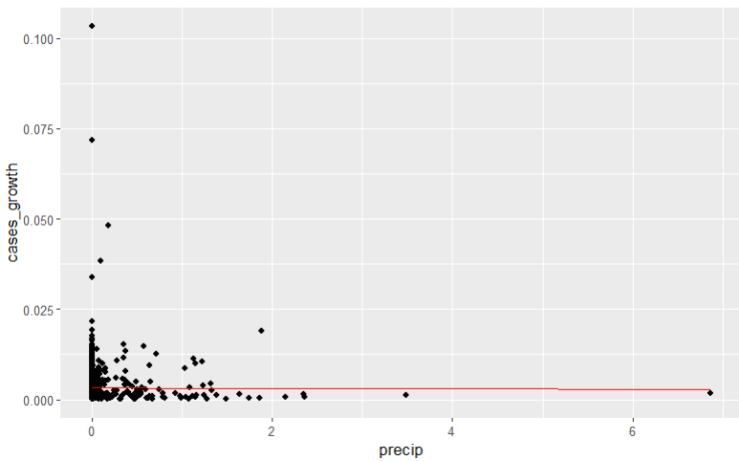
Other Weather Variables

Slide 28
Correlation Matrix

Slide 29
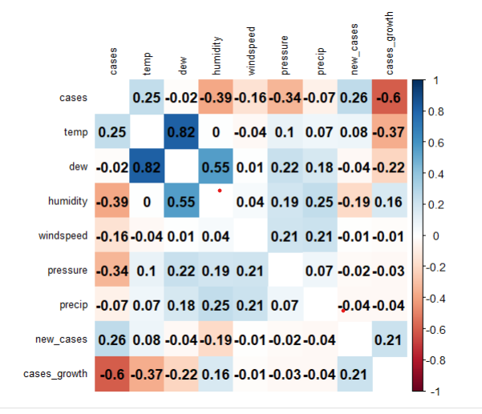

Slide 30
Polynomial Regression Model

Slide 31
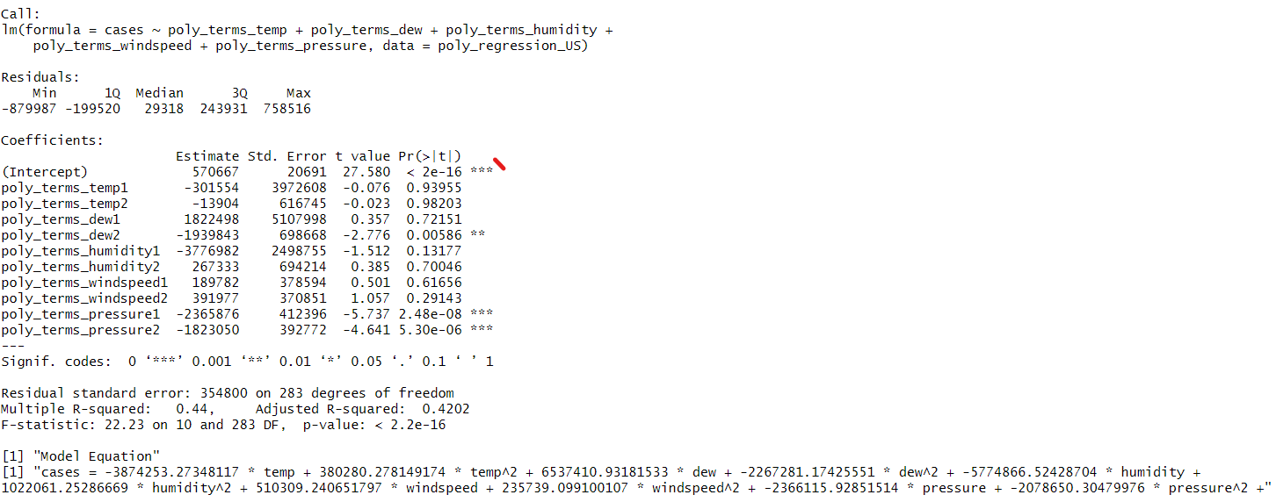
x1: temp
x2: dew
x3: humidity
x4: windspeed
x5: pressure
Y: cases
Residual Standard Error A measure of how much our predictions (or our line) might be off from the actual data points. In this case, it's around 354800, which means our predictions is really off
Multiple R-Square
A grade for our weather model's performance. In this case, the grade is 0.44, which means that about 44% of the variation in COVID cases can be explained by the weather factors we included in our model.

Slide 32
Current Results
Notes:
The results from our applied model indicate that we did not identify a significant correlation between weather variables and COVID-19 case numbers. Despite exploring various weather factors such as temperature, dew, humidity, windspeed, and pressure, the model did not reveal a strong statistical relationship with the observed COVID-19 cases. The Adjusted R-squared value of 0.4202 suggests that the chosen weather variables collectively explain only a moderate portion of the variability in COVID-19 cases, leaving a substantial portion unaccounted for. This underscores the complexity of factors influencing COVID-19 dynamics beyond the selected weather parameters.

