Slide 1



Data_techsters
View in Power BI
Last data refresh:
5/26/2023 5:43:53 PM UTC
Downloaded at:
5/26/2023 5:48:08 PM UTC

Slide 2
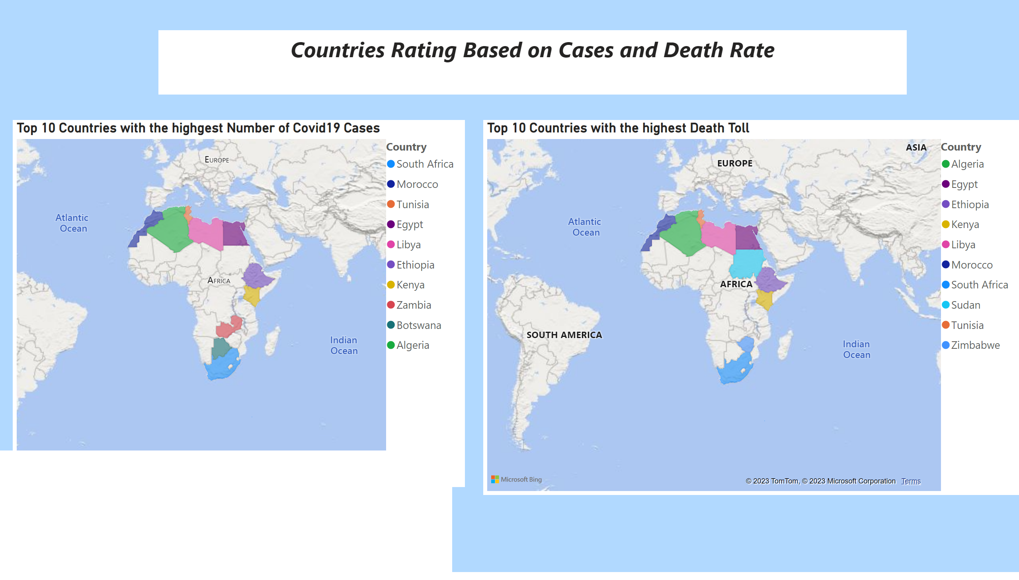
Country Rating
Notes:
Top 10 Countries with the highgest Number of Covid19 Cases
No alt text provided
Top 10 Countries with the highest Death Toll
No alt text provided
textbox
No alt text provided
textbox
No alt text provided

Slide 3
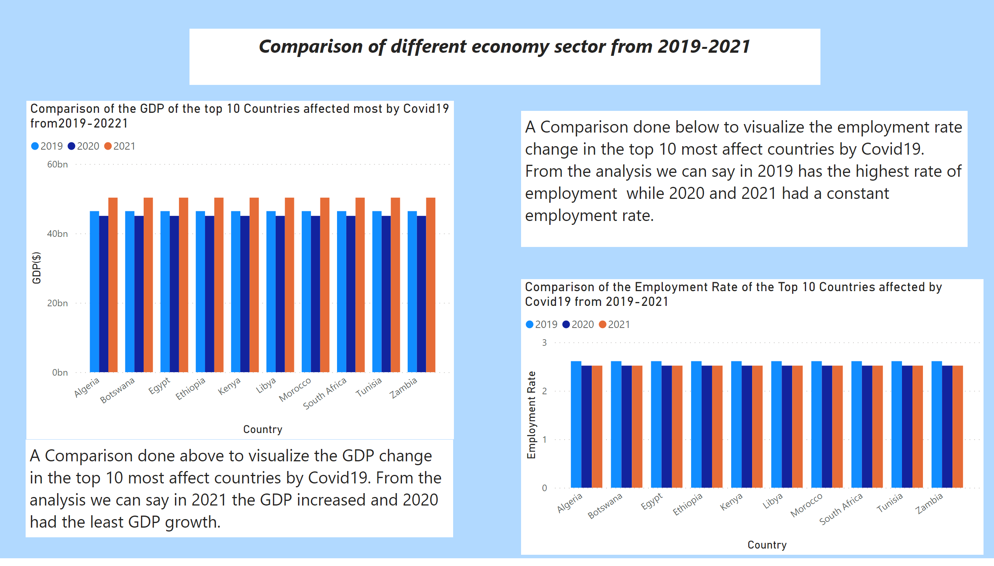
Economy Sectore 2
Notes:
Comparison of the GDP of the top 10 Countries affected most by Covid19 from2019-20221
No alt text provided
Comparison of the Employment Rate of the Top 10 Countries affected by Covid19 from 2019-2021
No alt text provided
textbox
No alt text provided
textbox
No alt text provided
textbox
No alt text provided

Slide 4
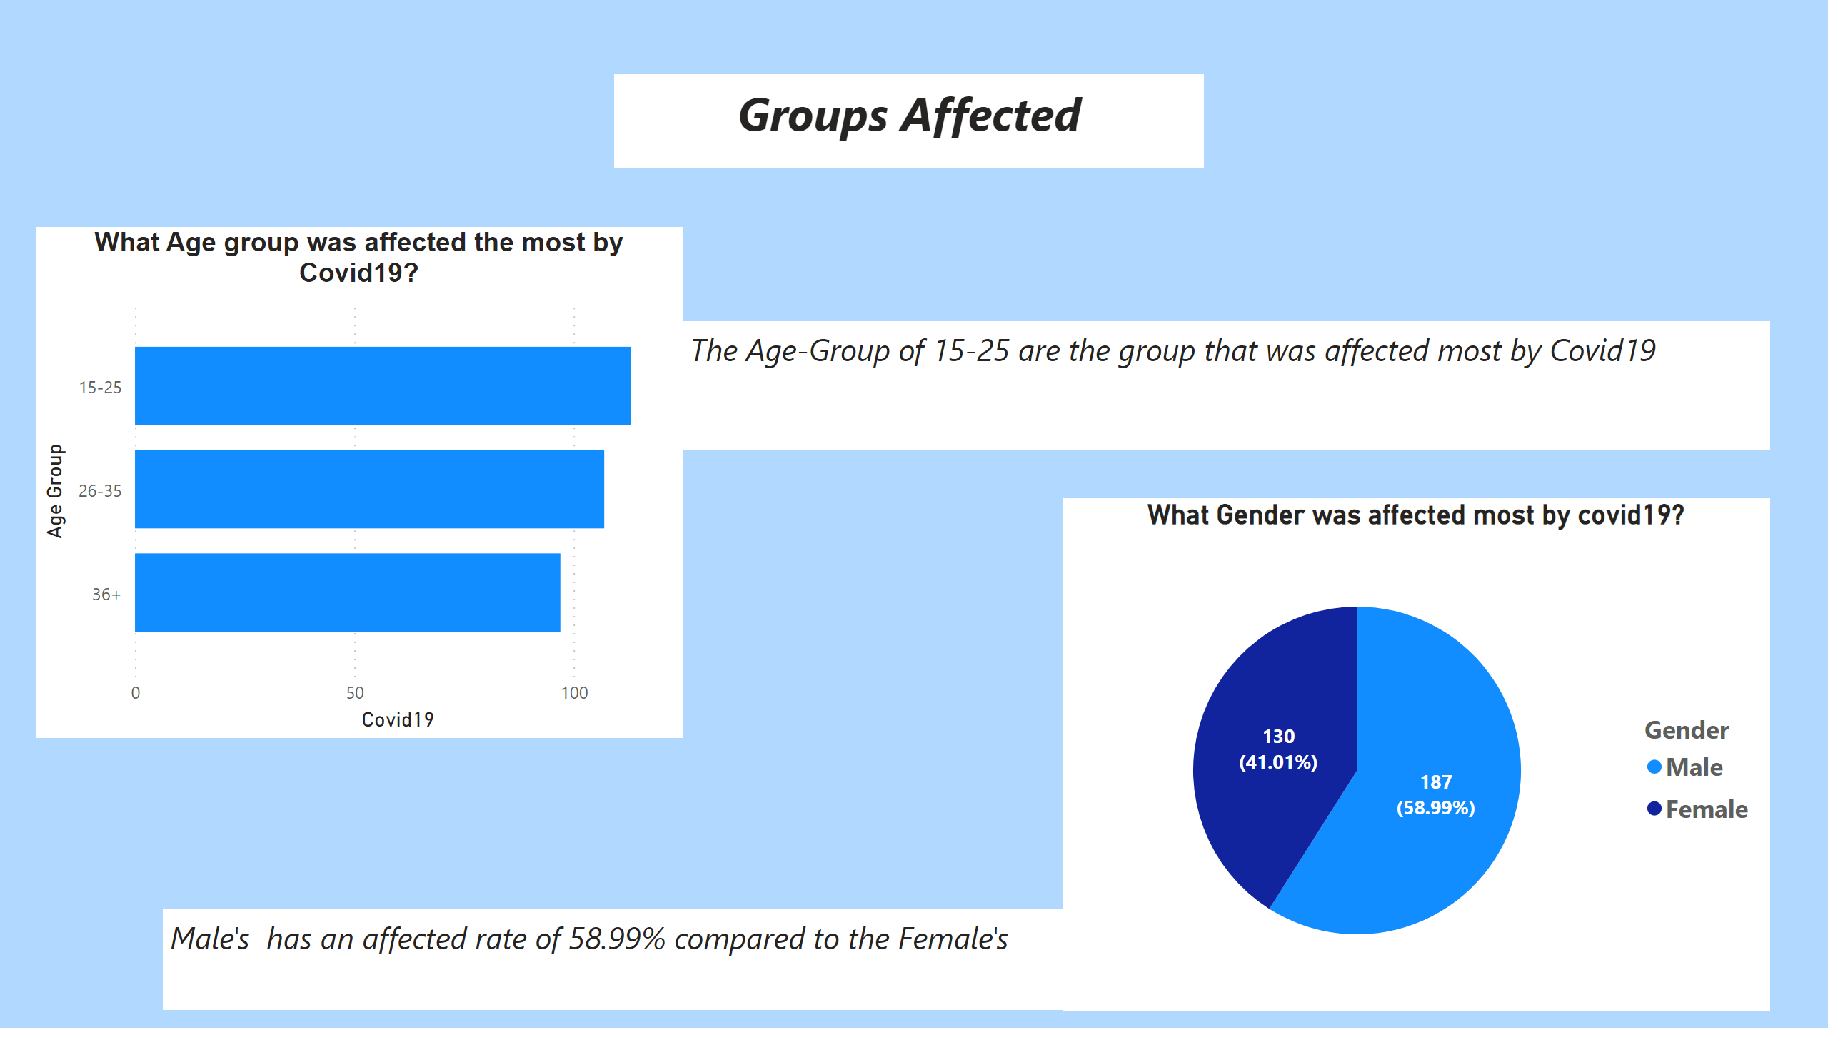
Group Affected Most
Notes:
What Age group was affected the most by Covid19?
No alt text provided
What Gender was affected most by covid19?
No alt text provided
textbox
No alt text provided
textbox
No alt text provided
textbox
No alt text provided

