Slide 1


INVENTORY
LABORATORY
MANAGEMENT
SYSTEM
Angelo Pio Pompeo
Alessandro Nese

Slide 2

PROJECT OVERVIEW
Designed to improve the management and control of resources used in research projects across Sapienza’s Research Departments, ensuring greater operational efficiency and reducing waste
The primary objective is to create an intuitive and functional tool that allows real-time stock monitoring and simplifies communication among laboratory members
The system will be a fundamental tool for improving resource management in research laboratories, making operations more organized and ensuring that every laboratory member has access to the information needed to carry out their work efficiently

Slide 3
The lab manager configures the platform to meet the laboratory's specific needs
Researchers update the system to reflect material usage during daily activities
Researchers submit requests for unavailable materials or report damaged equipment, allowing the lab manager to address issues promptly
PRIMARY
USE CASES

Slide 4
USER TYPES
ADMIN
LAB MANAGER
ADMIN
  View materials
  Update stock levels
  Submit requests for unavailable items
  and Report damaged equipment.
  Defines categories
  Adds materials
  Sets reorder thresholds
  Manage researchers
  Monitors resource usage
  Downloads reports
  Configure departments
  Manager researchers and lab managers of all departments

Slide 5
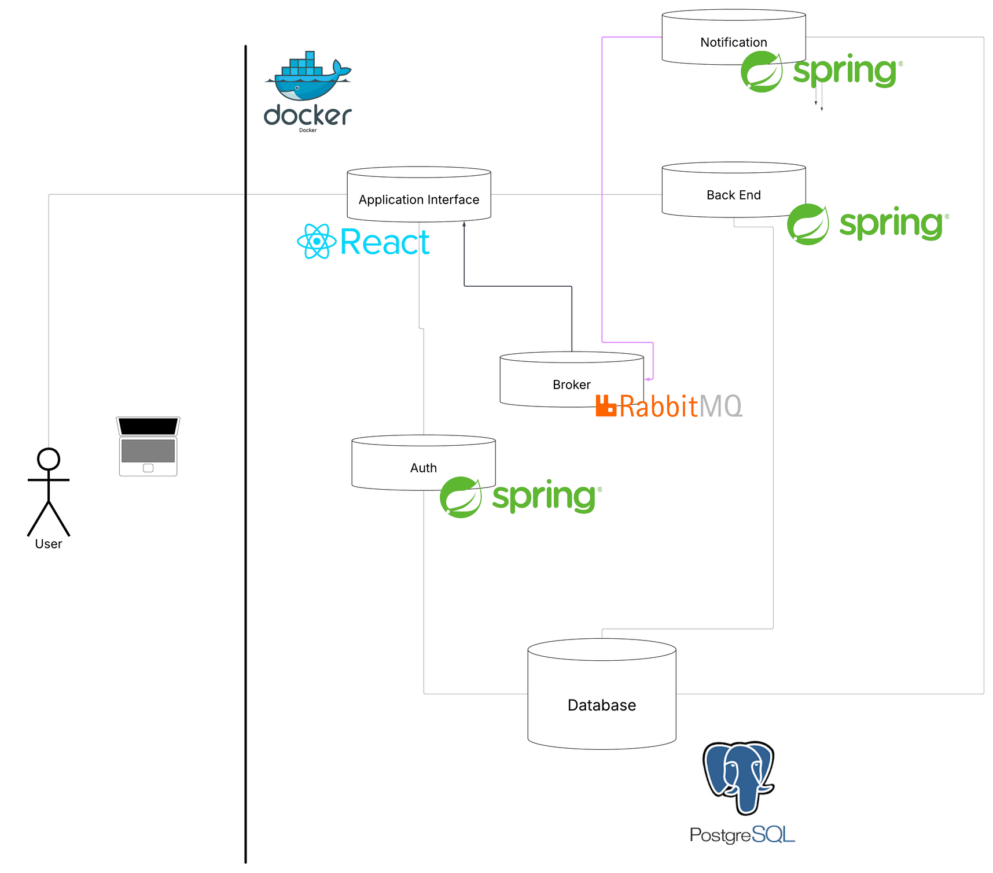
TECHNOLOGIES USED & WHY
React: Component-based, fast UIs
Spring: Robust Java backend framework with DI and REST support
RabbitMQ: Reliable message broker for async, decoupled communication.
PostreSQL: Powerful, standards-compliant relational DB

Slide 6
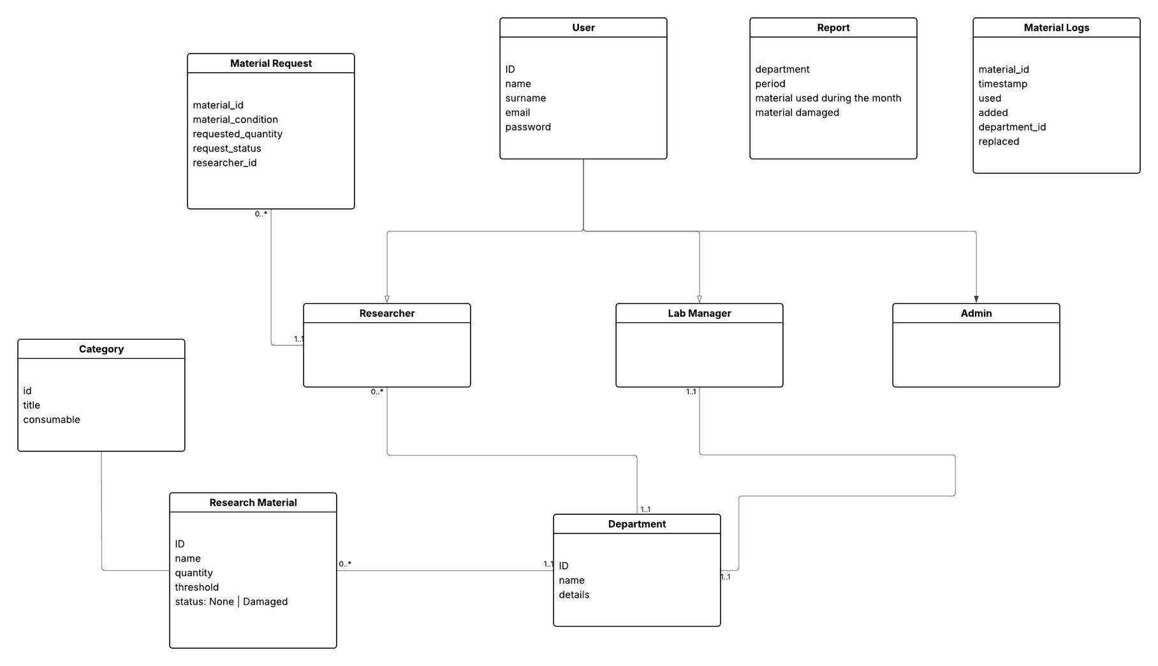
UML

Slide 7
DOCKERIZATION
Database — database-service
  Image: postgres:17
  Port: 5432:5432
  Volumes: db_data:/var/lib/postgresql/data
  Description: Provides persistent storage for materials, users, and categories.
Authentication — authentication-service
  Build: built from Dockerfile.auth
  Port: 9002:8080
  Depends_on: db, back-end
  Description: Handles user authentication and authorization
Back End — back_end-service
  Build: built from Dockerfile.back
  Port: 9001:8080
  Depends_on: db
  Description: Handles all business logic, material management, requests, and notifications
Notification— notification-service
  Build: built from Dockerfile.notif
  Port: 9003:8080
  Depends_on: db, back-end, broker
  Description: Handles alerts sent to broker.

Slide 8
DOCKERIZATION
PgAdmin— pgadmin
  Image: dpage/pgadmin4
  Port: 5050:80
Broker — rabbitmq-service
  Build: rabbitmq:3-management
  Ports:
    5672:5672 (AMQP protocol)
    15672:15672 (RabbitMQ management UI)
    1883:1883 (MQTT native)
    15675:15675 (MQTT over WebSockets)
  Volumes: rabbitmq_data
  Description: Handles asynchronous messaging and notifications between services
Front end — front_end-service
  Build: built from Dockerfile.front
  Port: 3000:3000
  Depends_on: back-end, authentication
  Description: provides the user interface and interacts with backend REST APIs

Slide 9
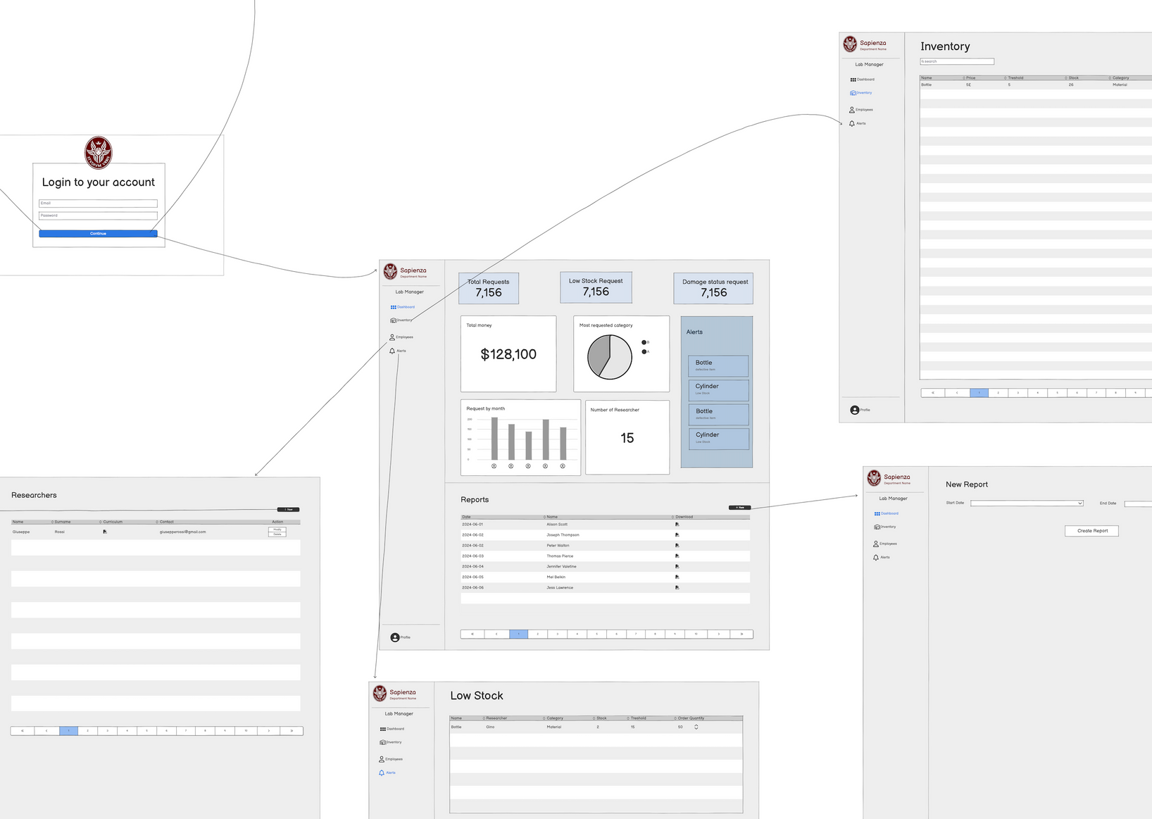
FRONT-END MOCKUP

Slide 10
FUNCTION POINTS
Section | Type | Complexity | Count | FP
Summary | EI | Low | 6 | 18
Summary | EI | Average | 5 | 20
Summary | EO | Low | 1 | 4
Summary | EO | Average | 1 | 5
Summary | EQ | Low | 2 | 6
Summary | EQ | Average | 4 | 16
Summary | ILF | Low | 6 | 42
TOTAL: 111

Slide 11
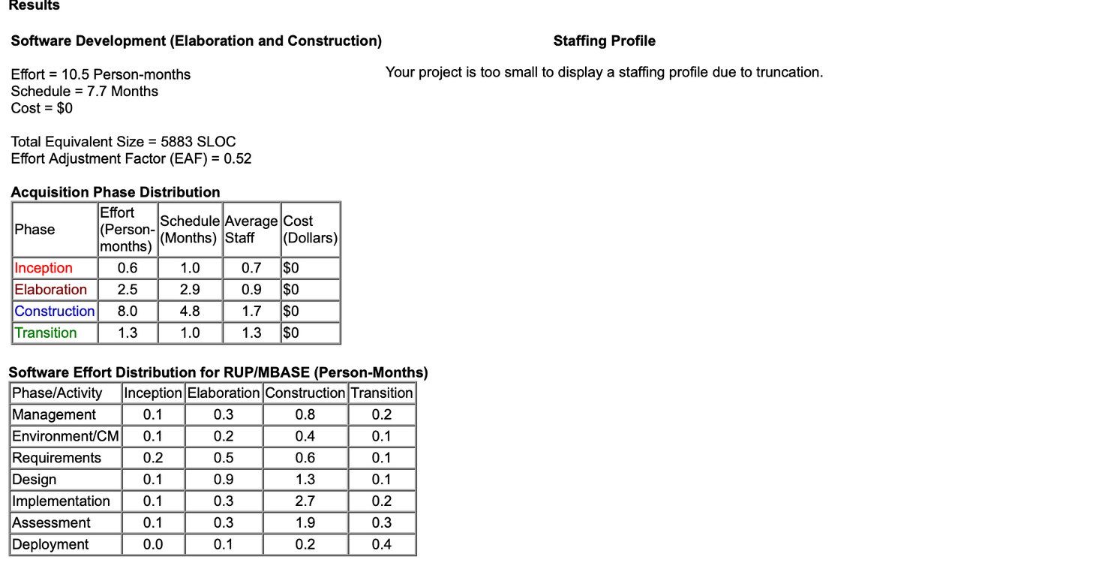
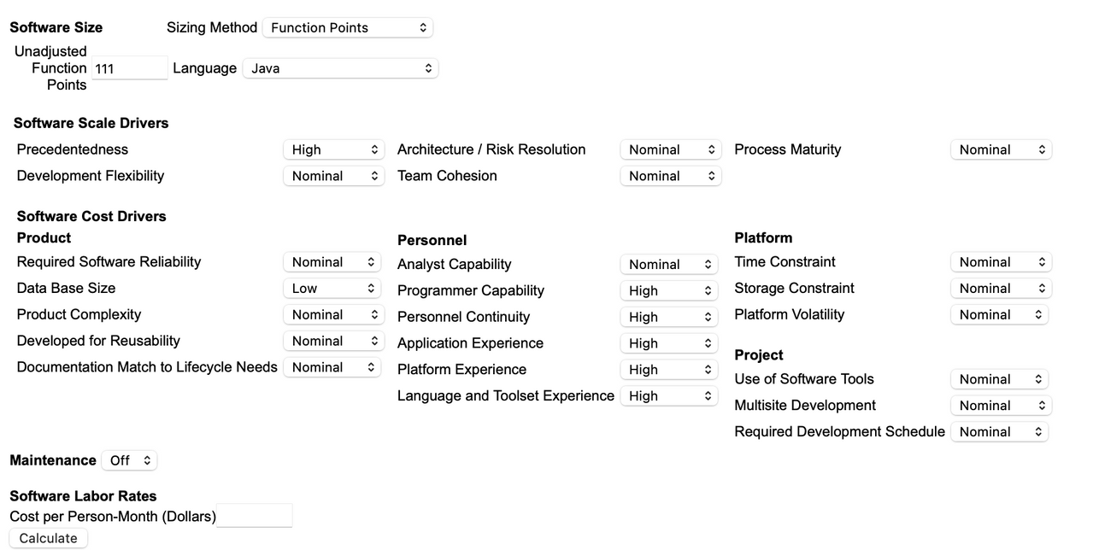
COCOMO II

Slide 12
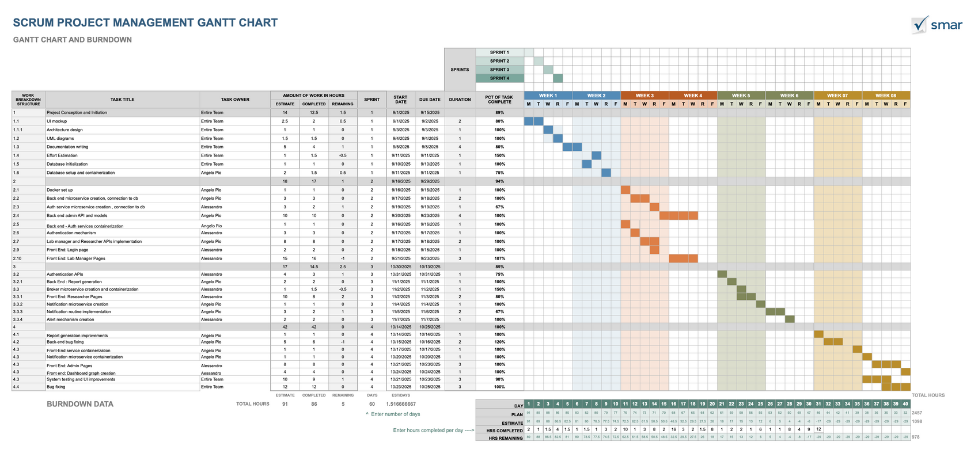
SCRUM PLANNING
Sprint length: 2 Weeks
Project duration: 2 Months
Total Sprint Number: 4

Slide 13
AND NOW LET’S TAKE A LOOK AT THE APPLICATION

