Slide 1

BUILDING
Rally Apps
(
)
Extending the Platform
with javascript
Getting Started
Dev Environment & Custom Grid

Slide 2
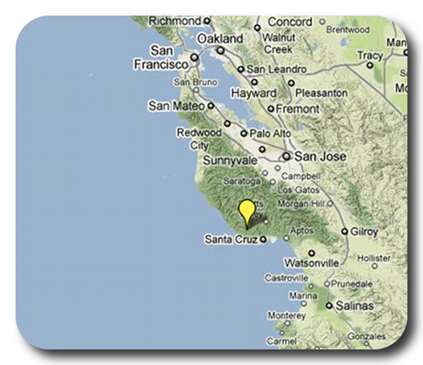

David P Thomas
dthomas@rallydev.com
ME
ABOUT
Notes:
Things that are nice to include in your introduction or things you might think about:
Where are you from?
Where do you work?
A funny Story.
Use some images that show who you are.

Slide 3
Purpose
As a Rally Customer, I want to be comfortable
extending the Rally platform to provide our
business with unique insights into our own data.
Acceptance Criteria:
Know where to find existing apps
Know where to find help & resources
Start a new app in < 3 minutes
Comfortable trying, failing, debugging, and learning.
Feel overwhelmed with possibilities… not stress.

Slide 4
Development Environment
Chrome Browser – Ideal debugging tools
(https://chrome.google.com)
Chrome Terminal Extension – ‘Devtools Terminal’
(https://chrome.google.com/webstore -> search ‘devtools terminal’)
Rally App Builder – Create, build, and deploy apps
(https://github.com/RallyApps/rally-app-builder)
Github.com – Store and share your app.
Before you begin…install chrome and the extension. Then install Rally App Builder
on your local machine. Lastly, create an account on github.com if you haven’t
already.

Slide 5
Let’s Do this…

Slide 6
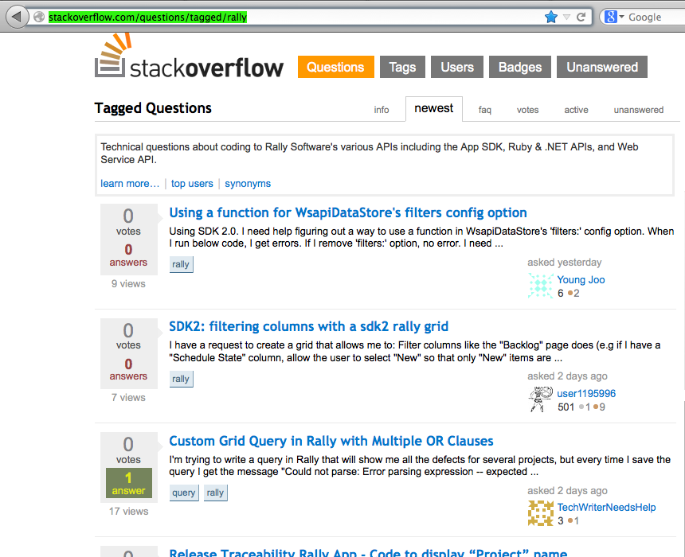
Stackoverflow
When in doubt, phone a friend. Or a few thousand of them on stackoverflow.
http://stackoverflow.com/questions/tagged/rally

Slide 7
This slide intentionally left blank
(except for this text)

