Slide 1

BUILDING
Rally Apps
(
)
Extending the Platform
with javascript
Interactive Grid
refactored

Slide 2
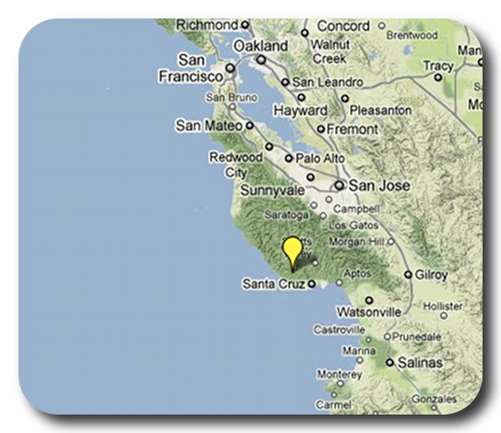
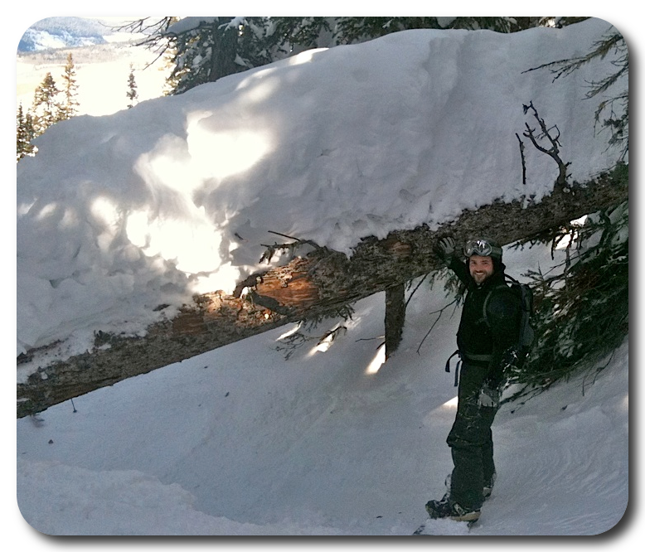
David P Thomas
dthomas@rallydev.com
ME
ABOUT
Notes:
Things that are nice to include in your introduction or things you might think about:
Where are you from?
Where do you work?
A funny Story.
Use some images that show who you are.

Slide 3
Purpose
As a Rally Customer, I want to be comfortable
extending the Rally platform to provide our
business with unique insights into our own data.
Acceptance Criteria:
Know where to find existing apps
Know where to find help & resources
Start a new app in < 3 minutes
Comfortable trying, failing, debugging, and learning.
Feel overwhelmed with possibilities… not stress.

Slide 4
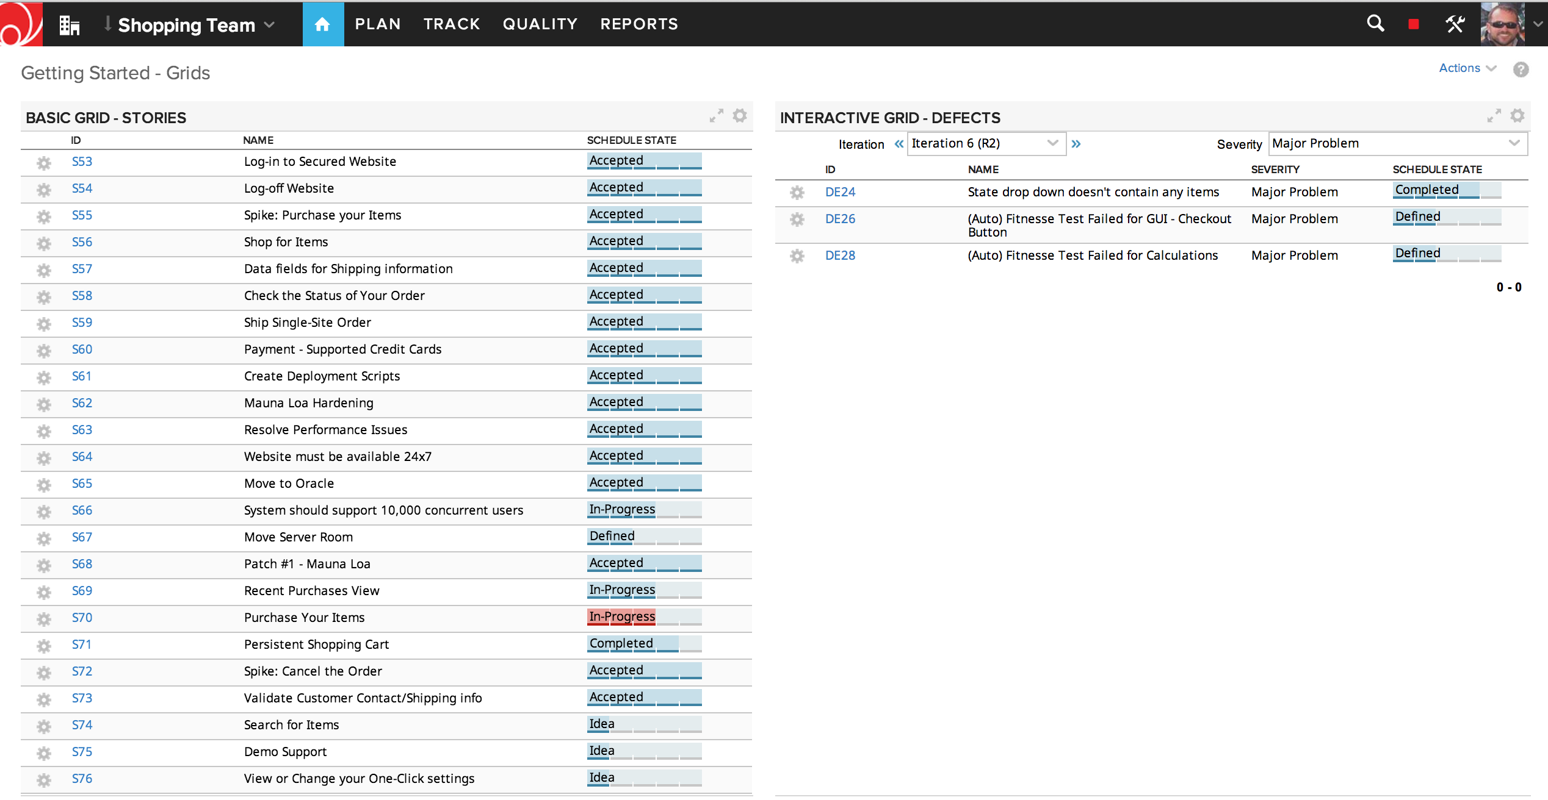
Basic Grid –Stories
Interactive Grid – Defects

Slide 5
Where to Find Code
github.com/RallyApps – Official Rally Apps
github.com/RallyCommunity – User Contributed Apps
github.com/RallyHackathon – Experimental Apps

Slide 6
Refactor List
Query Filters – use the Filters object to create AND’d filters instead of an Array.
Ext Id’s vs. ‘app-level’ components – set itemId on all components and query when needed.
Define layout in App – Setup the layout and components in advance instead of as-we-go.
Event Handler function calls – Naming convention and assumptions about how javascript passes params.
Scope ‘me’ – Gain some sanity with the ‘this’ variable

Slide 7
Let’s Do this…

Slide 8
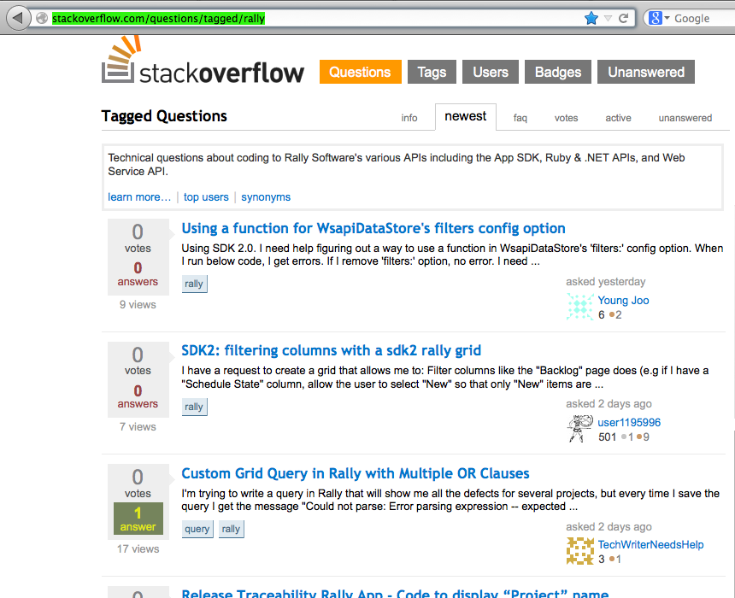
Stackoverflow
When in doubt, phone a friend. Or a few thousand of them on stackoverflow.
http://stackoverflow.com/questions/tagged/rally

Slide 9
This slide intentionally left blank
(except for this text)

