Slide 1
Adquisición de imágenes con cámaras 3D RealSense para aplicaciones de Smart-Agriculture
Angelo D. Espinoza V

Slide 2
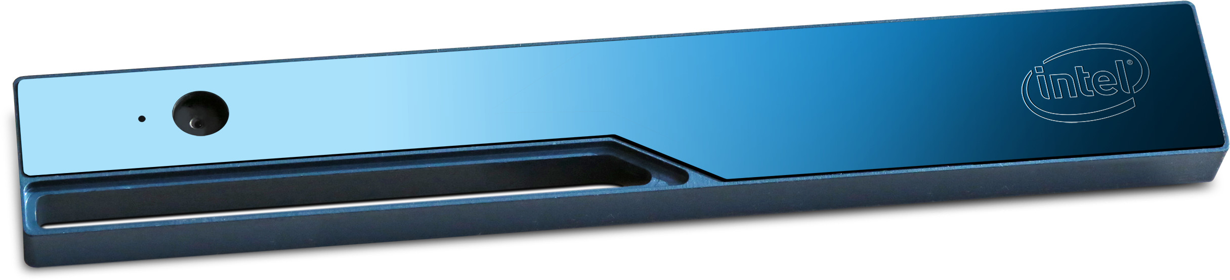
Intel RealSense R200

Slide 3
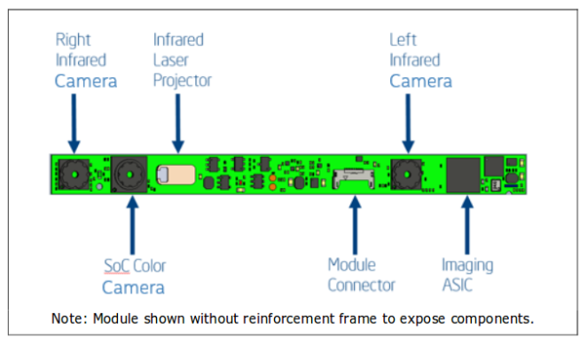
Datasheet and Manuals
The camera consists of two infrared and one full HD colour imaging sensors, as well as an infrared laser projection system. As a result, the camera provides three video streams: colour, depth, and infrared. The colour stream is provided by the full HD colour imaging sensor.

Slide 4
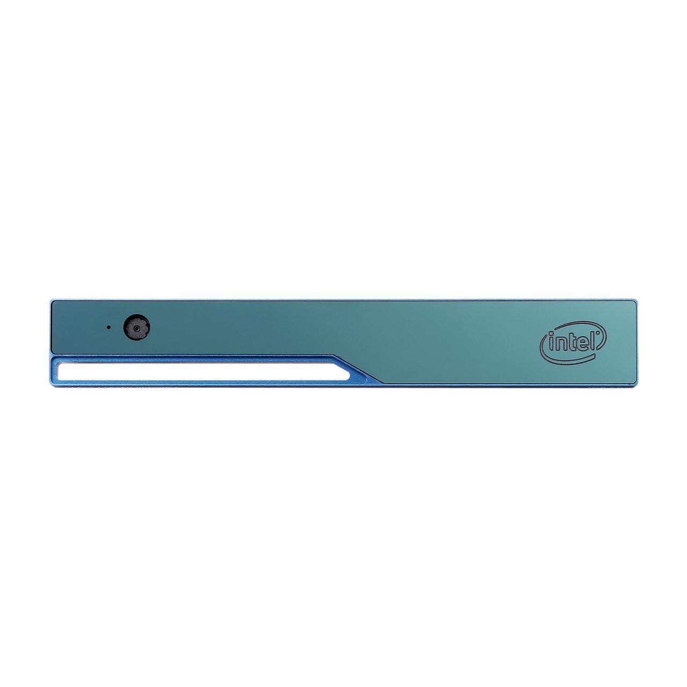
Characteristics
Specifically, the depth stream is generated internally by a stereo vision algorithm that uses the two infrared imaging sensors and the infrared laser projector data. Every pixel in this stream represents the distance from the camera.

