Slide 1
Average cost of undergraduate student by state USA

Slide 2

Cost of college education in the USA?

Slide 3
Overview and problem statement
The USA is known to be a very expensive place when it comes to undergraduate studies
What is the average cost of undergraduate education in the United States for public university?
Is the average cost the same for public in state and public out of state?
If no, by how much is the difference?

Slide 4
Data Analyzed
The dataset has 3548 entries and 6 columns
Average cost depends on the state, the type of university, program's length, and others
Data can be accessed with the below lAverage cost of undergraduate student by state USA

Slide 5

???

Slide 6
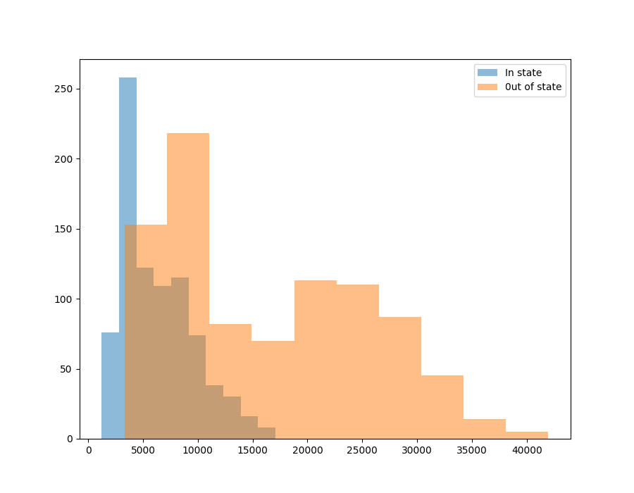
Analysis: Normality check, skewness, kurtosis
In state: skewness=0.82, kurtosis=0.019
Out of state: skewness=0.426, kurtosis=-1.013

Slide 7
Experiment results
Ttest_indResult(statistic=-30.443497252772996, pvalue=1.4407205749674063e-163)
On average, the two groups of data are significantly different
By how much is that difference?

Slide 8
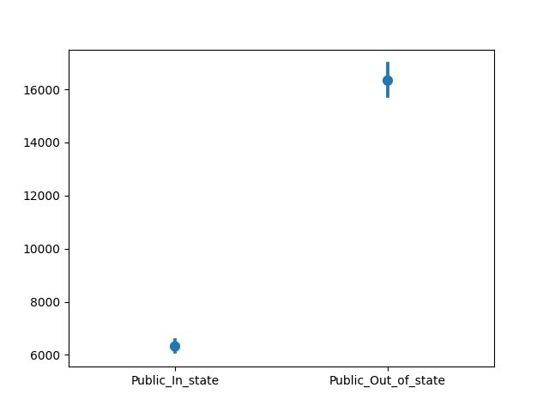
Statistically significant difference
With 95% confidence, the undergraduate average cost is between 9379.22 and 10639.48 higher in public out-of state universities.

Slide 9
Conclusion and recommendation
Public out-of state cost more than public in-state universities
That might be because public out of state students do not pay taxes and then are charged more than in-state students
We may gather new information about in-state students' annual taxes and run an A/B test on it to see if there is any change.

Slide 10


