Slide 1
THINKFUL CAPSTONE PROJECT 2:
SUPERVISED LEARNING

Slide 2
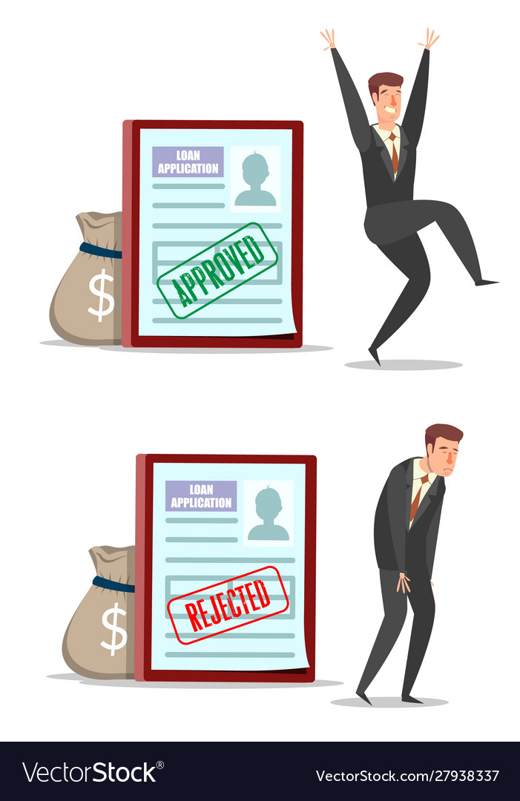
Loan Approval
No matter what type of loan is it (school, house, car, personal), almost every US resident has already applied for a loan
Why do some loans receive approvals while others do not?

Slide 3
Overview and problem statement
This study is going to give help the audience in understanding what criteria actually influence a loan application's outcome.
A supervised machine learning study has been conducted with a suitable dataset
This is a classification problem

Slide 4
Data set
The data set has 4269 entries with 13 columns, the last column being the target variable.
Some variable include: loan_id, no_of_dependents, education, self_employed, income_annum, loan_amount, loan_term, cibil_score.
Below is a link to access the data
Loan Approval Dataset

Slide 5
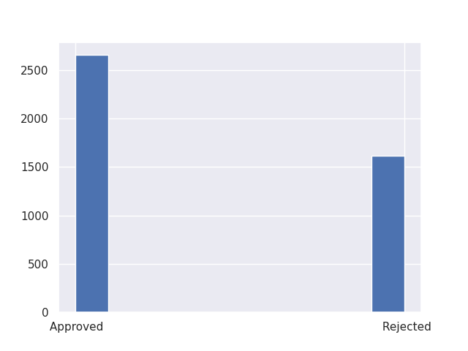
Exploratory Data Analysis
There is no missing values
10 variables are numerical and 2 are non numerical
Only two variables show some variance with respect to the target: loan_term and cibil_score.

Slide 6
Model definition
The data set has been split into training set (80%) and test set (20%).
Four classification machine learning methods have been implemented with the training set.
The best model has been tested on the validation set.

Slide 7
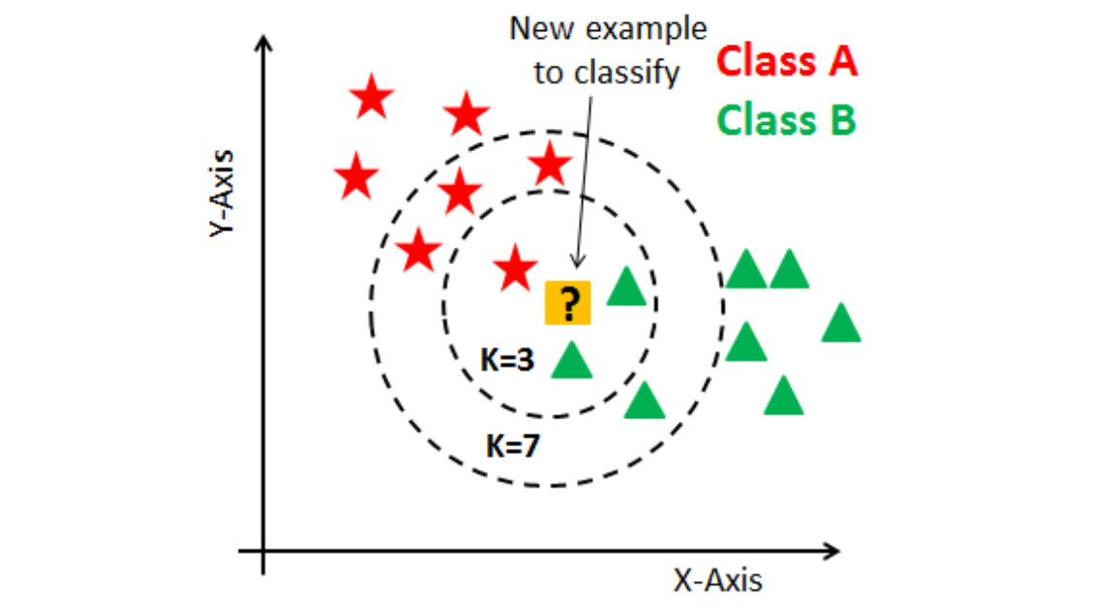
First Model used: KNN

Slide 8
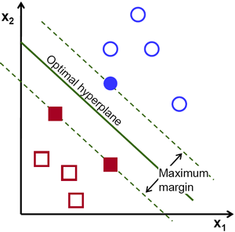
Second model used: SVM

Slide 9
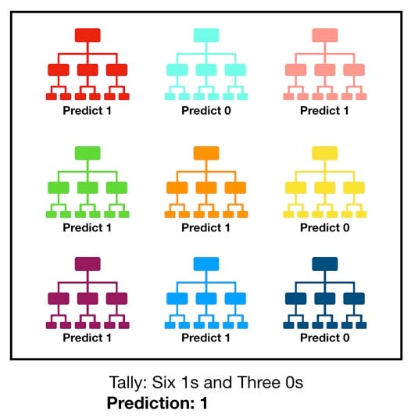
Third model used: Random Forest

Slide 10
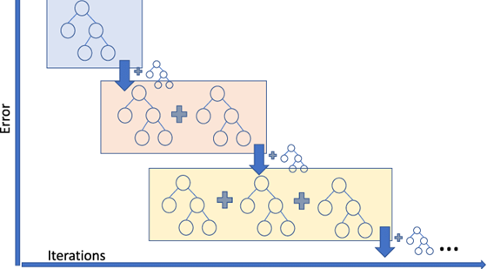
Fourth model used: Gradient Boosting

Slide 11
Performance of the models on the training set
Models | Accuracy on training set
KNN | 0.792
SVM | 0.949
Random Forest | 0.952
Gradient Boosting | 0.957
Gradient Boosting perform slightly better than the other models, we chose it for validation.

Slide 12
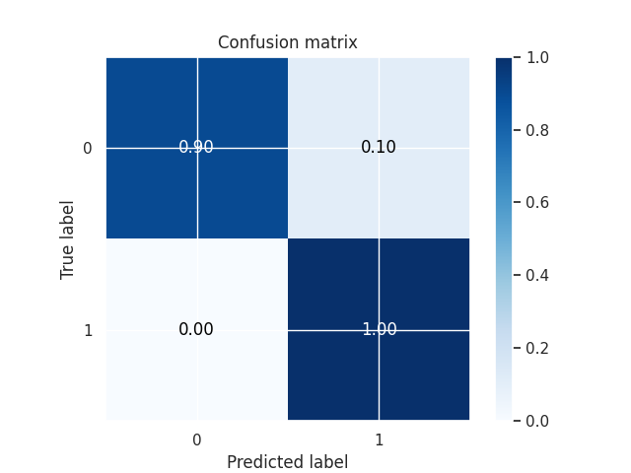
Performance of gradient boosting on the test set
Accuracy | 0.96
Precision | 0.94
Recall | 1.00
F1 score | 0.97
Fbeta score favoring precision | 0.95
Fbeta score favoring recall | 0.99

Slide 13
Conclusion and recommendations
The gradient Boosting proved to perform really well on the training set and even better on the test set.
The hyper parameters of the models have been tuned but further study might increase the overall performance.
Future work will focus on delving deeply into all the hyperparameters and boosting performance..

Slide 14
What have we learned from this study?
When someone applies for a loan with a good credit score, the application is certainly going to be approved.
Applying with a reasonable loan term will enhance approval chances, especially for borrowers with bad credit.
With the model used, we are able to predict if someone loan application status with the person credit score and loan term.

Slide 15
Further study question
What if someone with a low credit score apply with a cosigner ?

Slide 16


