Slide 1
THINKFUL CAPSTONE PROJECT 3:
UNSUPERVISED LEARNING

Slide 2
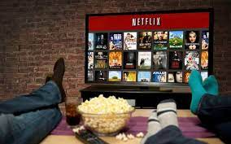
Netflix Movies/TVseries clustering
Netflix wants to identify similar movies/Tvseries based on movies/TV characteristics
How can unsupervised learning help Netflix to group similar program together?

Slide 3

Overview and Problem statement
Netflix customers are likely to look for more of the same movies/Tvshows they usually to watch
In this unsupervised learning project, we are going to identify similar movies or series based on movie characteristics

Slide 4
Data set
The Data set used has 8807 entries (movies/TVshows) with 12 columns
Some variable include details such as cast, directors, ratings, release year, duration and so on.
Below is the link to access the data
Netflix Movie/TV data

Slide 5
Exploratory Data Analysis (EDA)
We will go through the following steps
1- Cleaning the data
2- Exploring the data
3- Selecting the most important features for our model

Slide 6
Cleaning Data
The variables “director”, “cast”, “country”, “data added”, “rating” and “duration” present some missing values
For most of the missing values, we replace them with the respective mode for each variable
We end up with a data of 8804 entries
The variable “duration” is in time for movies and “seasons” for series; for a better analysis we changed it to integer

Slide 7
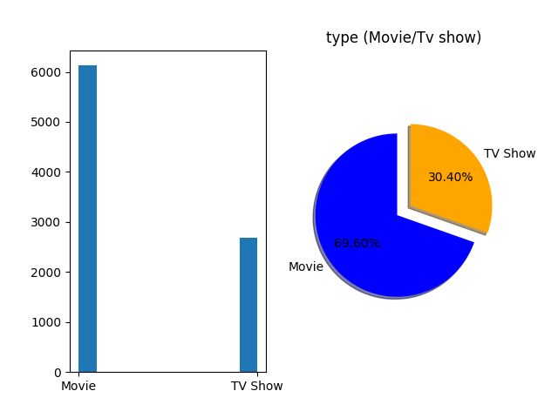
Exploring Data
There are over 6000 (69.6%) movies in the data set and just around 2700 (30.4%) TV shows.

Slide 8
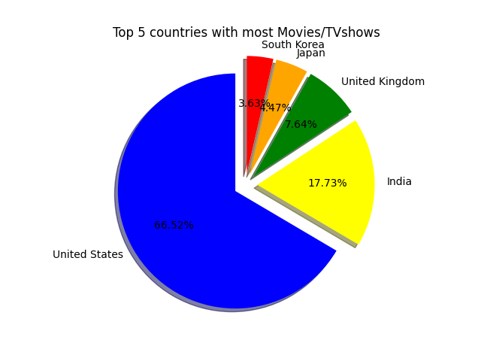
Top 5 countries with most Movies/TV shows
The United states has produced more than half of the movies.
India, the United kingdom, Japan, South Korea come respectively 2nd, 3rd , 4th and 5th

Slide 9
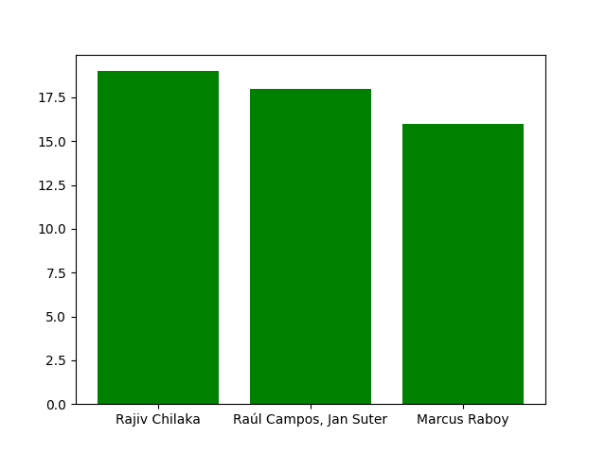
Top 3 directors with most movies
Rajiv Chilaka, Raul Campos and Jan Suter and Marcus Raboy have each directed more than 10 movies.

Slide 10
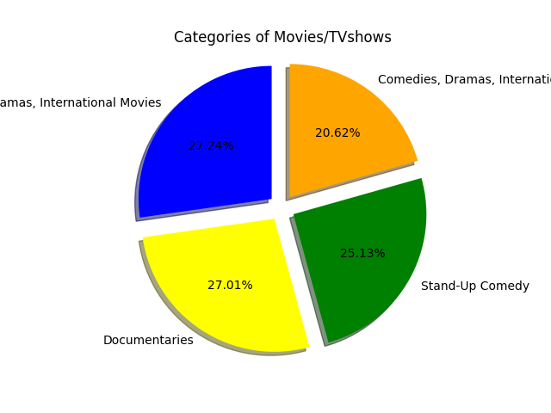
Most watched categories of movies/TVshows
Most movies/TV shows are in the drama category and international movies, closely followed by documentaries and stand-up comedy.

Slide 11
Feature engineering
For our clustering algorithm, we will focus the the following variables: "type , country, rating, duration, listed_in".
We transform these variables to numerical variables before moving forward.

Slide 12
Model definition: Clustering
Model
Model
We continue analysis by implementing the following clustering models:
1- K-means
2-Hierarchical clustering
3- Gaussian Mixture Model
4- DBSCAM
The model with the most logical results will be chosen.

Slide 13
K-means
We implemented Kmeans with different number of clusters
Kmeans with 20 clusters performs quite well with a silhouette score of 0.71.

Slide 14
Hierarchical clustering
We implemented the with different methods and different clusters
Yet again, the best silhouette is accomplished with 20 clusters. With a linkage method average, the silhouette score is 0.698.

Slide 15
Gaussian Mixture Model
We implemented GMM with different covariance types and different clusters
The best silhouette score of 0.69 is accomplished with a tied covariance and 20 clusters.

Slide 16
DSCSAN
We got an almost perfect silhouette score with 0.931 with eps= 0.5 and min samples = 5.
However, the previous implementation produced 83 clusters and is way too much
With 20 clusters, DBSCAN produced a silhouette of 0.69

Slide 17
Model selection
Kmeans with 20 clusters is optimal choice.

Slide 18
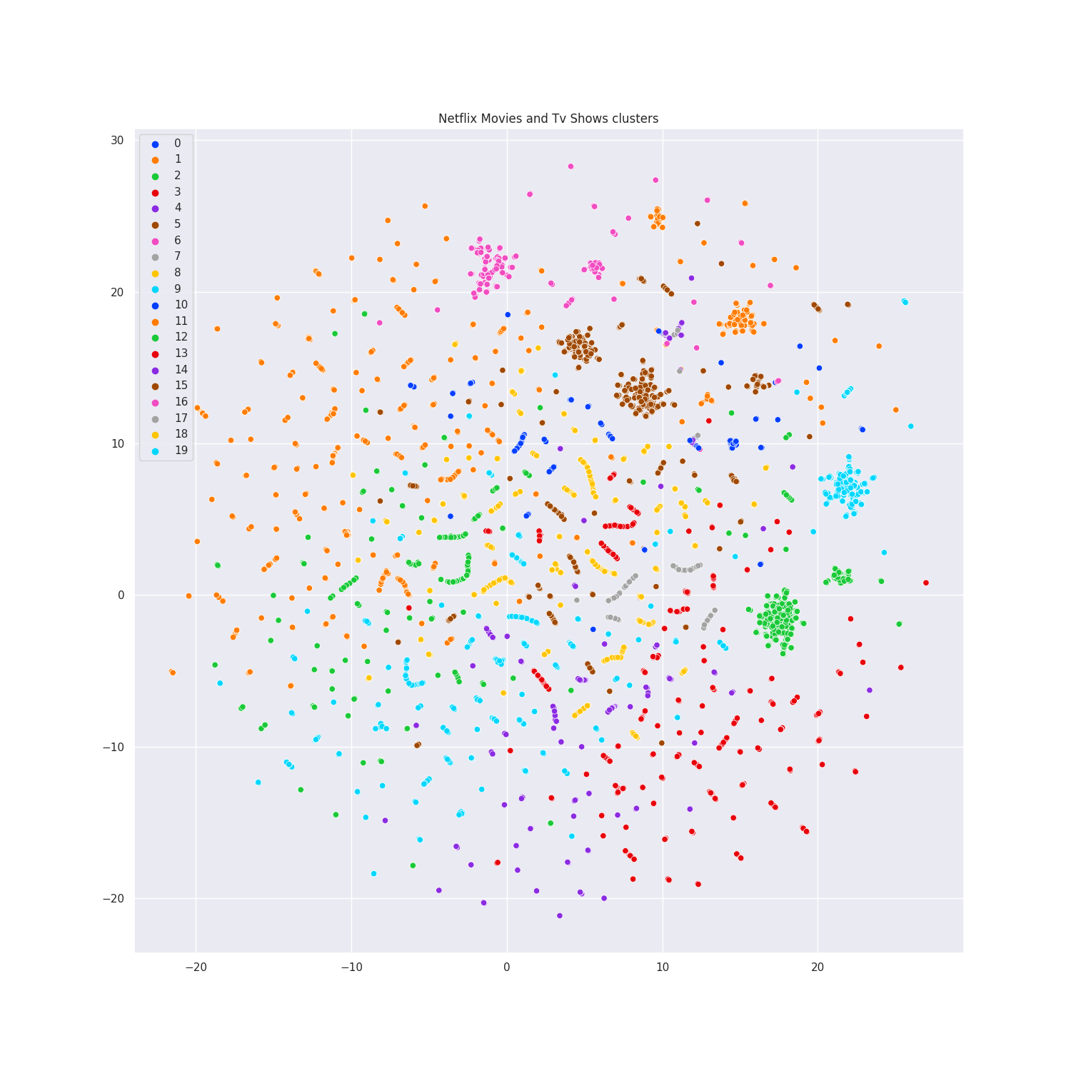
Visualization of the 20 clusters with UMAP
We can identify many clusters and this is a pretty satisfactory result.

Slide 19
Conclusion
Following a thorough examination, we arrive at the results listed below:
Our best model produced a silhouette score of 0.71 with 20 clusters, which that the model is close to be perfect than random.
Netflix can suggest (8804/20), or almost 440 similar TV shows and movies, for each movie or television program. This is the insight we get from the analysis.
The ability to suggest films to clients based on what they typically view is a big perk that enhances the approach the Netflix platform uses to consistently satisfy its users.

Slide 20


