Slide 1

From Gameplay to Expressive Speech: a Multimodal Pipeline for Automatic Football Videogame Commentary
Bachelor’s Degree Programme in Applied Computer Science and Artificial Intelligence
AI Lab: Computer Vision – Signal Processing – Natural Language Processing
Name Surname (Email)
Name Surname (Email)
Name Surname (Email)
Name Surname (Email)
A.Y. 2025/2026
1

Slide 2


Table of Contents
Context
Problem and Motivation
Related Work and Gap with Respect to the State of the Art
Proposed Solution and Our Contribution
Dataset and Experimental Protocol
Critical Discussion and Limitations
Conclusion and Future Work

Slide 3


Context ●
Automatic Expressive Commentary for Football Videogames
The task
A raw EA SPORTS FC gameplay clip goes in; a timed, expressive Italian commentary track comes out. Shipped game commentary is pre-recorded and repetitive - it cannot cover emergent play.
One compact problem chains three AI fields: computer vision (WHAT happens), NLP (WHAT to say), speech synthesis (HOW to say it). Each stage feeds the next.
Everything runs end-to-end on consumer hardware; large pretrained models are used only where they actually transfer to this domain.
AI Lab: Computer Vision – Signal Processing – Natural Language Processing

Slide 4
Table of Contents
Context
Problem and Motivation
Related Work and Gap with Respect to the State of the Art
Proposed Solution and Our Contribution
Dataset and Experimental Protocol
Critical Discussion and Limitations
Conclusion and Future Work

Slide 5
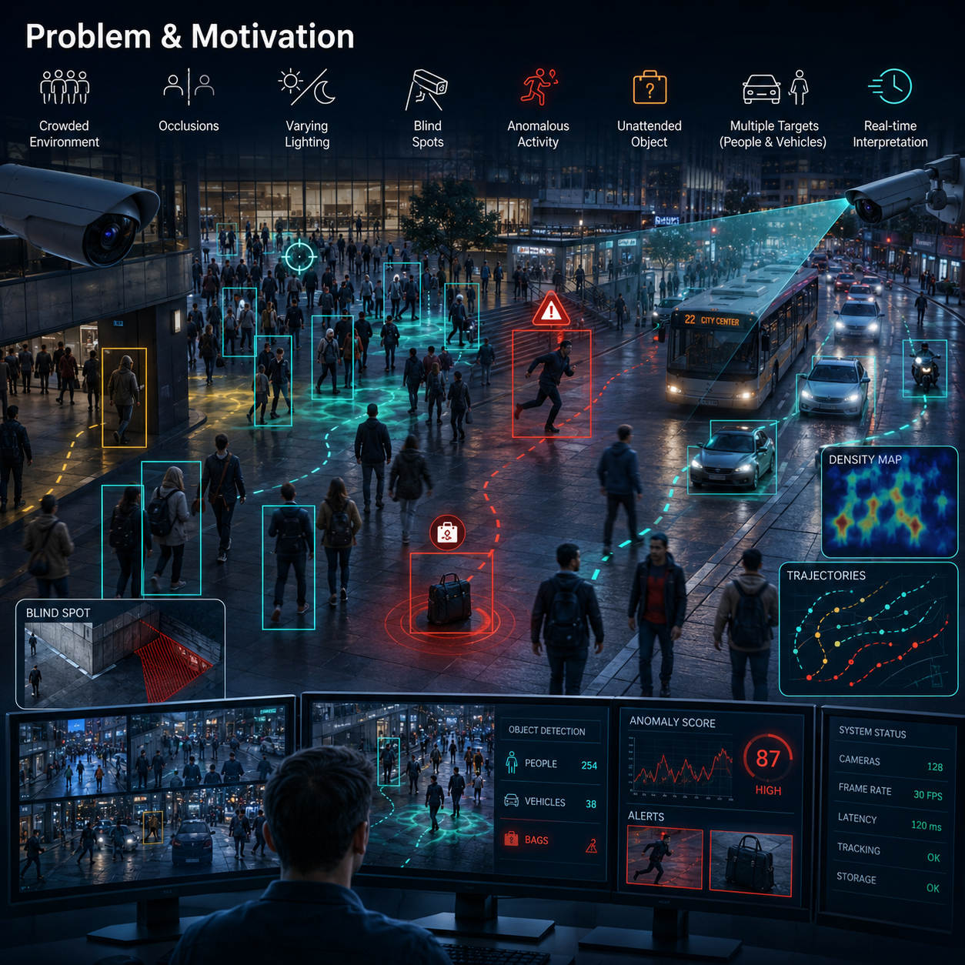
Problem and Motivation ●○
No Data, Noisy Perception: the Real Constraints
Why it is hard
No annotated dataset of videogame football events or commentary exists. State-of-the-art action spotting (SoccerNet) is trained on real broadcasts: the domain gap to rendered game graphics is unquantified.
Expressive TTS with prosody control normally requires thousands of hours of speech in the target register - unavailable for Italian football commentary.
Perception is noisy everywhere: OCR score flicker, motion-blurred balls, goalkeepers lost mid-dive, low-fidelity game audio.
AI Lab: Computer Vision – Signal Processing – Natural Language Processing

Slide 6
Problem and Motivation ○●
No Data, Noisy Perception: the Real Constraints
Our design answer
A modular relay pipeline: each phase writes JSON for the next, so every component can be developed, tested and swapped in isolation.
Pretrained models where they transfer (EasyOCR, YOLOv8, Whisper, XTTS v2); small data-efficient learned components where they do not (prosody MLP).
All game-specific calibration confined to per-interface PROFILES: HUD regions, team rosters, radar marker colors, tracking thresholds.
Evidence-driven engineering: per-frame telemetry is logged, thresholds are derived from measured values, every change passes regression tests on known clips.
AI Lab: Computer Vision – Signal Processing – Natural Language Processing

Slide 7
Table of Contents
Context
Problem and Motivation
Related Work and Gap with Respect to the State of the Art
Proposed Solution and Our Contribution
Dataset and Experimental Protocol
Critical Discussion and Limitations
Conclusion and Future Work

Slide 8

Related Work and Gap with Respect to the State of the Art ●○
SOTA Needs Broadcast-Scale Annotations
State of the art
SoccerNet: action spotting and game state reconstruction on real broadcast footage, trained on hundreds of annotated matches.
Speech stack: XTTS v2 zero-shot voice cloning, Whisper robust multilingual ASR, AST audio tagging, wav2vec2 dimensional speech emotion recognition.
LLMs generate fluent sports commentary from structured data - but hallucinate player names, roles and match facts.
AI Lab: Computer Vision – Signal Processing – Natural Language Processing

Slide 9
Related Work and Gap with Respect to the State of the Art ○●
SOTA Needs Broadcast-Scale Annotations
Our gap and our shortcuts
End-to-end spotting is not applicable without an annotation campaign that does not exist for videogames - so we use interpretable rules over a fine-tuned detector.
Game-native shortcut: the in-game radar is a FREE camera-independent top view - conceptually our 'game state reconstruction'.
Prosody is imposed externally by a small, auditable model instead of a data-hungry end-to-end expressive TTS.
Against hallucination we use a validation layer with template fallback, not prompting alone.
AI Lab: Computer Vision – Signal Processing – Natural Language Processing

Slide 10
Table of Contents
Context
Problem and Motivation
Related Work and Gap with Respect to the State of the Art
Proposed Solution and Our Contribution
Dataset and Experimental Protocol
Critical Discussion and Limitations
Conclusion and Future Work

Slide 11
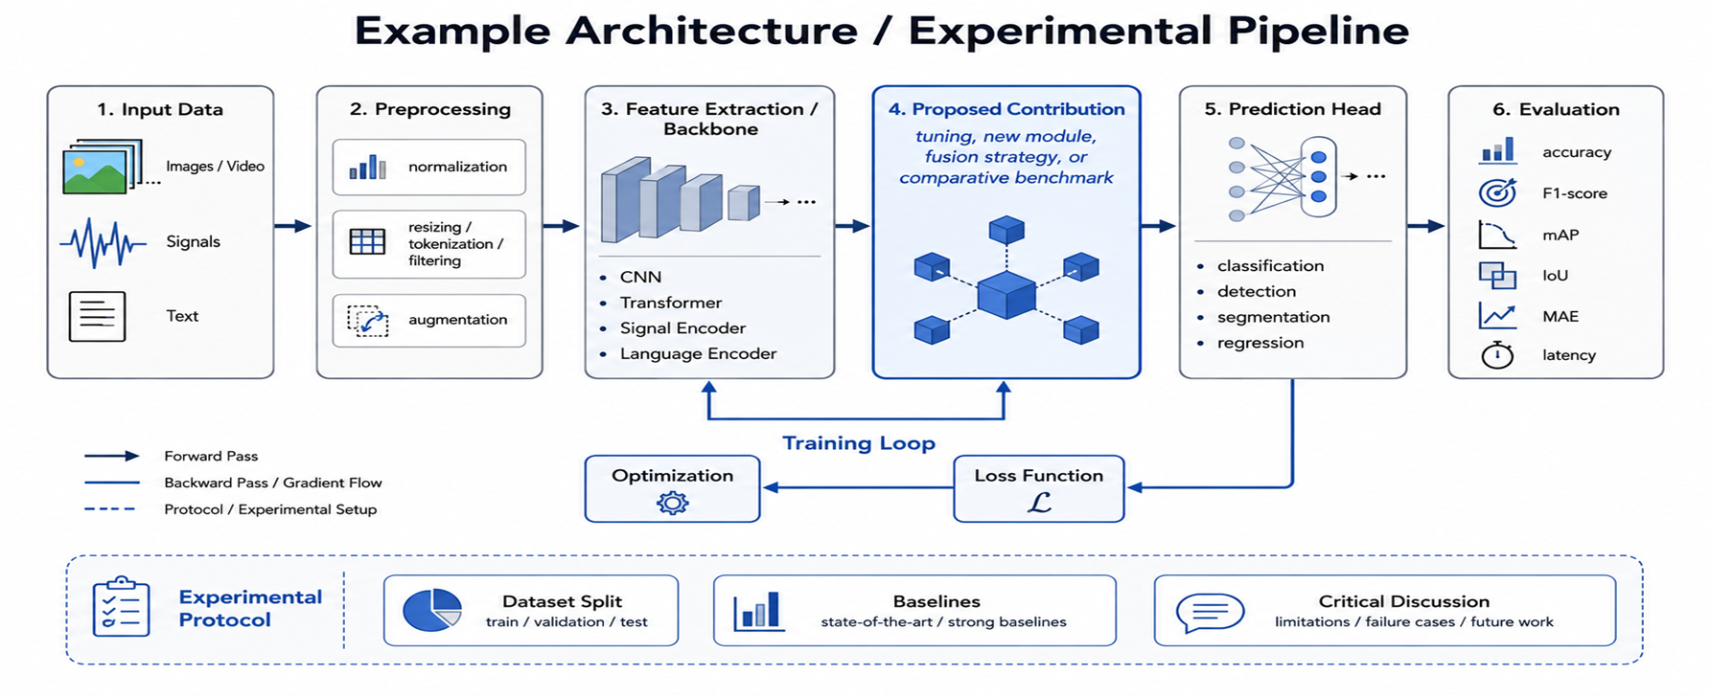
Proposed Solution and Our Contribution ●○○
An Event-to-Speech Multimodal Pipeline
Phases 0-1: video normalization; HUD OCR with score debouncing and fuzzy roster matching ("INHOS" resolves to MARQUINHOS).
Phases 1b-1c: fine-tuned YOLOv8 (960 px, 8 fps), ball tracking in px/s, calibrated event rules; radar possession; audio-energy descriptor + Whisper.
Phases 2-4: template/LLM text guarded by the validator, event-aware prosody MLP, XTTS dual-voice cloning placed on a synchronized timeline.
AI Lab: Computer Vision – Signal Processing – Natural Language Processing

Slide 12
Proposed Solution and Our Contribution ○●○
An Event-to-Speech Multimodal Pipeline
The learned contribution: event-aware prosody
A small MLP (hidden 32, 16): event type one-hot + importance + measured audio energy (13 features) -> speaking rate, pitch, energy gain, safely clamped.
It drives XTTS v2: rate modulates speed, energy modulates gain; dual reference voice - calm base, excited timbre only above an importance threshold.
Real-data training path implemented: prosodic targets measured from annotated commentary segments (onset density, pYIN f0, RMS, median-normalized).
Verified by a 10-segment bootstrap: the model DIVERGES from the hand-written rules; with synthetic data it can only reproduce them - stated openly.
AI Lab: Computer Vision – Signal Processing – Natural Language Processing

Slide 13
Proposed Solution and Our Contribution ○○●
An Event-to-Speech Multimodal Pipeline
Keeping the text honest: LLM + validator
Templates are the deterministic, hallucination-free floor: event slots filled from possession-corrected data.
Interchangeable LLM providers (local Ollama Llama 3.2, Groq, OpenAI, Anthropic) with per-event verb constraints in the prompt.
Every generated line is fuzzy-matched against the event and BOTH rosters: violations are discarded and fall back to templates, with the outcome recorded.
Measured on a 22-event clip (local 3B model): 9 LLM lines accepted, 7 name-only, 6 template fallbacks - invented players caught and blocked.
AI Lab: Computer Vision – Signal Processing – Natural Language Processing

Slide 14
Table of Contents
Context
Problem and Motivation
Related Work and Gap with Respect to the State of the Art
Proposed Solution and Our Contribution
Dataset and Experimental Protocol
Critical Discussion and Limitations
Conclusion and Future Work

Slide 15
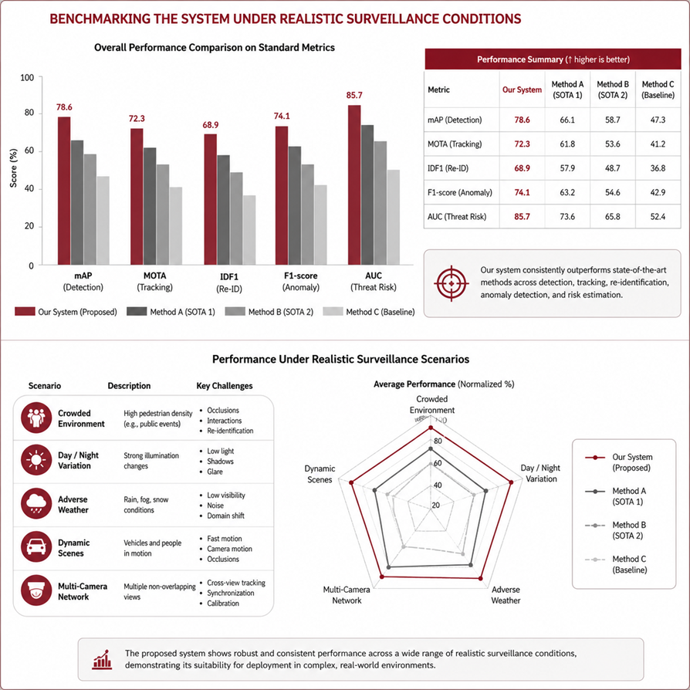
Dataset and Experimental Protocol ●○○
Behavioural Evaluation on Real Clips
Data
Seven self-recorded EA SPORTS FC clips (8-42 s, ~3.5 min total) across two matches and two graphics generations; clip names encode ground truth (shot-and-save, shot-off, possession-only).
Detector dataset: 660 legacy Roboflow images + 2,567 of our current-graphics frames (anti-cutscene filter, pre-labeled, human-verified) = 3,227 images, 70/20/10.
Three current-graphics clips never used for any calibration serve as a held-out behavioural test; one clip was kept out of annotation entirely.
AI Lab: Computer Vision – Signal Processing – Natural Language Processing

Slide 16

Dataset and Experimental Protocol ○●○
Behavioural Evaluation on Real Clips
Training and protocol
Detector fine-tuned FROM the base FIFA weights (adapt style, not re-learn): 40 epochs, 960 px, lr 1e-4, frozen backbone, batch 8, Colab T4 (~1.2 h).
Prosody MLP: Adam 1e-3, MSE, 200 epochs, best-validation checkpoint, fixed seed; StandardScaler on features.
Evaluation is behavioural: frame telemetry (ball/GK visibility), event correctness vs ground truth with regression tests, validator outcome counts. Benchmark mAP reported but treated as optimistic (split leakage, circular pre-labels).
AI Lab: Computer Vision – Signal Processing – Natural Language Processing

Slide 17
Dataset and Experimental Protocol ○○●
Behavioural Evaluation on Real Clips
Results
Detector fine-tuning, identical frames: goalkeeper 40%->66% and 13%->23% of frames; ball 27%->32% and 35%->47%. Validation mAP50-95: 0.529 -> 0.664.
Events: 4/4 calibration clips correct after telemetry-driven recalibration; 3 held-out clips behave correctly (real save verified visually, zero false events on possession-only material).
Audio energy recalibrated to clip percentiles: full 0-1 range and all four levels populated (before, 'peak' never fired).
Prosody reacts to the measured signal: same event, energy gain 1.23 -> 1.35 and rate 1.10 -> 1.27 as audio energy goes from 0 to 1.
AI Lab: Computer Vision – Signal Processing – Natural Language Processing

Slide 18
Table of Contents
Context
Problem and Motivation
Related Work and Gap with Respect to the State of the Art
Proposed Solution and Our Contribution
Dataset and Experimental Protocol
Critical Discussion and Limitations
Conclusion and Future Work

Slide 19
Critical Discussion and Limitations ●
Coupled Heuristics, Out-of-Domain Models, Honest Limits
What we learned - including failures
Improving the detector BROKE a save rule that was implicitly tuned to the old detector's failure mode: heuristics are coupled to perception. Re-derived from clean telemetry, validated by regression.
Negative results: AST finds no crowd in our audio (it is speech + effects, Crowd = 0.00); SER arousal is flat and inverted (domain mismatch). The signal was honestly renamed 'audio energy'.
Main limitation: prosody is currently trained on synthetic rule-derived data, so the A/B study would be circular - until the real annotation campaign (protocol and tooling ready).
Cloning residue: slight robotic timbre and Italianized foreign names (NEUER, KIMMICH) - a phonetic respelling dictionary is the planned fix.
AI Lab: Computer Vision – Signal Processing – Natural Language Processing

Slide 20
Table of Contents
Context
Problem and Motivation
Related Work and Gap with Respect to the State of the Art
Proposed Solution and Our Contribution
Dataset and Experimental Protocol
Critical Discussion and Limitations
Conclusion and Future Work

Slide 21
Conclusion and Future Work ●
From Pixels to a Voice That Reacts
Takeaways
A working end-to-end multimodal pipeline: clip -> events -> validated text -> expressive cloned speech, on consumer hardware.
Contributions: event-aware prosody model (real-data path verified), measured anti-hallucination validator, domain fine-tuning, telemetry + regression-test methodology.
Philosophy: declare what is reused, what is ours, and what failed and why - negative results are results.
Next: prosody annotation campaign -> genuinely learned model -> blind A/B listening study (binomial test, already implemented).
AI Lab: Computer Vision – Signal Processing – Natural Language Processing

Slide 22

THANK YOU FOR LISTENING!
ANY QUESTIONS?

