Slide 1

EE221L Final Project
Angelo Nolasco

Slide 2
Project description
The noise detector should be able to detect the noise level someone makes. Also any sound, like clap, TV sound, music, etc. So A LED should turn on when it hear a sound, when the noise level is normal or loud the led turn on. When the noise level low the led will just blink, and no noise turns off. IF you yell and take 1 second pause the led will blink fast.

Slide 3
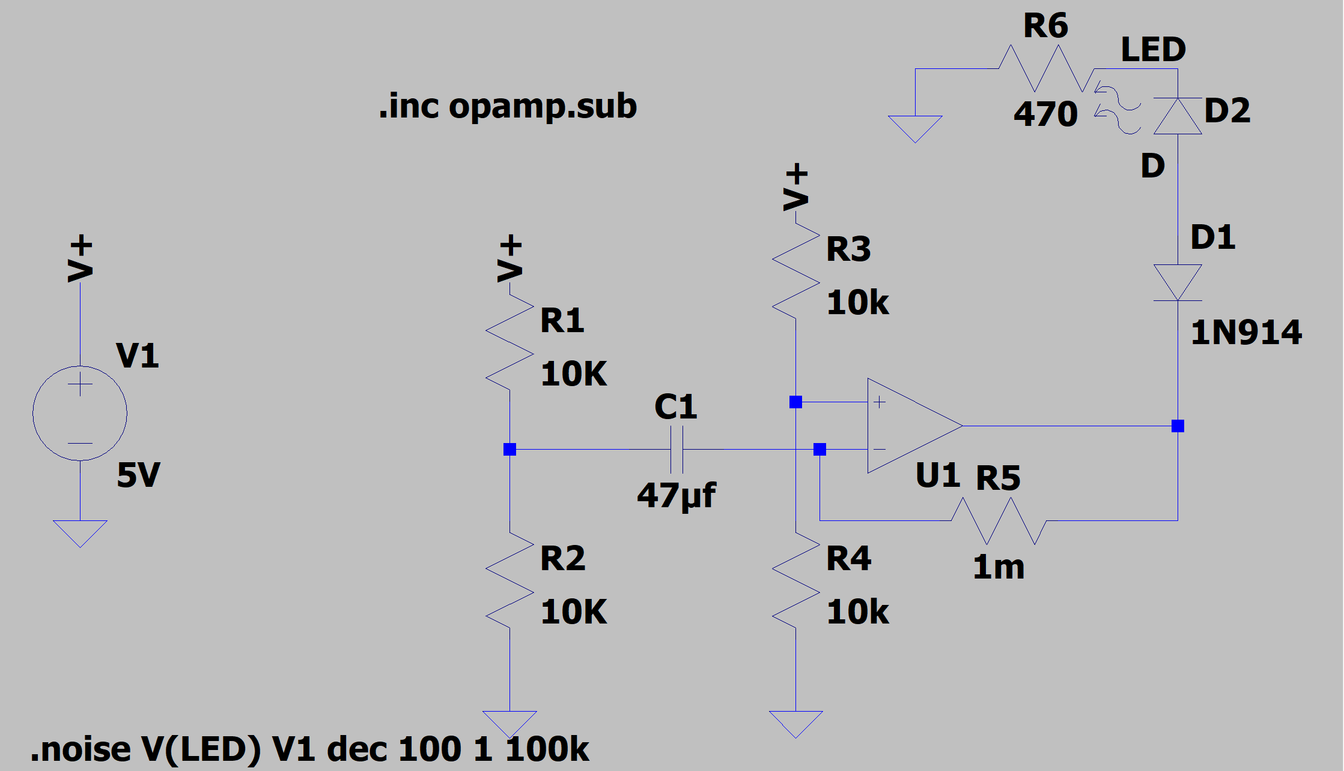
Circuit Implementation

Slide 4
Circuit Explanation
I put two voltage divider to create a smaller resistor for the op amp, the voltage dividers are the 10k.
Then I put a feedback resistor which is the 1M. It acts like a negative feedback for the op amp.
I add a diode, so when there no noise the LED will turn off.
The 5v is the power it gives to the led, and the mic.

Slide 5
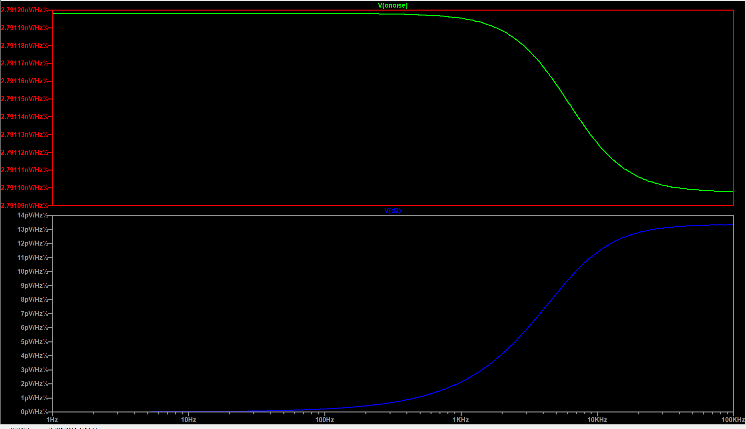
Circuit Output

Slide 6
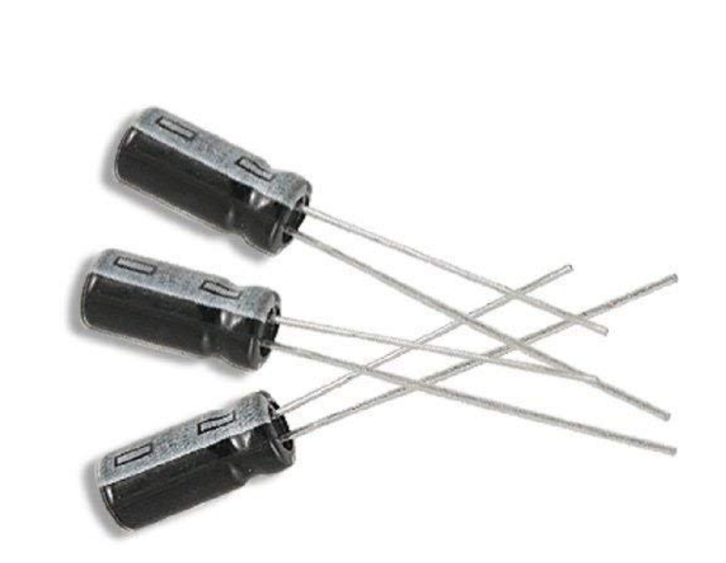

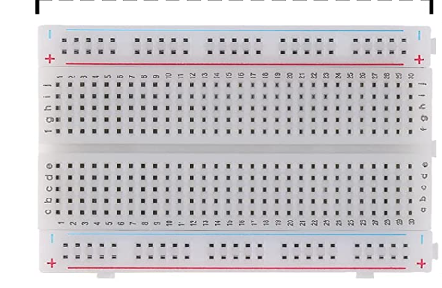
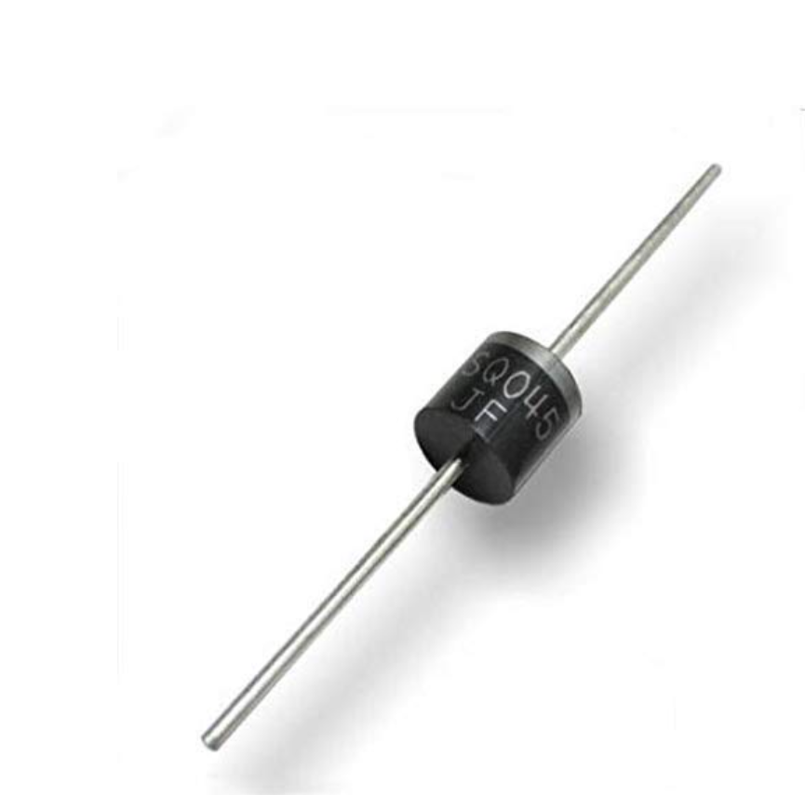
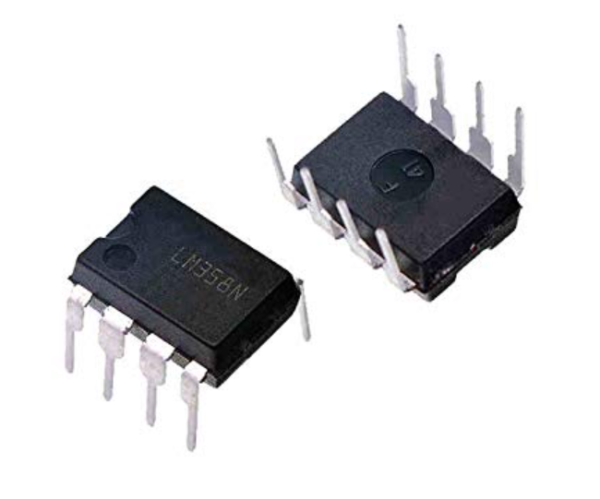
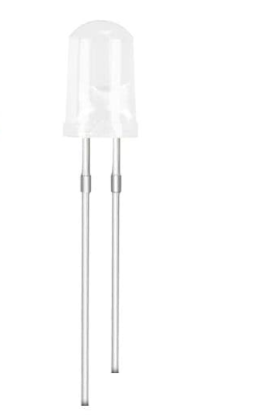
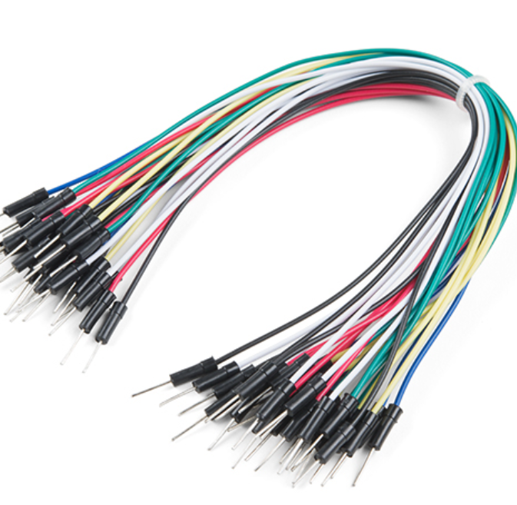
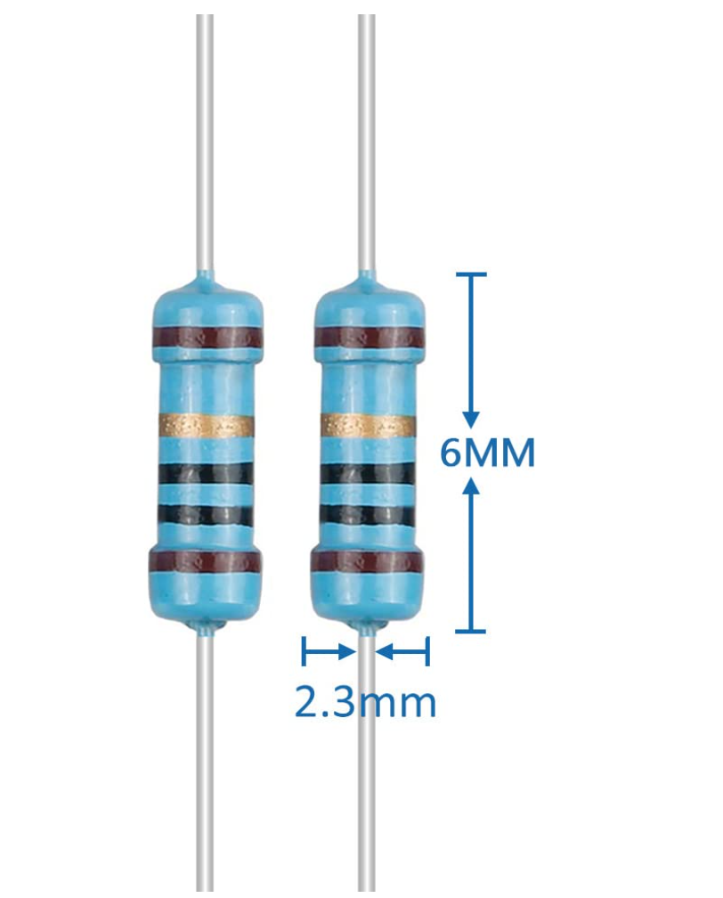
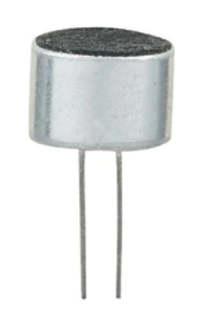
Application and components used for the project
APPLICATION
LTSPICE
COMPONENTS
Breadboard
0.47uF Capacitor
5v battery
LED
LM358 op amp
Diode
470,10k,1M Resistor
Microphone
Jumper wires

Slide 7
Issue Encounter
First Issue was getting noise to show the led turn on in simulation on LTSPICE

Slide 8
Solution
First Issue
The main issue was get noise, so it can show to LED turn on in the simulation. What I did was use the simulation command, which allowed me to use the noise simulation. Since LTSPICE has no component for microphone. The use noise simulation it allow you to set the frequency from start to end. They you but the input, the output is the what is graph which is the noise.

Slide 9
Issue Encounter
Second Issue was that I did not get the right size on diode.

Slide 10
Solution
Second Issue
The main issue was that the diode was too big to fit in my breadboard. So what I did was use two test hook clip and jumper wires to connect to the breadboard.

