Slide 1

TypeScript&Cypress

Slide 2
JavaScript Dynamic type
JavaScript provides a dynamic type system
The Good:
Variables can hold any object
Types determined on the fly
Implicit type coercion
The Bad:
Difficult to ensure proper types are passed within tests
Enterprise-scale apps can have 1000s of lines of code to maintain
lack of OOP principle (i.e. encapsulation, interfaces…)
Notes:
Type coercion means that when the operands of an operator are different types, one of them will be converted to an "equivalent" value of the other operand's type. For instance, if you do:
boolean == integerthe boolean operand will be converted to an integer: false becomes 0, true becomes 1. Then the two values are compared.
However, if you use the non-converting comparison operator ===, no such conversion occurs. When the operands are of different types, this operator returns false, and only compares the values when they're of the same type

Slide 3
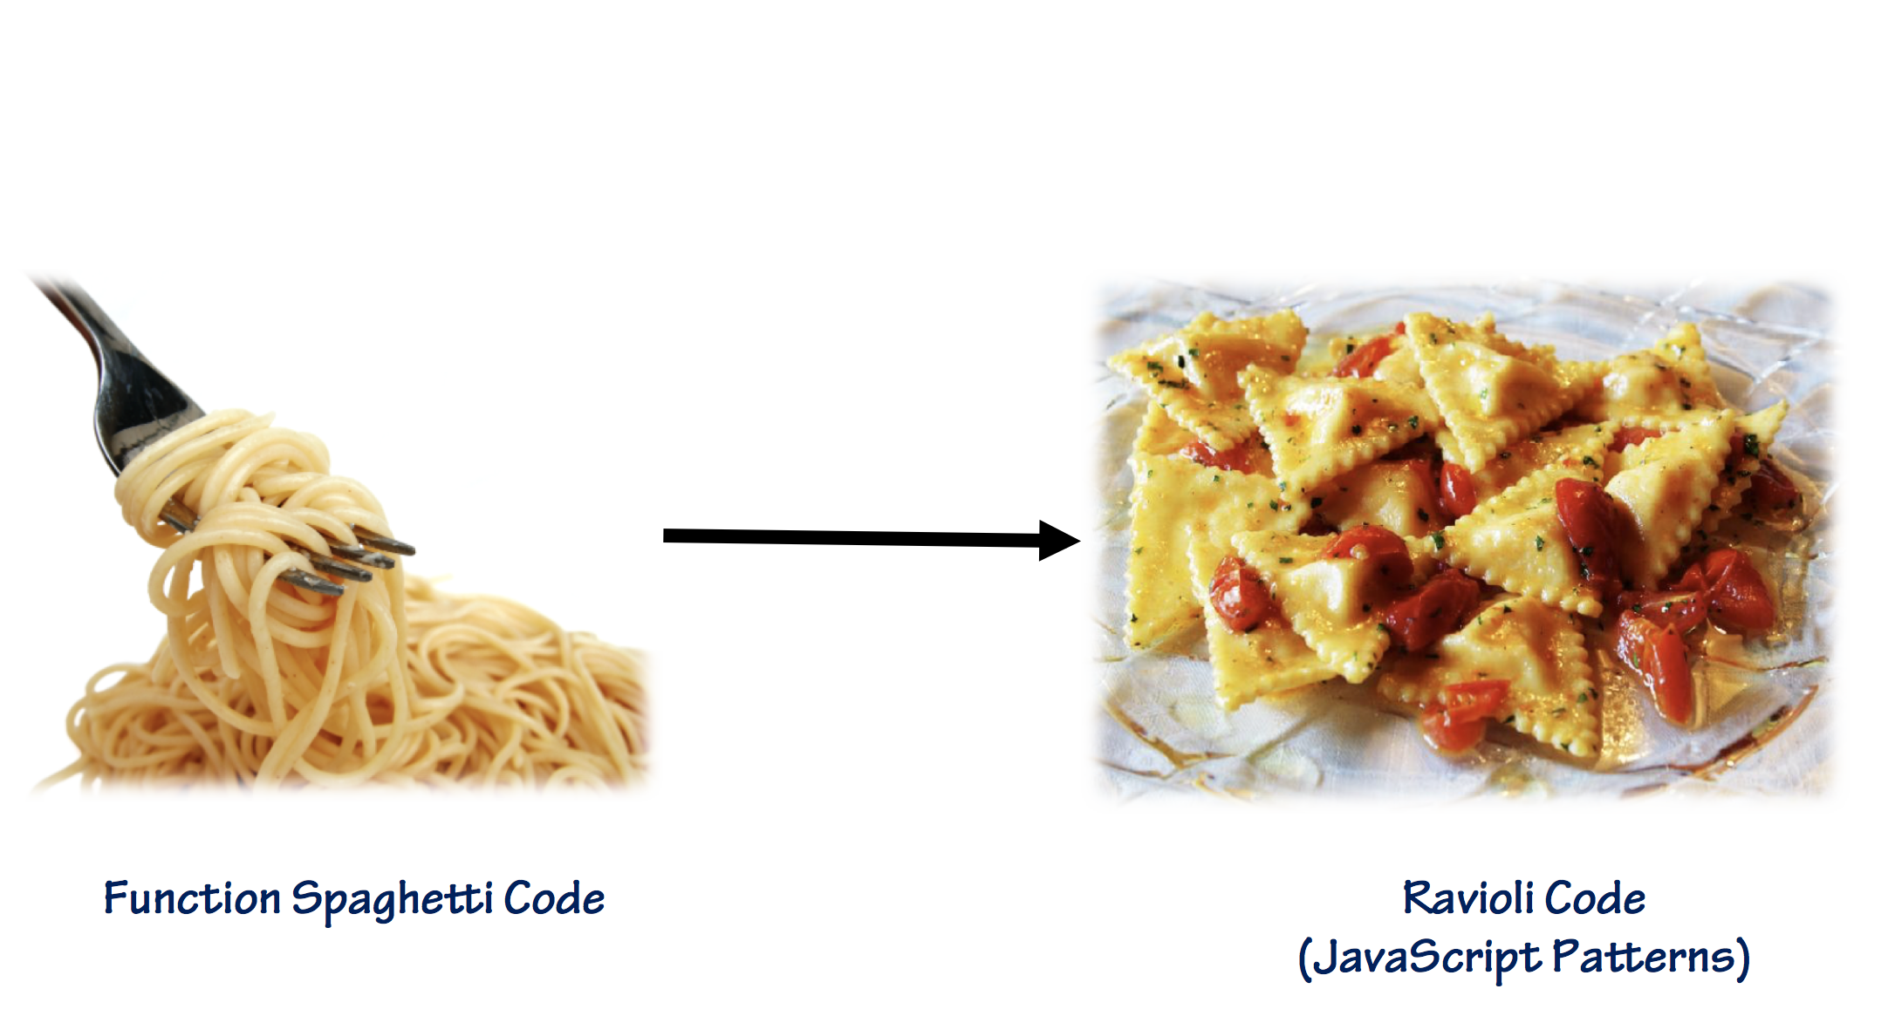
Code Encapsulation

Slide 4
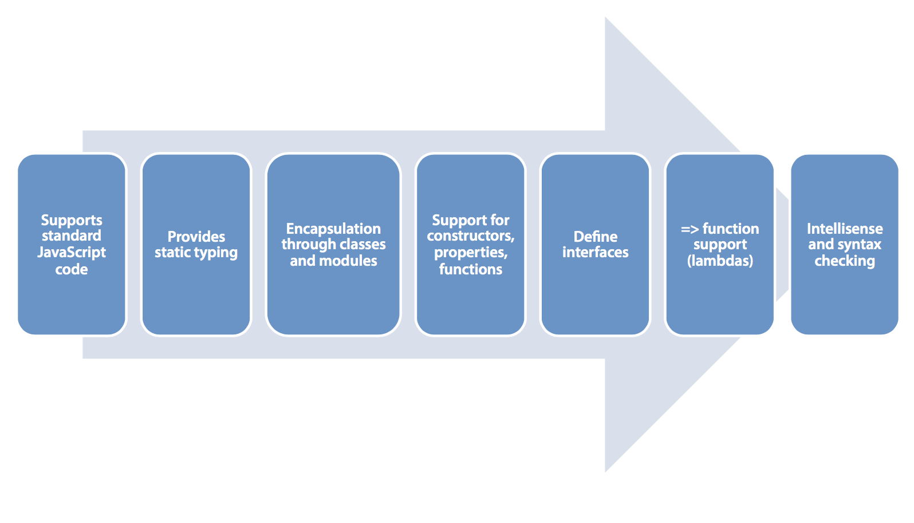
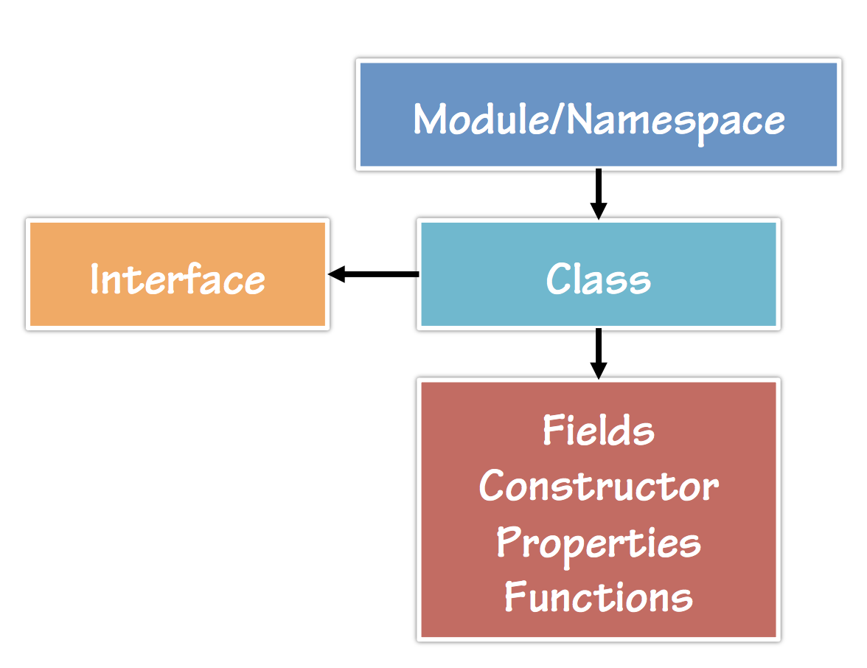
What is TypeScript?
"TypeScript is a typed superset of JavaScript that compiles to plain JavaScript.“ ~ typescriptlang.org
- Flexible options: Any Browser, Host, OS, Open source, Tool Support

Slide 5
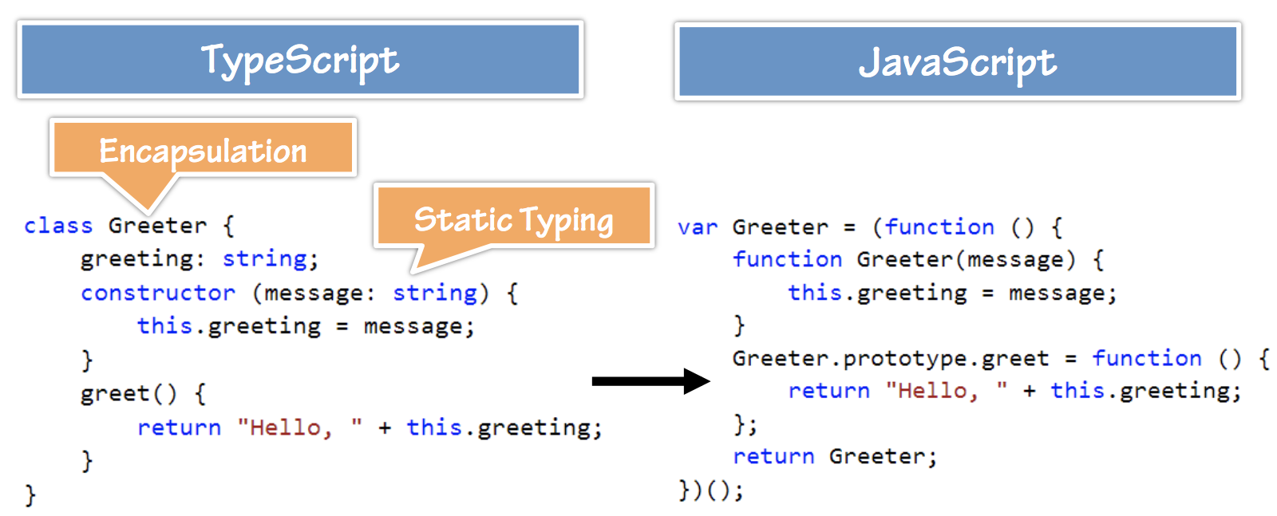
TypeScript -> JavaScript
Notes:
The JavaScript prototype property allows you to add new properties to an existing prototype

Slide 6
Important Keywords and Operators
Keyword | Description
class | Container for members such as properties and functions
constructor | Provides initialization functionality in a class
exports | Export a member from a module
extends | Extend a class or interface
implements | Implement an interface
imports | Import a module
interface | Defines code contract that can be implemented by types
module / namespace | Container for classes and other code
public/private | Member visibility modifers
... | Rest parameter syntax
=> | Arrow syntax used with definitions and functions
<typeName> | < > characters use to cast/convert between types
: | Separator between variable/parameter names and types

Slide 7
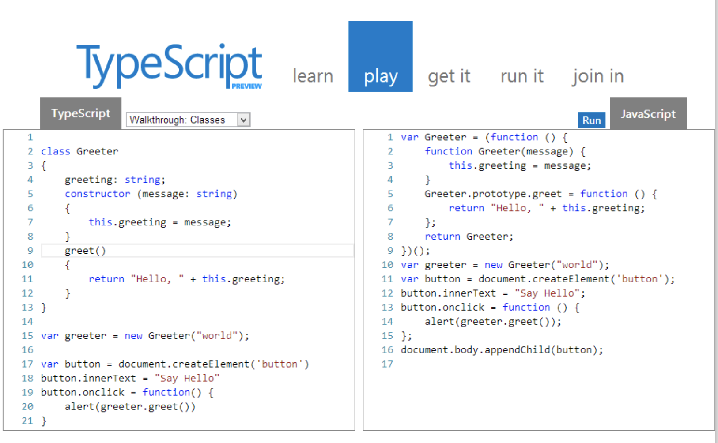
Tools/Framework Support
Node.js Emacs
Visual Studio
Sublime
Atom
TypeScript Playground online

Slide 8
Typed-cypress
TypeScript type definitions for Cypress. Provided by StackState.
Installation:
typings install github:StackVista/typed-cypress dt~mocha --global --save
This should write to typings.json something like this:
{ "globalDependencies":
{ "cypress": "github:StackVista/typed-cypress",
"mocha": "registry:dt/mocha#2.2.5+20161221010438" } }
@types/cypress package. Provided by npmjs.
Installation:
npm install --save @types/cypress

Slide 9
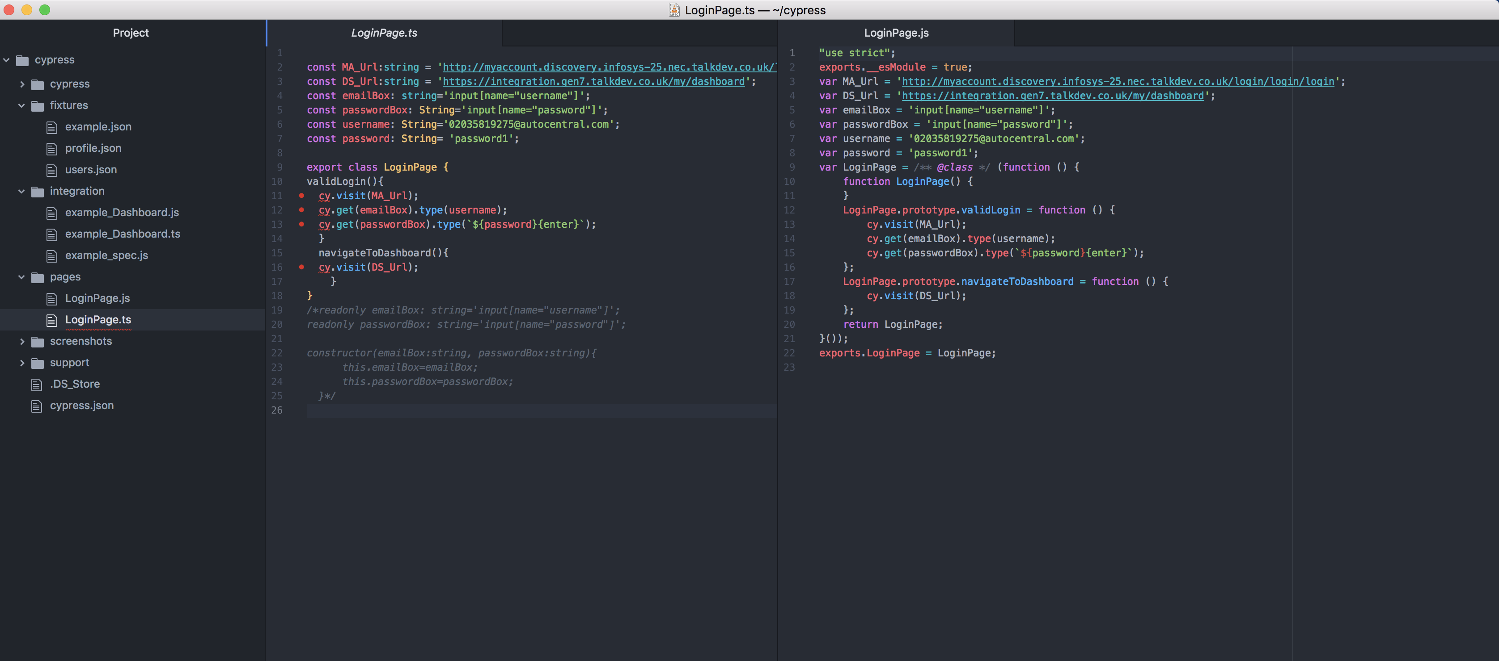
TypeScript files with cypress extension
Compile a .ts file: tsc LoginPage.ts
Open Cypress:./node_modules/.bin/cypress open
Notes:
The JavaScript prototype property allows you to add new properties to an existing prototype

Slide 10
Why choose Typescript?
Modularity (POM, BDD, patterns)
Scalability
Maintainability
Large Projects or Multiple Developers: TypeScript makes the most sense when working on large projects or you have several developers working together. Using TypeScript’s interfaces and access modifiers can be invaluable in communicating APIs (which members of a class are available for consumption).
Automation Tester/ Developer with OOP background

Slide 11
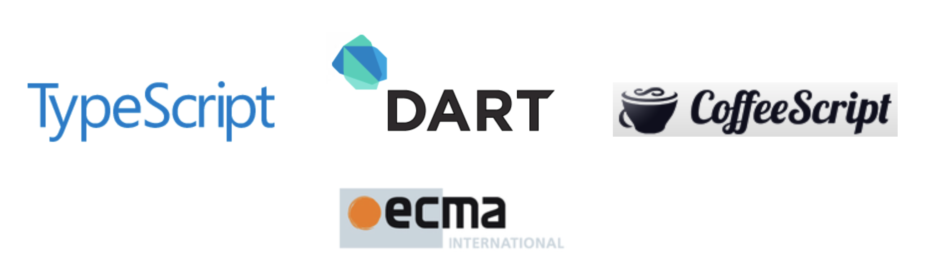
What are the Alternatives?
Several TypeScript alternatives exist:
Write pure JavaScript
Apply JavaScript patterns
CoffeeScript – http://coffeescript.org
Dart – http://dartlang.org

Slide 12
Useful links
Roadmap · Microsoft/TypeScript Wiki
Microsoft/TypeScript
Welcome to TypeScript
Handbook - Welcome to TypeScript
Microsoft/TypeScript-Sublime-Plugin
palantir/eclipse-typescript
atom-typescript
https://github.com/Microsoft/TypeScript-Sublime-Plugin
borisyankov/DefinitelyTyped
Home | DefinitelyTyped
TypeScript/spec.md at master · Microsoft/TypeScript
Architectural Overview · Microsoft/TypeScript Wiki
https://docs.cypress.io/examples/userland/userland-extensions.html
https://www.pluralsight.com/courses/typescript

