Slide 1

GITHUB WORKSHOP
THE BASICS

Slide 2
WHY GITHUB?
It provides a way for multiple people to work on the project at the same time!
It’s used professionally by major tech companies.
It’s a great tool for maintaining version control.
The software is already on the university’s computers.

Slide 3
TERMINOLOGY
Version Control: It’s the process of tracking and making changes to code, in school projects this don’t matter too much, but in bigger projects(aka finals, 10k lines of code) this MATTERS.
Git: A open source (anyone can edit it/ FREEEEEE) program for tracking changes in files.
Repository(repo) : A bunch of code in a folder, either on the web or on your computer.
Main: The default development branch, where unless you change it, all you edits will happen here and affect all the things.
Branch: A parallel copy of a repo, residing in the same repo. Useful for VERSION CONTROLL, you can mess with stuff on here without affecting MAIN and can merge it back into main when you want.
Fork: This is making a personal copy of someone else’s REPO for your use. It can be Merged back into the original at ANY time.

Slide 4
TERMINOLOGY (Words… So Many Words…)
Pull Request: This is how we merge either a branch or a fork back into the MAIN codebase
Git Clone: This is where we copy a remote repo (such as one on the internet) to our computer
Git Checkout: This is how we change branches on a local repository (ADVANCED TOPIC)
Git Add(or Stage): This preps the changes you’ve made to be sent back to the remote repository on github. They then need to be committed
Git Commit: This records the changes you’ve made, and in this step, you add a MESSAGE on what you’ve changed.
Git Push: This pushes your changes on your local machine to the remote repository.

Slide 5
Prologue (or, download Git)
First thing figure out is your computer 32 or 64 bit.
Do this by searching in your taskbar and type system information.
Next Google Git or go to this link https://git-scm.com/downloads
Click downloads, click your operating system, and if your on Mac you may now cry.
Download it and follow the instructions
THE ONLY THING TO EDIT IN THE INSTALLATION IS GIT’s DEFAULT EDITOR
Otherwise keep the selected stuff.

Slide 6
Step 1 - Get an Account
Google Github
Go to main webpage
Look at the top right for the sign up
Follow the prompts
NOTE: You can have multiple emails connected to one account, so don’t worry about if you should use your angelo.edu email or your personal one

Slide 7
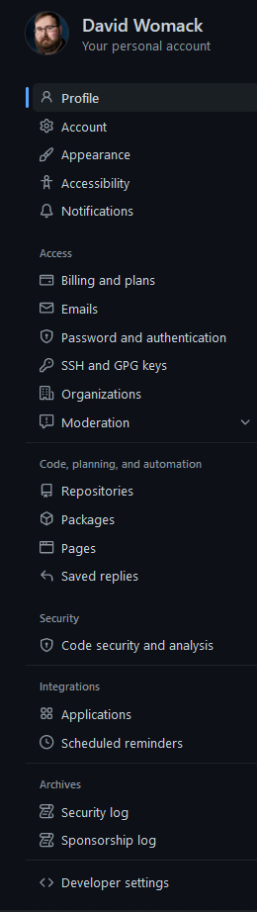

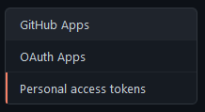
Step 2: Create a Personal Access Token (PAT)
Click the Icon on the top right
Go to Settings.
On the Left, Click on Developer Settings.
Click on Personal Access Token
Generate a New Token
Name it, set when it expires, select all the checkboxes.
COPY IT, THIS IS THE ONLY TIME YOU WILL SEE IT, EMAIL IT TO YOURSELF

Slide 8
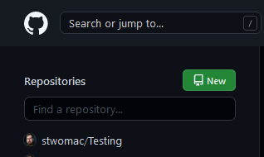
Step 3: Creating a Repository
Click the cat logo on the upper Left
Click on the New Button
Give it a name, make this first one private, and click the add README file
Then Hit click create.

Slide 9
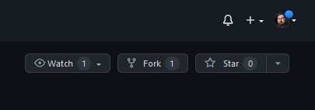
Step 4: Fork a Repository
Go to https://github.com/AngeloStateCS/GitWorkshop
Hit the Fork button on the top right.
And BOOM you got a copy of it on your github account

Slide 10
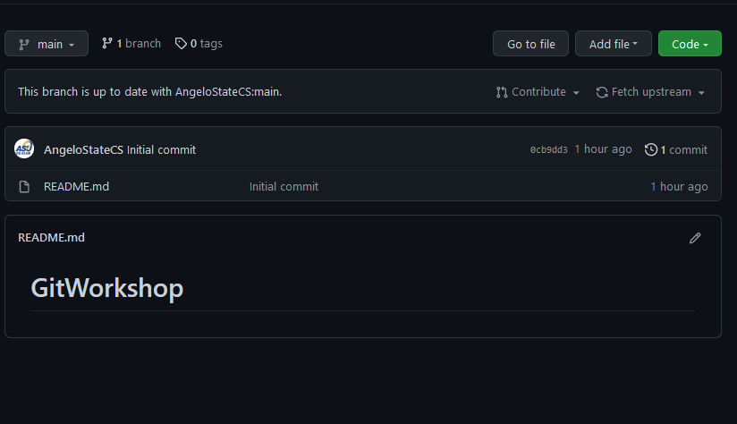
Step 5a (GIT GUI): Getting it on the Local Machine
Click on Code on your local fork.

Slide 11
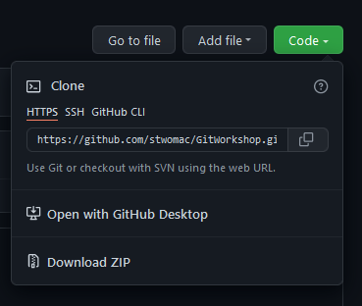
Step 5a (cont.)
Copy the https link

Slide 12
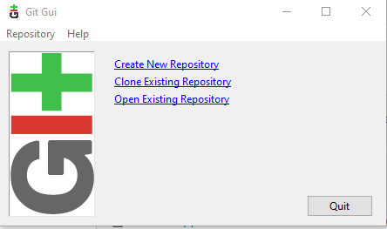
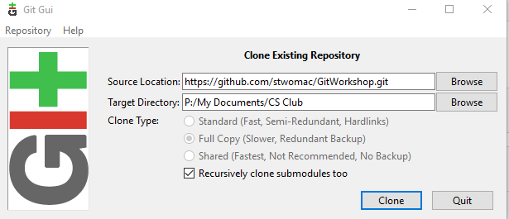
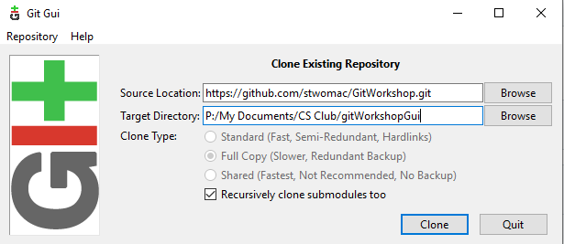
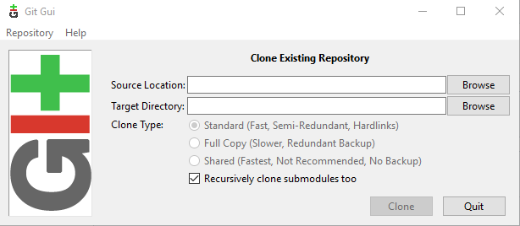
Step 6: Git Gui
Open up the start menu, and search git gui, and click it.
Click on Clone Existing Repository
In Source Location, paste that https link
In target Directory, select a file to store the repo in.
Now add a /[fileNameHere] to the end of the target
directory, this will be the name of the file your repo will be stored in.

Slide 13
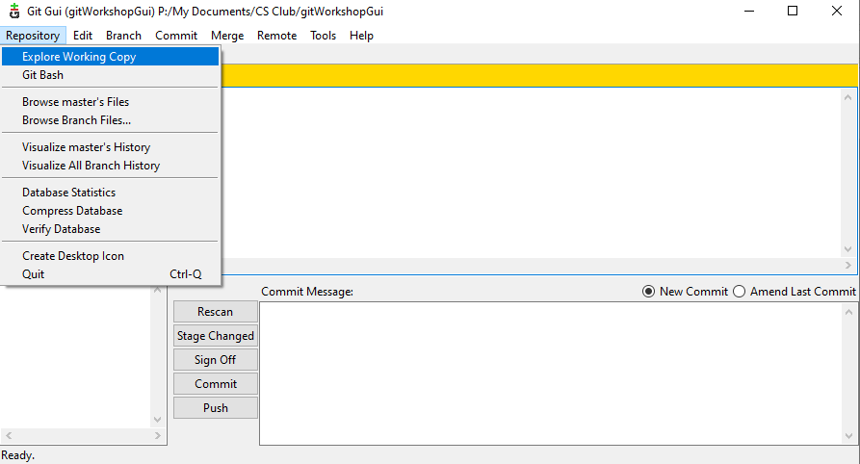
Step 6a: Opening up your local copy
Click on Repository on the top left.
Click on explore working copy.
Welcome to your local copy of the code from the internet!
Go ahead and right click, and make a new text document, name it the something unique +GitGUI
Ex: bananaGitGui.
Now open that text file and write some gibberish in it, and save it.
THE WRITING PART IS IMPORTANT. Blank text files are not uploaded onto github.

Slide 14
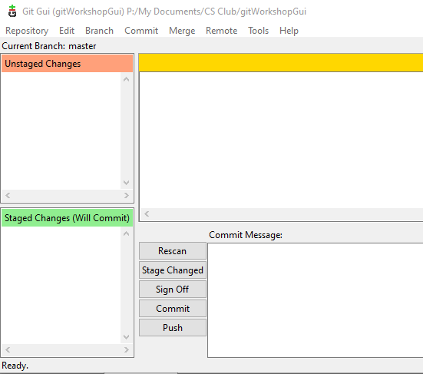
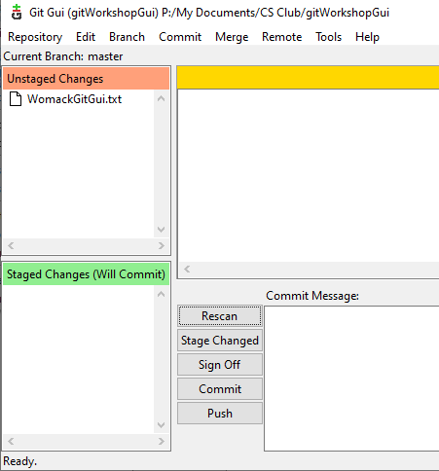
Step 7a: Git Gui
Now go back to your gui, and it will look something like this
Click on rescan, and it will now look like this:
Hit Stage Changed and it will move down a section.
Now type something in the commit message box, this is the
same thing as commenting your code. Basically a short and sweet
message for why your changing the repo.
5. Hit push and you’ll get a new screen where you’ll just hit push
again.

Slide 15
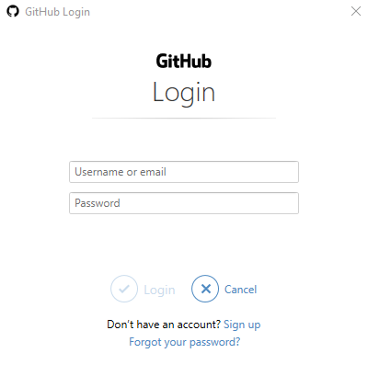
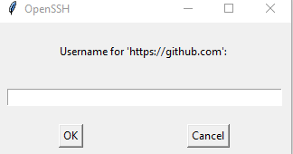
Step 8a: Authentication
Welcome to the password part, and where working at the school is a bit weird.
You’ll see this screen
Enter your github email, and your PAT
Now you’ll see this, enter the github email and the
PAT again.
5. And congrats! That file is now on the internet,
where companies can judge you for it’s content.
Notes:
Remember to show them a updated repository at the end of this slide

Slide 16
Step 5b (GIT Bash): Getting it on the Local Machine
Click on Code on your local fork.

Slide 17
Step 5b (cont.)
Copy the https link

Slide 18
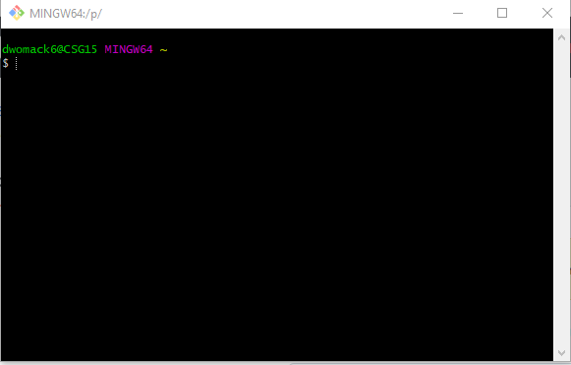
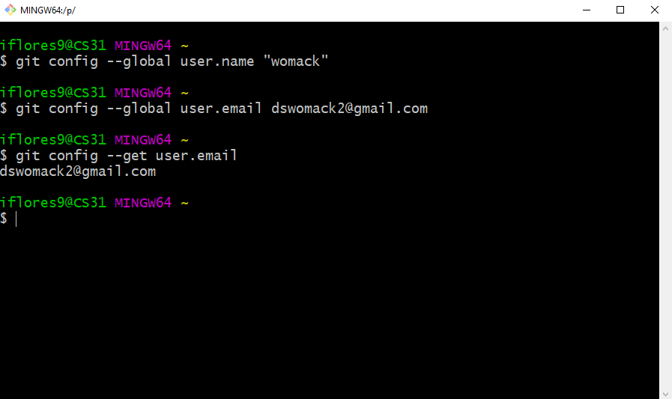
Step 6b: Git Bash
Note, for people that don’t wanna do things on the command line, you can take a nap now.
For the rest of us, go to the start menu and search up git bash and click on it.
git config --global user.name “[YOUR NAME]” git config --global user.email [YOUR EMAIL]
You should see this.
Use the cd command to navigate to your
documents, note you can just type
cd My and then hit the tab key to autofill.

Slide 19
Step 7b: Getting a local copy
Now that your in My Documents, type
mkdir repos
To create a folder for your repos and cd into it.
Now for the next part you need to know that shift + Insert is how you paste things in git bash
So type without the brackets
git clone [https link here]
Ex:
git clone https://github.com/stwomac/GitWorkshop.git

Slide 20


Step 7b(cont)
Now if you type ls (that’s a lowercase L) you should see this now
So cd into it.
Now type
touch [inset name here]GitBash.txt

Slide 21
Step 8b: Editing files on Git Bash
You can edit these files in one of three ways on school machines easily.
git explorer . This open up the file explorer
code WomackGitBash.txt If Visual Studio Code is on the computer it will open it up
start notepad++ WomackGitBash.txt This will open up the file in notepad++
Either way you do it add some gibberish to that text file.

Slide 22
Step 9b: Git workflow
To upload things back to the repo type these things.
git add . Note: the period adds all the things in the current file so do it high up in the file chain
git commit –m “This is where your comment on the changes go”
git push
Note sometimes the authentication will show up, and you might see that it doesn’t work the first time, just look for the dialog boxes on the next slide to fill out and it’ll go through (if nothing else on the second git push command)

Slide 23
Step 10b: Authentication
Welcome to the password part, and where working at the school is a bit weird.
You’ll see this screen
Enter your github email, and your PAT
Now you’ll see this, enter the github email and the
PAT again.
5. And congrats! That file is now on the internet,
where companies can judge you for it’s content.

Slide 24

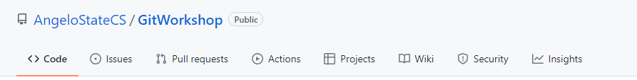
Merging Forks
So we have your code, which is a copy of someone’s code you edited. How can you mix them?
MERGING
First click back to your online repository
Now click on pull requests near the top.
Click on the green button that says “New pull request” on the right

Slide 25
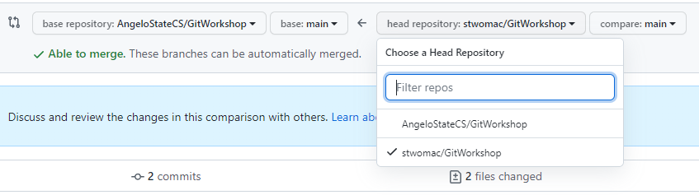
Merging Forks(cont)
At the top you’ll need to click on the head repository and then your forked repo(what we’re merging into the main repo)
Hit the create pull request button, and fill out the form, and your done!

Slide 26
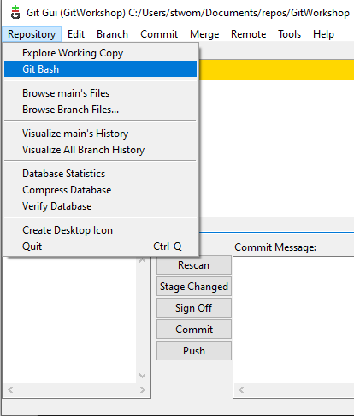
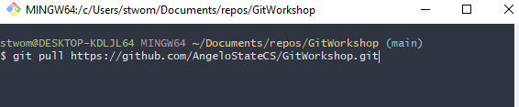
Pulling from a Repository
Or, how to grab an update from the repo
If you're on Git Gui, click on the upper left and hit Git Bash
Once your on git bash, type
git pull [insert https link here]
Remember shift + insert to paste
Ex:

Slide 27
