Slide 1
JSBB – Rules Algebra
Liviu Frateanu

Slide 2
Agenda
osstotalsoft/jsbb
RULES-ALgebra
Rules-algebra-react
Live coding

Slide 3
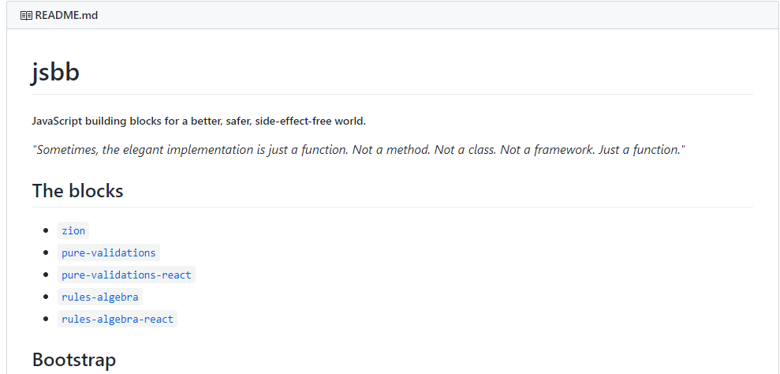
JSBB - https://github.com/osstotalsoft/jsbb

Slide 4
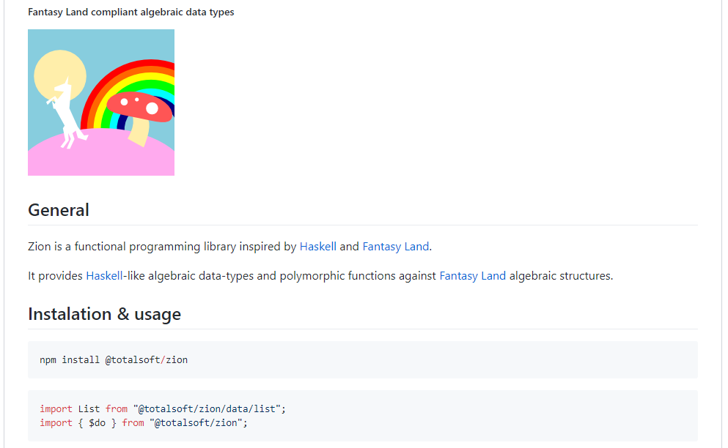
Zion

Slide 5
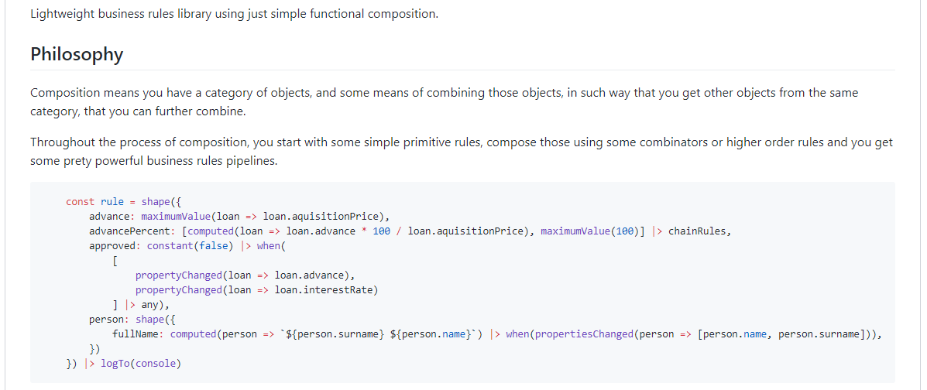
rules-algebra – npm: @totalsoft/rules-algebra

Slide 6
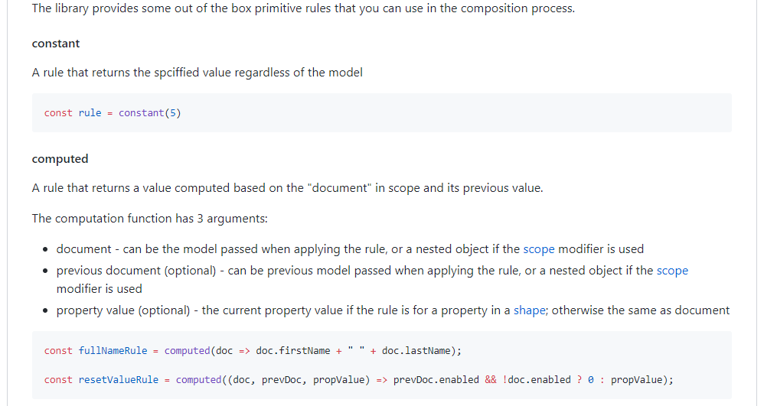
Primitive rules

Slide 7
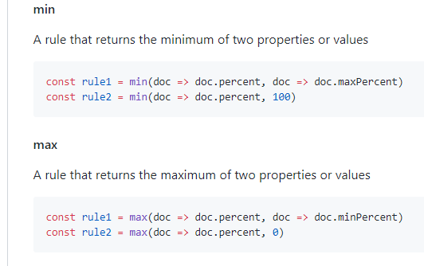
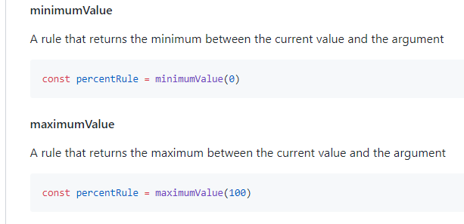
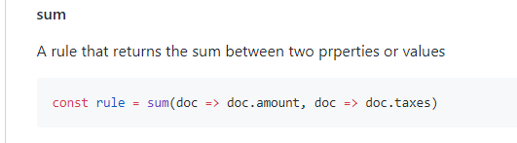
Primitive rules (2)

Slide 8
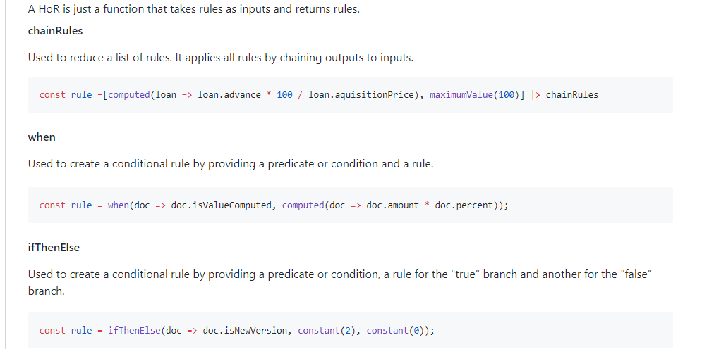
Higher order rules

Slide 9
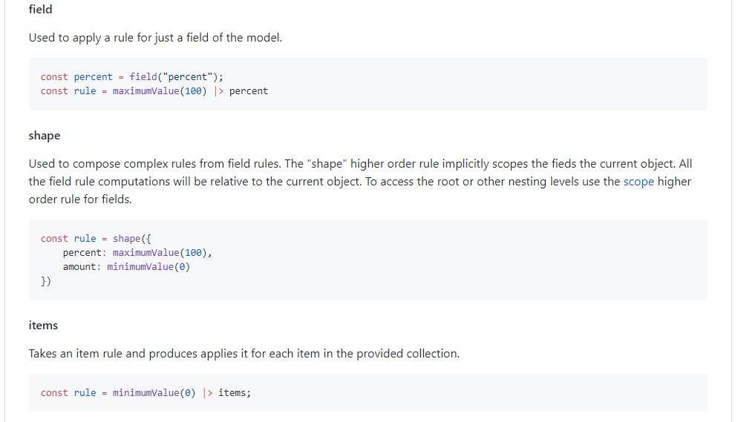
Higher order rules (2)

Slide 10
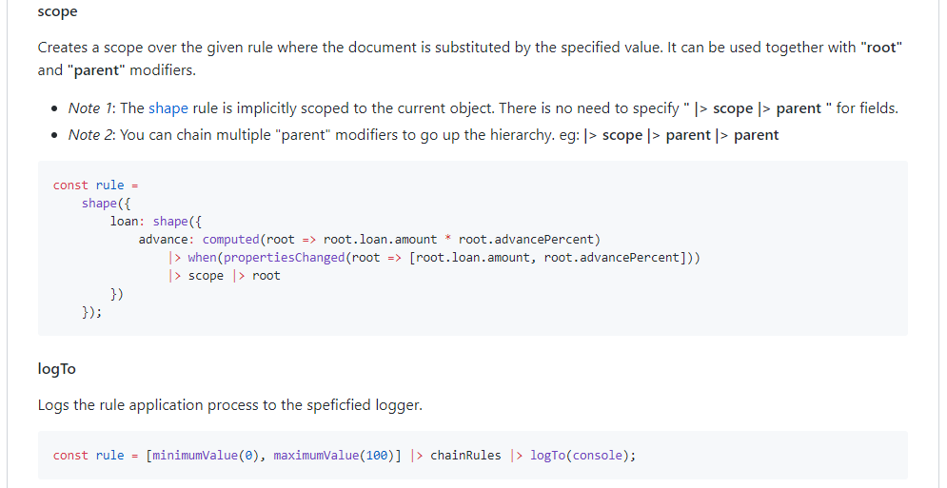
Higher order rules (3)

Slide 11
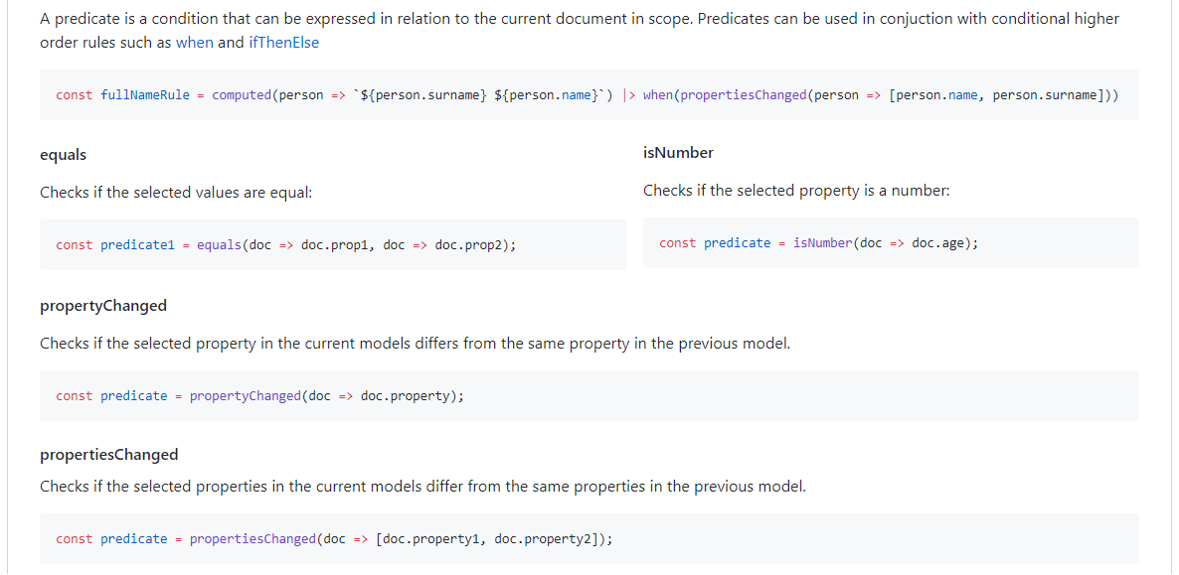
Predicates

Slide 12
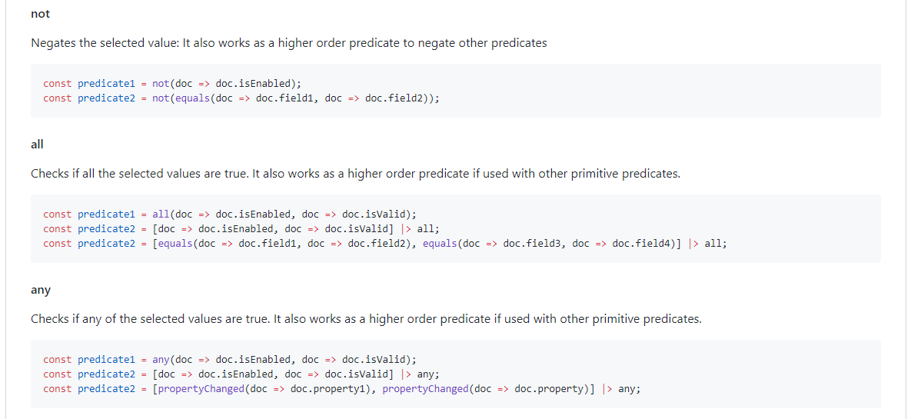
Predicate combinators

Slide 13
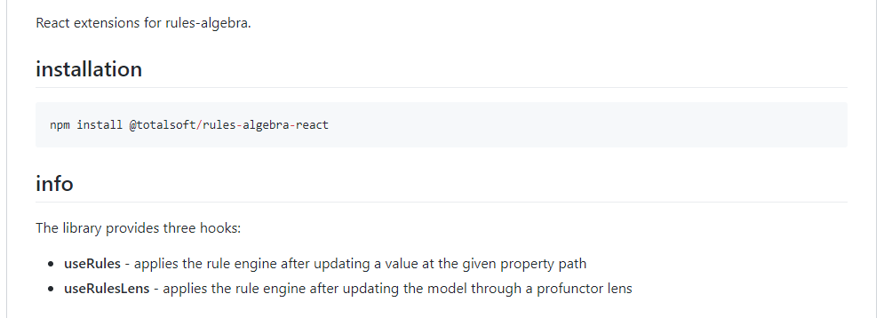
rules-algebra-react – npm: @totalsoft/rules-algebra-react

Slide 14
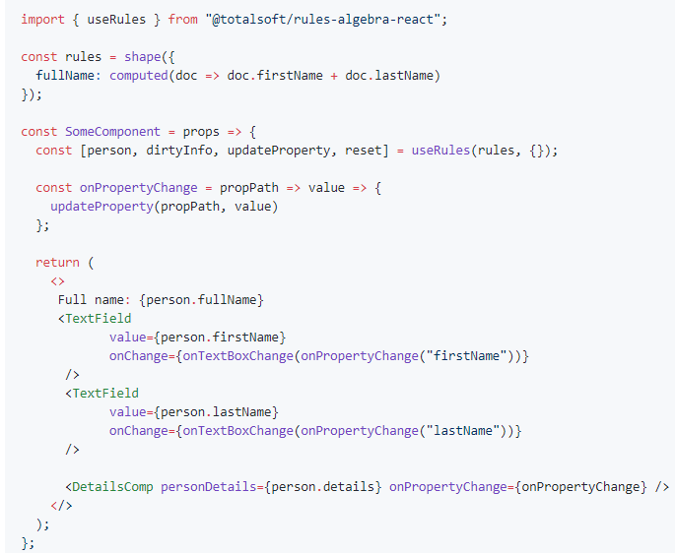
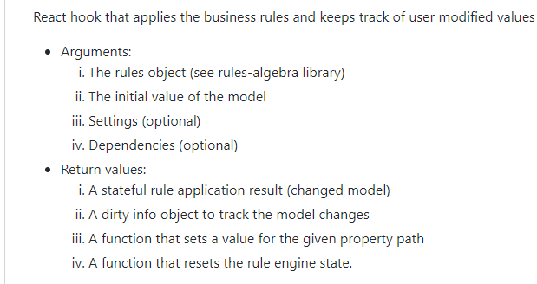
useRules hook

Slide 15
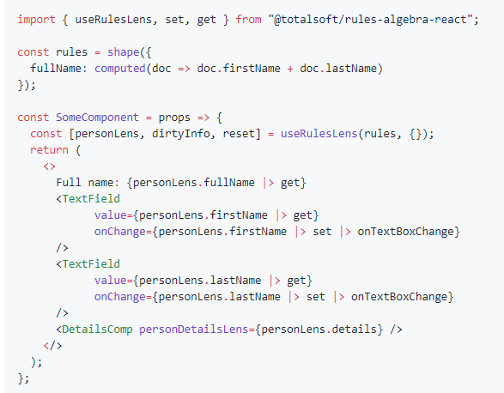
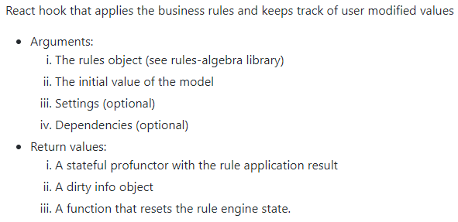
useRulesLens hook

Slide 16
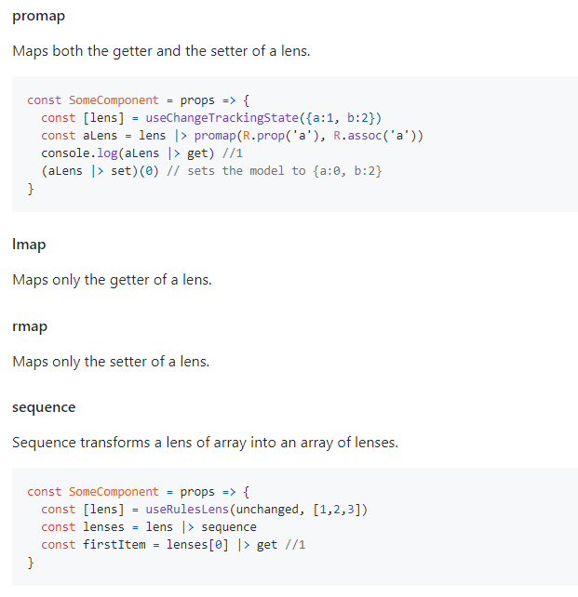
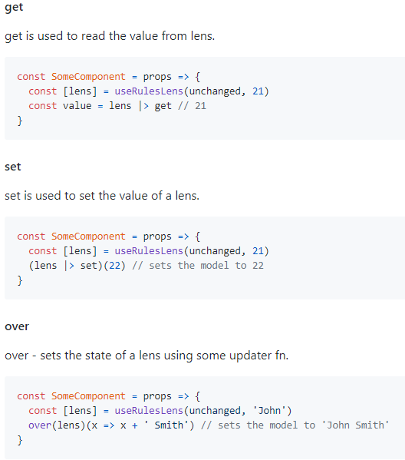
Lens operations

Slide 17
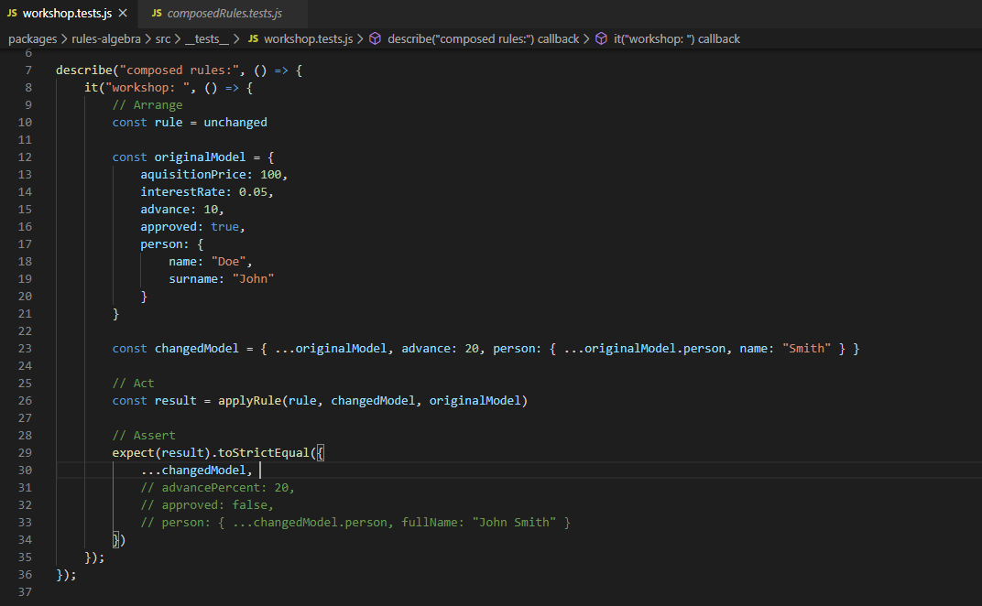
Live coding

Slide 18
Thank you!
Any questions?

