Slide 1
Venture Skeleton v0.1
TFG Copilot · final-year IE students · v0.1 refresh · Session 8
Every row cites a file. Riskiest row highlighted.
Field | v0.1 content | Source
Opportunity | Final-year IE students drift from their TFG's requirements or scope during the ~2-month gaps between deliverable meetings, and find out only at the meeting, after weeks or months of work. | opportunity.md
Product Goal | Enable them to realise when their TFG stops fulfilling its requirements or scope while working between supervisor meetings, so they don't lose weeks or months and deliver on time. | goals.md
Jobs to Be Done | Finding out at the meeting that the last two months of work were faulty prompts students to seek a way to know beforehand that their work meets what's required, so they can move on instead of redoing it. | jtbd.md
Personas | 3 selected: The AI Cross-Checker, The Hopeful AI Improviser, The Accidental Discoverer. Not validated with real users. | personas/ ai-persona-01..03.md
Riskiest Assumption | Students will use it instead of their AI of choice. IE approval is a gate; adoption is the risk that survives the gate. | assumptions.md
Sprint Goal | Learn whether final-year IE students actually do their TFG work in this tool instead of their AI of choice, strongly enough to guide the next decision. | goals.md
Smallest Test | Wizard of Oz: a 20-minute session in a chat loaded with the student's topic and IE TFG guidelines; they check topic fit, structure, format and dates; answers given behind the curtain; we observe whether they stay in the chat instead of switching to their own AI. | experiment-card.md
Decision rule | Metric: students completing the task without opening their own AI, out of 10. Threshold ≥ 6, committed before the test. Met → CONTINUE, build a working slice. Missed → CHANGE, reframe as a complement and rerun. | experiment-card.md
Evidence strength: MEDIUM · Personas: not validated with real users · Recruitment: recruitment.md

Slide 2
Jobs to Be Done & Selected Personas
3 critical personas for the same JTBD · personas/ai-persona-01..03.md, selection.md
Job to Be Done: When students work through the ~2-month gap between deliverables without knowing whether they're on track, finding out at the meeting that work was faulty prompts them to seek a way to know beforehand, so they can move on to the next phase instead of redoing it.
The AI Cross-Checker
The Hopeful AI Improviser
The Accidental Discoverer
Runs almost all coursework through AI: pastes in the rubric, asks it to confirm the work meets it, and checks the result herself.
OBSERVED (coursework)
Says she'd move her TFG work off Claude for a tool that keeps her context, instead of re-prompting it each time.
REPORTED – stated intention, Participant 02, not observed switching
On new or unfamiliar topics she leans on the AI even more, so her own check is weakest exactly where the material is new.
OBSERVED
Drafts the thesis with a familiar AI, judges the result personally, rewrites it so it won't be flagged as AI writing, then hopes it holds at the meeting.
REPORTED, second-hand
Keeps using the AI already used for most work, because it's the best-known option and worries a university tool would run an outdated model.
REPORTED, second-hand
Has limited time, because TFG work competes with other subjects, and rework can consume the next deliverable's time.
REPORTED
Doesn't know what TFG information exists or where to find it; TFG documents are scattered across courses and emails.
OBSERVED / SUPPORTED
Found a critical document only because a friend happened to mention it – not through any official channel.
OBSERVED, one first-hand episode
Mentor email responses can take days, leaving the student waiting on an idea they don't yet know is safe to pursue.
REPORTED, first-hand
Selected 2026-09-21, not validated with real users (personas/selection.md). ai-persona-01's switching condition is stated, not observed (Participant 02).

Slide 3
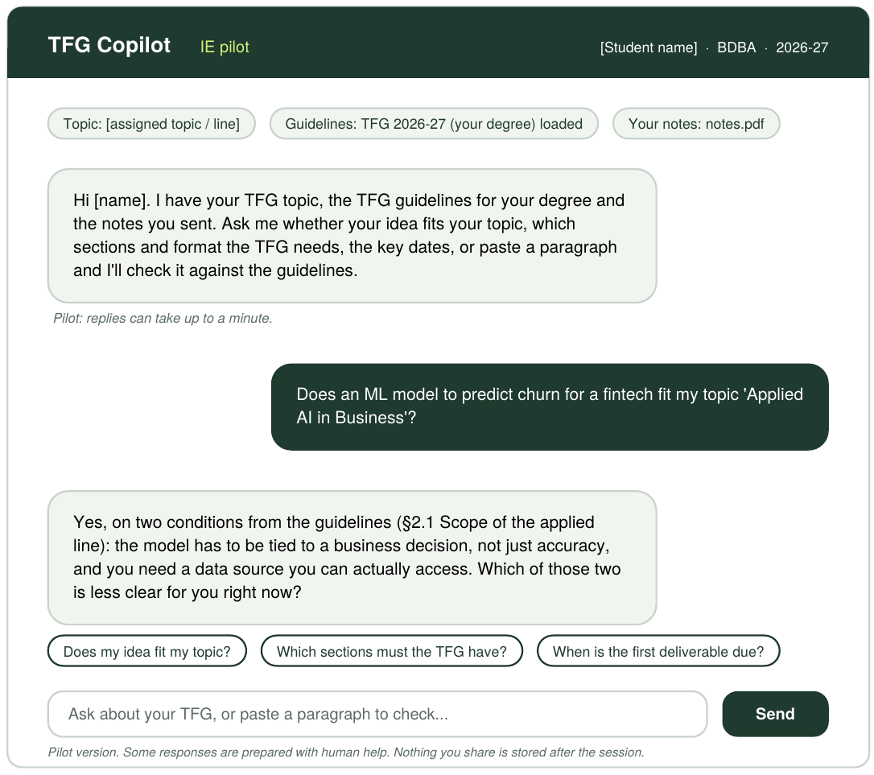
The Smallest Test
Wizard of Oz · 20-minute session · experiment-card.md, recruitment.md
Hypothesis & Method
Metric, Threshold & Decision Rule
Hypothesis: final-year IE students will do the TFG task with the copilot instead of their AI of choice, in a 20-minute session.
Method: Wizard of Oz – a simple chat loaded with the student's topic and the IE TFG guidelines; they ask about topic fit, structure, format and dates; answers are produced behind the curtain.
Metric: students who complete the task without opening their own AI, out of 10 tested. Threshold ≥ 6, committed before the test.
Evidence strength: MEDIUM – 10 real final-year classmates, one simulated session; some haven't started their own TFG work yet.
Met → CONTINUE: build a working slice with the IE guidelines loaded. Missed → CHANGE: reframe as a complement to their own AI and rerun.
Prototype-v0 screenshot: what the student sees in the Wizard-of-Oz chat.
Recruitment
Sessions: Mon 28 Sep – Fri 2 Oct 2026. Results and decision recorded by Mon 5 Oct 2026.
10 tested of 12 recruited (to cover no-shows); no decision on a partial sample.
Reached via the class WhatsApp group and the TFGPT landing page (tfgpt-production.up.railway.app).
Test access: recruitment.md · Full method and decision rule: experiment-card.md

Slide 4
What Changed Since v0, and What's Still Unknown
opportunity.md · assumptions.md · interview-evidence.md · personas/selection.md
What changed since v0
Top open gaps – not yet validated
The pain point now centres on the ~2-month gap between TFG deliverables, not drift at any stage.
The need is reframed as a failsafe: not perfect, but better than anything students have today for knowing they're on track.
The riskiest assumption is kept (students using it instead of their AI of choice), now with new evidence: one stated, conditional switch tied to keeping context (Participant 02), against a reported worry that university tools run outdated models.
No persona is validated with real users; all three rest on the authors' own observations or second-hand reports (personas/selection.md).
Stated vs. actual switching: Participant 02's switching condition is a stated intention, not observed behaviour (interview-evidence.md, ai-persona-01.md).
“Any degree” is still a hypothesis: all evidence so far comes from Computer Science, and AI habits may differ by degree (opportunity.md).
Sprint Goal moved from intention to behaviour
Validation status
v0 asked whether students would use a university-proposed tool and engage with it. v0.1 asks whether they actually do their TFG work in it instead of their AI of choice.
The team deferred real-user validation on 2026-09-21 for lack of time; no synthetic Persona output is treated as validation (personas/selection.md).
Next: run the test 28 Sep – 2 Oct 2026 and record results by 5 Oct, before the Phase 1 gate (experiment-card.md).

