Slide 1
Venture Skeleton v0
TFG Copilot · final-year IE students · Rapid Prototyping with AI · Session 5
Every row opens a file. Riskiest row highlighted.
Field | Confirmed content | Source file
Target user | Final-year IE students doing their TFG, any degree | opportunity.md
Problem | They spend weeks or months of work before detecting that it no longer fulfils the requirements or scope of their topic, at any stage of the process, hurting the process or delivery on time | opportunity.md
Product Goal | Enable them to realise when their TFG stops fulfilling its requirements or scope while working between supervisor meetings, so that they don't lose weeks or months and deliver on time | goals.md
Riskiest assumption | Students will use it instead of their AI of choice. IE approval is a gate; adoption is the risk that survives the gate | assumptions.md
Sprint Goal | Learn whether they would use a university-proposed tool for their TFG instead of their AI of choice, and actively engage with it, strongly enough to guide the next decision | goals.md
Smallest test | Wizard of Oz: 10 final-year classmates do a real TFG task (topic fit, structure, dates) in a chat loaded with their topic and the IE guidelines, answers produced behind the curtain, their own AI available; we observe whether they switch | experiment-card.md
Decision rule | Metric: students who complete the task in the copilot without opening their own AI, out of 10. Threshold ≥ 6, committed. Met → CONTINUE, build a working slice. Missed → CHANGE, reframe as a complement alongside their AI and rerun | experiment-card.md
Evidence strength: MEDIUM · AI traceability: ai-usage-log.md (5 rows) · Test access: recruitment.md · Rough test: prototype-v0
Notes:
2-minute script. 0:00 User: any final-year IE student doing the TFG. Problem: they work for weeks or months, mostly with a general AI, and find out late that the work no longer fits the scope or requirements of their topic. Five supervisor meetings in six months, everything in between is unsupervised. 0:35 Product goal: enable them to realise it while working between meetings, so they don't lose weeks and deliver on time. 0:50 Riskiest assumption: they will use a university-proposed tool instead of their AI of choice. IE approval is a gate; adoption is the risk that survives the gate. 1:05 Sprint goal: learn whether that substitution holds. 1:15 Smallest test: Wizard of Oz with 10 classmates, a real TFG task, their own AI on the table, we answer behind the curtain from the official guidelines. Metric: how many finish in the copilot without opening their AI. Threshold 6 of 10, committed before the test. Decision: continue with a working slice, or change to a complement and rerun. Evidence strength MEDIUM. 1:45 Still unsupported: that drift is real (experience only), IE backing, and anything beyond one session. Cheaper test we rejected: interviews, because they can't observe the switch.

Slide 2
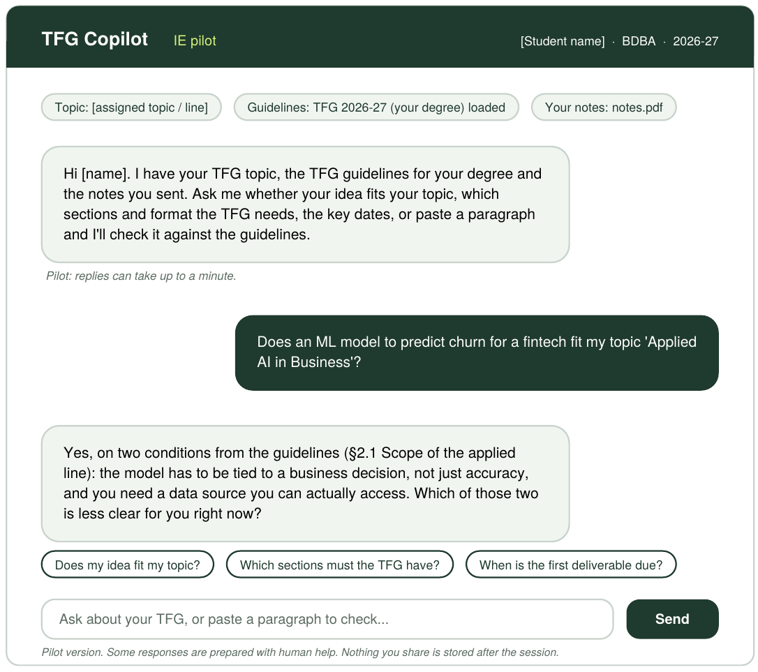
Rough test · prototype-v0
Wizard of Oz. What the student sees; a person answers behind it from the IE TFG guidelines.
What we watch
Metric: students who complete the task in the copilot without opening their own AI, count out of 10
Threshold ≥ 6 of 10, committed. Met → CONTINUE (working slice). Missed → CHANGE (complement, rerun)
Intentionally excluded
No automation behind the chat, no memory across sessions
No thesis writing, no grading, no approval, no supervisor view
No login, no IE integration, nothing stored after the session
Only three task types: topic fit, structure and format, dates
Still unsupported
That drift is real and detected late: assumed from experience, not evidenced yet
Everything in IE backing (Area 3)
Substitution beyond one session, which is why evidence strength is MEDIUM
Runs next week as a chat window the student types into while a teammate answers from another device. Backup: prototype-v0-backup.png.
Notes:
The reviewing team will ask: what is still unsupported (right column, bottom) and what cheaper test could challenge it (interviews: cheaper, but they cannot observe the switch; a fake door: clicks are not work).

