Slide 1
Deploying a scalable and highly available AI application on AWS
Ángel Sánchez Guerrero
Matricola 2117499
sanchezguerrero.2117499@studenti.uniroma1.it

Slide 2
Outline
1. Problem addressed
2. Designed solution
3. Implementation process
4. High availability and scalability testing
4.1 Experimental design
4.2 Experimental results

Slide 3

1. Problem addressed
AI enhanced photo gallery with image and speech recognition
Use AWS infrastructure
Main objective: achieve high availability and scalability
Multidisciplinary project

Slide 4
2. Designed solution
Focus on Cloud Computing aspects
Static website hosting: AWS S3 Bucket
Static website deploying from GitHub to S3: ASW CodePipeline
Image files storage: AWS S3 Bucket
Image files accessing: AWS Cognito
Image tags database: AWS DynamoDB
Image classification: AWS Lambda
Container image hosting: AWS Elastic Container Registry
Content Delivery Network: AWS CloudFront
SSL/HTTPS: AWS Certificate Manager

Slide 5
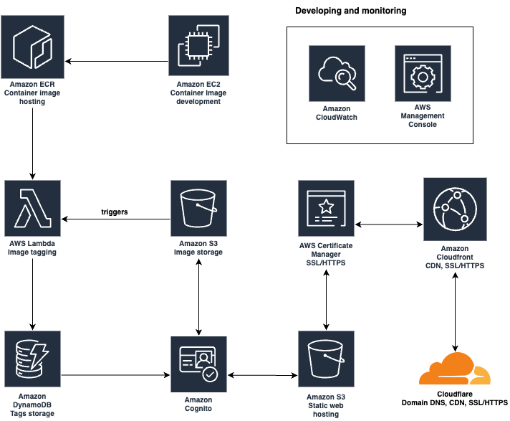
Diagram

Slide 6
3. Implementation process
AWS Learner Lab restrictions
Website hosting
AWS CodePipeline
Images storage
AWS Cognito Identity Pool
Risks
AWS Lambda
Problems
Container support

Slide 7
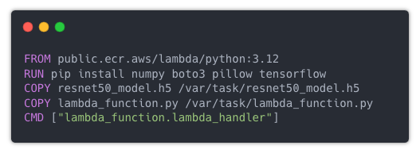
Image building
lambda_function.py
Obtains image that triggered the function
Classifies it using Machine Learning model
Stores predictions in DynamoDB
Developing environment problems
Solution: EC2
Elastic Container Registry

Slide 8
Last step
Linking custom domain
Cloudflare
Enabling HTTPS
AWS CloudFront
AWS Certificate Manager

Slide 9
4. High availability and scalability testing
“High availability means that an IT system, component, or application can operate at a high level, continuously, without intervention, for a given time period, delivering quality performance and handle different loads and failures with minimal or zero downtime.”
High availability
AWS Lambda
Automatically manages compute capacity across multiple Availability Zones
Fault tolerant out of the box thanks to AWS Infrastructure
AWS S3:
They promise 99.999999999% durability and 99.99% availability
S3 automatically handles all complexities in data replication, node failures, etc
AWS DynamoDB:
The same as S3, it is built to offer fault tolerance and automatic data replication with high reliability and performance

Slide 10
4. High availability and scalability testing
“Scalability is the measure of a system’s ability to increase or decrease
in performance and cost in response to changes in application and system processing demands.”
Scalability
Methods for servers
AWS Auto Scaling
AWS Elastic Load Balancing
AWS Lambda:
Scales automatically
Limit of 10 concurrent execution to new accounts
AWS S3:
Also handles scaling out of the box. When demand increases S3 spreads the load across its network of servers and facilities. Minimizes latency, maximizes throughput and avoids bottlenecks
AWS DynamoDB:
Same as S3, adjusts its capacity to varying loads. Only configuration to change is Capacity mode from ”Provisioned” to “On-demand”

Slide 11
4.1 Experimental design
We still need to verify system’s capacity to handle unusually high loads to ensure that the designed architecture operates reliably under stress.
Reproduce user behavior
Task 1: Visit the website. HTTP request to the webfiles. JavaScript shows images in S3 Bucket and tags in DynamoDB table.
Task 2: Upload an image. The upload triggers the Lambda function, and therefore DynamoDB too.
Tools
Testing: Artillery
Monitoring: AWS CloudWatch

Slide 12
4.1 Experimental design
Test phases
Ramp-up phase. Increase load until certain amount
Steady state phase. Load is stable at max value
Ramp-down phase. Decrease load to test scale down

Slide 13
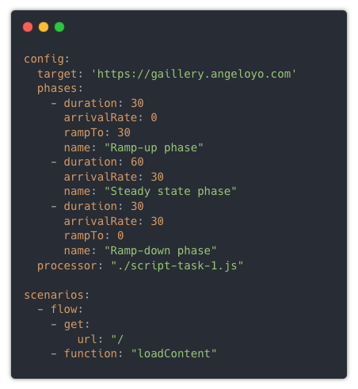
4.1 Experimental design
Artillery configuration file for task 1

Slide 14
4.2 Experimental results
Problems
Avoid getting banned
Tests in EC2
CPU bottleneck
Finding the limit amount of load
16 vCPU limitation
c5.4xlarge instance used

Slide 15
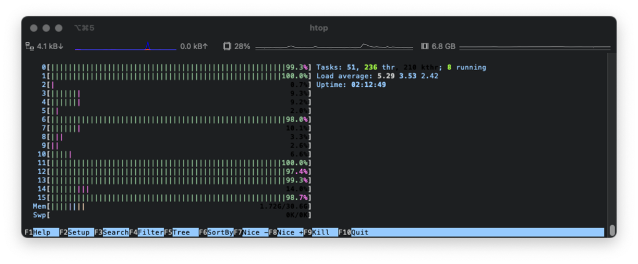
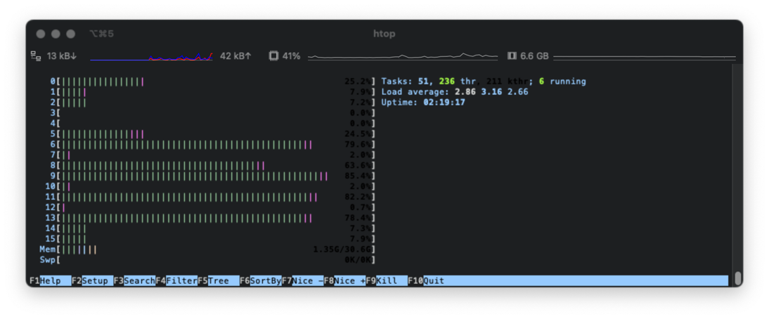
4.2 Experimental results
TASK 1
7 virtual users
5 virtual users

Slide 16
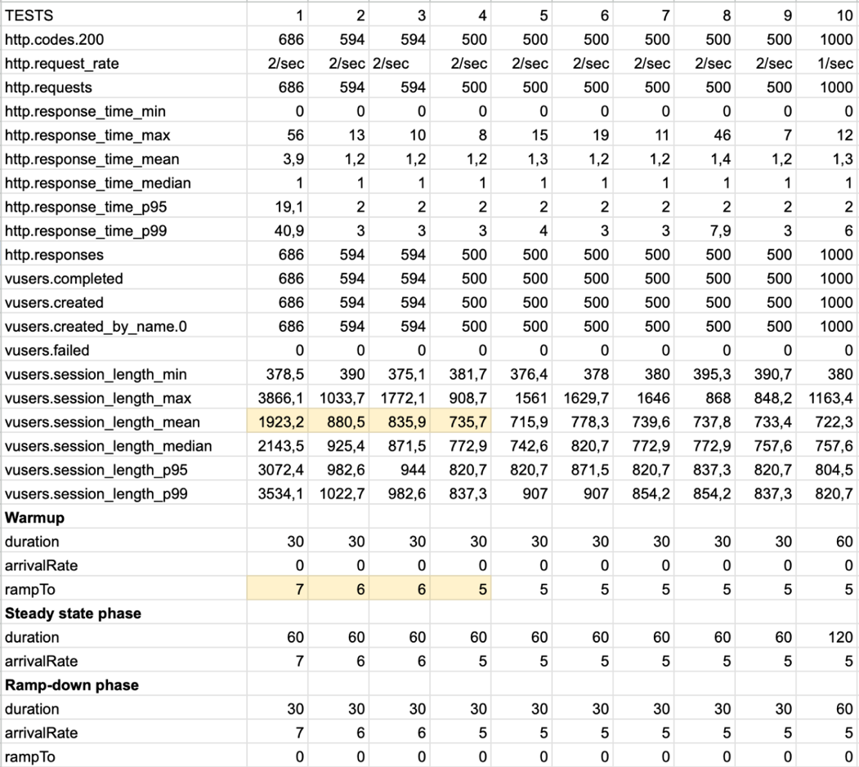
4.2 Experimental results
TASK 1
Results
Clear bottleneck
No errors
Good response times

Slide 17
4.2 Experimental results
TASK 2
Custom script uploads random amount of images between 1 and 5 to the bucket
Lambda function is triggered by each upload
Problem…
AWS limitation to new accounts of 10 concurrent executions. Would need to ask Amazon to increment this.

Slide 18
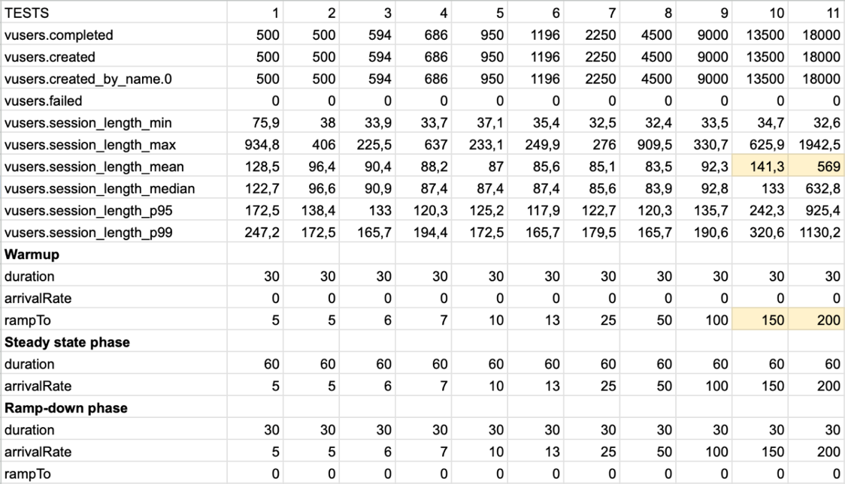
4.2 Experimental results
TASK 2
CPU bottleneck
between 150 and
200 VU/s
No errors

Slide 19
Conclusions
Despite these challenges, the test results confirmed that my solution was capable of scaling to meet increased demands. Even when pushing the system to the current setup’s limits, the system remained operational and responsive. The Artillery tests concluded without any errors from virtual users, CloudWatch metrics verified a 100% success rate for Lambda executions, and DynamoDB reported no errors either.
GitHub repository https://github.com/angeloyo/sapienza-project
Live website https://gaillery.angeloyo.com/
Thank you

