Slide 1
NEOSTATS · AI ENGINEER
CreditLens AI
0–1000
RISK SCORE
Explainable credit-risk intelligence
LOW
EDA · Default prediction · Explainability · Guarded NL-to-SQL · Docker
MEDIUM
HIGH
Submitted By:
Angel Proshia F

Slide 2
CREDITLENS AI
One platform connects evidence, scoring and explanation
1
Understand
Quality, distributions and business patterns
2
Predict
Default probability, score and risk band
3
Explain
Local drivers and readable surrogate rules
4
Explore
Natural language to validated SQL
02

Slide 3
CREDITLENS AI
The architecture keeps every decision traceable
Home Credit CSV
Preprocessing
Risk model
Explanations
Streamlit UI
Business question
Gemini / 5 fallbacks
SQL guard
DuckDB
One SELECT · table whitelist · mutation blocking · row limit
03

Slide 4
CREDITLENS AI
EDA turns data quality into five lending questions
1
Do external scores separate defaults?
2
Which income groups carry higher risk?
3
Where does credit exceed affordable income?
4
How do age and employment stability matter?
5
Can missingness reveal process weakness?
04

Slide 5
CREDITLENS AI
A transparent baseline handles imbalance deliberately
Split
80/20 stratified
WHY THIS BASELINE
Prepare
Impute · scale · encode
Fast
Auditable
Learn
Class-weighted logistic regression
Deployable
Measure
ROC-AUC · PR-AUC · confusion matrix
Exact metrics are generated after training—never hard-coded.
05

Slide 6
CREDITLENS AI
Every applicant receives probability, score and band
DEFAULT PROBABILITY
RISK SCORE
RISK BAND
Model estimate from 0% to 100%
Probability translated to 0–1000
Low <10% · Medium <25% · High ≥25%
Demonstration thresholds must be calibrated to lending loss, approval capacity and policy.
06

Slide 7
CREDITLENS AI
Explanations support review without claiming causality
LOCAL SHAP CONTRIBUTIONS
READABLE RULES
EXT_SOURCE_2
A shallow surrogate tree summarizes model behaviour for business review.
AMT_CREDIT
DAYS_EMPLOYED
Not policy. Not causal. Validate before use.
INCOME_TYPE
07

Slide 8
CREDITLENS AI
The chatbot treats generated SQL as untrusted input
1
2
3
4
5
Prompt
Generate
Validate
Execute
Show
Schema + target definition
Gemini or deterministic pattern
Parse AST · allow SELECT only
DuckDB · LIMIT 100
Result table + exact SQL
Five working questions remain available even without an API key.
08

Slide 9
CREDITLENS AI
The evaluator can run the complete app with one command
✓
Modular Python
✓
Environment contract
docker compose up --build
✓
Saved pipeline
Dataset mounted read-only · model artifact persisted · health check enabled
✓
Core tests
✓
No dataset in Git
09

Slide 10
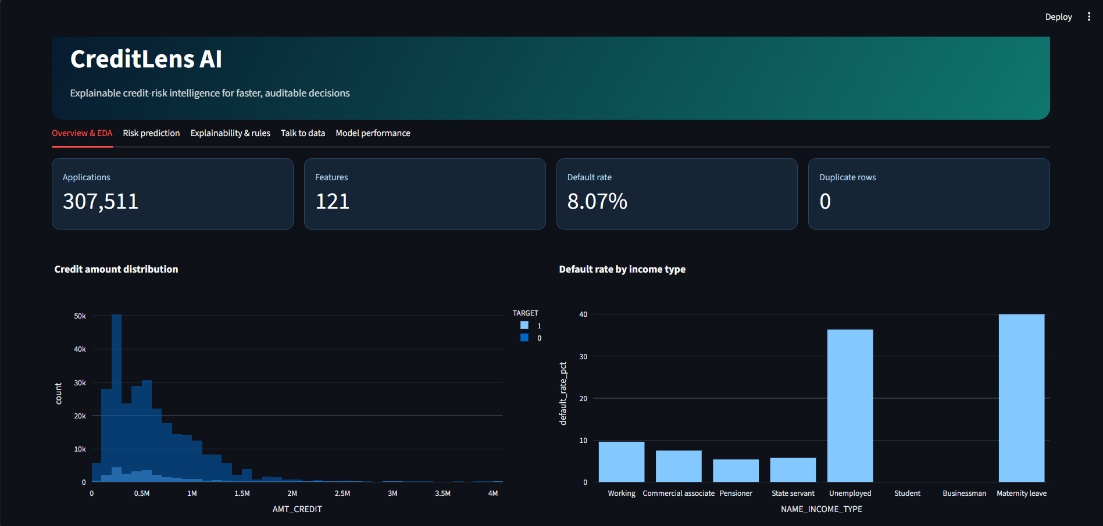
VALIDATED APPLICATION OUTPUT
EDA confirms scale, imbalance and portfolio patterns
307,511 applications · 121 source features · 8.07% observed default rate
10

Slide 11
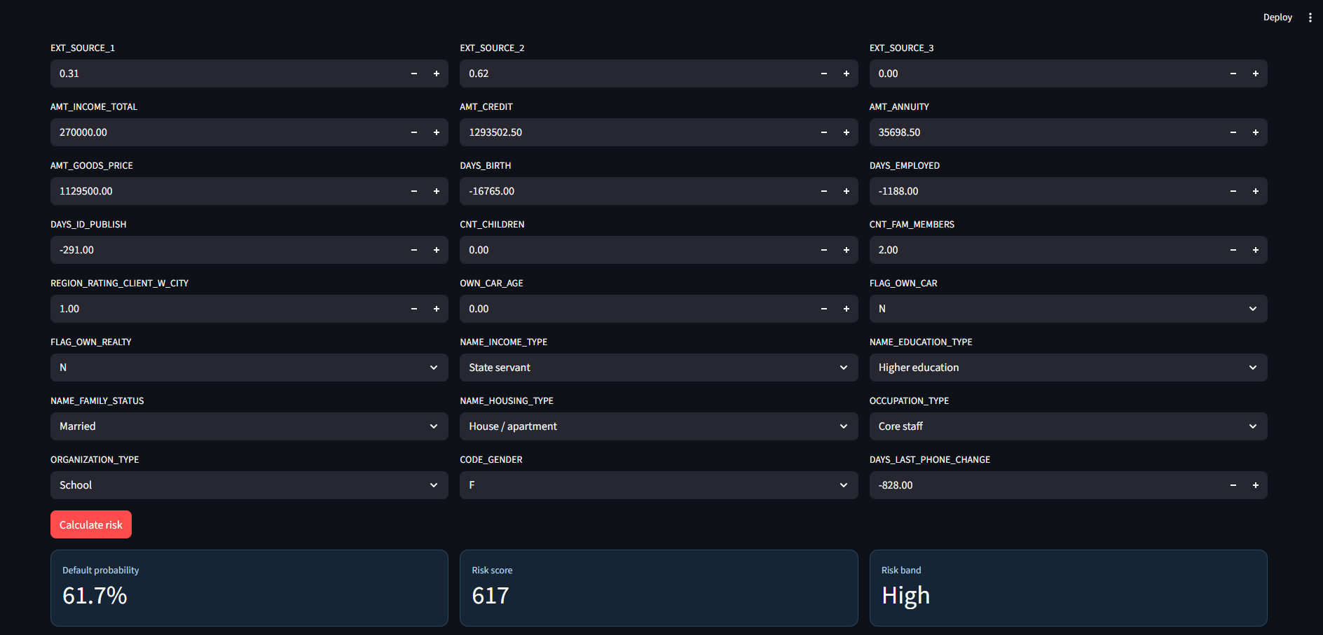
VALIDATED APPLICATION OUTPUT
Applicant scoring produces an actionable risk band
Example output: 61.7% default probability · score 617 · High risk
11

Slide 12
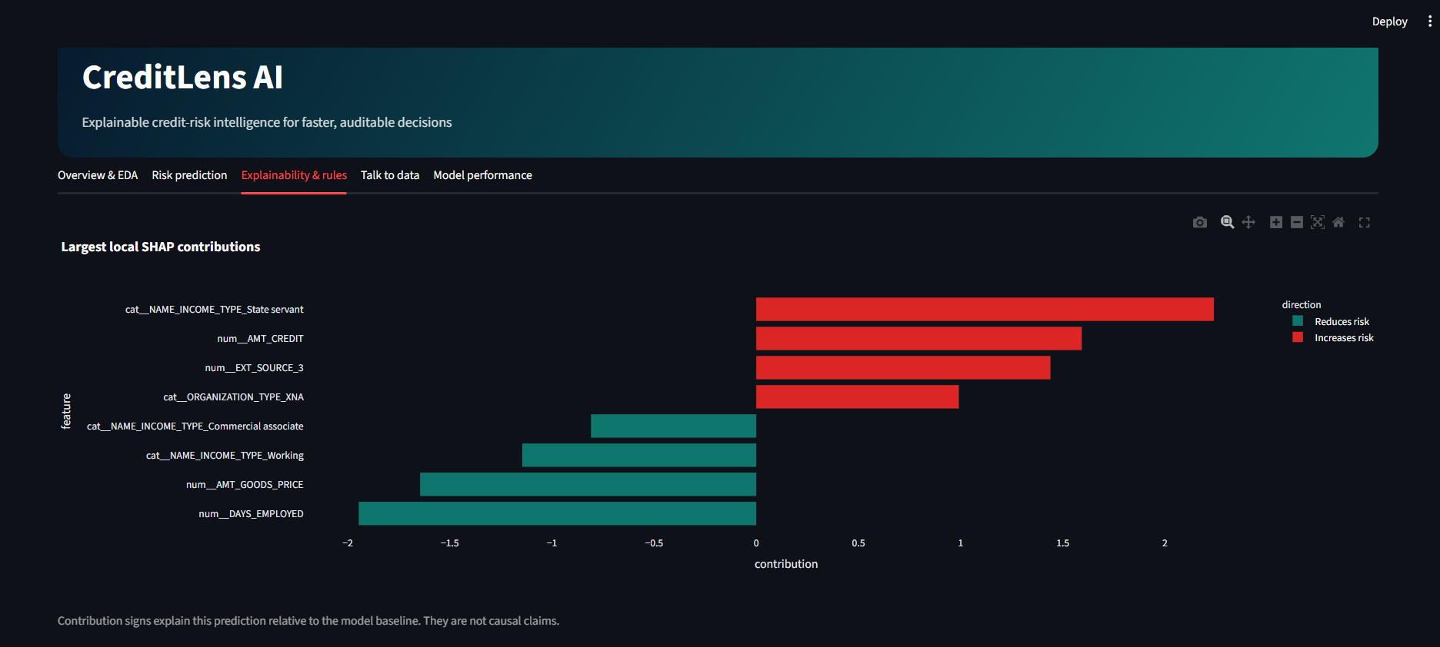
VALIDATED APPLICATION OUTPUT
SHAP identifies the strongest drivers for one decision
Red increases predicted risk; teal reduces predicted risk. Contributions are not causal.
12

Slide 13
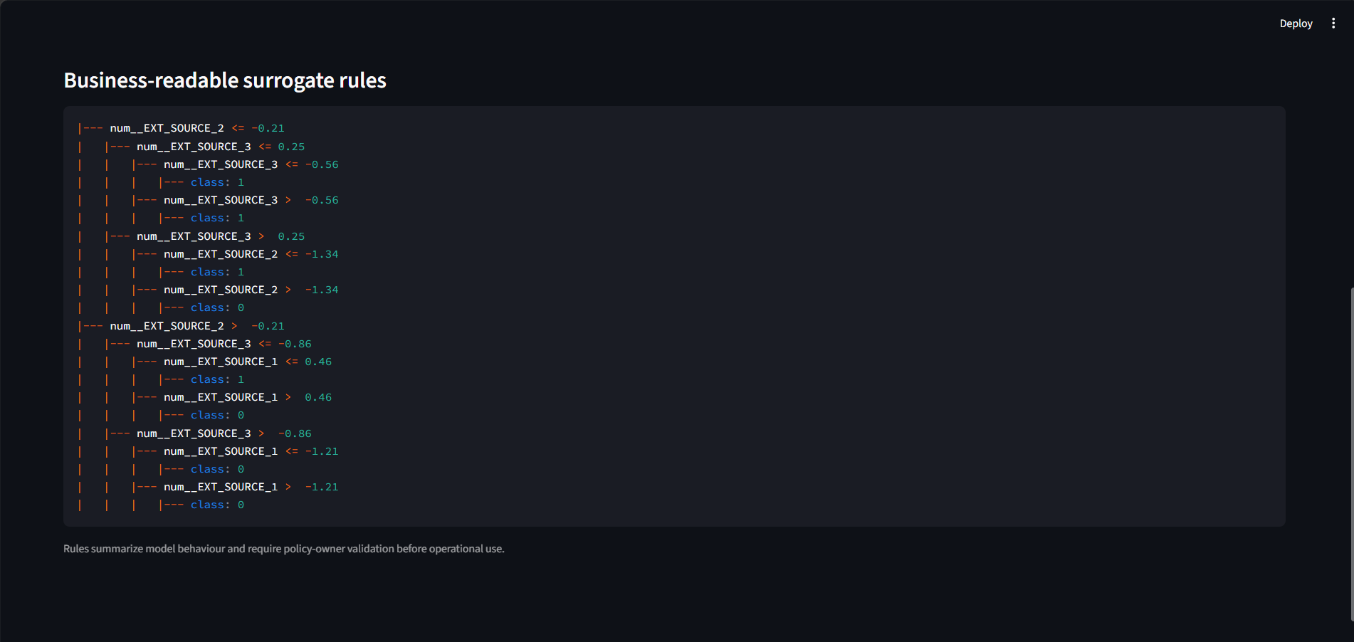
VALIDATED APPLICATION OUTPUT
Surrogate rules translate model behaviour for review
Depth-3 rules support audit discussion and require policy-owner validation.
13

Slide 14
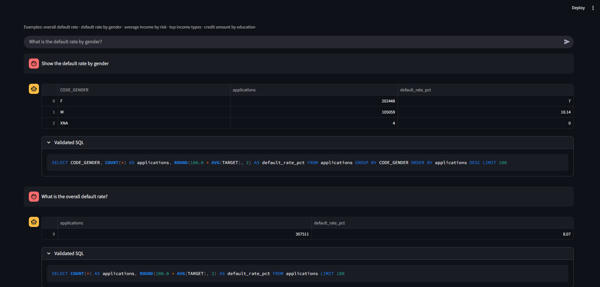
VALIDATED APPLICATION OUTPUT
Natural-language questions return validated SQL evidence
Verified patterns include overall default rate and default rate by gender.
14

Slide 15
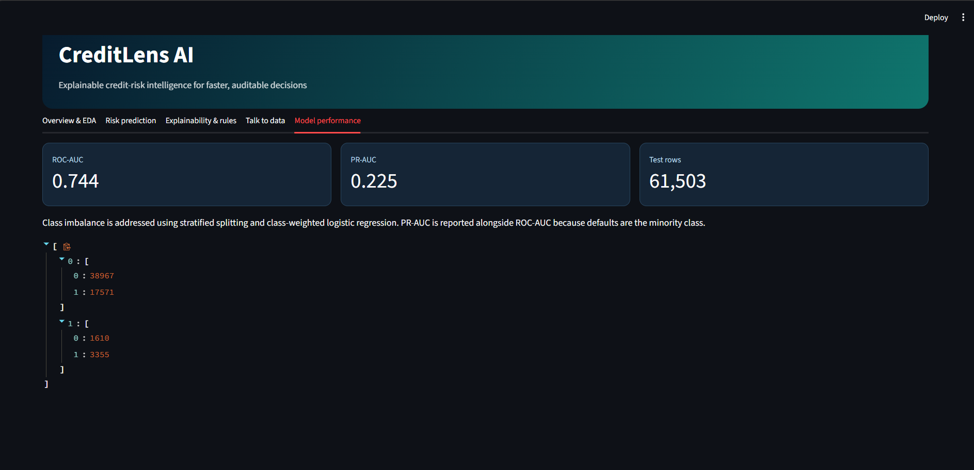
VALIDATED APPLICATION OUTPUT
The baseline separates risk with ROC-AUC 0.744
PR-AUC 0.225 · 61,503 test rows · stratified split and class-weighted training
15

Slide 16
CREDITLENS AI
The prototype is complete—and honest about production gaps
DELIVERED
PRODUCTION NEXT
✓ EDA + data quality
→ Join bureau and repayment tables
✓ Class-balanced risk model
→ Calibrate bands to loss
✓ SHAP explanations + rules
→ Fairness and subgroup testing
✓ Guarded talk-to-data
→ Drift + model monitoring
✓ Streamlit + Docker
→ Authentication and PII controls
Decision support, with human review and policy governance.
16

