Slide 1


COLAN INFOTECH
PROPOSAL PRESENTATION
Service Management System
6

Slide 2


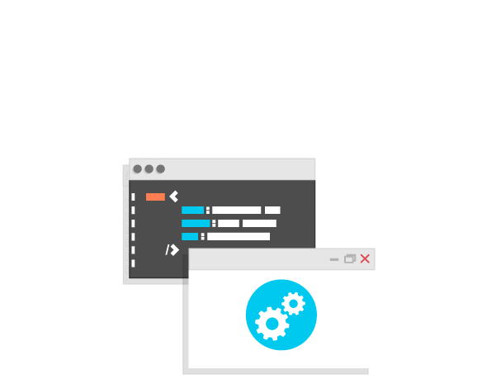







Who we are?
- Company Founded in 2009
- Privately held - by founding team
- CMMi Level 3, currently audited by KPMG for CMMi Level 5
- On a pre-IPO stage and going public in 2018
- ISO 27001-2015 certified
250+
Technical
Consultants
150+
Apps Launched
- - - - - - - - - - - - - - - - - - - - - - - - - - - - - - -
- - - - - - - - - - - - - - - - - - - - - - -
350+
Clients
350+
Websites Launched
15+ years Offshore Development Experience

Slide 3
Table of Contents
Table of contents | Slide No
Project Scope | 5
Understanding | 5
Technology Stacks | 6
Work Breakdown Structure | 7
Team Composition | 9
Delivery Plan | 10
Assumptions | 11
Project cost & Milestones | 13
Business Terms & Conditions | 14
Design Methodology | 16
Development Sprint Task | 17
6

Slide 4
Project Title
Service Management System
6

Slide 5
Project Scope
Develop the web application for users to access multiple services(Support Ticket System, Survey Management and Church Management) for different industries in one single platform as SAAS model.
Our Understanding
User can Register/Login to the application with the credentials. User will have to verify his/her email address.
User can change profile information from the dashboard.
Once logged in, User will find the list of services and add services into the dashboard. Services are Support Ticket System, Survey Management and Church Management. All services will display as content page in Phase 1.
User can also login using social media credentials are Facebook, Twitter and Google+.
The application will have single sign on feature where user can use single user name and password in accessing of all services in the application.
User manuals to be placed in the documentation section.
Admin from the backend can Add/Edit/Delete Users and Manage services (only content of services) and update manual documents.
6

Slide 6





Technology Stack
Programming Language
Framework
Database
Scripting Languages
Query Language
7

Slide 7
Work Breakdown Structure for Mobile App
Requirement gathering
UI Design
UI Implementation
User Registration/Login
Verify Email
Forget password
Manage profile
Service list - HTML Static
List services as tree view menu
Customize the menu
Service description, demo link, list of installed instances
Facebook, Twitter, Google + Login
User Subscription (design view) - HTML STATIC
Single Sign on
Web based documentation ( use the tool http://bananadance.org) - WE assume like overview page
Admin
Add/Edit/Delete Users
Manage Services (1. http://osticket.com/ (Support Ticket System)2. https://www.limesurvey.org (Survey Management)3. http://www.churchdb.org/ (Church Management).
12

Slide 8
Work Breakdown Structure for Mobile App
Testing
UI Testing
Functional Testing
Regression Testing
Sanity Testing
Build & Release
12

Slide 9
Team Composition
UI Designer
Tech
Lead
PHP Developer
Project
Manager
Offshore Team
Team Member Role | FTE
Project Manager | 1
Technical Lead/Architect | 1
Test Engineer | 1
Designer | 1
Developer | 1
Test engineer
15

Slide 10
Delivery Plan
Milestones | Timeline Chart
Requirement Gathering, Analysis & Documentation | Week 1 - 2
UI Design & Implémentation |  |  |  | Week 2-3
Functionality Implementation |  |  |  |  |  |  | Week 3-5
Internal Testing |  |  |  |  |  |  | Week 3 - 5
UAT Release, Sign off & Deployment |  |  |  |  |  |  |  |  |  |  |  |  |  |  |  |  |  |  |  |  |  |  |  |  |  |  | Wee k 5-6
Note:
The given project delivery plan is based on our regular resource planning. In case of any deadline we can tweak the plan based on mutual consent.
CIPL will be sharing regular build hosted on CIPL server, from week 3 onwards
CIPL will provide 12 months of support after UAT sign off to fix any issues within scope, with no extra cost.
13

Slide 11
Assumptions & Constraints
The estimate covers the efforts for developing functionalities mentioned in WBS.
The estimates are based on requirement shared by the client.
We assume that users can view services as content page in Phase 1.
We assume that Admin from the backend to add content for each services and it will display the same content in front end. The subscription plan shows as static view in Phase 1.
CIPL assume that the stakeholders will be available for clarifications and support throughout the project timeframe.
10

Slide 12




Support
Support
Level 1 Support – Basic Troubleshooting and Resolution
Level 2 Support – Minor Fixes, Troubleshooting and Resolution
Level 3 Support - Large Fixes, Redeployments & Change Management
JIRA Tracker would be used for Managing the Tickets
18

Slide 13
Project Cost & Milestones
Total Development Cost: $2800
S No. | Milestones | Payment %
1 | Project Initiation | 50%
2 | Full Development completion & Release | 50%
Note: The project will be completed within 6 weeks
14

Slide 14
Business Terms & Conditions
CIPL expects client to provide us a suitable host that will support the bandwidth needed for this website/web application. CIPL will give recommendations based on client’s request.
CIPL expects client to provide us the login credentials of the CMS & host, APIs for 3rd party software, contents, images, banners for sliders, logo images, video & audio files etc needed for this project at the time of project initiation (Refer slide – Assumptions & Constraints). Any delays will cause changes in the project deadline.
CIPL expects client to purchase and provide the plugins, widgets, theme needed for this project at the time of project initiation (Refer slide – Assumptions & Constraints).
CIPL will provide 3 months free support after Delivery & Release. We will fix issues and provide support for the same for free of cost if it is within the scope of this project.
Any changes that are not part of the scope or not listed in the Work Breakdown Structure in this proposal will be considered as ‘Change Request’ (CR) and CIPL will give separate cost estimate for the changes needed by the client. It will be billed separately.
Client project representative would sign-off on completed work in all phases.
CIPL shall request sign off on Milestone achievement
Scope changes that will have monetary impact or schedule impact to the current scope of work
Any change in payment schedule as mutually agreed upon by the customer and CIPL’s sales team
Client will provide the necessary resources for acceptance testing and would sign-off complete work.
Source code will be delivered by Colan Infotech only after the final payment from the client.
During the Design phase, we will send 2 or 3 design templates and send it for approval from the client. ‘N’ number of changes in the templates will be accepted.
The client will be able to look at the progress of the project development via Jira, Trillo, TFS etc or any other if needed.
Only for Retainer engagement model, the source code can be shared to the client through Github etc during the project development. Source code will not be shared until final payment in Fixed bid.
12

Slide 15
Business Terms & Conditions
Sign off request would be in CIPL’s format and would need to be sent back by the customer with changes requested or signed and faxed within two working days, failing which CIPL retains the right to put the work on hold until we achieve sign off.
Upon receiving sign off, if the sign off has been delayed for in excess of 2 working days CIPL shall provide a time line to restart work based on resource availability position at that point in time.
Client would provide the latest and working version of source code and database if applicable.
The proposal does not include hardware and other related aspects and addresses only the application design and development.
This proposal does not include maintenance of the application.
CIPL Refund Policy
CIPL does not provide any refunds on projects that have been initiated. Our business model calls for us to provide our services upon initiation and full or partial refunds are not possible based on the amount of work done. All work products (Documents, code and other artifacts) created In association with the project shall be provided to the client upon cancellation of the project
On projects that have NOT YET been initiated, we offer to adjust the amount paid against any subsequent project ONLY within a timeframe of 6 calendar months from the date of intimation of cancellation
We do not offer monetary adjustments arising out of scope changes on an individual scope of work against any other.
12

Slide 16

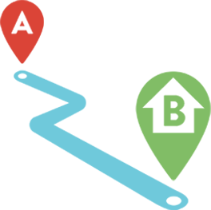


Design methodology
We follow a design methodology covering 7 steps of iterative designs
STEP 1
Persona Identification & Development
Limit top level personae to a manageable number (less than 7)
Allows hierarchy of up to 3 levels to support more fine grained insights into the user
STEP 2
User Journeys
Steps through the end to end journeys with distinct phases that each of the personae go through
Maps directly to the Information Architecture in the next step
STEPS 3, 4
Information Architecture
3 pronged approach with distinct “Navigation”, “Layout” and “Theme” tracks
Permutations and combinations are produced for selection of primary journeys
STEPS 5, 6, 7
Decision Points
Stakeholder reviews of the design options result in up to 3 (indicative) final designs
Focus Group reviews of the 3 clickable prototypes (implicit and explicit feedback) identified final design
12

Slide 17
Development Sprint tasks & Deliverables
Type | Description | Deliverables
Handover * | Client would handover all assets & documented information to Colan Infotech and Services will also exposed to check for Service assurance | Services Assurance Checklist Wireframes (Handed over by Client) Use Cases Documentation (Handed over by Client)
Grooming * | Think through the use cases (in form of development stories) and also create wireframes that would satisfy the use cases | Use Cases Identification (Colan Infotech) Wireframes (Colan Infotech)
Pre-Sprint | Create the mocks satisfying the wireframes and also flesh out the technical specification such as API signature, sequence diagrams or test cases related to the stories | Mocks API Signature Sequence Diagram Test Cases
Sprint | Take the stories that are groomed during grooming period and use the specifications during pre-sprints to develop the stories. At the end of development, we will also perform a QA on the test cases for the stories that we are developing. | Codes Service Integration QA Reports
Post Sprint | Ensure that the stories that we have developed doesn’t break other features developed prior, we will perform the End to end testing (E2E) for the current and prior features that we have developed. | Regression Testing Performance Testing Security Testing
* Indicates either Handover or grooming will be part of the sprint and not both at any case
12

Slide 18


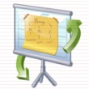















Quality Assurance
We offer a comprehensive set of services
To address these challenges head on
Our offerings include
Requirement Analysis
Determine - Types of Testing
Derive Test Plan
Determine Platform Matrix
Review - Requirements
Create Test Cases & Test Scripts
Testing & Defect Management
Weekly Test Reports
Daily Defect Analysis Report
Standup Calls
QA Sign-Off for a Release
12

Slide 19
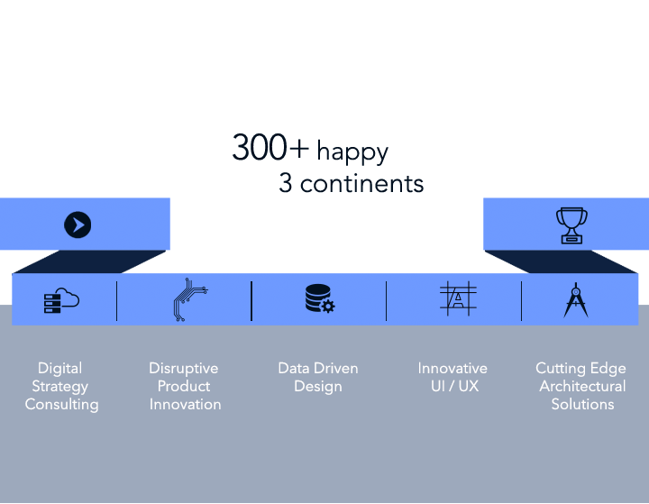
Why are we better to work with?
19

Slide 20


Thank You
THANK YOU!
Sakthi@colaninfotech.net
www.facebook.com/ColanInfotechTeamwww.colaninfotech.com
Chennai / Bangalore / USA / Canada / Dubai
20

