Slide 1
Vocabulary: Economic issues
Section 1

Slide 2
Vocabulary
economy [ɪˈkɒnəmɪ]: n.
1. [C] the system by which the trade, industry and money of a country or region are organized
- a market/planned/industrial economy
2. [C] the wealth and resources of a country or region, esp. in terms of the production and consumption of goods and services
- The Chinese economy grows at an annual rate of 5 percent.
- The economy is beginning to revive.

Slide 3
Vocabulary
economy [ɪˈkɒnəmɪ]: n.
3. [C] a country considered as an economic system
- one of the fastest-growing economies in Asia-Pacific region
4. [U, C] the careful use of money, time, etc. so that very little is wasted
- They’ve had to make economies since he lost his job.
- There are great improvements in the fuel economy of cars.

Slide 4
Vocabulary
economy [ɪˈkɒnəmɪ]: n.
5. (*attrib 做定语) inexpensive to buy or use
- economy class [U]
- an economy pack/size
- an economy car

Slide 5
Vocabulary
economic [ˌiːkəˈnɒmɪk]: adj.
1. [only before noun] connected with the trade, industry and development of a country, region or society.
- economic reform/growth/policy/benefit
2. making a profit, or likely to make a profit 盈利的, 有利可图的
≈ profitable
 economically [ˌiːkəˈnɒmɪkli]: adv.
经济地，在经济上

Slide 6
Vocabulary
economical [ˌiːkəˈnɒmɪkəl]: adj.
▪ not spending or costing much money; not wasteful
经济实惠的，节俭的，节约的
- Electric vehicles are clean, quiet, and economical.
- Buying in bulk is more economical than shopping for small quantities.
 economically: adv.
经济地，节俭地，节约地

Slide 7
Vocabulary
economics [ˌiːkəˈnɒmɪks]: [U]
1. (a) the study of how a society organizes its money, trade and industry;
(b) economic theory, principles, or practices

Slide 8
Vocabulary
economist [ɪˈkɒnəmɪst]: [C]
▪ a person who studies, teaches, or writes about economics

Slide 9
Vocabulary
economize/economise [ɪˈkɒnəˌmaɪz]: vi.
▪ to make an effort to save money, time, resources, etc.
- We must economize on water.
- A lot of companies are trying to economize by not taking on new staff.

Slide 10
Vocabulary
cost of living
- standard of living
income: money that a person, an organization, a country, etc. earns from work, investments or business, etc.
revenue: money that a government receives from taxes or that an organization receives from its business
 in business, incomes = revenues – costs/expenses

Slide 11
Vocabulary
job market/labour market
consumer confidence
public/private sector
- industrial/economic sector
- the service/banking/manufacturing/financial sector

Slide 12
Vocabulary
rate: a measurement of the number of times something happens in a particular period
e.g. birth/crime/success rate
interest/exchange/mortgage rate
ratio: the relationship between two amounts, represented by two numbers or a percentage, expressing how much bigger one is than the other
e.g. The ratio of teachers to students is 1:20.
teacher-student ratio; male-female ratio

Slide 13
Vocabulary
benefit [C or U]: money provided by the government to people who need financial help because they are ill, unemployed, etc.
e.g. unemployment/disability benefit
subsidy [C]: money given by a government or an organization to reduce the cost of producing a product, etc. and to help to keep prices low
e.g. export/agricultural subsidy
 subsidize: vt.

Slide 14
Vocabulary
grant [C]: money given by the government or other institution to an individual or organization for a particular purpose
e.g. government/research/student grant

Slide 15
Vocabulary
the jobless/the unemployed
trade deficit; trade surplus
- budget/fiscal deficit
- food/water/power/labour shortage; a shortage of funds
purchasing power
tax burden

Slide 16
Vocabulary
Put the words that describe the economy in proper columns.
strong, weak, stable, booming, buoyant, depressed, healthy, stagnant, sluggish, resilient, fragile, prosperous, robust, volatile, vibrant, sound, flourishing, dynamic, flagging, progressive
Most positive | positive | negative | Most negative
booming, prosperous, robust, flourishing, vibrant | strong, stable, buoyant, healthy, resilient, dynamic, sound, progressive | weak, stagnant, sluggish, volatile, flagging | fragile, depressed

Slide 17
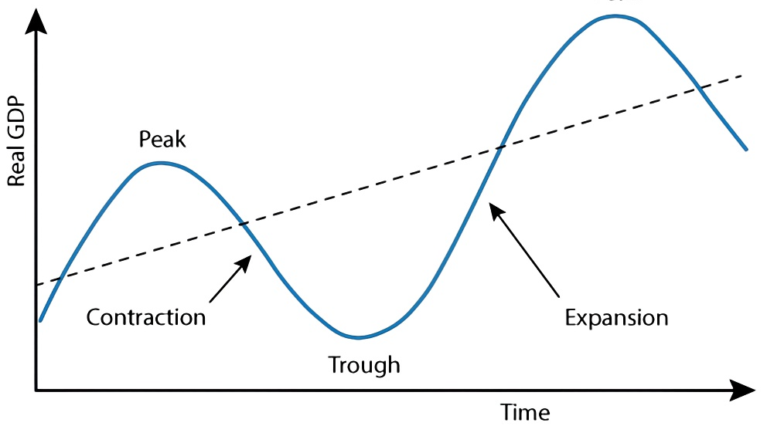
Vocabulary
Words to label the economic cycle:
Growth trend
Peak
Contraction
/Recession
Expansion
/Recovery
/Growth
Boom:
extreme expansion
Trough
 Depression

Slide 18
Vocabulary
Recession
Depression
A significant decline in economic activity spread across the economy, lasting more than a few months (two consecutive quarters), normally visible in GDP, income, employment, industrial production, and wholesale-retail sales.
A sustained, long-term downturn in the economy that lasts three or more years or results in a decline in GDP of at least 10%.
It follows the second stage of recession if the period of economic decline is prolonged and severe.

