Slide 1
1
Income
▪ Income gap
☒ There are still wide gaps in income distribution between urban and rural areas and between regions. [二十大报告]
(Objectives of the 15th FYP)
Personal incomes should increase in step with economic growth, and remuneration should rise in tandem with labor productivity increases.
(居民收入增长和经济增长同步、劳动报酬提高和劳动生产率提高同步)
(Major tasks) Advancing common prosperity for all

Slide 2
1
Income
Improving the income distribution system
( to build an institutional framework under which primary, secondary, and tertiary distribution are well coordinated and mutually complementary) [二十大报告]
(构建初次分配、再分配、第三次分配协调配套的制度体系)
- We should work to raise the share of personal income in the distribution of national income and give more weight to work remuneration in primary distribution.
(提高居民收入在国民收入分配中的比重，提高劳动报酬在初次分配中的比重。 )

Slide 3
1
Income
- We should leverage multiple channels to increase the property income of both urban and rural residents and promote further redistribution by means of taxation, social security, and transfer payments.
(多渠道增加城乡居民财产性收入。加强税收、社会保障、转移支付等再分配调节。 )
- an income growth plan for urban and rural residents (增收计划)
- to increase the earnings of low-income people
- to enlarge the middle-income group
- to form an oval-shaped structure of distribution (橄榄型分配格局)

Slide 4
1
Income
To consolidate and expand poverty alleviation gains
 To advance special initiatives to boost consumption
- an income growth plan for urban and rural residents
- consumer goods trade-in programs (消费品以旧换新)
- to energize consumption off-line and in lower-tier markets
(活跃线下消费，激发下沉市场消费活力)
- to unlock spending potential in areas such as culture, tourism…
(释放消费潜力)
- to expand inbound consumption (入境消费)

Slide 5
2
Aging population/aging society
▪ Aging/ageing population
- a rapidly aging population in China
- a shrinking working-age population (aged 16-59)
- diminishing demographic (population) dividend/bonus
(Principle) Proactive national strategy in response to population aging
Reform to gradually raise the statutory retirement age
- postponing retirement/retirement age
- to raise/postpone/extend/delay retirement age

Slide 6
2
Aging population/aging society
(Major tasks) Building a childbirth-friendly society and improving population services
To refine the policies and incentives for boosting birth rates and bring down the costs of childbirth, parenting, and education
- housing support
- childcare subsidies
- personal income tax credits
- the maternity insurance and parental leave systems
- subsidized and public-interest childcare services (补助/普惠托育)
- one year of free preschool education

Slide 7
2
Aging population/aging society
Elderly care
- to develop the multi-tiered, multi-pillar old-age insurance system
- basic old-age benefits (for rural and non-working urban residents)
 pensions (for retirees)
pension insurance
- to increase the supply of public-interest elderly care services
- to improve elderly care service networks
- insurance schemes for long-term care
To develop the silver economy

Slide 8
3
Unemployment
▪ Unemployment
☒ Our people face many difficulties in areas such as employment, education, medical services, childcare, elderly care, and housing. [二十大报告]
☒ It is more challenging for people to secure employment. [2026]
…considerable pressure weighing on employment [15th FYP]
…both pressure on overall job creation and structural employment problems (就业总量压力和结构性矛盾并存) [2025]
☒ Statistics:
- surveyed urban unemployment rate: 5.2% in 2025
- the number of college graduates

Slide 9
3
Unemployment
(Principle) Employment is the most basic component of the people’s wellbeing. (就业是最基本的民生。) [二十大报告]
(Objectives) Keeping employment stable
(General policy) the employment-first policy
(Major tasks) To promote high-quality full employment
- unemployment insurance premium refunds (稳岗返还)
- to support labor-intensive sectors and enterprises in keeping payrolls stable (支持劳动密集型行业企业稳定岗位)
- to nurture new occupations and jobs to serve emerging industries and industries of the future

Slide 10
3
Unemployment
- The service sector plays a greater role in job creation.
To roll out large-scale training programs for upgrading vocational skills to equip more workers with marketable skills (让更多劳动者拥有一技之长)
- in emerging fields of new quality productive forces, such as artificial intelligence, new energy vehicles and the low-altitude economy

Slide 11
3
Unemployment
Flexible employment and new forms of employment
 work to effectively guide public opinion regarding career choices and personnel recruitment
To broaden the coverage of unemployment insurance and expand trials of occupational injury insurance
To facilitate employment for college graduates
- Unemployed college graduates who meet the conditions will be included in the minimum living standard guarantee program. [2025]
- To train graduates and youths to improve their employability.

Slide 12
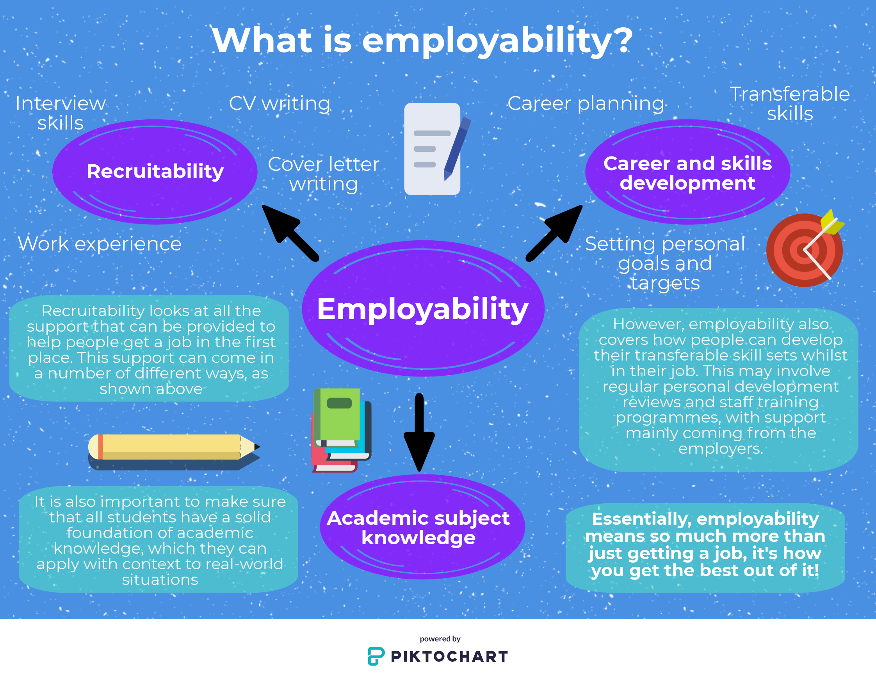

Slide 13
4
Education
▪ Education equality/equity and quality
☒ Our people face many difficulties in areas such as education…
 We have built the largest education system in the world.
- 4 categories: basic education, higher education, vocational education and adult education
(Major projects) To build a high-quality education system
(Major tasks) To enhance education equity and quality
- to adjust the layout and structure of educational resources
- to upgrade basic education, to develop balanced, quality compulsory education and inclusive, quality preschool education

Slide 14
4
Education
(Higher education)
- to improve mechanisms for ensuring that talent training programs are geared to economic and social development needs
- to advance reforms of higher education institutions on a categorized basis
- to adjust academic disciplines and majors as needed
- to launch a new round of initiatives to develop world-class universities and academic disciplines

Slide 15
4
Education
( Talent needed)
- professionals with expertise of strategic importance to our country
- first-rate scientists and young talent
- outstanding engineers
- master craftspeople
- highly-skilled workers
- first-rate industrial technical workforce

Slide 16
5
Healthcare and social security
▪ Healthcare and social security
☒ Our people face many difficulties in areas such as employment, education, medical services, childcare, elderly care, and housing. [二十大报告]
☒ Our work to ensure the people’s wellbeing was fraught with weak links.[二十大报告]
☒ There are still many weak links in public services. [2026]
☒ There are weak links in our work to ensure public wellbeing. [2025]

Slide 17
5
Healthcare and social security
(Principle) We have worked continuously to ensure people’s access to childcare, education, employment, medical services, elderly care, housing, and social assistance, thus bringing about an all-around improvement in people’s lives. [二十大报告]
(在幼有所育、学有所教、劳有所得、病有所医、老有所养、住有所居、弱有所扶上持续用力，人民生活全方位改善。)
(Objectives of 15th FYP) In the area of public wellbeing, seven indicators are proposed, covering employment, income, education, medical care, health, elderly care, and childcare, with the aim of better addressing pressing difficulties and problems that concern people most.

Slide 18
5
Healthcare and social security
 We have built the largest social security system in the world.
- old-age insurance
- maternity insurance
- unemployment insurance
- occupational injury insurance
- medical insurance
(basic medical insurance + major disease insurance + long-term care insurance + commercial health insurance)
(Major tasks) To strengthen basic medical and health services
- to improve the multi-tiered medical security system
To improve living standards (惠民生）

Slide 19
6
Housing
▪ Housing
☒ Our people face many difficulties in areas such as housing…
☒ - risks and potential dangers in real estate [2025]
- There are many risks and hidden dangers in key areas. / The real estate market remains in a period of adjustment.[2026]
☒ Statistics: e.g., high housing price, undelivered property …
(Principle) To build a housing system featuring multiple suppliers and various channels of support that encourages both housing rentals and purchases [二十大报告]
(建立多主体供给、多渠道保障、租购并举的住房制度)

Slide 20
6
Housing
government-subsidized housing (保障性住房)
affordable housing (经济适用房)
better housing (改善性住房)
commodity housing; commodity housing stock (存量商品房)
(Major tasks) To stabilize the real estate market
- to introduce city-specific policies (因城施策)
- to deepen reform of the housing provident fund system
- to ensure timely delivery of housing projects
- to improve property services
- to create a new development model for the real estate sector

Slide 21
7
Debt
▪ Debt burden (government, corporate & household)
☒ household/personal debt
 mortgage slave
Lowering housing purchase costs
- to cut interest rates on mortgages
- to reduce the ratios of down payments, and taxes and fees on housing transactions
To broaden the coverage of loan interest subsidies for personal consumers (贷款贴息)

Slide 22
7
Debt
risks and hidden dangers in key areas (local government debt)
Some local governments are burdened by severe budgetary imbalances [2026]
(Major tasks) To take active and well-ordered measures to defuse local government debt risks
- to replace hidden debts and settle overdue payments owed by governments
- local government special-purpose bonds (地方政府专项债券)
- The central government will increase its fiscal transfer payments to local governments.

Slide 23
7
Debt
☒ corporate debt
To ensure that overdue payments owed to enterprises are settled
To further reduce overall financing costs
The one-time credit repair scheme (一次性信用修复政策)
To develop a credit-based economy
- to refine the systems for … social credit, … and market exit …

Slide 24
8
Environment
▪ Environment and green transition
 A drop of 5.1 percent in energy consumption per unit of GDP contributed to continued improvement in the environment.
 Initiative to build a Beautiful China
(Principle) Green development is a defining feature of Chinese modernization. (绿色发展是中国式现代化的鲜明底色)
(Major tasks) Accelerating the green transition across the board
- five indicators; 18 projects
- to strengthen our green development drivers
(增强绿色发展动能)

Slide 25
8
Environment
- to boost the green and low-carbon economy
- to launch initiatives for upgrading quality, lowering costs, and reducing carbon emissions in key industries
- to phase out outdated production capacity

Slide 26
9
Infrastructure
▪ Infrastructure development
 China has built the world’s largest networks of high-speed railways and expressways and made major achievements in building airports, ports, and water conservancy, energy, information, and other infrastructure. [二十大报告]
(Major projects) To modernize the infrastructure system
- 23 projects target the development of a national comprehensive and multidimensional transportation network, a new type of energy system, new types of infrastructure, and platforms for opening up
- to build digital and smart infrastructure

Slide 27
10
Regional development imbalance
▪ Regional development imbalance
☒ There are still wide gaps in development between urban and rural areas and between regions. [二十大报告]
(Major tasks) To narrow disparities between urban and rural areas and between regions
- to give full play to the synergies between the coordinated regional development strategy, major regional strategies, the functional zoning strategy, and the new urbanization strategy (four strategies)
(发挥区域协调发展战略、区域重大战略、主体功能区战略、新型城镇化战略叠加效应)

Slide 28
10
Regional development imbalance
- to develop a regional economic layout that enable regions to leverage their complementary strengths in pursuit of high-quality development
(构建优势互补、高质量发展的区域经济布局)
- to encourage the Beijing-Tianjin-Hebei region, the Yangtze River Delta, and the Guangdong-Hong Kong-Macao Greater Bay Area to build themselves into world-class city clusters
- to consolidate and enhance the roles of the Beijing-Tianjin-Hebei region, the Yangtze River Delta, and the Guangdong-Hong Kong-Macao Greater Bay Area as engines of high quality development (高质量发展动力源作用)

Slide 29
10
Regional development imbalance
- to support major provincial economies in assuming greater responsibility and encourage them to play a leading, exemplary role in advancing Chinese modernization.
(支持经济大省挑大梁，在推进中国式现代化中走在前作示范)
- to strengthen differentiated/tailored policy support
- to boost interconnected development between regions
(促进区域联动发展)

Slide 30
11
Digital transformation
▪ Digital transformation and industrial upgrading
 transformation and upgrading of traditional industries continued, emerging industries and industries of the future achieved impressive growth
 moved ahead with digital transformation of manufacturing and the AI Plus Initiative.
Advancing the Digital China Initiative
- data as a factor of production
- to promote full integration between the real economy and the digital economy
- to advance the AI Plus Initiative across the board

Slide 31
11
Digital transformation
Building a modernized industrial system
- to ramp up support for small and medium-sized enterprises (SMEs) undergoing digital and intelligent transformation
- to enhance smart manufacturing (smart factories and intelligent supply chains)
- to develop smart construction (construction industrial chains)
- to promote integrated development of advanced manufacturing and modern services
To create new forms of smart economy

