Slide 1

1. Inquiry/Enquiry
⬥ Making an inquiry:
We are interested in …
Please quote us (your lowest price) for …
Please offer … / make an offer for/ …
We’d like to enquire about / make an enquiry for / know / have details of …
Please let us know on what terms / what quantities you can supply …
Would (Could) you please send / Please send us your quotation (price list, latest catalogue, sample) for …

Slide 2
2. Offer
Firm offer (offer with engagement):
- with specific and definite terms (at least the name, quantity and price of goods)
- with a term of validity

Slide 3
2. Offer: firm offer
We subject to your
reaching here/us
The offer is/remains
valid/firm/open/effective for 20 days / until June 30.
offer (firm)
make you the following offer
- within two weeks/five days.
- before June 30, 2026.
- not later than June 30, 2026.
- by June 30, 2026.
- on or before June 30, 2026.
- not later than 17:00 (Beijing Time) on June 30, 2026
reply
acceptance
confirmation

Slide 4
2. Offer
Non-firm offer (offer without engagement):
- without a term of validity

Slide 5
2. Offer: non-firm offer
- our final confirmation.
- change without notice.
- materials being available.
- goods being unsold.
- prior sale.
- sample approval.
We offer subject to
We make the following offer without engagement/ obligation.
This offer is without engagement.

Slide 6
Exercises: Offer
现报1000打毛巾(towel)如下，以我方最后确认为准。
- We make the following offer for 1000 dozen towels subject to our final confirmation.
为复你方5月10日的询盘，我方特向你方发盘如下，以你方在7天内接受为有效。
- In reply to your enquiry of May 10 / As requested by you on May 10, we offer as follows / we are offering you the following subject to your acceptance within seven days.

Slide 7
2. Offer
Make an offer based on the following information:
- 白云牌精制糖，A级，50公吨，用牛皮纸袋包装，每袋净重50千克，FOB广州价每吨100美元，9月份装运（或收到信用证一个月后装运），不可撤销、即期信用证付款。
- 报实盘、虚盘各一。

Slide 8
2. Offer
Make an offer based on the following information:
- We offer subject to your reply here by June 30, 2026, 50 M/T “Baiyun” Brand refined sugar Grade A at USD100 per M/T FOB Guangzhou, packed in kraft paper bags of 50 kg net each, September shipment (or shipment within one month of receipt of L/C), and payment by irrevocable sight L/C.

Slide 9
2. Offer
Make an offer based on the following information:
- 白云牌电动车，型号EX9，500辆，每辆用出口纸箱包装，FOB深圳价每辆200美元，9月份装运（或收到信用证一个月后装运），不可撤销、即期信用证付款。
- 报实盘、虚盘各一。

Slide 10
2. Offer
Make an offer based on the following information:
- We offer subject to our final confirmation, 500 units “Baiyun” Brand electric bicycles model EX9 at USD200 per unit FOB Shenzhen, packed in an export carton of one unit each, September shipment (or shipment within one month of receipt of L/C), and payment by irrevocable sight L/C.

Slide 11
2. Offer
- We make you the following offer, subject to our final confirmation:
1. Commodity: “Baiyun” Brand refined sugar, Grade A
2. Quantity: 50 M/T
3. Price: USD100 per M/T FOB Guangzhou
4. Packing: In kraft paper bags of 50kg net each
5. Shipment: During September (Within one month of receipt of L/C)
6. Payment: By irrevocable, sight L/C

Slide 12
3. Acceptance & order
 Types of order:
initial order
fresh order
trial order
repeat order (re-order)
duplicate order
regular order
outstanding order
back order

Slide 13
3. Acceptance & order
place an order
accept/confirm/close/book an order
decline/refuse/turn down an order
execute/fulfill/fill/carry out/perform an order
withdraw/cancel/revoke an order
be fully/heavily booked/committed

Slide 14





4. Terms in offers & contracts
quality
quantity
price
packing
shipping
payment
insurance

Slide 15

Price
⬥ Price terms
trade terms/price terms/delivery terms
 the language of international trade
Incoterms
- International Commercial Terms

Slide 16
Price
Written modes:
- FOB, CIF, CFR, FAS
- fob, cif, cfr, fas
- F.O.B., C.I.F., C.F.R., F.A.S.
- f.o.b., c.i.f., c.f.r., f.a.s.

Slide 17
Price
Unit price:
- EUR100 per carton FOB Guangzhou Incoterms 2020
- CNY100 per set FCA Shenzhen net
- JPY100 per yard CFR Tokyo including 2% commission
- GBP100 per unit CIFC2 London
- USD100 per dozen CIF & C2 New York
- EUR100 per M/T CIF Hamburg less 2% discount

Slide 18
Packing
▪ bulk cargo / cargo in bulk; nude cargo
- in bulk 散装; in nude 裸装; in bundle 捆装
▪ Packing of goods
Two types of packing:
- transport packing: outer packing, big packing
- sales packing: inner packing, small packing, immediate packing, packaging

Slide 19




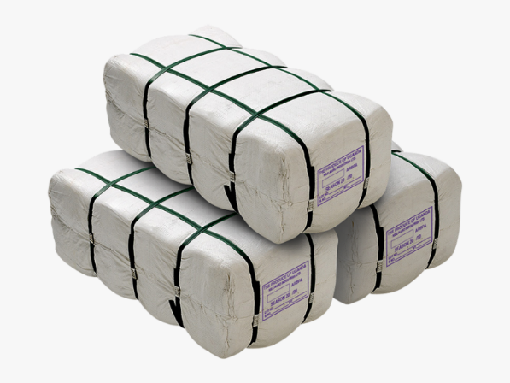

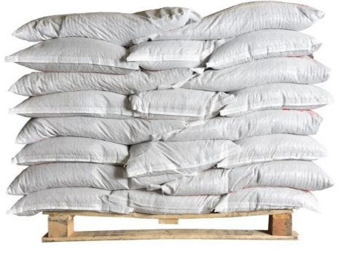

Packing
transport packing:
wooden cases
cartons
crates
bags
bales
pallets
drums

Slide 20
Packing
⬥ pack vt. (sentence patterns):
packed in …
- packed in … of … each
- packed in …, each containing …
packed … to …
- packed … to … and … to …
each packed in … and … to …

Slide 21
Shipment
 Cargo transport: key terms
shipment [U, C]
consignment [U, C]
cargo [U, C]; freight [U]
freight [U]; carriage [U]
carrier
consignor
shipper
consignee
forwarder/forwarding agent/freight forwarder

Slide 22
Shipment
 Cargo transport: key terms
loading, unloading/discharge
freight to collect
freight prepaid
FCL: Full Container Load
LCL: Less than Container Load

Slide 23
Shipment
Shipment (to be effected) during … from … to …,
- with partial shipment and transshipment allowed
(not allowed / prohibited).
- in two equal lots/shipments.
- in two equal monthly lots/shipments.
- to be transshipped at Hong Kong.

Slide 24
Insurance
 Cargo transport insurance: key terms
insurer; underwriter
the insured
insurance broker
insurance amount
insurance coverage/cover
insurance premium
insurance policy; insurance certificate

Slide 25
Insurance
 Cargo transport insurance: key terms
total loss
partial loss
- general average
- particular average

Slide 26
Insurance
 C.I.C./CIC (China Insurance Clauses)
FPA
- covering mainly total loss and general average
WA/WPA
= FPA + particular average caused by natural calamity
All Risks
= FPA + WA + general additional risks
General additional risks (11 types)
Special additional risks (8 types)
Free From Particular Average
With Average/With Particular Average

Slide 27
Insurance
Under FOB/CFR/FCA/CPT terms:
“Insurance: To be covered by the buyer.”
Under CIF/CIP terms:
“Insurance: To be covered by the seller for 110% of total invoice value against All Risks and War Risk, as per and subject to the relevant ocean marine cargo clauses of the China Insurance Clauses dated 1/1/1981.”

