Slide 1
Understanding in Use Cases
Vehicle Data (Streaming)
Extract High volume Streaming data from multiple vehicles, Ingest into Data Lake, Processing and Publishing into Target system for Analytics.
Manufacturing Data (Batch)
Integrate Existing BigQuery Analytics into Data lake and Schedule to refresh data in Near real time.
Strategies to handle multiple data formats from BigQuery
Benefits of Integrating in Near real time
Need to Integrate Streaming Pipeline with Existing BigQuery Pipeline and Ensure Data consistency, Data Deduplication and Data Governance.
Handle potential growth of data from both Vehicles and BigQuery.
Monitoring Mechanism and Alert.

Slide 2
Assumptions
Streaming data which are receiving from Vehicles is in JSON format with high nested data
There is a mechanism/Agent already available in Vehicles to Push data into Kinesis Data Streams
Size of Streaming data from Vehicles at max of 1 MB per payload/File.
Vehicle data is having some personal data (PII) and needs to be protected.
Vehicle data is having some data quality issues and should be sorted out before publishing for Consumption.

Slide 3
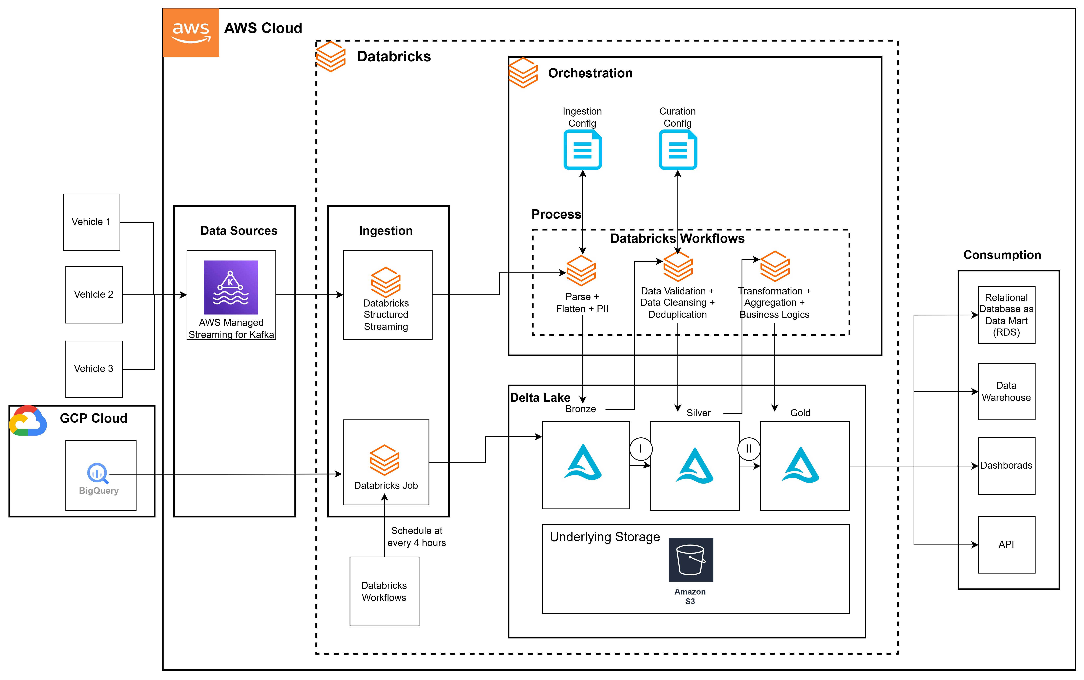
Conceptual Architecture Diagram - High Level – Option 1

Slide 4
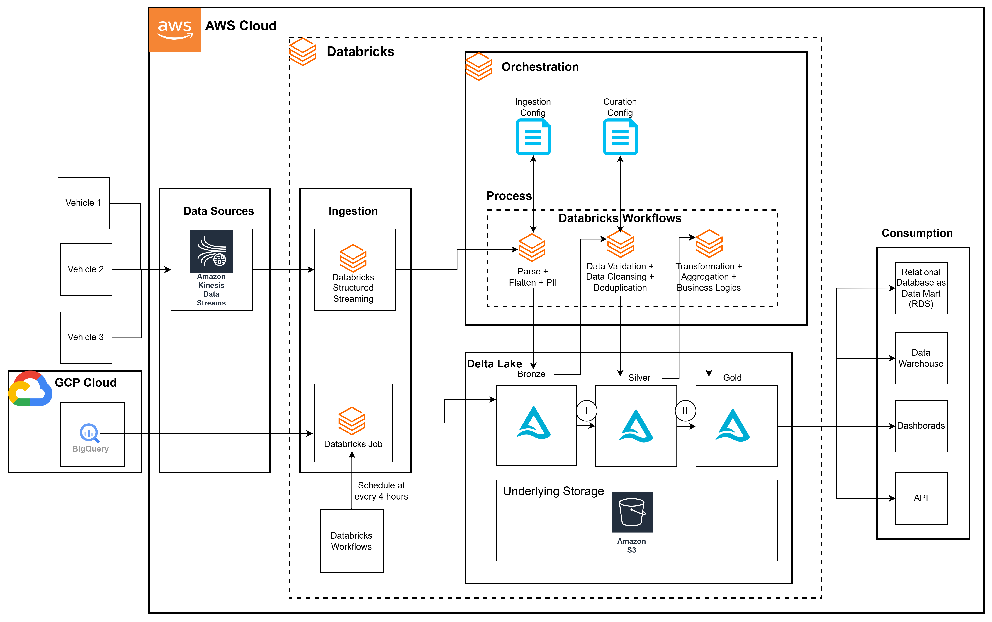
Conceptual Architecture Diagram - High Level – Option 2

Slide 5
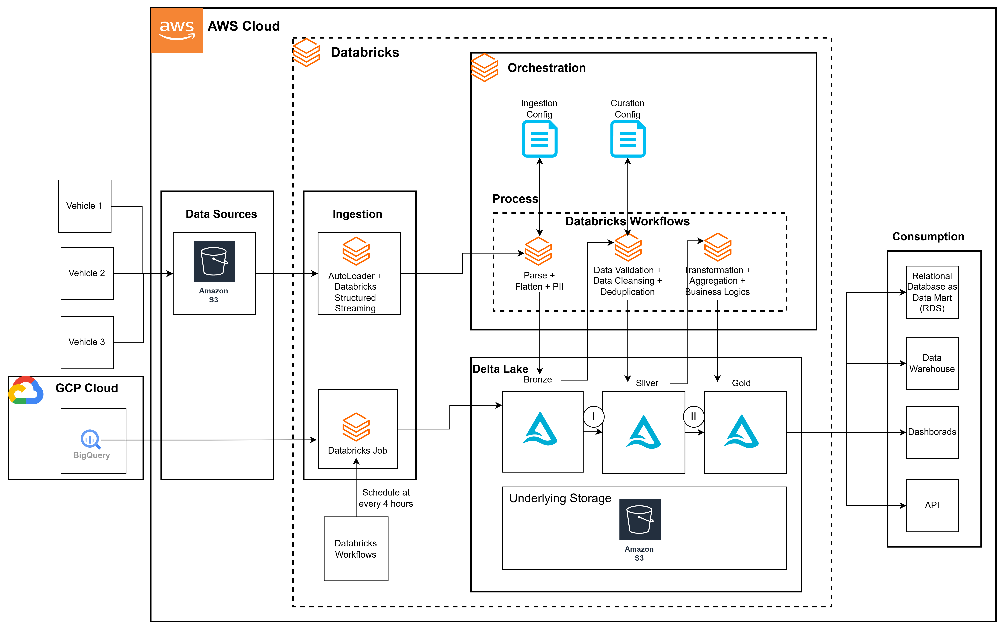
Conceptual Architecture Diagram - High Level – Scenario 2

Slide 6
Streaming Pipeline - Services can be used
Data Source
Kinesis Data Streams
S3
Ingestion
Databricks Structured Streaming
Autoloader + Databricks
Curation/Processing/Transformation
Databricks Jobs
Delta Live Tables
Consumption
Relational databases
Data Warehouses (Redshift, Snowflake, BigQuery. etc.)
Dashboards (PowerBI, Tableau, QuickSight, Spotfire, etc. )
API
Orchestration
Databricks Workflows
Catalog and Query Exploration
Unity Catalog
Databricks SQL
Monitoring and Alert/Notification
Databricks Workflows

Slide 7
Existing BigQuery - Batch (Near Real time) - Services can be used
Ingestion
Databricks Job
Glue
Ingestion – Scheduling (Near Real Time)
Databricks Workflows
Glue Trigger/Event bridge
Curation/Processing/Transformation
Databricks Job
Consumption
Relational databases(RDS ,CloudSQL, etc.)
Data Warehouses (Redshift, Snowflake, BigQuery. etc.)
Dashboards (PowerBI, Tableau, QuickSight, Spotfire, etc. )
API
Orchestration
Databrick Workflows
Catalog and Exploration
Unity Catalog
Databricks SQL
Monitoring and Alert/Notification
Databricks Workflows

Slide 8
Challenges to be Faced
Data Latency
Data Inconsistency
Schema changes from Source
Spike of Data from Source
Data Observability

