Slide 1




class TestFunc {
public static String concat_varchar(String ... string_array) {
return String.join(" ", string_array);
}
}
jar
SQL
JVM
3. Bind and use in Snowflake

Slide 2


class parrotClass() extends Serializable {
// Temporary (unnamed) says Hello
def sayHello = (s: String) => {
s"Hello there $s"
}
// Temporary (named) says Howdy
def sayHowdy = (s: String) => {
s"Howdy $s"
}
// Permanent (named) says Goodbye
def sayGoodbye = (s: String) => {
s"Goodbye $s"
}
// Local says Welcome to my town
def localSays = (s: String) => {
s"Welcome to my town $s"
}
}
Temporary (Snowpark)
Permanent
3. Bind and use in Snowflake

Slide 3
class parrotClass() extends Serializable {
// Temporary (unnamed) says Hello
def sayHello = (s: String) => {
s"Hello there $s"
}
// Temporary (named) says Howdy
def sayHowdy = (s: String) => {
s"Howdy $s"
}
// Permanent (named) says Goodbye
def sayGoodbye = (s: String) => {
s"Goodbye $s"
}
// Local says Welcome to my town
def localSays = (s: String) => {
s"Welcome to my town $s"
}
}
Temporary
Permanent
3. Bind and use in Snowflake

Slide 4
class parrotClass() extends Serializable {
// Temporary (unnamed) says Hello
def sayHello = (s: String) => {
s"Hello there $s"
}
// Temporary (named) says Howdy
def sayHowdy = (s: String) => {
s"Howdy $s"
}
// Permanent (named) says Goodbye
def sayGoodbye = (s: String) => {
s"Goodbye $s"
}
// Local says Welcome to my town
def localSays = (s: String) => {
s"Welcome to my town $s"
}
}
Temporary
SAY_HOWDY(varchar)
Permanent
3. Bind and use in Snowflake

Slide 5
class parrotClass() extends Serializable {
// Temporary (unnamed) says Hello
def sayHello = (s: String) => {
s"Hello there $s"
}
// Temporary (named) says Howdy
def sayHowdy = (s: String) => {
s"Howdy $s"
}
// Permanent (named) says Goodbye
def sayGoodbye = (s: String) => {
s"Goodbye $s"
}
// Local says Welcome to my town
def localSays = (s: String) => {
s"Welcome to my town $s"
}
}
Temporary
Permanent
SAY_GOODBYE(varchar)
3. Bind and use in Snowflake

Slide 6
class parrotClass() extends Serializable {
// Temporary (unnamed) says Hello
def sayHello = (s: String) => {
s"Hello there $s"
}
// Temporary (named) says Howdy
def sayHowdy = (s: String) => {
s"Howdy $s"
}
// Permanent (named) says Goodbye
def sayGoodbye = (s: String) => {
s"Goodbye $s"
}
// Local says Welcome to my town
def localSays = (s: String) => {
s"Welcome to my town $s"
}
}
Temporary
Permanent
.foreach(x➔)
3. Bind and use in Snowflake

Slide 7
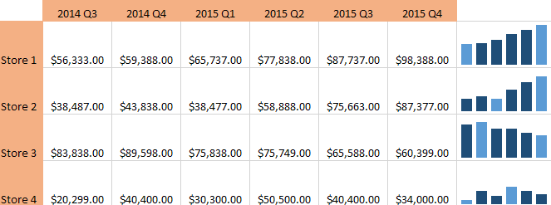
TINY BAR CHARTS
MODELED
TINY_BARS(ARRAY)
select TINY_BARS(
[’1’, ’12’, ’15’, ’17’]
)
3. Bind and use in Snowflake

Slide 8
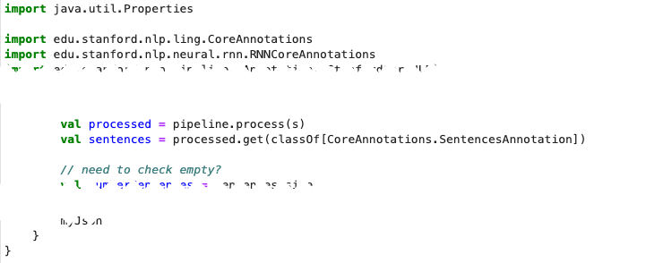

SENTIMENT DETECTION
CREATE FUNCTION ANALYZE_TEXT(arg1 STRING)
RETURNS VARIANT
… lib1.jar, lib2.jar,
RAW
ANALYZE_TEXT(ARRAY)
STAGE
STAGE
-- compile SentimentAnalyzer.scala -- jar sentiment.jar put sentiment.jar @JAVA_UDF_STAGE
sentiment.jar
lib1.jar
lib2.jar

Slide 9

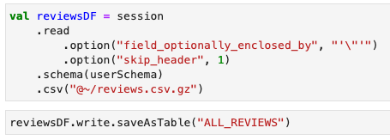
SNOWBEAR REVIEWS (LOAD)
66k reviews
session.file.put()
USER STAGE @~
@~/reviews.csv.gz
ANIMAL_DB.RAW
ALL_REVIEWS

Slide 10
SNOWBEAR REVIEWS (REFINE)
Val conformedDF =
Session
.table(s"${user}_DB.RAW.ALL_REVIEWS")
…
conformedDF
.createOrReplaceView("CLEAN_REVIEWS_VW")
DB.RAW
ALL_REVIEWS
DB.CONFORMED
CREATE OR REPLACE VIEW CLEAN_REVIEWS_VW AS SELECT … FROM RAW.ALL_REVIEWS
CLEAN_REVIEWS_VW

Slide 11
SNOWBEAR REVIEWS (PUBLISH)
DB.CONFORMED
DB.MODELED
CLEAN_REVIEWS_VW
AVG_OVERALL_SCORE_VW
DB.RAW
LAST_TWENTY_SENTIMENT_VW
ANALYZE_TEXT()
TINY_BARS()

