Slide 1

Cajun Toastmasters
January 5, 2023

Slide 2
Cajun Toastmasters Dream
“To create an environment in which we enjoy working together and, as owners, contribute to building a club we can be proud of.”

Slide 3
Toastmasters Mission
“We provide a supportive and
positive learning experience in which members are empowered
to develop communication and leadership skills, resulting in greater self-confidence and personal growth.”

Slide 4
Lincoln Douglas Debate Day!
“He who moulds public sentiment goes deeper than he who enacts statutes or pronounces decisions.
He makes statutes and decisions possible or impossible to be executed.”
― Abraham Lincoln
The Lincoln-Douglas Debates

Slide 5
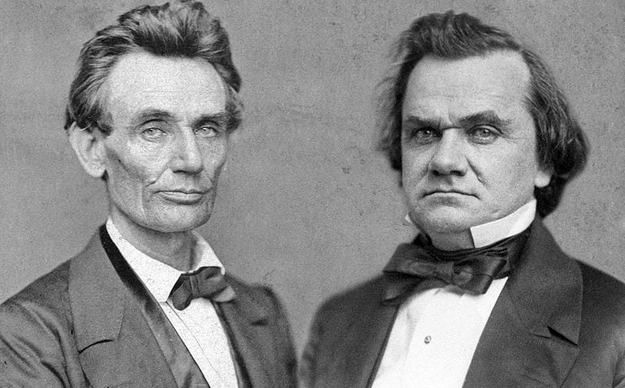

Slide 6

Word of the Week cerebral
Type: adjective
Meaning:
  Of or relating to the brain or the intellect
  An event or scene regarded in terms of its visual impact
Sentence: Cecil Phillips thrived on the cerebral challenge of cracking Soviet codes.

Slide 7
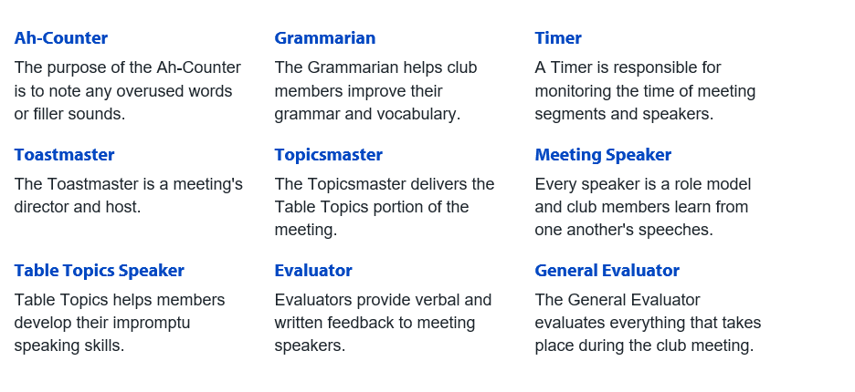
Roles Overview

Slide 8


Roles

Slide 9

Toastmaster – Angie Davis Rincon
Debate Topics – Angie Davis Rincon
Timer – Daniel Journic
Agh Counter – ?
Grammarian – ?
Speech – Blake
Speech Evaluator – Meredith

Slide 10
Speech #1

Slide 11
Speech #2

Slide 12
Speech #3

Slide 13
Debate Topics

Slide 14
Yell Out (One person will yell out a word that you have to incorporate)
Your day at the beach
Your day at work
Your first holiday with your inlaws or friends
Your favorite sport or activity

Slide 15
Guess It
Speaker will feel and describe an object
The audience has to guess what it is
Notes:
Mirror; toy; cotton ball; lotion; candy; hair comb; socks

Slide 16
Table Topics
What music were you exposed to as a child?
How did you feel about your Spotify wrapped?
Do you have a go-to karaoke song?
What’s your favorite live music memory?
What artists got your through your teen years?
Tell us about the music of your region.
What kind of musical education did you receive?
Did your parents sing to you? If so, what?

Slide 17
Lincoln Douglas Debate
- Participants will be chosen randomly for the first four topics.
- The fifth and sixth are pretty sports specific.
- One participant argues for the topic and the other argues against.
- Same time length as table topics.
- The second speaker can speak directly to points made by the first.

Slide 18
“This uncertainty requires them to think through the issue with an open mind and, channeling empathy, to see how others might present a case in which they might not personally believe.”
- Pearl Deards on teaching debate

Slide 19
Debate Topic 1
Pineapple is good on pizza!

Slide 20
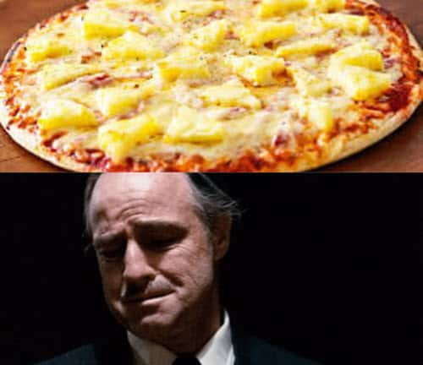

Slide 21
Debate Topic 2
Chili should contain beans!

Slide 22
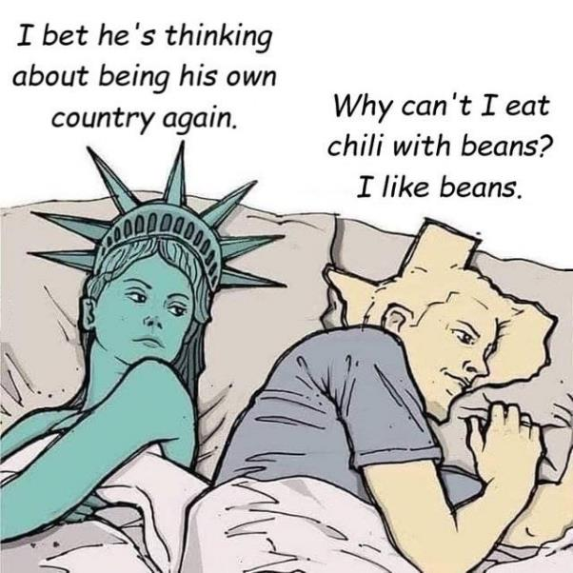

Slide 23
Debate Topic 3
Genetically modified foods are dangerous.

Slide 24
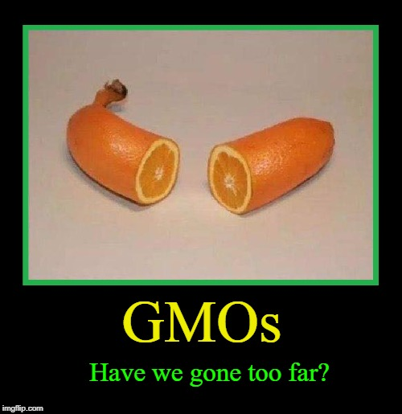

Slide 25
Debate Topic 4
Smartphones are making us stupid.

Slide 26
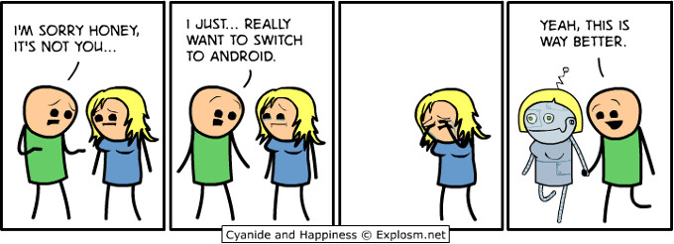

Slide 27
Debate Topic 5
Argue for and against paying college athletes.

Slide 28
Debate Topic 6
LSU has proposed changing the mascot to the nutria rat.

Slide 29
Ballot Vote

Slide 30
Speech
Evaluation

Slide 31
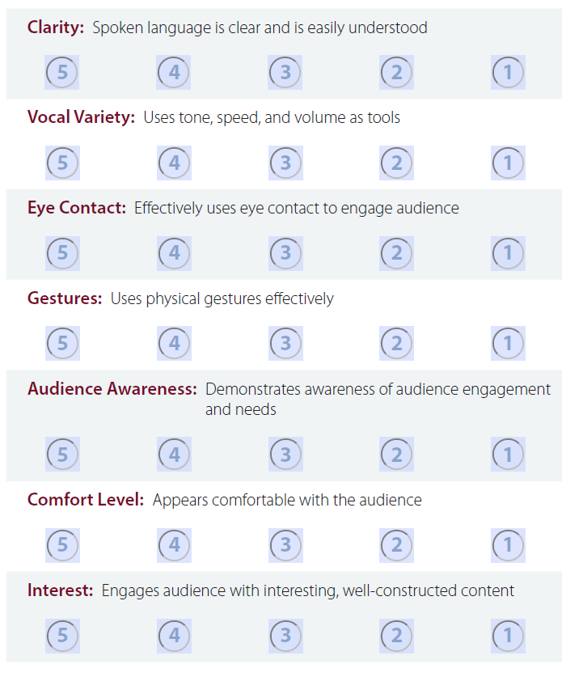
Speech Evaluation
Clarity
Vocal Variety
Eye contact
Audience Awareness
Gestures
Comfort level
Interest
Notes:
Working on this for next 2-3 months

Slide 32
Group Collaboration –
Microsoft Teams (dedicated time)

Slide 33
Meeting Evaluation

Slide 34
Meeting Evaluation
Ah Counter
Grammarian
Timer
General Evaluator

Slide 35
Table Topics Winner

Slide 36
January Speech Schedule
 | Speakers | Evaluators | Toastmaster
Dec 15th
Dec 22nd
Dec 29th

Slide 37
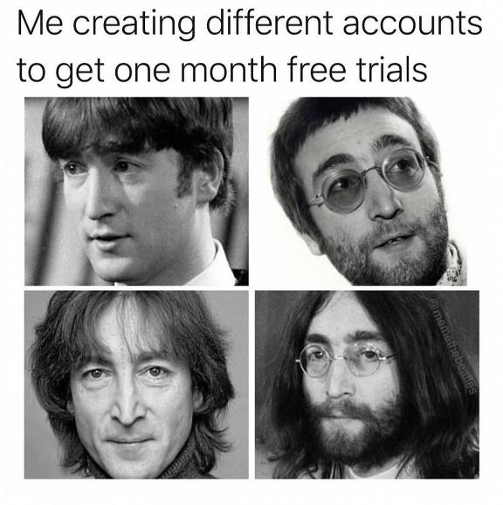
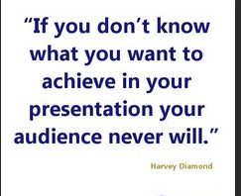

Slide 38
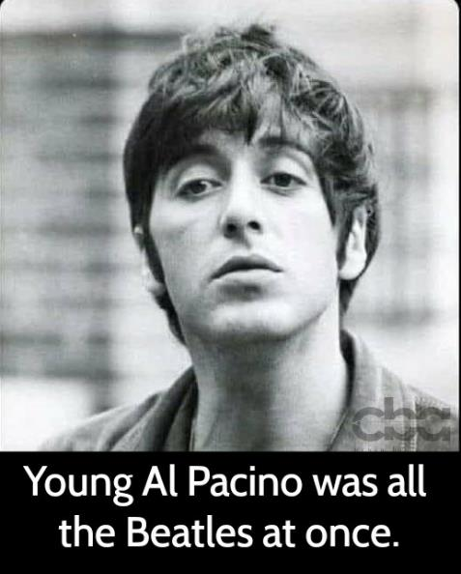

Slide 39
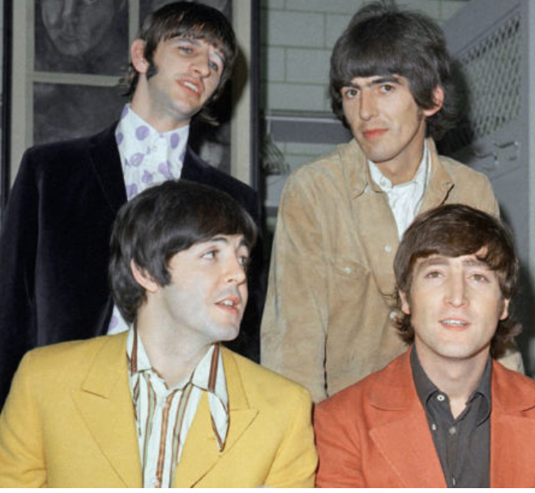

Slide 40
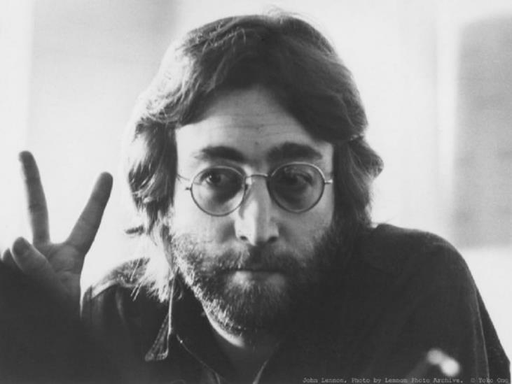

Slide 41
Actions
Open House

Slide 42
Let’s Discuss Your Pathways
Blake-Innovative Planning
Meredith-Visionary Communication
Billie-

Slide 43
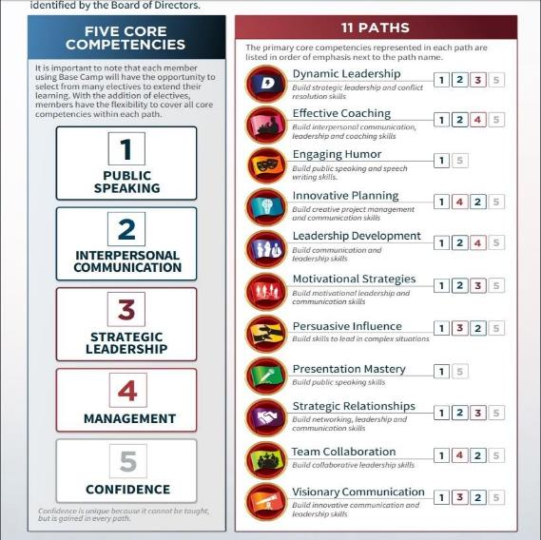
Pathways Overview

Slide 44
Thank you!
1.5.23 Toastmaster: Angie Davis Rincon

Slide 45
Cajun Toastmasters
January 5, 2023

